Slide 1
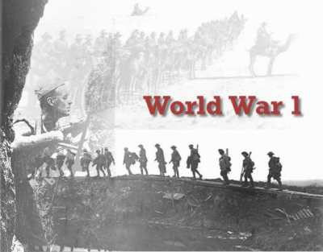

Slide 2
Europe 1914
By 1914 Europe was separated into 2 factions the Triple Alliance, and the Triple Entante
Germany, Austria-Hungary, and Italy made the Triple Alliance, a defensive alliance pledging that if anyone was attacked the rest would come to their aid
At the same time Britain, France, and Russia created the Triple Entante, which was also a defensive alliance, however no one knew how much anyone would honor those agreements

Slide 3
Leaders of Europe
Germany→ Kaiser Wilhelm II
Austria Hungary → Emperor Franz Joseph
Russia → Tsar (Czar) Nicholas II
United States → Woodrow Wilson

Slide 4
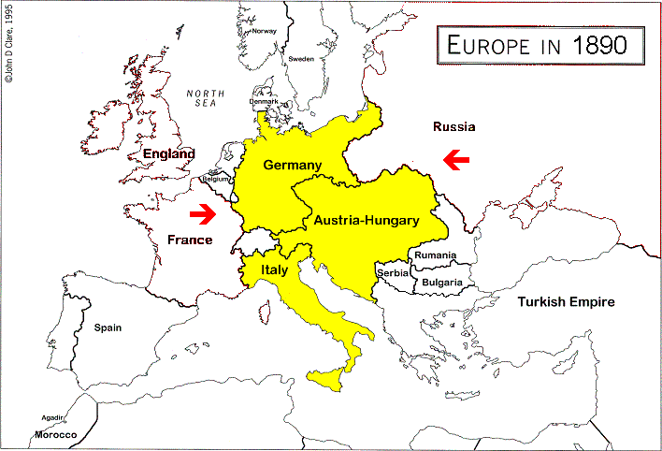
Triple Alliance Encircled

Slide 5
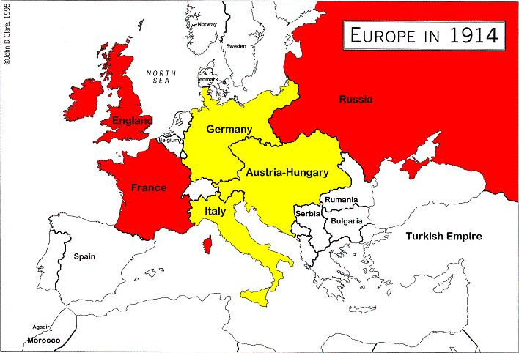
Alliances and the First World War:
Triple Entente, 1907
In 1907 Russia joined Britain and France to make the Triple Entente.
So by 1914 Europe had divided into two massive superpower blocs.
People thought this BALANCE OF POWER would keep the peace.

Slide 6
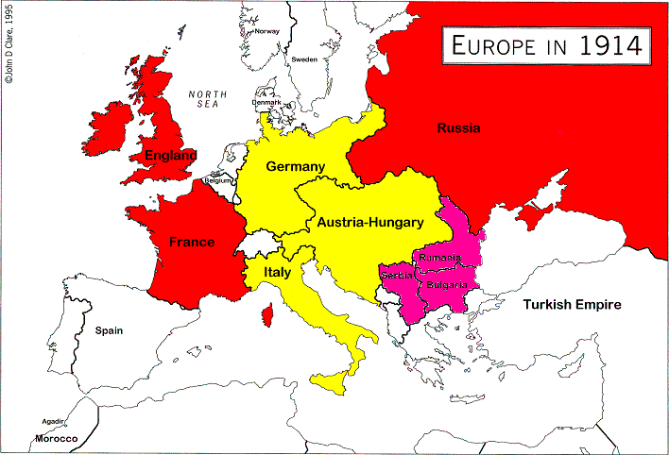
The Balkans
But Russia was also allied to Serbia, Romania and Bulgaria. When trouble erupted in the Balkans in 1914, the nations found their alliances dragged them into war…

Slide 7
Summary

Slide 8
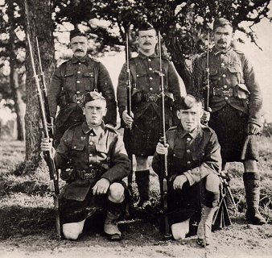
Causes of the War
There were a great many reasons for the war to break out, by 1914 Europe was ready to explode, all it needed was a spark why?
Militarism: Europe had begun a large military build up, no nation wanting another nation to get an advantage.

Slide 9
More Causes for War
Imperialism: Many countries wanted to gain an advantage in colonies, especially Britain, France, and Germany who wanted more land to colonize particularly in Africa
Nationalism: At this time many countries would use propaganda (convincing using emotions) to tell their people that they were the best in the world, and that all other people in the world were inferior to them
Add to that a belief, taught to children, that war is glorious and an honorable thing to do

Slide 10
Half a league, half a league, Half a league onward, All in the valley of Death Rode the six hundred. "Forward, the Light Brigade! "Charge for the guns!" he said: Into the valley of Death Rode the six hundred. | "Forward, the Light Brigade!" Was there a man dismay'd? Not tho' the soldier knew Someone had blunder'd: Theirs not to make reply, Theirs not to reason why, Theirs but to do and die: Into the valley of Death Rode the six hundred. | Cannon to right of them, Cannon to left of them, Cannon in front of them Volley'd and thunder'd; Storm'd at with shot and shell, Boldly they rode and well, Into the jaws of Death, Into the mouth of Hell Rode the six hundred.

Slide 11
Flash'd all their sabres bare, Flash'd as they turn'd in air, Sabring the gunners there, Charging an army, while All the world wonder'd: Plunged in the battery-smoke Right thro' the line they broke; Cossack and Russian Reel'd from the sabre stroke Shatter'd and sunder'd. Then they rode back, but not Not the six hundred. | Cannon to right of them, Cannon to left of them, Cannon behind them Volley'd and thunder'd; Storm'd at with shot and shell, While horse and hero fell, They that had fought so well Came thro' the jaws of Death Back from the mouth of Hell, All that was left of them, Left of six hundred. | When can their glory fade? O the wild charge they made! All the world wondered. Honor the charge they made, Honor the Light Brigade, Noble six hundred.

Slide 12
Germany vs. France

Slide 13
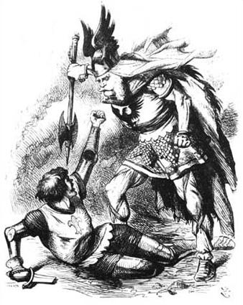
Alliances and the First World War:
France and Germany hated each other! When Germany became united country in 1870-1, France went to war to try to stop it and failed.

Slide 14
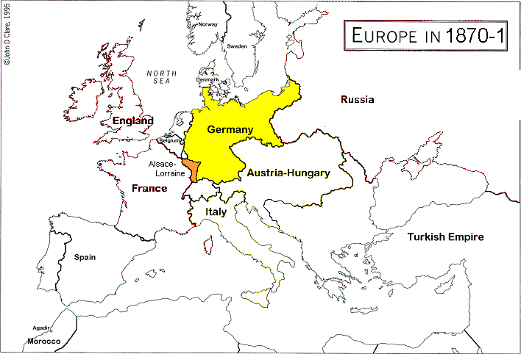
Essential Background Fact 2 (cont.)
France also lost Alsace-Lorraine in 1870-1.
The French never forgave the Germans. They wanted REVENGE.

Slide 15
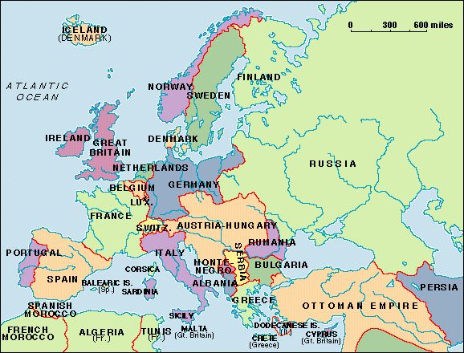

Slide 16
The Spark
The heir to the Austro-Hungarian throne Archduke Franz Ferdinand was visiting Sarajevo in 1914 when he was assassinated by a Serbian
Austria-Hungary demanded Serbia pay compensation, and turn over all their secret service documents
Serbia refused, and Austria-Hungary declared war
In response Russia declared war on Austria-Hungary, then Germany on Russia, then France on Germany
Britain will stay out of the war in the beginning and Italy will declare neutrality

Slide 17
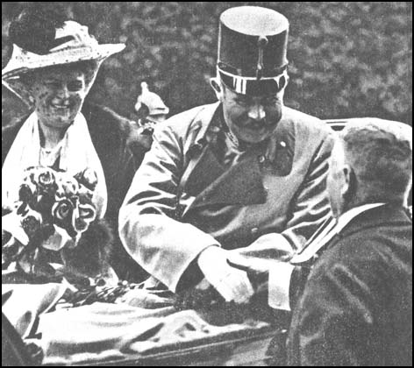

Slide 18
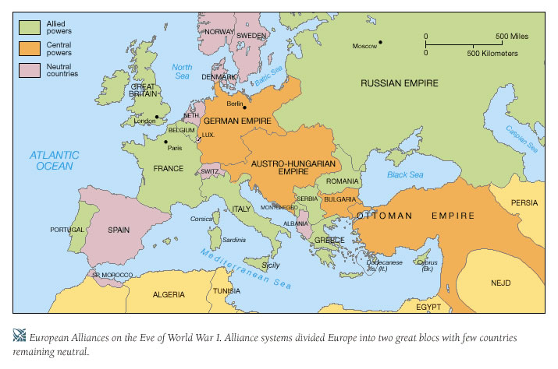

Slide 19
The Schlieffen Plan
Before the war German General Alfred Von Schlieffen developed a plan to defeat the Allied Powers
91% of the German forces were to be sent to France and 9% to hold off Russia while it mobilized
However right before the war, the plan was modified and less troops were sent into France, the result was France was not quickly defeated and they held the Germans at the Battle of the Marne

Slide 20
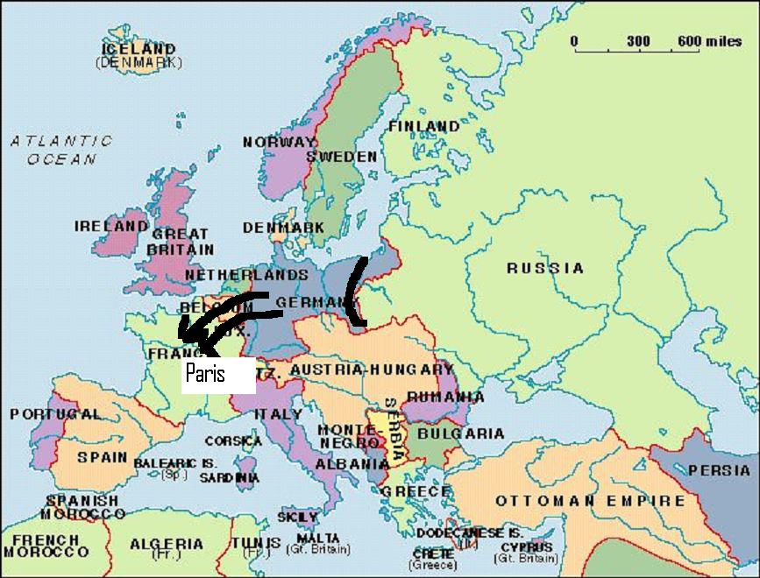

Slide 21
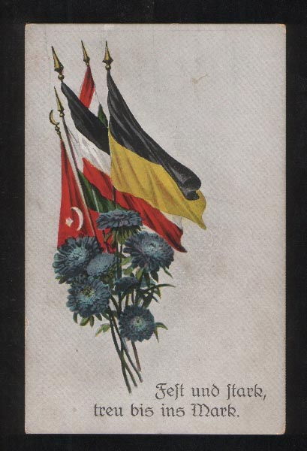
Central Powers
Germany
Austria Hungary
Ottoman Empire

Slide 23
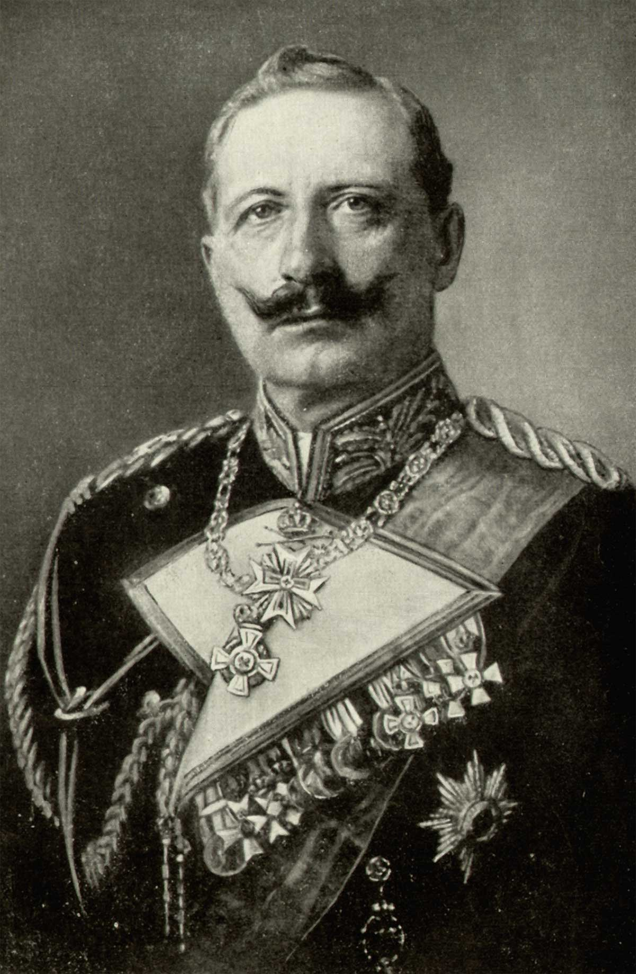

Slide 24
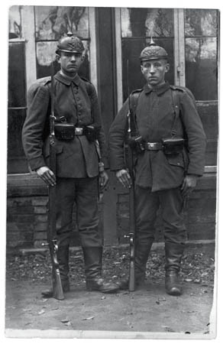

Slide 26
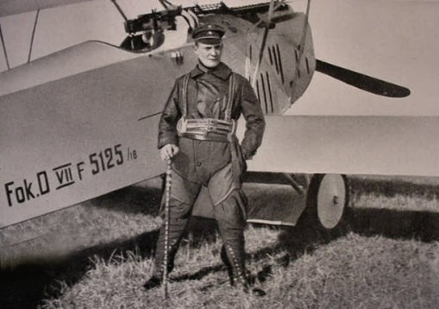

Slide 27
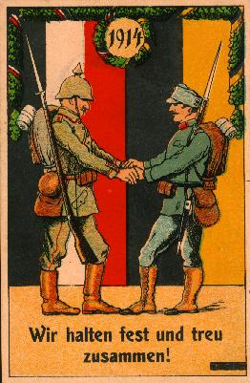

Slide 28
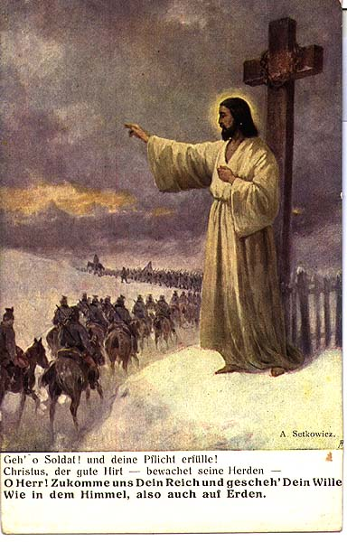

Slide 29
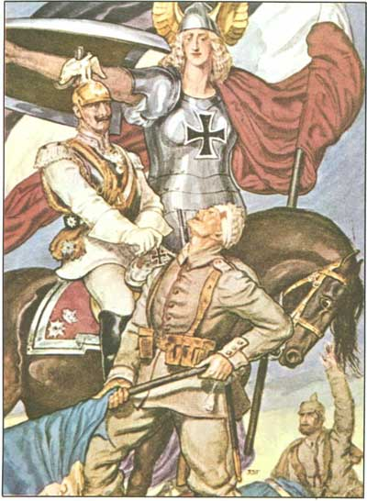

Slide 30
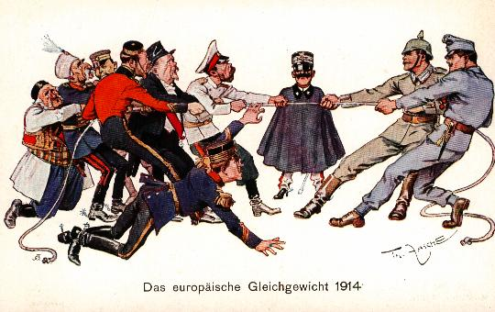

Slide 32
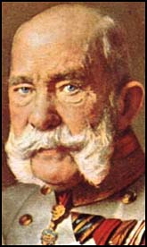

Slide 33
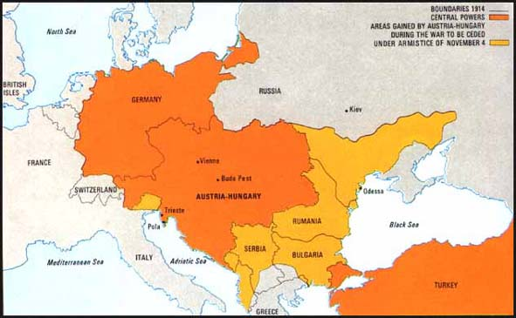

Slide 34
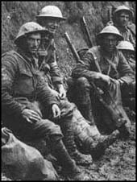

Slide 35
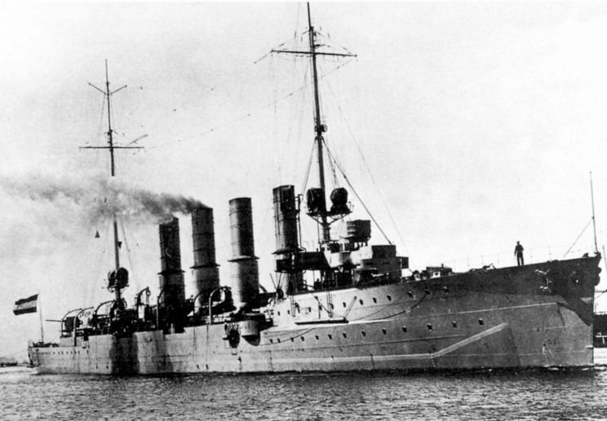

Slide 37
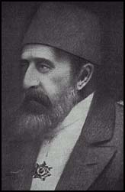

Slide 38
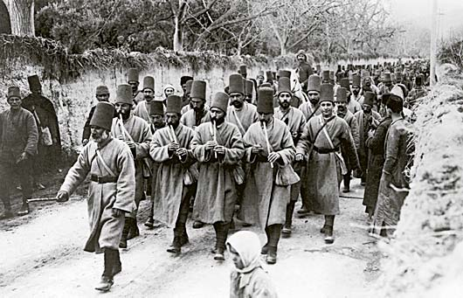

Slide 39
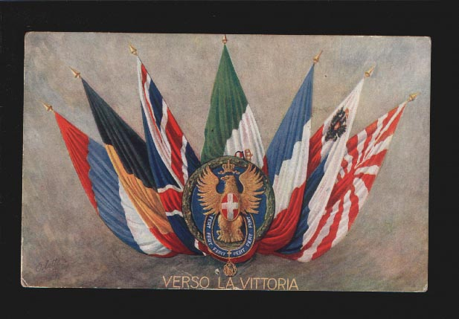
Allied Powers

Slide 41
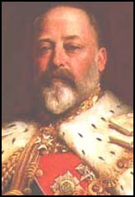

Slide 42
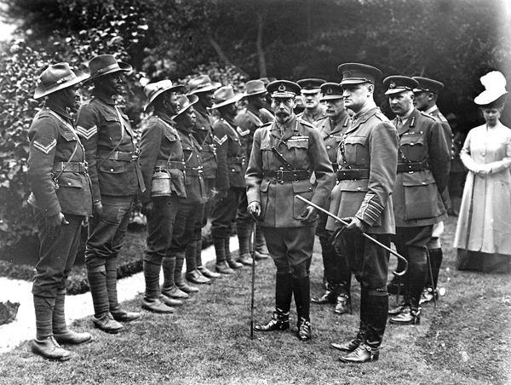

Slide 43
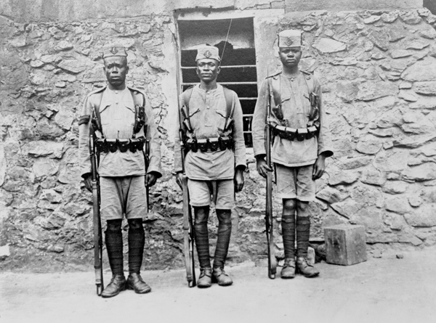

Slide 44
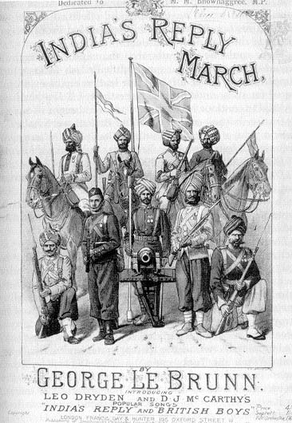

Slide 45
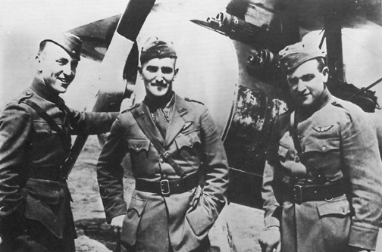

Slide 46
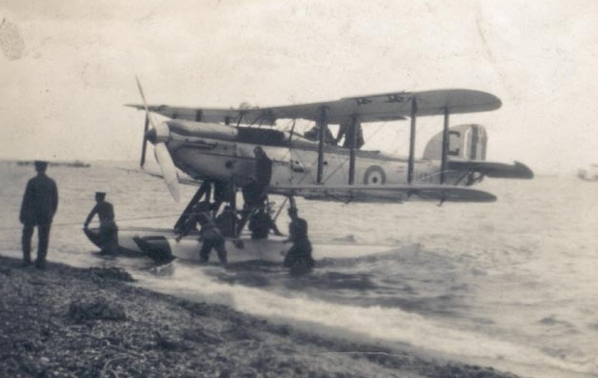

Slide 47
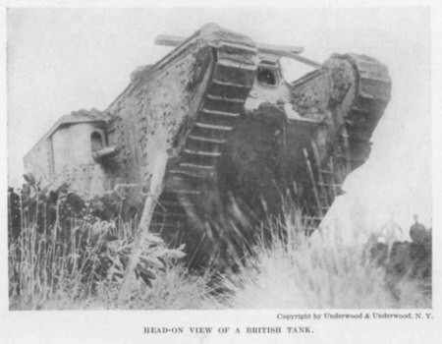

Slide 48
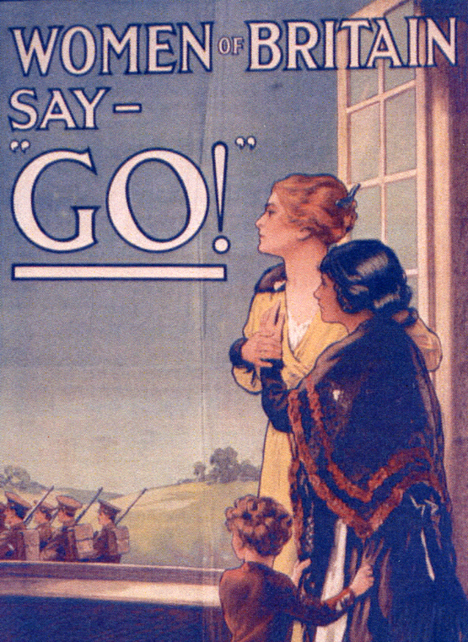

Slide 49
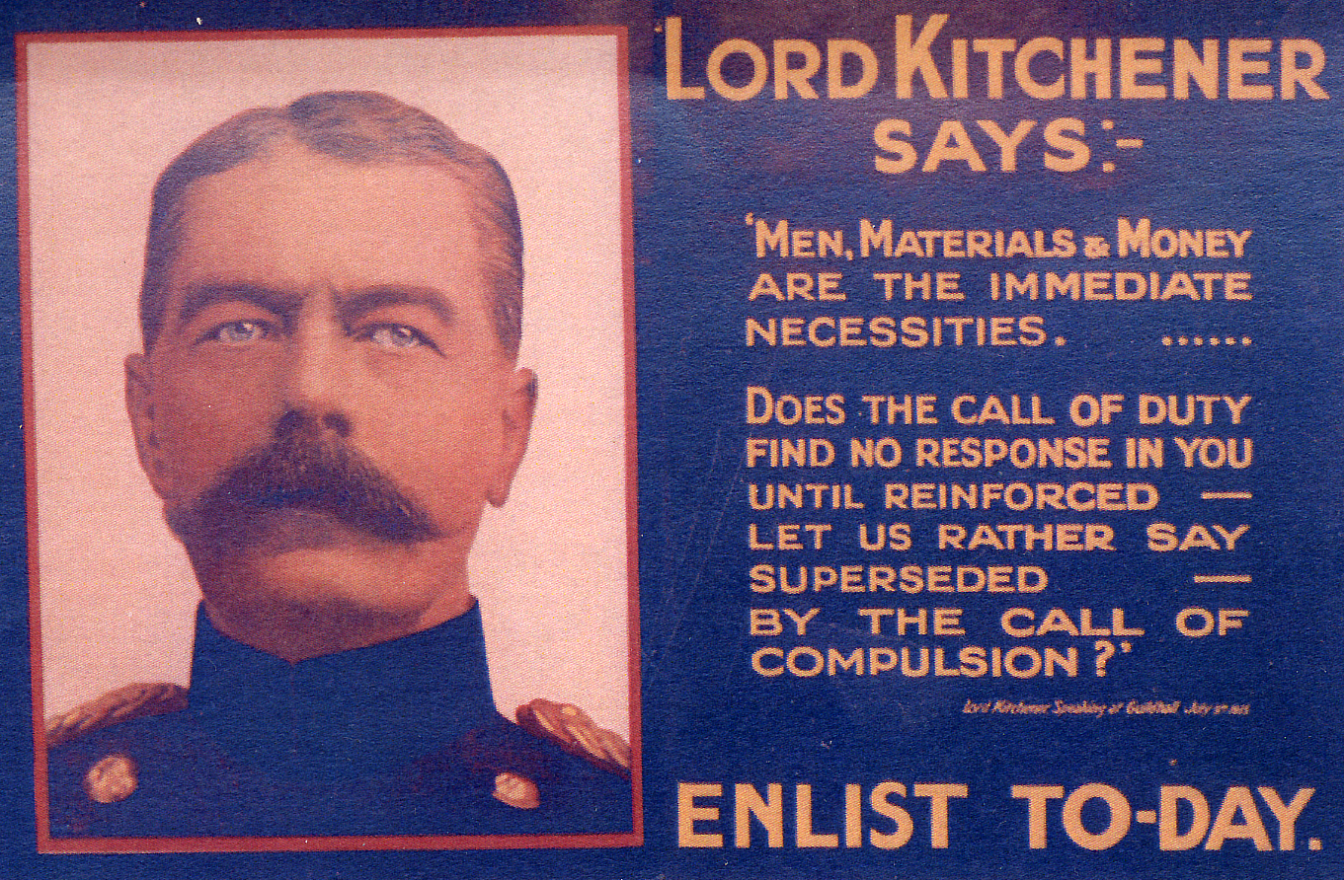

Slide 50
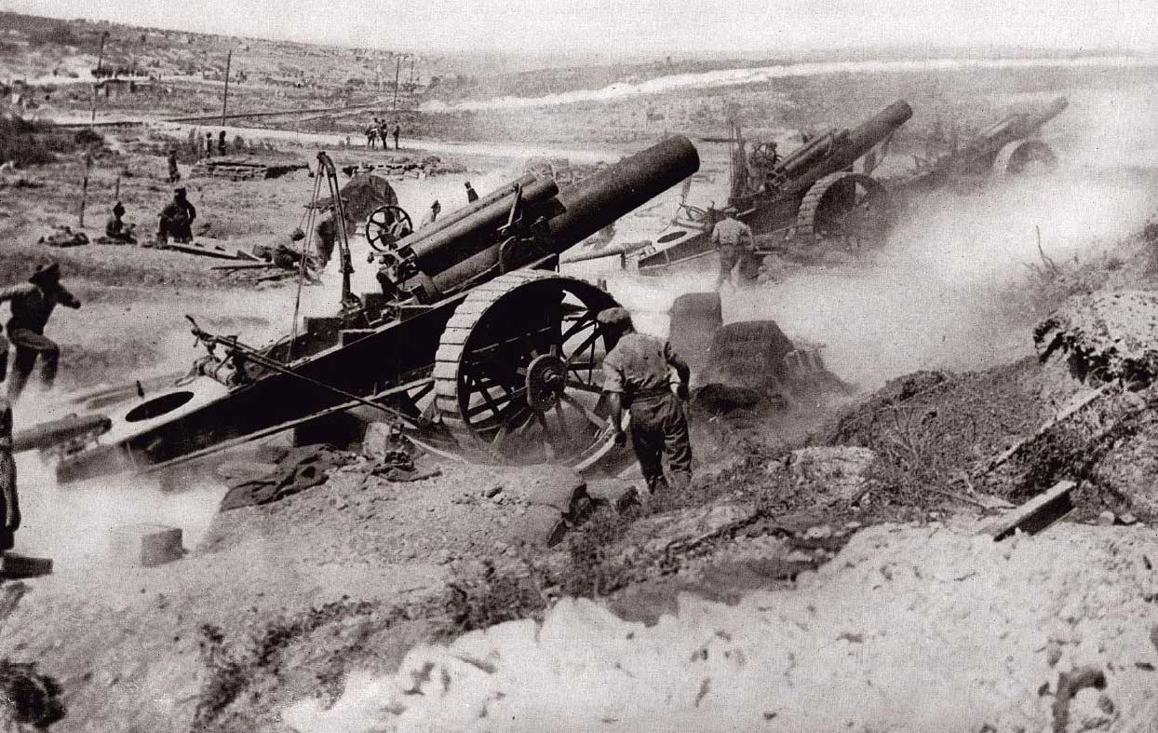

Slide 51
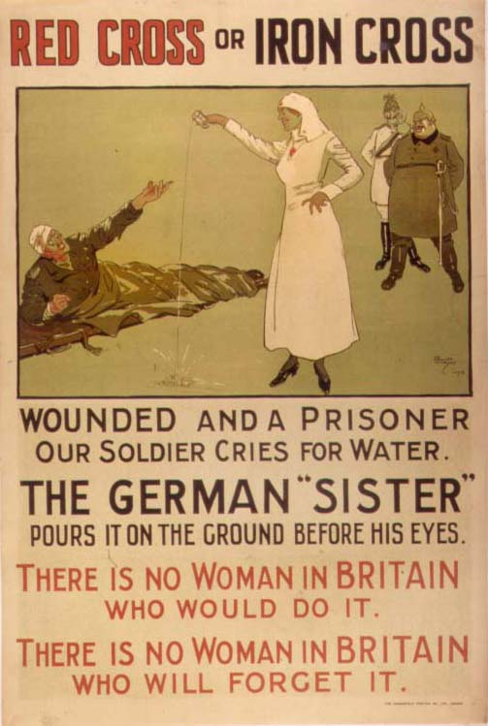

Slide 52
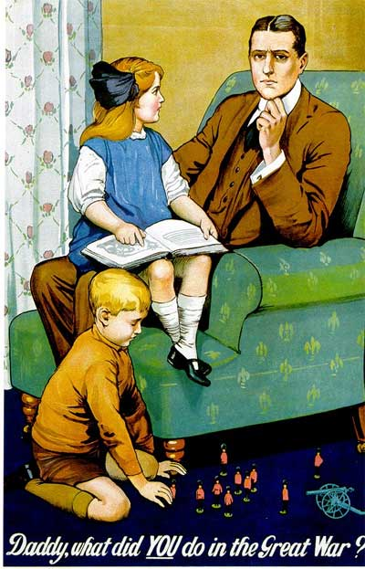

Slide 54
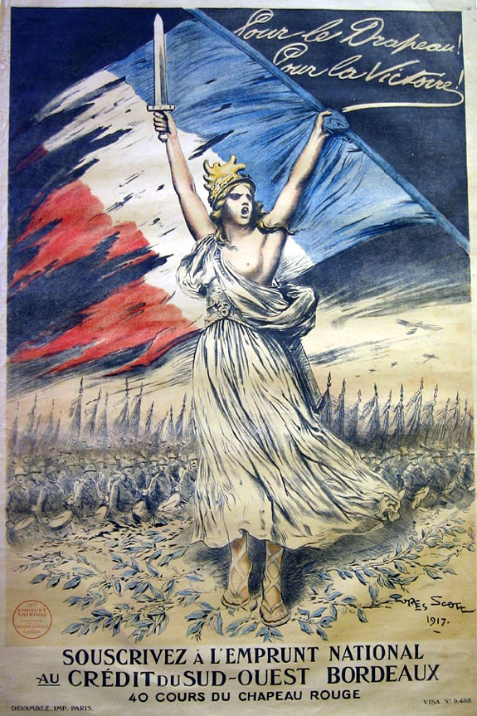
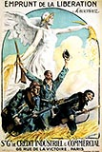

Slide 55
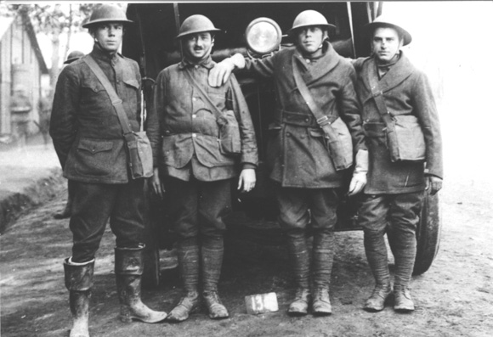

Slide 56
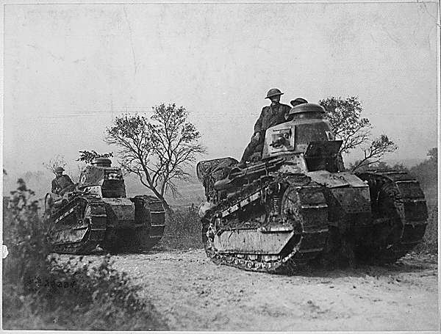

Slide 57
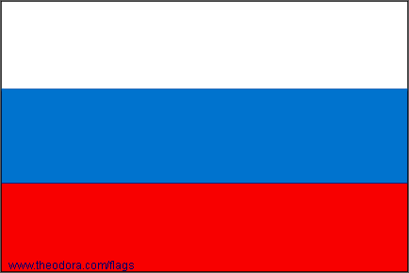

Slide 58
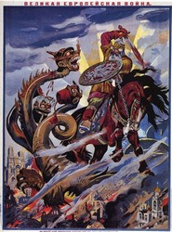

Slide 59
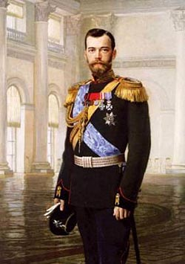

Slide 60
The Trenches

Slide 61
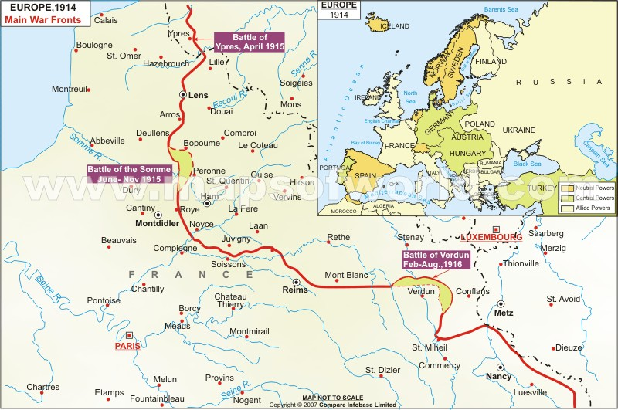

Slide 62
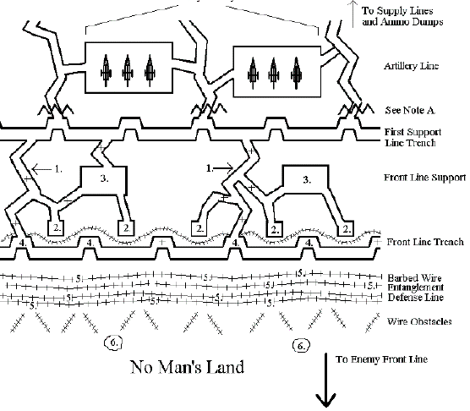

Slide 63
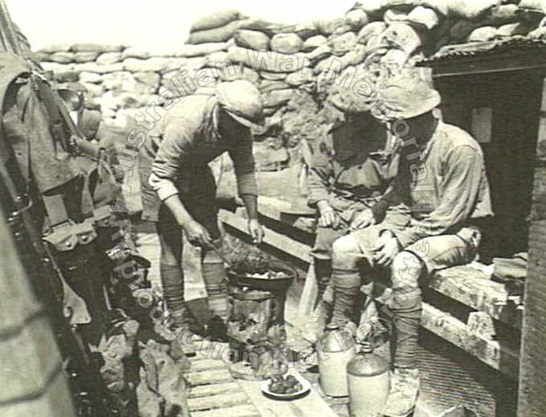

Slide 64
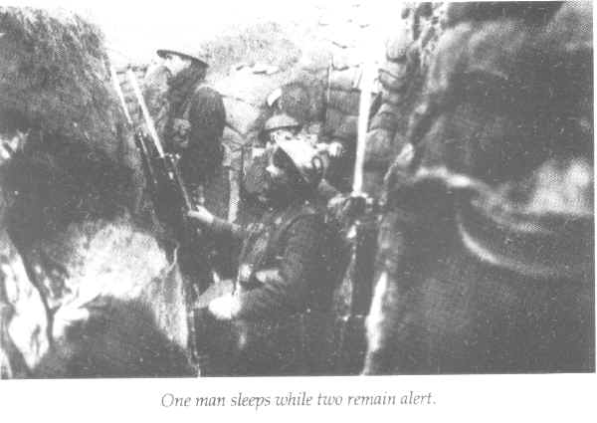

Slide 65
