Slide 1
World War II:
The Home Front
Notes:
At the dawn of the 1940s, some Americans suspected that the war raging in Europe would eventually pull the U.S. into the fight, but most saw the conflict as far away and felt secure that they would be safe. However, the Japanese attack on the U.S. naval base at Pearl Harbor on December 7, 1941—“a date which will live in infamy”—changed things.
The attack thrust the nation into a global war that it had barely prepared for. The fight required the rapid mobilization of all aspects of American society, drawing all citizens into the war effort by demanding a degree of sacrifice by everyone. To this end, the federal government under Franklin Delano Roosevelt assumed tighter control of the economy and directed the energies of industry toward producing goods and materiel. The workforce was transformed as women took over traditionally male occupations, while business chafed under new regulations and price controls. Household staples became scarce as resources were diverted. Intense propaganda campaigns made Americans feel as if practically every move they made either helped or hurt the war effort.
Americans, meanwhile, tried to live their lives as normally as possible. Some could not: Misguided fears of espionage and sabotage resulted in the forced removal and internment of Japanese American citizens in large numbers. African Americans wanting to serve their country or work in the war industry faced racial discrimination but proved their worth to the war effort, as did other minorities.
America lost FDR not long before the war came to a close, leaving his successor to deal the final blows against the Axis powers. In many, the joy and relief of a hard-fought victory mingled with feelings of uncertainty about what would happen when the soldiers, sailors, and Marines came home to a country that had changed greatly in their absence.
1

Slide 2
Essential Questions
How did America initially respond to the events leading to WWII?
How did the war change the American home front, both culturally and socially?
How did the war transform the U.S. economy both immediately and in the long term?
How did the war affect minority groups during the period?
What effect did the war have on American industry?
How did the war unify America in a common purpose?

Slide 3
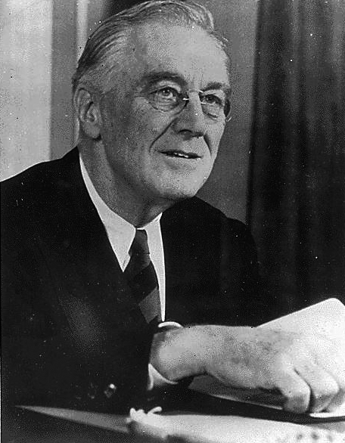
“The Arsenal of Democracy”
America “officially neutral” as European war began
FDR increased military production and skirted Neutrality Acts after Nazi victories
FDR ran for third term
Lend-Lease Act passed
U.S. embargoed oil and scrap-iron sales to Japan
Notes:
Mindful of popular opinion as well as congressional investigations into America’s entry into World War I, the U.S. proclaimed itself “officially neutral” as the European war began in 1939. After rapid Nazi victories in Poland and France, however, President Franklin D. Roosevelt decided that the U.S. could not sit idly by.
Congress had passed a series of Neutrality Acts in the late 1930s to keep the U.S. out of costly, destructive entanglements such as WWI. FDR agreed to revise the acts to allow belligerents to purchase weapons and non-military goods on a “cash and carry” basis (that is, having a nation pay the entire bill now and arrange for all transport of goods). In addition, he requested significant budget increases for the military and stepped up airplane production.
As the situation in Europe deteriorated, FDR ran for an unprecedented third term as president. He defeated internationalist Republican Wendell Willkie in 1940, promising voters that “your boys are not going to be sent into any foreign wars.” However, by Christmas 1940, he stated in a fireside chat that the U.S. must become the “great arsenal of Democracy.” In January, FDR proposed the Lend-Lease Act, which allowed the U.S. to “lend or lease” weapons to Britain, to be paid for after the war. This effectively skirted the “cash and carry” provision of the Neutrality Acts. Though the U.S. had not officially declared war against Germany, it had certainly become involved in the fight.
Meanwhile, the U.S. looked for a peaceful way to stop Japanese aggression against China. In an effort to derail the Japanese war machine, the FDR decided to embargo sales of needed military goods, such as oil and scrap metal. The embargo convinced some Japanese leaders to best handle any threat by the U.S. military with a stunning attack against military installations, such as the naval base at Pearl Harbor.
3

Slide 4
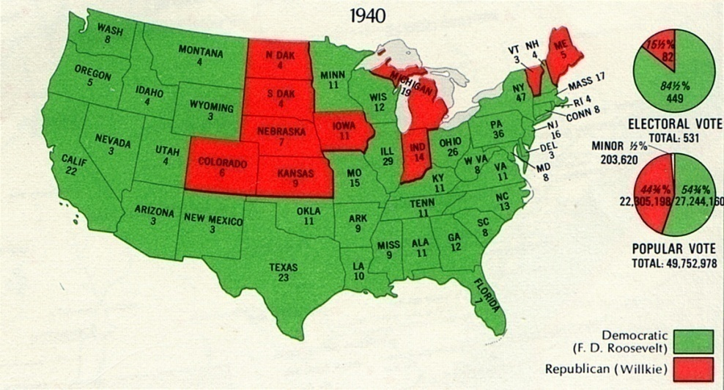
The Election of 1940
FDR won unprecedented third term
Defeated Willkie
Both candidates considered “internationalists”
In this map of electoral results, FDR is indicated in green, Willkie in red
Notes:
With war looming, President Roosevelt decided to seek a third term. Using the peacetime draft as an excuse, he told Democrats that he would not actively campaign for the nomination, but if “drafted” he would accept the nomination and a third term as president.
The Republicans nominated Wall Street banker Wendell Willkie, who had recently switched from the Democratic to Republican Party. Both candidates were so-called “internationalists,” meaning that both felt the U.S. should take a leading role in world affairs as the war in Europe expanded.
Although not with as great a margin as in 1932 or 1936, FDR won a third term against Willkie, defeating him in the popular vote by nearly five million votes. FDR carried 449 electoral votes to Willkie’s 82.
4

Slide 5
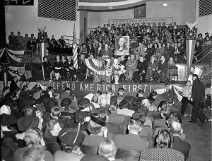
The America First Committee
Formed in 1940
An estimated 800,000 members at its height
Most prominent member was Charles Lindbergh
Advocated building up U.S. defenses and staying out of Europe’s problems
Dissolved four days after Pearl Harbor
Charles Lindbergh speaking at an America First rally
Notes:
Many Americans did not wish to risk military involvement in the war in Europe, regardless of the threat that Adolf Hitler appeared to pose to the world’s security and stability. Some became vocal in their opposition to increasing American involvement, most notably the America First Committee.
Founded in September 1940, the AFC soon rose to more than 800,000 members across the nation. Members included Robert E. Wood, chairman of Sears, Roebuck, and Co.; WWI flying ace Eddie Rickenbacker; and “New Deal agitators” Father Charles Coughlin and Gerald L.K. Smith. However, the most famous member was probably aviator Charles Lindbergh, whose 1927 solo transatlantic flight had made him a national hero. He believed that the U.S. should focus on building up its air and coastal defenses, asserting that what FDR was asking the American people to enter into and support were actually Europe’s problems, and decrying the fact that voters never had an opportunity to vote on these policies.
For nearly a year, the America First Committee spoke out against American involvement in the war in Europe. However, the Japanese attack on Pearl Harbor silenced the organization, which dissolved less than a week after the attack on Pearl Harbor.
5

Slide 6
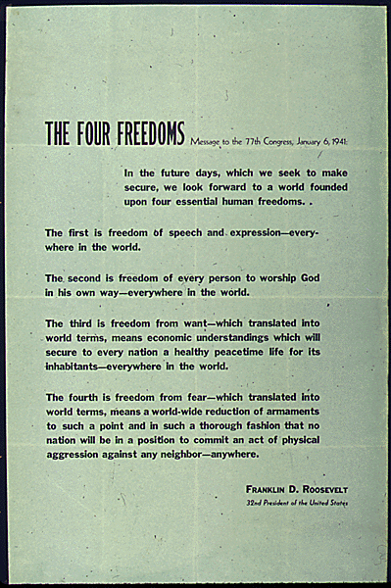
FDR’s “Four Freedoms”
FDR’s 1941 State of the Union address
Early in his third term
Equated aid to Britain with protecting universal freedoms
An excerpt from the speech
Notes:
Perhaps no one made a better case for American internationalism in the days before the U.S. entered the war than President Roosevelt himself in his famous “Four Freedoms” speech. FDR, recently elected to an unprecedented third term, wanted to impress on the American people—many of whom still opposed U.S. involvement in the widening war in Europe—that aid to Britain, now standing alone against Germany, not only ensured their security but protected basic freedoms of all persons everywhere.
6

Slide 7
From the “Four Freedoms” Speech
“In the future days, which we seek to make secure, we look forward to a world founded upon four essential human freedoms.
The first is freedom of speech and expression—everywhere in the world.
The second is freedom of every person to worship God in his way—everywhere in the world.
The third is freedom from want—which, translated into world terms, means economic understandings which will secure to every nation a healthy peacetime life for its inhabitants—everywhere in the world.
The fourth is freedom from fear—which, translated into world terms, means a worldwide reduction of armaments to such a point and in such a thorough fashion that no nation will be in a position to commit an act of physical aggression against any neighbor—anywhere in the world.”
Notes:
Note to teacher: The CD-ROM includes an audio file of FDR’s speech that you may wish to play here.
7

Slide 8
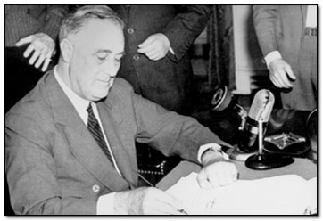
Selective Service Act of 1940
First peacetime draft in U.S.
All men aged 21–35 required to register; later 18–65
Required men picked for duty to serve 12 months
Service in the U.S. or its possessions
FDR signs the Selective Service Act into law
Notes:
President Roosevelt had promised American voters that “your boys aren’t going to be sent into any foreign wars.” However, he also recognized the need for bolstering the armed forces in case the U.S. did enter the war. To that end, Congress passed the Selective Service and Training Act of 1940 (commonly called the “Selective Service Act”), instituting the country’s first peacetime draft.
The law required all males aged 21–35 to register. A lottery system would help to select draftees for duty; if selected, the act required a man to serve for 12 months, after which he would be discharged. All service had to occur in the mainland U.S. or in a U.S. possession. The act limited the peacetime army to a maximum of 900,000 men. It also allowed for non-combat duty for conscientious objectors.
By summer 1941, it had become increasingly evident that the U.S. would enter the war. By a single vote, Congress extended the act’s term of service from 12 to 18 months. Congress passed a new Selective Service Act soon after U.S. joined the war, which required all men aged 18–65 to register for the draft and made all men aged 18–45 eligible for military service. This new act lengthened the term of service to six months after the end of the war. From 1940 until 1947 (when the wartime draft law expired), more than 10 million Americans were inducted into military service.
8

Slide 9
Discussion Questions
What steps did FDR take toward making the U.S. the “Arsenal of Democracy”?
What was the America First Committee? Who were some of its more famous members? Why did it disband?
How did FDR explain the need to provide aid to Britain in his “Four Freedoms” speech? Why do you think that FDR took this approach?
Notes:
As Nazi Germany grew more powerful, FDR first modified the Neutrality Acts to permit the sale of weapons to belligerents on a cash-and-carry basis. He also asked for increases in the federal defense budget and stepped up airplane production. To help Britain even further without disobeying the Neutrality Acts, FDR instituted the “Lend-Lease” plan, by which Britain could receive materiel now and pay for it after the war. He signed the Selective Service and Training Act of 1940 to establish a peacetime draft. Finally, he embargoed oil and scrap-metal sales to Japan in response to its aggression against China.
The America First Committee was an organization formed in 1940 that actively spoke out against American intervention in Europe and advocated bolstering the defenses of the U.S. mainland instead. Several prominent Americans joined the group, including aviator Charles Lindbergh, World War I flying ace Eddie Rickenbacker, and Robert E. Wood, chairman of Sears, Roebuck and Co. The America First Committee disbanded immediately following the attack on Pearl Harbor, probably because U.S. intervention had become a foregone conclusion.
By portraying aid to Britain as a means of protecting fundamental human rights—such as the freedoms from fear and want, and of speech and worship—Roosevelt explained his position in a way that most Americans could understand and support. FDR took this approach likely because (1) it framed the war in Europe in larger, moral terms as a conflict between right and wrong, and not one nation versus another in one particular circumstance, (2) it played to the American ideals of freedom, fairness, and standing up for a worthy cause, and (3) it gave FDR room to expand U.S. involvement in Europe as needed, in pursuit of the speech’s goals.
9

Slide 10
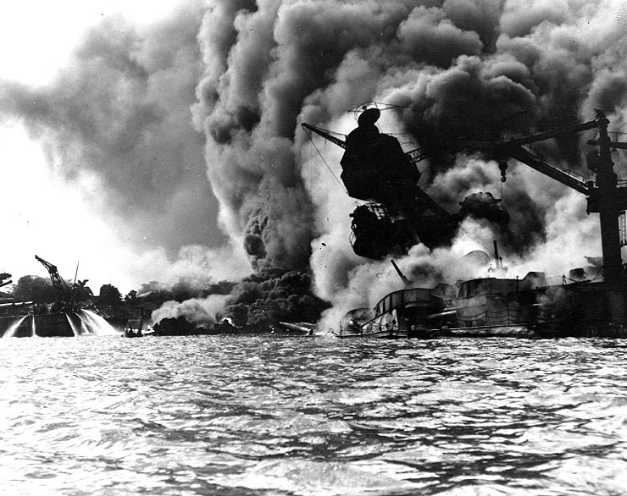
Pearl Harbor
December 7, 1941
Carrier-based Japanese planes bombed naval base at Pearl Harbor, Hawaii
More than 2400 Americans killed
U.S. Pacific fleet temporarily crippled
The USS Arizona burns during the Japanese attack on Pearl Harbor
Notes:
American hopes of staying out of war ended on December 7, 1941, when carrier-based Japanese planes bombed the U.S. naval base at Pearl Harbor, Hawaii. In the attack, more than 2400 Americans were killed, with over 1100 wounded. Several American battleships were either sunk or badly damaged. The USS Arizona was destroyed by an armor-piercing bomb that detonated in the ship’s fuel and ammunition chain; more than 1100 sailors and Marines died onboard the ship.
Other Japanese planes heavily damaged Pearl Harbor’s army installations and airfields. American naval and airpower eventually recovered from the attack, but on that day, it was far from certain whether the U.S. military could adequately respond to the Japanese threat.
10

Slide 11
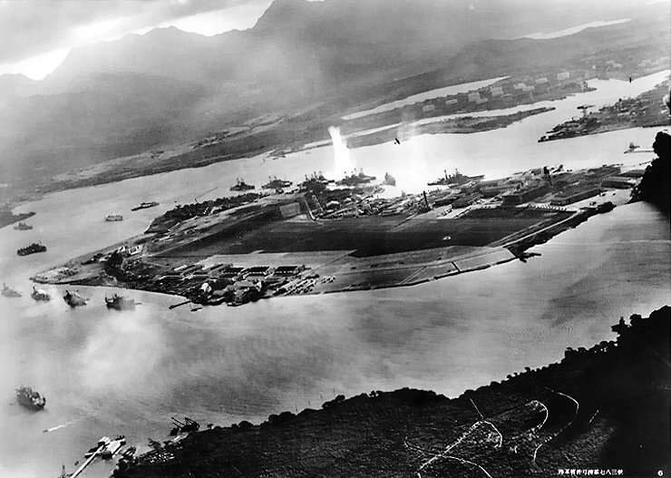
Pearl Harbor: The Nature of the Attack
Japanese intended to knock out U.S. military power
U.S. officials knew of a coming attack, but not at Pearl Harbor
Not meant to be a “sneak attack”
Japanese aerial view of Pearl Harbor under attack
Notes:
The Japanese designed their attack on Pearl Harbor to be a knockout blow. Members of the Japanese high command felt that if they could deliver a crippling blow to the Pacific Fleet, the U.S. would not have the heart for a prolonged war. However, the Japanese underestimated both the U.S. ability to make war and its economic capability.
In order to avoid detection, the Japanese fleet used a difficult northern, rather than eastern, route to approach Pearl Harbor. Many U.S. military officials, however, thought a Japanese attack at Pearl Harbor was impossible—due first to the distance from Japan to Hawaii, and second because the relatively shallow harbor would make torpedoes launched from planes simply impact harmlessly on the harbor floor.
Most Americans believed that the Japanese had planned a “sneak attack” on a Sunday to catch American military forces off-guard. In actuality, the Japanese plan did not call for the attack first and a declaration of hostilities later. Translation of a diplomatic cable to the U.S. government was delayed, and by the time the Japanese ambassador could deliver the cable, the attack had already begun.
11

Slide 12
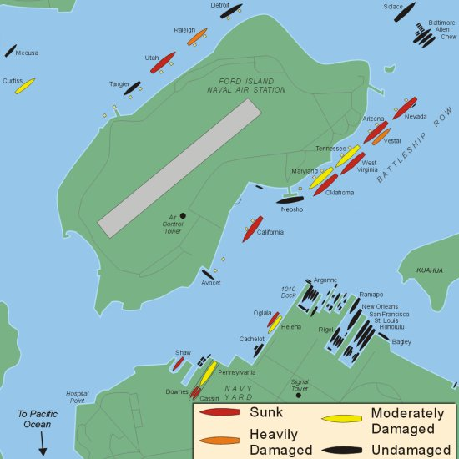
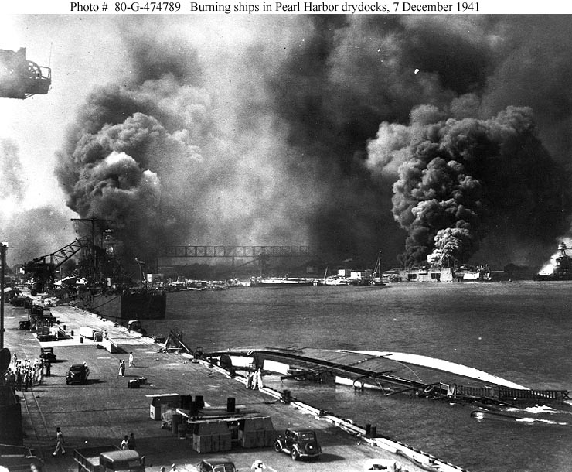

Slide 13
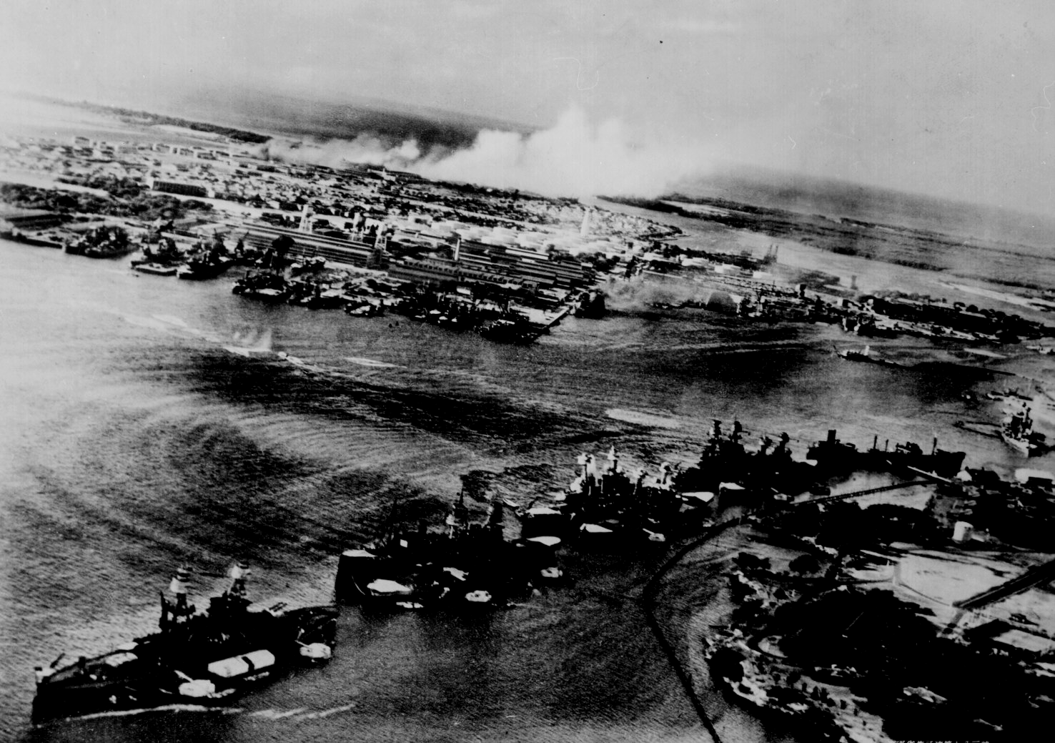
Pearl Harbor from the Cockpit of a Japanese Pilot

Slide 14
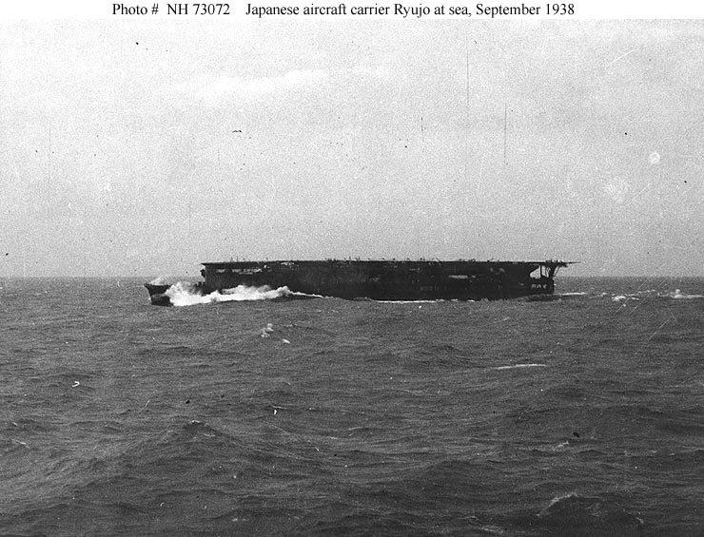
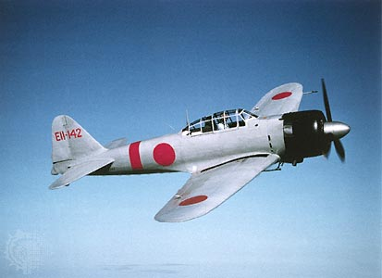
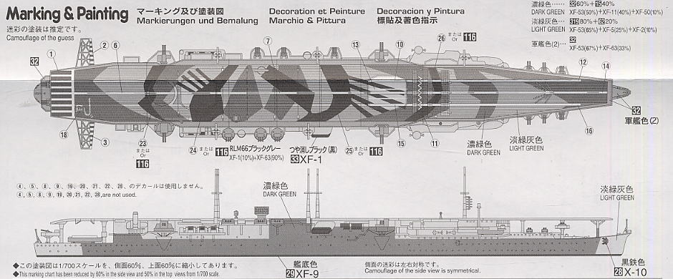
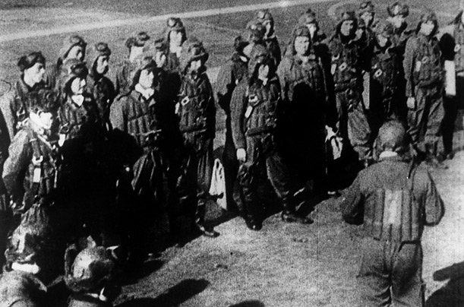

Slide 15
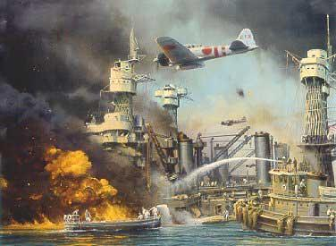

Slide 16
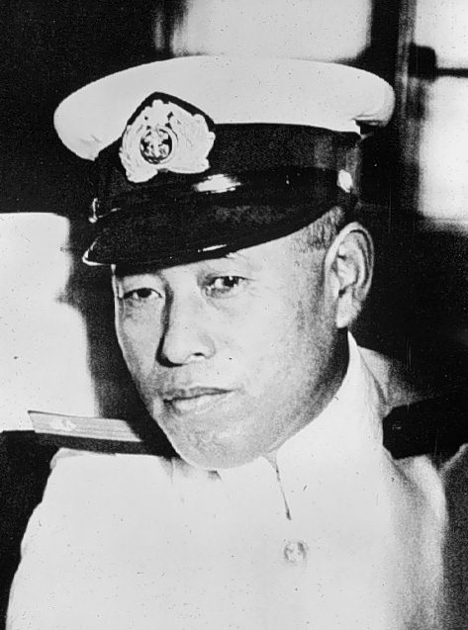
Admiral Isoroku Yamamoto

Slide 17
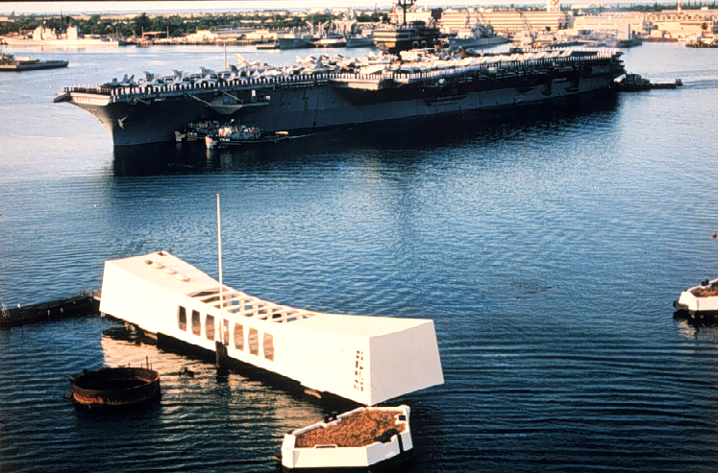
Pearl Harbor Memorial
2,887 Americans Dead!

Slide 18
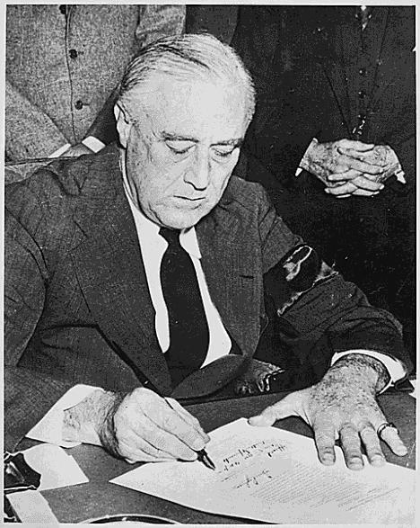
FDR’s War Message
Delivered to Congress on December 8, 1941
Only one member of Congress voted against declaring war
Germany declared war on the U.S. a few days later
FDR signs the declaration of war with Japan
Notes:
The day after the Japanese attack on Pearl Harbor, President Roosevelt addressed a joint session of Congress and asked for a declaration of war against Japan. He opened his speech with the famous words, “Yesterday, December 7, 1941, a date which will live in infamy.” FDR also described the attack as “dastardly and unprovoked.”
The Senate voted unanimously to declare war on Japan. Only one member of the House of Representatives, Jeanette Rankin of Montana, voted against the resolution. Rankin became the only member of Congress to vote against U.S. entry into both World War I and World War II.
FDR did not ask Congress to declare war against Germany; however, both Germany and Italy declared war on the U.S. on December 11th. America now found itself fighting a two-front war.
Note to teacher: You may wish to play the audio file of this speech, included on the CD-ROM.
18

Slide 19
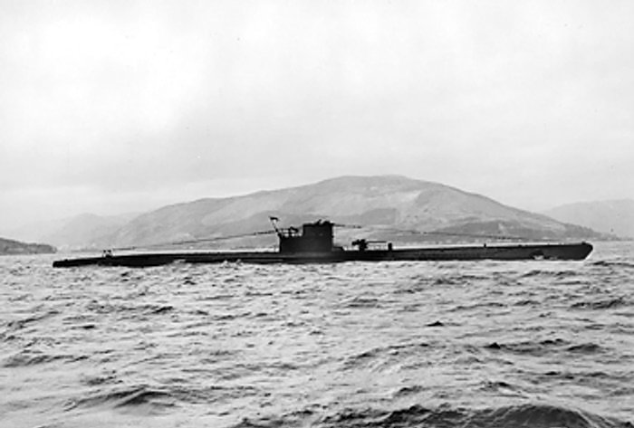
U-Boats in the Western Atlantic
Operation Paukenschlag
East Coast essentially undefended
U-boats sank over 500 ships in the U.S. defense zone, July–December 1942
U.S. 10th Fleet fought against U-boats in western Atlantic
Sank 65 U-boats in six months
A German U-boat
Notes:
German submarines (Unterseeboote, or “U-boats”) patrolling off the East Coast of the U.S. in the days after Pearl Harbor found the coastline essentially unguarded. In addition, most shipping in the region traveled with lights on and unescorted—easy prey for German U-boats.
The German navy instituted Operation Paukenschlag (Drumbeat), in which German U-boat “wolfpacks” sank ships with impunity in what they called the “American shooting season.” In ten days, five U-Boats sank 25 ships, without a single U-boat sunk or damaged. U.S. shipping losses skyrocketed throughout the first part of 1942. More and more U-boats appeared in the waters of the western Atlantic—at one point, 105 U-boats were patrolling the U.S. coast, sinking 524 ships, along with nearly eight million tons of shipping.
Increased patrols by the U.S. navy’s 10th Fleet managed to strike back against the U-boats. Given the mission of finding, tracking, and destroying German subs, the fleet sank 65 in late 1943 and early 1944; it eventually sank more than 100. Eventually, the German high command judged losses in the western Atlantic too high and pulled the remaining U-boats from the area, reassigning them to the northern Atlantic.
19

Slide 20
Civil Defense
Fears of attack by Axis Powers on U.S. mainland
Office of Civilian Defense
Civil Air Patrol and Civil Defense Corps
Performed various protective services
The WWII-era Civil Defense logo
Notes:
Just as the terrorist attacks on September 11, 2001, showed that American cities were not safe from foreign attack, the attack on Pearl Harbor convinced many that “homeland security” had to be maintained in addition to fighting in Europe and the Pacific.
To ensure that American cities would remain safe, the Office of Civilian Defense, first headed by New York Mayor Fiorello La Guardia, had the responsibility of devising protective measures and elevating national morale. Soon, cities required citizens to practice blackout conditions, and air-raid wardens conducted drills as if German or Japanese aircraft were approaching to destroy houses and businesses.
The Civil Air Patrol’s duties included commissioning civilian pilots to patrol American coastlines and borders, and facilitating search-and-rescue missions where needed. Officials established the Civil Defense Corps to fight fires which might occur after a bombing raid, decontaminate areas following a chemical-weapons attack, and administer first aid. While the Axis Powers never attacked the mainland, the prevalent thought at the time was that an attack was not only possible, but likely.
Officials had dissolved the civil defense agencies established during World War I soon after the war. However, most of the World War II–era agencies remained in effect to help civilian populations deal with Cold War concerns.
20

Slide 21
The War Powers Act
Gave the president sweeping powers to conduct the war
President allowed to initiate and terminate war contracts
Government agencies set for wartime priorities
Foreign assets also frozen
Censorship allowed, though media generally censored themselves
Notes:
Within days of formally declaring war against the Axis Powers, Congress passed the 1941 War Powers Act, which gave the president sweeping authority to conduct the war. As commander-in-chief, FDR could enter into and terminate contracts with defense industries. The act reconfigured government agencies to deal with war-related situations and emergencies and allowed for freezing foreign assets if needed.
Most significantly, the act gave the president the power to censor all incoming and outgoing communications. FDR appointed Byron Price, executive news director of the Associated Press, as director of censorship. Price relied mainly on the media to regulate itself, which it did fairly effectively. However, there were instances of fairly heavy-handed censorship. Magazines that sometimes included “adult” content were considered obscene, and Esquire magazine successfully sued the postal service to allow for distribution in the mail. In another instance, First Lady Eleanor Roosevelt received a letter of reprimand due to an entry in her “My Day” newspaper column in which she described the weather while on a trip with her husband; Mrs. Roosevelt promised not to do it again.
21

Slide 22
Discussion Questions
What were the immediate effects on the U.S. of the Japanese attack on Pearl Harbor?
What were some ways in which the Germans and Japanese tried to directly attack the U.S.?
What did the War Powers Act give FDR the authority to do in conducting the war?
Notes:
While the Japanese attack on Pearl Harbor lowered U.S. morale in December 1941, it also resulted in a significant setback for the American military. More than 2400 American servicemen died in the attack, and several ships in the Pacific Fleet were severely damaged or destroyed. The attack also crippled the army installations and airfields there. Most importantly, the attack led FDR to ask Congress for a declaration of war against Japan.
In 1942, German agents attempted to infiltrate the U.S. from locations on Long Island (NY) and in Florida; while they did no significant damage to U.S. infrastructure, they planned to sabotage defense plants as well as bridges and railroads. German U-boats also inflicted great losses on shipping in the western Atlantic until American naval forces disrupted their sinking of merchant ships in 1944. The Japanese floated balloons carrying anti-personnel and incendiary bombs toward the West Coast.
The War Powers Act gave the president sweeping powers: he could enter into and terminate contracts with war industries, reconfigure government agencies to deal more effectively with war-related matters, and freeze the assets of foreign nations if needed. The act also allowed for censorship of the media, though the media essentially censored themselves.
22

Slide 23
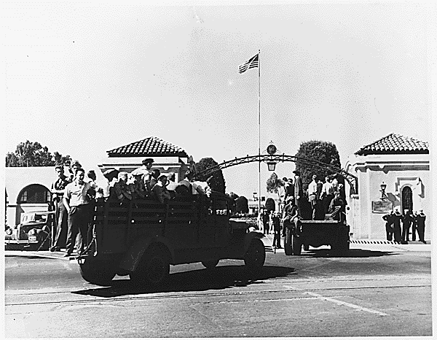
New Recruits
Over 60,000 enlisted immediately after Pearl Harbor
Military training facilities overwhelmed
Not enough barracks or materiel
Recruits processed, then sent to basic training
Recruits broke down cultural and class barriers
Recruits arriving at the naval training center in San Diego
Notes:
Immediately after the attack on Pearl Harbor, more than 60,000 Americans volunteered for military service. The already undersupplied U.S. military now found itself overwhelmed. Rather than house enlistees in barracks, the army put them in tents. The military also commonly had shortages of materiel: many recruits trained with broomsticks instead of rifles, rocks instead of grenades, and trucks rather than armored vehicles.
The typical enlistee first went to a “reception” center, where doctors administered physical exams and vaccinated recruits against diseases such as smallpox, typhoid, and others they might encounter overseas. In addition, doctors noted and assessed recruits’ physical issues such as poor vision and dental problems.
After the physical, the military issued recruits supplies needed for service, including uniforms, mess kits, and other equipment. Basic training for most recruits lasted eight weeks, in which instructors would subject them to physical training as well as classroom instruction on basic military strategies and tactics. Recruits with higher levels of education were frequently placed in Officer Candidate School. While the army segregated enlistees by race, they did not group them by region or social class. Mixed together, troops frequently developed a “brotherhood” with recruits from different backgrounds and ways of life.
23

Slide 24
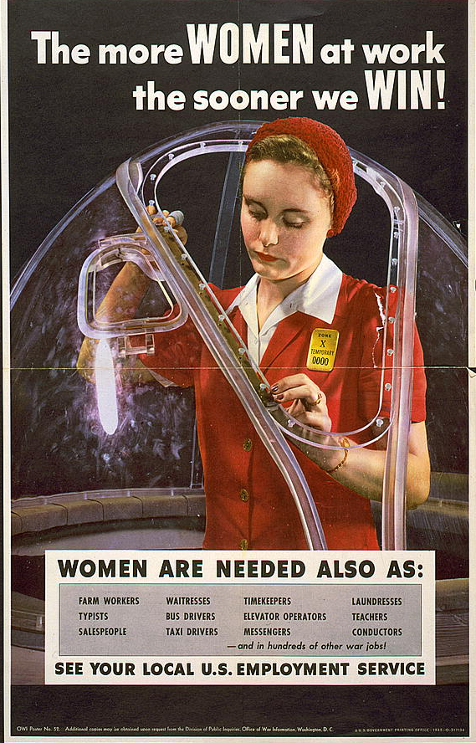
Women in the War Effort
Took over many jobs for servicemen, most notably in heavy industry
Some joined the military
A poster urging women to take manufacturing jobs to help the war effort
Notes:
With millions of American men either enlisting in the armed forces or drafted, women had to take over many jobs usually performed by men, such as working in heavy industry, manufacturing tools of war including tanks, planes, and other materiel. The image of “Rosie the Riveter” became commonplace as women soon became the backbone of American industry during the war years.
Other women sought a more active role in defense by joining specially created women’s units in the armed forces. Many joined the WACs, WAVEs, SPARs, and other related units, filling many noncombat positions both stateside and overseas. Women also served as drivers, clerks, communications officers, pilots, and nurses. Thirty nurses were killed in action during World War II.
However, while many women became the family breadwinner and proved that they could work as hard as their male counterparts, wartime employment had substantial drawbacks. The divorce rate increased substantially, as did juvenile delinquency among females. The incidence of alcoholism among women also grew. Many women had to uproot themselves and their families to relocate to communities that provided more defense-industry opportunities. A new generation of “latchkey kids” frequently found itself without parental guidance or supervision, perhaps with fathers in the military and mothers working a shift at a defense plant.
24

Slide 25
WACS WAVES WASPS
“Women Accepted for Voluntary Emergency Service”
Navy program similar to WACs
Did not serve overseas
Nurses, clerical work, communications jobs
Chief of Staff John Marshall noted British success in using women for noncombat duties
Congress created Women’s Auxiliary Army Corps in 1942
WAAC later renamed “Women’s Army Corps”
“Women’s Airforce Service Pilots”
Performed noncombat flight duties
Freed male pilots for combat missions
Notes:
U.S. military leaders saw in the early days of the war that the female population could provide significant military service as well. Impressed with the British army’s incorporation of women in military service, Army Chief of Staff George C. Marshall became a main proponent of a women’s unit for the U.S. Army. With his backing, and at the urging of other women leaders including First Lady Eleanor Roosevelt, Congress created the Women’s Auxiliary Army Corps (WAAC) in May 1942. Congress upgraded the WAAC to full military status within a year, renaming it the “Women’s Army Corps” (WAC).
WACs (as corps members were informally known) contributed to the war effort by performing more than 200 noncombat jobs, including operating switchboards, driving staff cars, and sorting mail. The military stationed WACs at more than 400 mainland military bases as well as in both the European and Pacific theaters. By the end of the European war, the WACs had more than 100,000 members, including more than 6000 commissioned officers.
The army named as director Oveta Culp Hobby, wife of former Texas Governor William Hobby and head of the War Department’s Women’s Interest Section. After the war, she became the first secretary of the newly created Department of Health, Education, and Welfare (later, the Department of Health and Human Services).
25

Slide 26
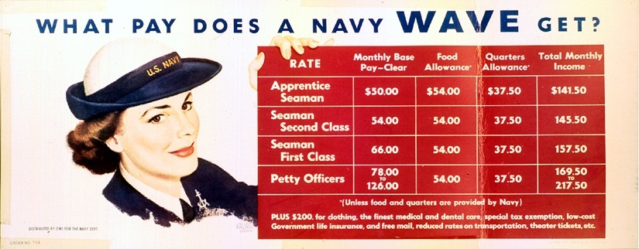
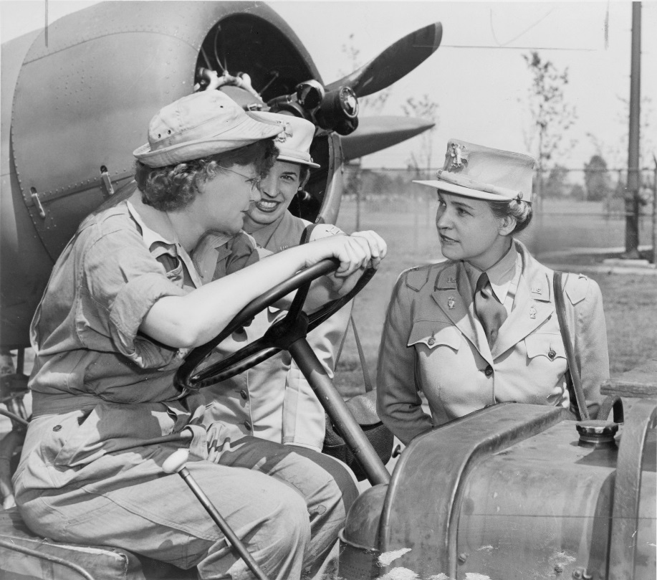
A WAVES recruitment poster explaining the pay scale for members
WAC Director Col. Oveta Culp Hobby (right) confers with WAC members at Mitchell Field, NY
Notes:
With the WAAC established by summer 1942, the navy followed suit with a similar program, called “Women Accepted for Voluntary Emergency Service” (WAVES). Although an official part of the navy, the program’s name indicated its temporary nature; after the war ended, members would be discharged.
The navy stationed WAVEs (as individuals were called) only in the continental U.S. or in U.S. possessions such as Hawaii. They did not serve in any combat zones. Most WAVEs worked as nurses, in communications jobs and clerical positions, and as storekeepers. The U.S. Coast Guard established a similar program, called “SPAR,” after the initials of that branch’s motto, “Semper Paratus” (“Always Ready”).
In 1948, Congress disbanded the WAVEs by passing the Women’s Armed Services Integration Act, which gave women permanent status in the armed forces. However, most female recruits were known as WAVEs for much of the 20th century.
26

Slide 27
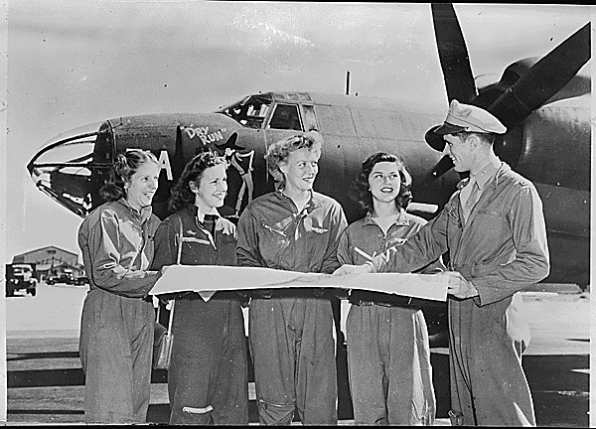
WASPs
Four WASPs receive final instructions as they chart a cross-country course
Notes:
Although the military barred women from participating in naval or ground combat operations, they still provided valuable service to the U.S. armed forces in noncombat roles. Female aviators did the same through their service in the Women’s Airforce Service Pilots program.
Two well-known pilots, Jacqueline Cochran and Nancy Harkness Love, independently proposed such a program prior to Pearl Harbor. While the Army Air Corps rejected these early submissions, the entry of the U.S. into WWII changed the position of General Henry “Hap” Arnold, as well as other military leaders. Women worked as civilian flight instructors, as well as ferried planes from factories to airfields. Female pilots towed airborne targets for anti-aircraft drills, simulated strafing drills, and transported cargo. Perhaps most importantly, the contributions of the WASPs made male pilots available to participate in combat.
Unlike the WACs and WAVEs, Congress failed to pass legislation giving the WASPs equal military status with the all-male Army Air Corps. Considered civilian civil-service employees, the WASP corps was disbanded in late 1944. Only in the late 1970s did the U.S. government retroactively give the WASPs equal military status, recognizing female pilots for their service.
27

Slide 28
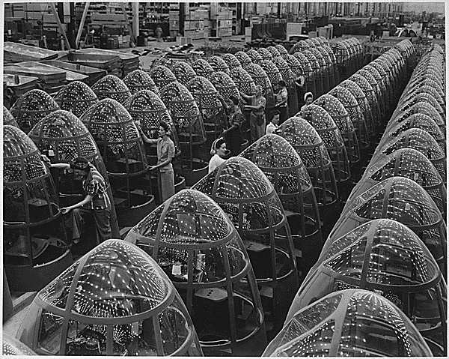
Women in the Workforce
Women were encouraged to work in defense plants
Others grew Victory Gardens and helped with recycling for the war effort
Generally earned less than male workers
Factory workers polish Plexiglas nose cones for A-20 attack bombers
Notes:
Although some women joined the military during the war, most found they could assist the war effort by working in the private sector. By war’s end, nearly 18 million women worked outside the home—one-and-a-half times the number that had performed similar labor in 1939.
The shortage of male workers led employers to suggest that women’s work as homemakers had adequately prepared them for work in industry. The majority of women working in defense plants earned much less than their male counterparts, though many used to working as homemakers without pay accepted lower salaries without question.
Many married women with the responsibility of raising children as well as managing the home, stayed housewives. However, they contributed to the war effort by growing Victory Gardens (which fed the family and freed food resources for troops’ consumption) and working in recycling drives, as well as buying war bonds.
28

Slide 29
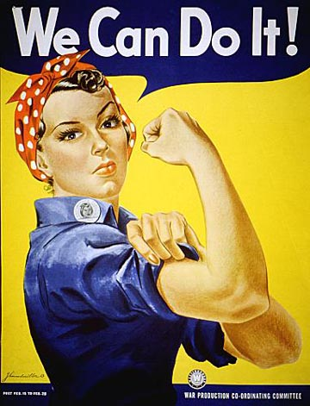
“Rosie the Riveter”
A symbol of working women during the war
Based on factory worker Rose Will Monroe
Miller and Rockwell both created iconic “Rosie” images
This poster for the Westinghouse Corporation is frequently associated with “Rosie the Riveter”
Notes:
One of the most iconic images of the home front was that of “Rosie the Riveter,” a symbol of the power of the working woman to help achieve victory in World War II. Though the famous “We Can Do It!” poster (by artist J. Howard Miller) is credited as one of the first uses of “Rosie” in wartime propaganda, Miller did not intend to associate his image with the character; Miller created the poster as a motivational tool for the Westinghouse Corporation, not the federal government.
An actual factory employee, Rose Will Monroe, likely inspired the character of “Rosie the Riveter.” She worked as a riveter at Michigan’s Willow Run Aircraft Factory. Several government posters encouraging women to work in defense plants featured her picture, and the government also sponsored a promotional film starring Monroe.
Illustrator Norman Rockwell drew another famous conception of “Rosie”—this time a welder—for the cover of the May 29, 1943, issue of The Saturday Evening Post. The original painting later sold at auction for nearly $5 million.
Regardless of the character’s origin, the “Rosie” image helped spur women to help in the war effort by taking on industrial jobs that had previously gone to men.
29

Slide 30
Discussion Questions
What role did General George C. Marshall play in mobilizing the armed forces early in the war?
How did women contribute to the U.S. war effort?
Notes:
Marshall became Army Chief of Staff in late 1939, in which position he secured major increases in funding for the armed forces, fearing an eventual conflict with a remilitarized and expansionist Germany. He convinced the government to appropriate $9 billion by May 1940, and also to pass the Selective Service Act, which instituted a peacetime draft and grew the size of the army from 190,000 to several million at its height.
Women played a major role in the mobilization of the country in the war effort as well as maintaining the wartime economy. Women joined various branches or subsidiary organizations of the armed forces, including the WACs, WAVEs, SPARs, and WASPs. They also joined the workforce in large numbers and in various industries—some for the first time, such as in airplane or munitions plants to help maintain domestic lifestyles while producing needed tools of war. “Rosie the Riveter” became a common emblem of American life, and many families depended on the woman’s income.
30

Slide 31
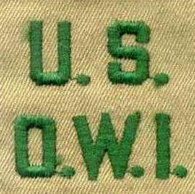
Office of War Information
Established in 1942
Coordinated release of war news
Promoted patriotism
Tried to recruit women into factory work
Propaganda program abroad
The Voice of America
Patch worn by Office or War Information personnel
Notes:
As the government worked to mobilize industry and manpower for the war effort, it also took steps to prepare the nation psychologically for a difficult struggle. This task fell to the Office of War Information, established in 1942. The OWI played several roles. One involved coordinating the release of war news via censorship and control of the media. In most instances, the OWI promoted media self-censorship of the media, which complied with many restrictions regarding troop movements, military campaigns, and so on.
The OWI worked to promote patriotism through various means, including posters, propaganda films, and radio shows—many featuring some of the era’s bigger celebrities. Similarly, the OWI helped to recruit women to work in the defense industry. The OWI also worked to educate foreign populations about “American democracy” through an international propaganda program, specifically with the Voice of America, a radio network that broadcasted American news and music to various nations in Europe, as well as to other parts of the world.
With the end of the war came the end of the need for the OWI, and it dissolved in
late 1945.
31

Slide 32
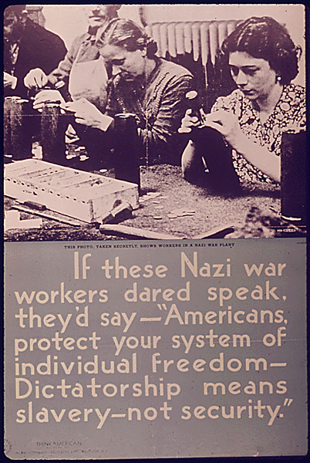
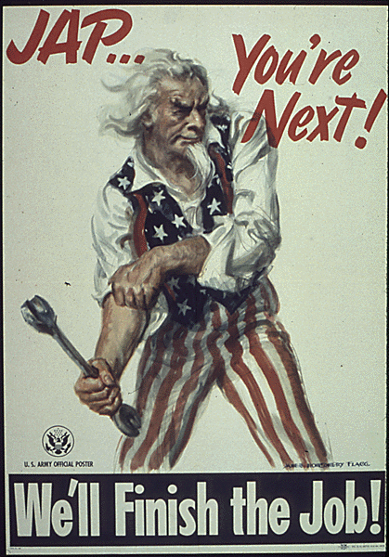
Wartime Propaganda Posters
Government propagandists sometimes used fear and racial slurs in order to convey their message
Notes:
Discussion questions:
Ask students to identify specific elements that make these posters propaganda. Ask students to speculate as to how effective posters such as these might be in keeping patriotism high and focusing American attention on the war effort.
Students may look at the image of Uncle Sam rolling up his sleeves (a symbol of getting down to work), as well as the Nazi workers, as good methods of propaganda, although the Nazi war workers picture is somewhat subdued compared to the picture of Uncle Sam. However, the use of the word “slavery” in the Nazi war workers poster may lead students to note that Americans who read that poster might be concerned about losing basic freedoms if the Nazis won the war.
32

Slide 33
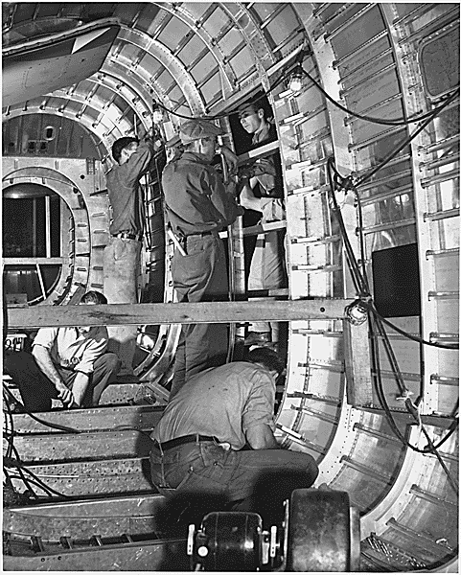
Mobilization of Industry
Many civilian industries converted to war production
Manpower needed for defense plants
Scarce goods rationed and price controls established
Disputes between management and labor to resolve
Workers assembling an aircraft
Notes:
Recovering from Pearl Harbor posed many significant military problems, but also posed significant problems on the home front as well. Used to federal regulation of the economy, Americans now found the government changing economic and industrial priorities to meet military needs—in the words of FDR, “ ‘Dr. New Deal’ [was] replaced by ‘Dr. Win the War’.”
To reach this goal, civilian industries converted to wartime production, which frequently required retooling factories and retraining workers. Factories needed more manpower (both male and female), especially to replace workers who enlisted into the armed forces or were drafted.
The sheer amount of products devoted to the war effort inevitably led to the scarcity of certain foods and goods. The government had to find a way to make sure that military populations would receive needed supplies, without subjecting civilian populations to extreme hardships.
Still another question concerned relationships between management and labor—how to maintain production without the threat of strikes.
33

Slide 34
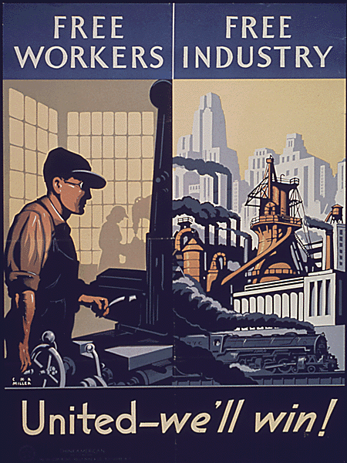
“A Production Miracle”
Axis Powers underestimated American production
Many factories and businesses converted to war production
New industries emerged
Output significantly increased
Notes:
One of the largest mistakes the Axis nations made was believing that most Americans would not tolerate shifting industrial production to build tanks, planes, and guns, instead of washing machines, automobiles, and radios. However, American industry and the public soon proved that they were willing to make sacrifices for the sake of victory.
Civilian automobile production ended two months after Pearl Harbor. Soon, automobile manufacturers had retooled and were producing airplanes and tanks. Other civilian industries did the same, and by 1942, war production involved one-third of the U.S. economy. American output of materiel equaled that of Germany, Japan, and Italy combined.
The war also spurred the expansion or creation of new industries. For example, Japanese-controlled territory contained most of the world’s supply of rubber. In response, the U.S. built nearly 50 synthetic rubber plants across the country. By war’s end, the U.S. had become the world’s largest importer of natural rubber to the world’s largest exporter of synthetic rubber.
All told, U.S. industry produced 300,000 military aircraft, 2.6 million machine guns, six million tons of bombs, and 86,000 warships.
34

Slide 35
Discussion Questions
What was the purpose of the Office of War Information? How did it accomplish this?
Notes:
The Office of War Information was formed in 1942 to ensure coordination of war news, promote patriotism, and develop and disseminate propaganda. The OWI produced posters, motivational films, and radio shows to keep Americans focused on the war effort. It also recruited women to work in the war industry by similar means. In addition, the OWI established and ran the Voice of America radio network to broadcast a steady stream of American propaganda to Europe and in the Pacific.
Hollywood helped the war effort by providing audiences with movies that showed the evils of the Axis and highlighted the goodness of the Allied cause. Movies such as Casablanca portrayed the Germans as sadistic warmongers, while Yankee Doodle Dandy promoted patriotism on the home front. Cartoons such as Donald Duck in Nutziland put a comic spin on why Americans had to support the war effort. Life on the home front was also brought to the silver screen in films such as Mrs. Miniver and Since You Went Away. Documentary films, such as Frank Capra’s series Why We Fight also helped to maintain American interest in fighting the war.
Kaiser made two innovations in shipbuilding: First was the use of welded hulls, rather than riveted hulls, which greatly reduced the time spent on construction. The second involved prefabricating sections of the ship at different locations, then bringing them together for final assembly at a shipyard.
35

Slide 36
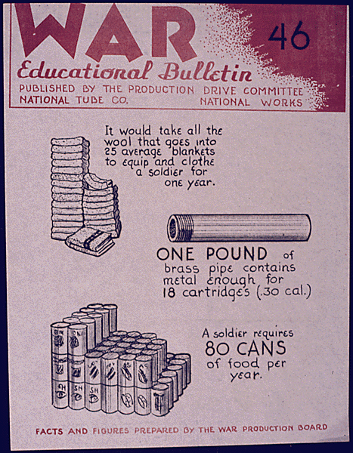
War Production Board
Ensured that the military had the resources it needed
Directed industrial output
Prohibited nonessential business activities
Allocated raw materiel
Organized scrap drives
A “War Educational Bulletin” produced by the War Production Board
Notes:
In order to coordinate the “production miracle” needed to win the war, the Roosevelt Administration created several boards and agencies which significantly altered American business and the economy during the war years. The War Production Board ensured that the military received the resources it needed to fight the war. Since the government had to acquire massive amounts of materiel to fight the Axis, it also needed to direct a large portion of industrial output to military purposes. Headed by Sears, Roebuck and Co. Chairman Donald Nelson, the WPB suspended nonessential business activities, such as the manufacture of civilian automobiles, for the duration of the war. It assigned priorities to scarce materiel and allocated raw materiel to key industries. It also organized and encouraged scrap drives to recycle waste materiel into needed goods.
36

Slide 37
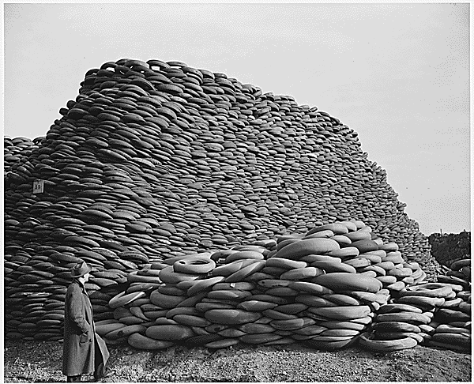
Scrap Drives
Organized by the WPB
Encouraged collection of waste and scrap goods for war use
Materiel included iron, aluminum, paper
Waste cooking fats for making glycerin
Results of a scrap rubber drive
Notes:
In addition to the War Production Board’s attempt to allocate scarce materiel to industry, it also encouraged civilian populations to recycle waste and scrap materiel for reuse as war resources. Women and children collected and turned in tons of scrap metal, aluminum, newspaper, and waste cooking fats. The U.S. government especially urged children to participate, calling them “Uncle Sam’s Scrappers,” or “Tin Can Colonels.”
The WPB estimated that 30 million schoolchildren across the nation collected 15 million tons of scrap metals. It declared that this amount of scrap metal could build 425 Liberty ships. The WPB especially prized waste cooking fats because they were used to make glycerin, an important ingredient in the manufacture of gunpowder. Making one pound of gunpowder required three pounds of glycerin; therefore, firing a 12-inch shell from a navy cannon took nearly 350 pounds of glycerin.
37

Slide 38
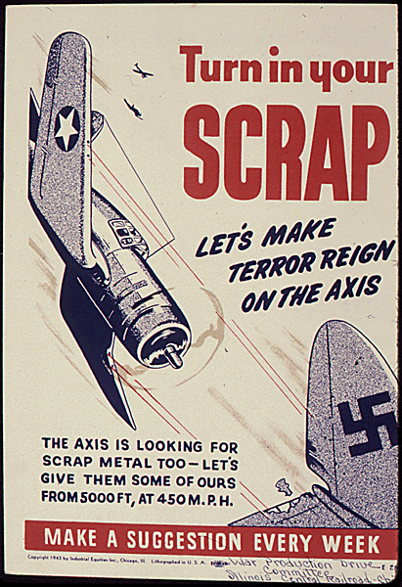
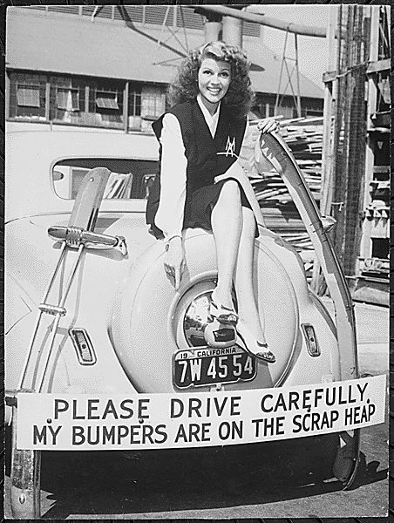
Scrap Drives: Posters
The government used posters and publicity pictures of celebrities such as Rita Hayworth (right) to encourage citizens to recycle scrap items.

Slide 39
Office of War Mobilization
Created in 1943 by FDR
Headed by James Byrnes
Became dominant mobilization agency
Byrnes worked well with labor and with the military
OWM head James F. Byrnes
Notes:
It soon became apparent that the WPB could not handle all aspects of war production, such as maintaining production of certain civilian goods while at the same time ensuring production of military supplies. To solve this issue, President Franklin D. Roosevelt created the Office of War Mobilization in 1943.
To head the new agency, Roosevelt appointed James F. Byrnes, a former Supreme Court associate justice as well as one of FDR’s closest advisers (whom many called the “assistant president”). While it didn’t abolish the War Production Board, the OWM became the more effective, dominant agency dealing with war production, primarily because Byrnes could better handle labor issues and reach compromises with the military regarding production levels.
39

Slide 40
Financing the War
U.S. spent more than $321 billion (more than $3 trillion today)
National debt increased dramatically
More Americans required to pay income taxes
War-bond sales raised needed revenue
Notes:
World War II demanded significant changes to the nation’s economic system. The U.S. spent more than $321 billion (more than $3 trillion in today’s dollars) fighting the Axis powers. This amounted to more than twice what the federal government had spent in its entire existence. As a result, the national debt skyrocketed as well, to nearly $260 billion by the war’s end.
One way the government helped pay its expenses was with a substantially increased income tax rate. By the end of the war, about 40 million Americans filed tax returns—more than ten times the number in 1941. For the first time, the government required employers to withhold a certain percentage of their employees’ paychecks, depending on their salary and how many dependents an employee claimed. That way, the employee would have withheld enough tax to avoid having to pay a much larger sum at the end of the year, or to receive a refund from the government.
In addition, the government raised $185 billion through the sale of war bonds to private individuals, banks, and industry.
40

Slide 41
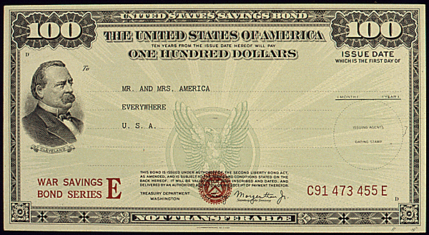
War Bonds
Used to help finance the war
More than $185 billion sold
Bought by businesses, banks, and civilians
Celebrities helped with bond drives
High interest rates
An example of a $100 war bond
Notes:
While the government sought to pay for the war with higher tax rates and deficit spending, assistance—to the tune of $185 billion—came also from the purchase of war bonds, a type of savings bond. Many corporations, banks, and insurance companies bought the bonds, but civilians did as well, including children, who could purchase “war stamps” they could later convert into bonds. Many celebrities and sports heroes participated in bond drives to raise demand.
War bonds yielded a substantial benefit to those purchasing them. Bonds could be used as a savings plan for expenditures such as buying a new home or providing for children’s education. Interest rates for bonds were comparable to or higher than rates for most other savings plans in the 1940s.
41

Slide 42
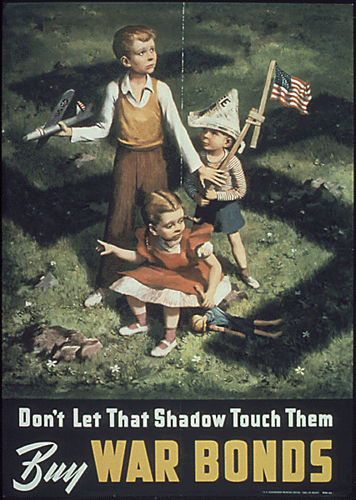
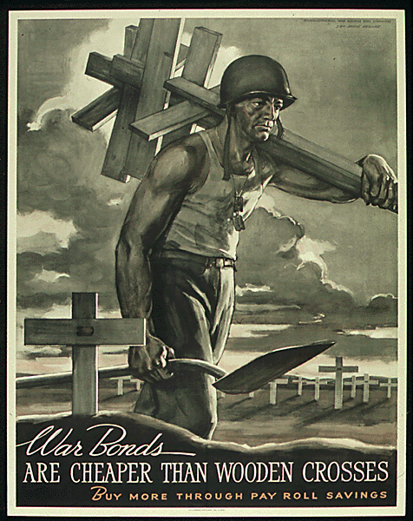
War Bonds: Posters
Posters such as these sought to convince Americans that they should help the war effort and stop the enemy by buying war bonds
Notes:
Discussion questions:
Have students view the posters. Ask the class the following questions:
In each example, what emotions or feelings is the poster attempting to stir? (Students will probably note that they appeal to fears that Americans might have had at the time. The “shadow” poster plays on the fear of the Nazi takeover of the U.S., with a giant swastika looming over defenseless children. The “wooden crosses” poster implies that American soldiers would die [with a wooden cross marking each grave] if civilians didn’t buy war bonds.)
Ask the class if they feel these are effective images (Answers will vary.)
Note to teacher: You may also show the class the video file included on the CD-ROM, a pitch for war bonds featuring “Mr. and Mrs. America.” (If you have any problems playing the video, you can view a streaming version online at http://www.archive.org/details/MrandMrs1945.)
42

Slide 43
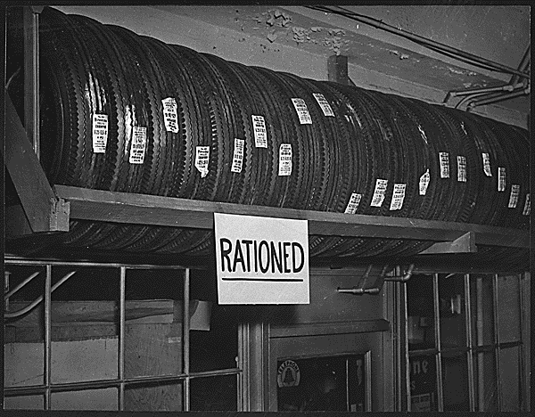
Office of Price Administration
Designed to limit wartime inflation
Established “ceiling prices” for many goods
Rationed scarce goods and many consumer staples
Rationing stopped at end of war
Dissolved in 1947
Notes:
The possibility of inflation greatly concerned the federal government. As goods became harder for the civilian population to purchase, their prices would skyrocket. Worried about the inflation’s effect on the U.S. economy, the Roosevelt Administration created the Office of Price Administration in early 1942. The OPA established “ceiling prices” for many commodities, most fixed at their March 1942 levels, above which they could not rise. The OPA froze nearly 90 percent of the nation’s retail prices during the war.
In addition, the OPA rationed what the government considered “scarce” goods. Several staples of American life, such as gasoline, automobile tires, sugar, coffee, meats, and processed foods were tightly rationed; some supplies were nearly nonexistent. Millions of Americans found themselves either substituting for scarce goods, doing without, or trying to purchase goods on the black market. With the end of the war, the OPA quickly abandoned rationing; the agency ceased to exist in 1947.
43

Slide 44
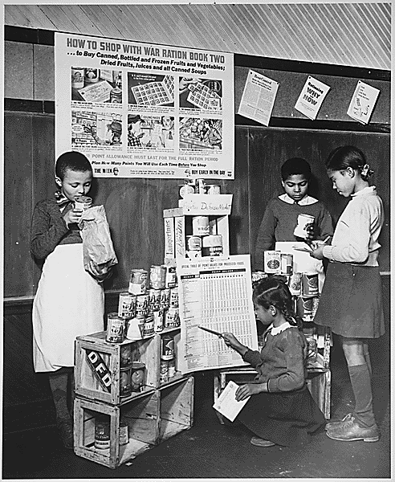
Rationing
Way to allocate scarce goods
Included meat, butter, sugar, coffee, shoes
Stamps and points system
Gasoline rationing particularly complex
Black market emerged
Children learning to tally points and ration stamps
Notes:
The government realized it needed a system for allocating goods so that both military and civilian populations could get what they needed. The response to this problem was rationing, a way to limit the purchase of scarce goods.
Some of the more contested-for rationed goods included meat, butter, sugar, coffee, canned and frozen foods, and shoes. To effectively calculate what goods the consumer might buy, the OPA devised a complicated system of stamps and points. A person without the right combination could not buy the good. Gasoline proved particularly difficult to ration. The OPA granted most motorists an “A” sticker for their car windshield, which guaranteed them four gallons of gas per week. “Essential” workers got “B” stickers entitling them to eight gallons per week. Those whose professions required them to drive (such as physicians, ministers, railroad workers, and mail carriers) received “C” stickers. “X” stickers went to government officials and public servants such as police, firefighters, and civil-defense workers. “T” stickers went to truck drivers who carried goods essential to the war effort; they could buy an unlimited supply of fuel.
Regardless of their level of patriotism, many Americans found doing without staples of daily life to be unappealing, and a robust black market soon developed to sell highly prized and highly priced goods. However, both civilian and military populations generally had the goods and materiel they needed during the war years.
44

Slide 45
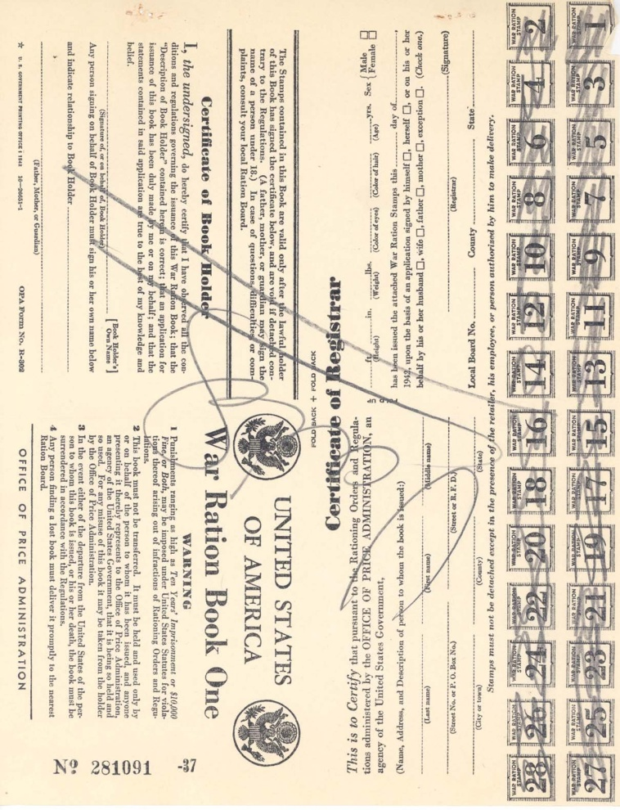
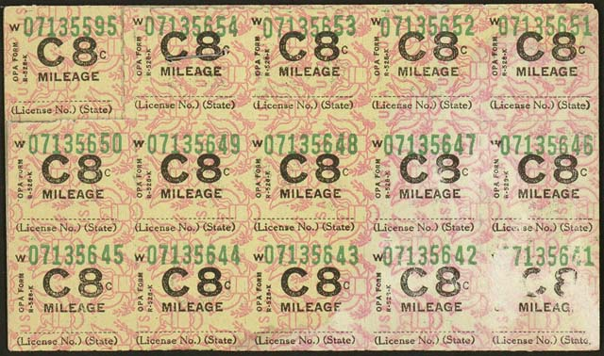
Rationing: Books and Stamps
Each family received ration books (left) and stamps (above) for determining its monthly allotment.
Notes:
The government devised a system of ration stamps and books, as well as a complex point system, to fairly determine what families and individuals could buy monthly. For example, goods such as meat, butter, fats, and cheese required red stamps; purchasing other goods, including fruits, vegetables, soup, and baby food involved blue stamps. The point system tended to frustrate many households, with some goods requiring a certain number of points, and others not needing any points. In addition to the multi-tiered system for rationing gasoline, drivers had to live with a 35 mph speed limit to conserve gas as well as tires.
Rationing ended along with the war, and all phases of it vanished by 1946.
45

Slide 46
Discussion Questions
About how much did WWII cost the U.S. government? How did the federal government raise revenue to pay for the war?
How did purchasing war bonds help the average citizen? How did they help the war effort?
How did the Office of Price Administration prevent wartime inflation? How did its system for rationing goods work?
Notes:
The U.S. government spent more than $321 billion (more than $3 trillion in today’s dollars) to fight the war—more than twice what the federal government had spent in its entire existence to this point. One way the government collected revenue was through substantially increased income tax rates, in addition to an expansion of who qualified for the income tax. The government also sold billions of dollars of war bonds (including war stamps purchased by children) to civilians, banks, and private industries.
Average Americans could invest in war bonds, which made money when the bonds matured at an interest rate higher than or comparable to other means of investment. War bonds helped the war effort by raising needed revenue and by making citizens feel as if they were directly contributing to the fight.
As goods become scarcer, prices tend to rise, making money worth increasingly less; the Office of Price Administration set the highest prices at which goods could sell, essentially freezing them at March 1942 levels. Regarding scarcity, the OPA devised a system of points and stamps for allotting staple items and other goods. With the right combination of stamps and points, a consumer could purchase their allotment of meat, sugar, or other items.
46

Slide 47
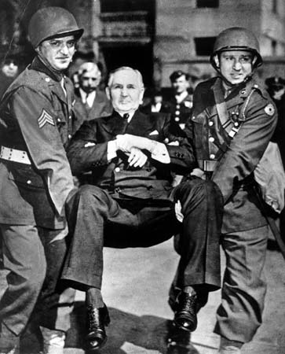
National War Labor Board
Arbitrated labor disputes during war
Board comprised of representatives from management, labor, and government
“No-strike pledge”
Some “wildcat” strikes still occurred
Guardsmen carry Sewell Avery, president of Montgomery Ward, from his office for failing to comply with NWLR rulings
Notes:
The Roosevelt Administration recognized that protracted disputes between management and labor could cripple the wartime economy and mobilization efforts. To settle these issues, FDR created the National War Labor Board in early 1942. The board comprised four labor union leaders, four corporate executives, and four public representatives. Early on, the board proved its usefulness when management and labor in communications and transportation industries agreed to a “no-strike pledge” for the duration of the war, agreeing that maintaining production outweighed striking for wages and benefits.
Union representatives to the board wanted a “closed shop,” in which all workers in a particular industry have to join the union. The NWLB refused that request, but did agree to what became known as the “maintenance of membership” clause, which forbade union members from quitting the union and required them to pay union dues, frequently through an automatic paycheck deduction. This approach helped to greatly increase labor union membership. While labor agreed to keep wage increases to a minimum, they gained significant benefits such as health insurance, vacation time, and pensions.
Regardless of the NWLB’s actions, some wildcat (i.e., unauthorized) strikes did occur. However, these generally caused little if any disruption to war production. The United Mine Workers under John L. Lewis struck three times in 1943, gaining some concessions, but losing a great deal of support as many states and Congress took steps to limit the power of unions.
47

Slide 48
The War’s Economic Impact
Nominal GDP more than doubled
Wages and salaries nearly tripled
Federal civilian employment more than tripled
Female employment up by a third
Labor union membership grew by over 50 percent
National debt ballooned by over 600 percent
Notes:
A number of changes to the U.S. economy occurred in the World War II era (1940–1945):
The nominal gross domestic product (the value of all goods and services produced inside a country in a year, not adjusted for inflation) of the U.S. increased substantially, from approximately $101 billion to about $223 billion. Wages and salaries rose from $45 billion to $120 billion.
In 1940, 14 million women worked outside the home; in 1945, the number was nearly 19 million, down slightly from 1944. Civilian employment by the federal government more than tripled, rising from slightly more than one million persons to nearly 3.5 million. Military employment mushroomed, as expected, from less than a million, to nearly 13 million.
Union membership also grew (due especially to the “maintenance of membership” clause enforced by the NWLB) from nine million to more than 14 million
Increases in GDP and employment led to a dramatic increase in the national debt, from about $41 billion to nearly $250 billion
48

Slide 49
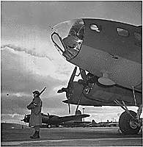
Geographic Shifts in the Economy
South saw great prosperity
Millions of jobs in textiles, chemicals, and aluminum
Southern shipyards and aircraft plants grew
West became economic powerhouse
California especially benefited from federal expenditures
An Army sentry guards new B-17 F (Flying Fortress) bombers at the airfield of Boeing's Seattle plant
Notes:
The American South and West benefited greatly from the war, economically speaking. Government spending and the need for increased production created millions of jobs in various Southern industries, including textiles, chemicals, and aluminum. Urban populations grew by about 40 percent. Consequently, the number of farm workers (including sharecroppers and tenant farmers) fell by about 20 percent. Shipyards and aircraft factories boomed, industrial capacity shot up by nearly 40 percent, and per-capita income tripled.
Western states received nearly $40 billion in federal funds. California alone got more than ten percent of this total, with 50 cents of every dollar in personal income coming from federally funded jobs. The military established many airbases and naval stations in Southern California especially; defense contractors followed, founding major shipyards and several aircraft manufacturing plants.
49

Slide 50
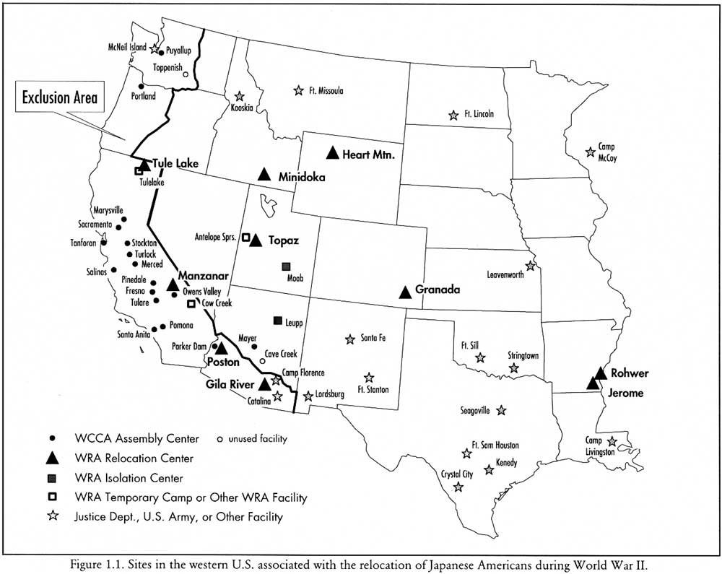
Japanese American Internment
Removed more than 110,000 Japanese Americans from the West Coast
About two-thirds were citizens
A map of relocation centers in the western U.S.
Notes:
Wartime civil-defense measures such as blackouts and air-raid drills prepared Americans for attacks that never occurred, but did little more than inconvenience people. However, the federal government instituted a program to maintain national security that proved far more damaging—the relocation of about 120,000 Japanese nationals (called Issei) and Japanese American citizens (Nisei) to internment camps across the interior of the western U.S.
In early 1942, FDR issued Executive Order 9066, which allowed for the exclusion from “military areas” anyone deemed a threat to national security. Designating the West Coast a “military area,” the government removed all persons of Japanese ancestry (along with a few thousand Germans, Italians, and German Jews). Many Americans, especially on the West Coast, supported the policy, contending that they had likely assisted the Japanese navy in planning and carrying out the attack on Pearl Harbor, and might help facilitate future attacks.
50

Slide 51
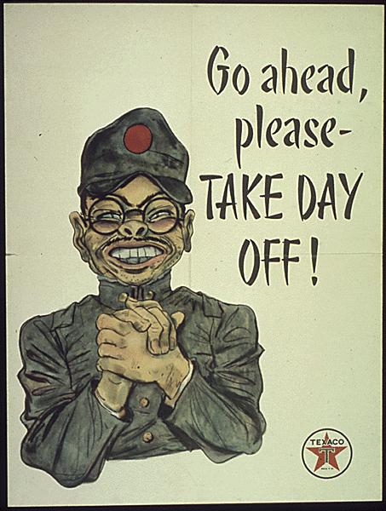
Prejudice Against Japanese
Long history of anti-Japanese sentiment in California
Falsely accused Japanese Americans of helping plan Pearl Harbor
No evidence of sabotage or espionage ever found
This propaganda poster displays typical American-held stereotypes of the Japanese
Notes:
The fear of Japanese Americans came not only from Japan’s attack on Pearl Harbor, but also from deep-seated prejudices against Nisei. Increasing Japanese immigration to California beginning the late 19th century had resulted in legislation in some cities similar to the Jim Crow laws of the American South. Reports of Japanese atrocities against the Chinese in the early 1930s further lowered public opinion of the Japanese. Groups of farmers in California resented having to compete with “foreigners” and wanted to take over their land.
However, no concrete evidence of Japanese American espionage or sabotage was ever uncovered during the war; no convictions on such charges ever materialized. In addition, Hawaii did not implement the relocation policy, and no incidents of espionage or sabotage occurred there.
Discussion question:
Ask students to view the poster included on the slide. What elements display stereotypes of how Americans viewed the Japanese and Japanese Americans? (Student answers should include the thick eyeglasses, buck teeth, and the pidgin English that many movies and radio shows used to imitate the Japanese; some may mention the rumpled uniform as typical of anti-Japanese propaganda.)
51

Slide 52
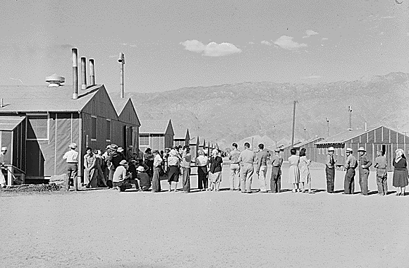
Life in the Camps
Japanese-Americans forced to sell homes, businesses, property
Lost an estimated $2 billion
Poor conditions:
Barbed-wire enclosures
Barracks with cots and no plumbing
Meager food budget
Notes:
Japanese Americans, faced with their immediate removal from cities on the West Coast, found themselves forced to sell their homes, businesses, and personal possessions for whatever they could get. The Nisei together lost an estimated $2 billion in property.
A 1943 War Department report noted that the internees were housed in “tar paper covered barracks of simple frame construction without plumbing or cooking facilities of any kind.” The Heart Mountain, Wyoming, relocation camp greeted internees with barbed-wire fences, toilets with no partitions, cots rather than beds, and a food budget of 45 cents per day. Temperatures at Heart Mountain frequently dropped to below zero during the winter months, and since many of the internees were not told where they were going, they did not include winter clothing in their belongings.
Note to teacher: You may play the video clip included on the CD-ROM about the propagandist view of camps such as Manzanar. Ask students who they think the government’s target audience was for films such as this one.
52

Slide 53
Korematsu v. U.S. (1942)
Korematsu refused to obey the relocation order
Appealed conviction on constitutional grounds
Supreme Court ruled the order a valid use of presidential power in wartime
Decision vacated in 1984, due to government-withheld evidence in the first trial
Notes:
One challenge to the relocation order came from Fred Korematsu, a Japanese American from San Leandro, CA, who refused to obey the relocation order. Authorities arrested him and put him in a relocation camp with his family until trial. He was convicted in federal court and sentenced to five years’ probation. With help from the American Civil Liberties Union, Korematsu appealed his conviction until it reached the U.S. Supreme Court.
In 1942, the Supreme Court ruled 6–3 against Korematsu, stating that Roosevelt’s order requiring relocation of Japanese Americans was a valid use of his power as commander-in-chief of the armed forces. However, Justice Frank Murphy’s scathing dissent noted that “the exclusion of Japanese falls into the ugly abyss of racism,” and equated relocation with the same type of racism exhibited by the Axis Powers.
In the early 1980s, documents came to light showing that the federal government had purposely withheld key evidence that might have cleared Korematsu, including documents proving that Japanese Americans had never posed any meaningful risk to national security. In 1984, a federal appeals court vacated the original judgment (that is, declared that Korematsu’s conviction had never legally happened), citing a WWII-era government report condemning the case for interment as having been based on “willful historical inaccuracies and intentional falsehoods.” The appeals court, however, did not overturn the Supreme Court’s decision concerning the president’s war powers.
In 1998, President Bill Clinton awarded Korematsu with the Presidential Medal of Freedom for his ongoing work in the field of civil rights. Fred Korematsu died in 2005.
53

Slide 54
African Americans and the War
The irony of fighting a racist regime in Europe while experiencing racism at home
Blacks found limited employment in defense plants
Race riots broke out in many cities
African Americans looked for equality in the workplace and in the military
Notes:
African Americans, who had been experiencing discrimination long before the war, found that conditions did not change substantially for them during the war years. Many struggled with the grim irony of helping to defeat a racist enemy in Europe while facing the effects of racism and discrimination at home. In addition, the U.S. military itself had segregated units.
Many African American workers could not find good jobs at defense plants because of their color. Those who did secure employment frequently received lower salaries than whites. Blacks who migrated to cities in search of defense jobs found housing scarce. Northern blacks unaccustomed to Jim Crow laws had difficulty adjusting to the culture of Southern industrial cities.
This migration of African Americans resulted in friction between whites and blacks which frequently boiled over into violence. In the summer of 1943, race riots erupted in 47 cities. In Detroit, riots claimed the lives of 25 blacks and nine whites, with hundreds of persons injured.
However, African Americans also looked for ways that they could ensure equality both on the battlefield as well as at home.
54

Slide 55
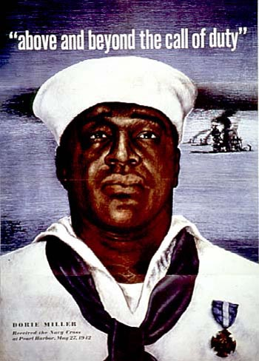
Dorie Miller
A hero of the Pearl Harbor attack
Not initially recommended for any commendation
Later received Navy Cross
Killed in the invasion of the Gilbert Islands
A poster featuring Miller
Notes:
The bravery and valor of many African American soldiers and sailors during World War II were frequently overlooked, such as the case of Doris “Dorie” Miller, who distinguished himself during Pearl Harbor. Miller was serving as a cook onboard the USS West Virginia when the Japanese attacked on December 7, 1941. When the alarm sounded, Miller immediately reported to his battle station but found it destroyed by a torpedo. Instead, Miller was ordered to help carry wounded sailors to aid stations. Seeing West Virginia Captain Mervyn Bennion wounded on the deck, Miller personally carried him to safety. Captain Bennion refused medical treatment and insisted on continuing his command; he bled to death during the attack. Miller then fired a 50-caliber machine gun (which he wasn’t trained to use) at attacking Japanese planes. When the Japanese finally sank the West Virginia, Miller and other sailors abandoned ship.
The navy awarded other sailors medals for valor but initially overlooked Miller, although he eventually received the Navy Cross (the navy’s third-highest honor). Captain Bennion posthumously received the Medal of Honor. The Pittsburgh Courier frequently called for Miller to be allowed stateside to participate in war-bond tours. The navy awarded no African American the Medal of Honor during World War II. Only in 1997 did seven African Americans receive the medal, six posthumously.
Miller continued his service as a mess cook. In 1943, a Japanese torpedo hit his ship during the invasion of the Gilbert Islands, sinking it in minutes. More than 200 sailors managed to escape; Miller did was not one of them.
55

Slide 56
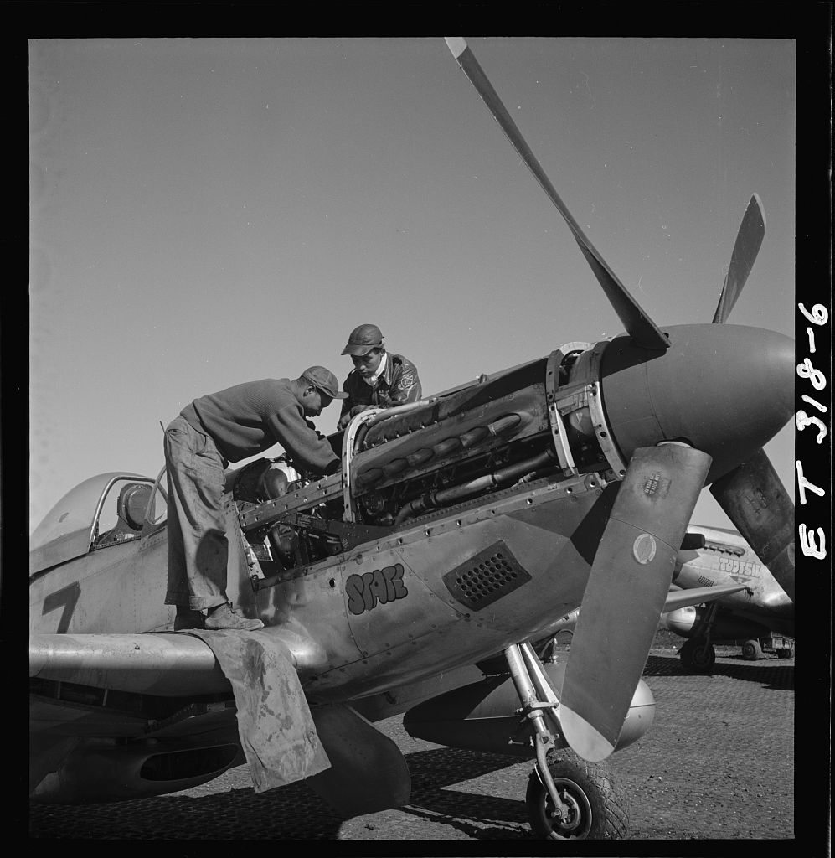
The Tuskegee Airmen
All-black combat unit formed in 1941
99th Fighter Squadron formed in AL
Commanded by Davis
Escorted bombers over central Europe
Proved superior or equal to white pilots
Airmen Marcellus G. Smith and Roscoe C. Brown in Italy, 1945
Notes:
Just as the 442nd Regimental Combat Team proved Japanese Americans to be as skilled in combat as white troops, the Tuskegee Airmen demonstrated the abilities of African Americans. The Army Air Corps formed an all-black unit in 1941, under congressional pressure. The War Department tried to thwart the plan by requiring that recruits either had flight experience or a higher education. A large number of African Americans nonetheless met the requirements and enlisted in the program. The Army Air Force established the 99th Fighter Squadron at Alabama’s Tuskegee Institute, selecting Captain Benjamin O. Davis, Jr. (one of the few black West Point graduates) to command the squadron.
A white officer commented in a Time magazine article that the black pilots were inferior to white pilots. Following a congressional committee hearing, a subsequent evaluation of all pilots in the Mediterranean Theater showed the Tuskegee pilots to be equal to or better than other P-40 pilots.
Tuskegee Airmen who escorted bombers in missions over central Europe shot down more than 100 enemy aircraft. Many claimed for years after the war that the Airmen did not lose a single plane they escorted, though later evidence proved that some bombers were lost. However, many point to the real achievement of the Tuskegee Airman as proving that African Americans could perform just as well as white pilots.
56

Slide 57
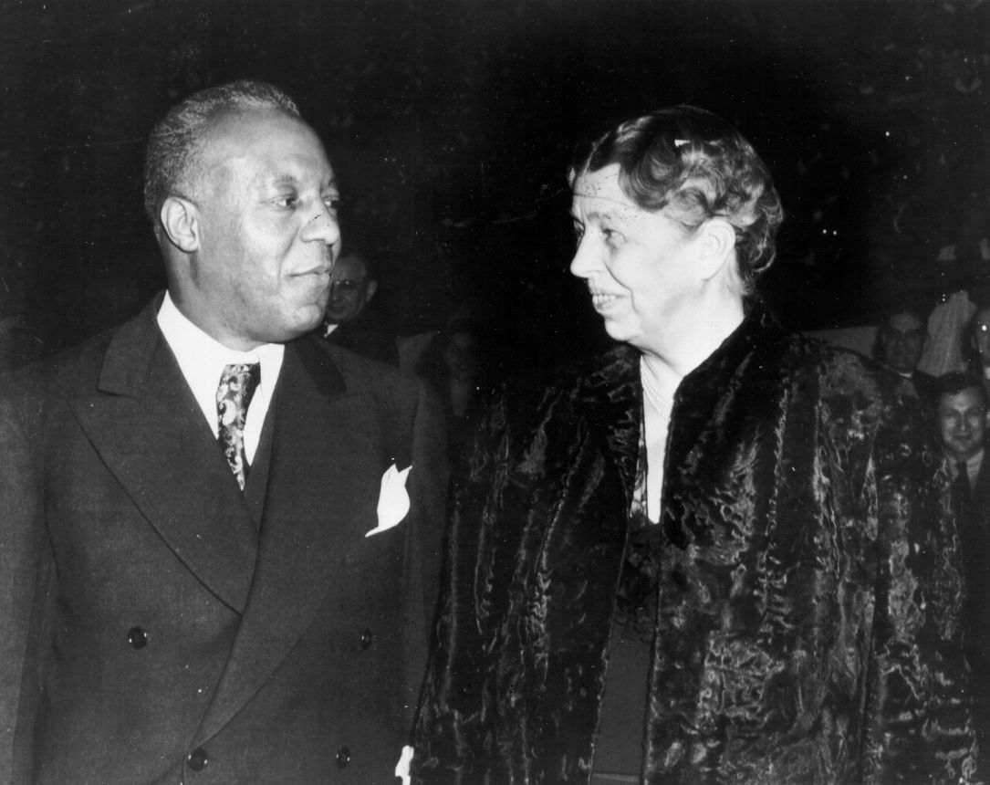
Randolph and the Fair Employment Act
Influential labor leader
Proposed a 1941 “March on Washington” to protest discrimination
FDR convinced him to cancel march; enacted Fair Employment Act
A. Philip Randolph meets with first lady Eleanor Roosevelt
Notes:
A. Philip Randolph made his name as a labor leader by founding the Brotherhood of Sleeping Car Porters, one of the largest African American labor organizations in U.S. history. The union had successfully bargained for better salary and benefits for its members during the 1930s.
In 1941, Randolph and civil rights activists Bayard Rustin and A.J. Muste began to plan a “March on Washington” to protest segregation in the armed forces, as well as discrimination in war industries. The march never took place, however, because of FDR’s promise to take steps to ensure fair treatment for blacks. FDR enacted the Fair Employment Act of 1941—the first federal law to address equal employment rights—prohibiting racial discrimination in government defense agencies as well as in private businesses that received defense contracts. The act created the Fair Employment Practices Committee to investigate possible violations of the executive order, and to “take appropriate actions for a redress of grievances.” The FEPC also made recommendations on how to make the act more effective. Segregation of the armed forces, however, lasted until 1948.
57

Slide 58
The Navajo Code Talkers
Used to transmit messages in the Pacific Theater
Based on the Navajo language
Navajo words frequently substituted for military terms
Code never broken
Code Talkers Henry Bake and George Kirk send messages in the Pacific Theater, 1943
Notes:
Native Americans also served with distinction in WWII, some of whom provided a unique, essential service—the Navajo Code Talkers. These soldiers helped to develop and transmit an unbreakable code for the American military in the Pacific Theater. Phillip Johnston, the son of a Protestant missionary, came up with the idea to use Navajo after reading a newspaper story about the military’s search for an “unbreakable code” to communicate sensitive material. The U.S. military had some success with Cherokee and Choctaw in World War I for this purpose. Johnston had spent most of his childhood around the Navajo people and knew the difficulty of learning their language.
The military had some major concerns, especially how to translate modern military terminology into Navajo. The Code Talkers handled this problem by simply substituting Navajo words for military terms. For example, “tank” became the Navajo word for “tortoise,” and “airplane” became “bird.” The Marines created an entire list of terminology for converting the Navajo language into military use.
The group of 29 Code Talkers in May 1942, grew to more than 400 by 1945. They never wrote in code, so each had to memorize the system. Code Talkers joined Marine units in the Pacific and served in several major battles, including Guadalcanal and Iwo Jima. Due to their physical resemblance to Japanese, the Code Talkers were sometimes assigned guards so they would not be confused with the enemy. In the end, the Japanese never broke the Navajo code.
Twenty-nine Code Talkers received the Congressional Gold Medal in 2001. The rest were similarly honored in 2007.
58

Slide 59
The Bracero Program
Established due to wartime labor shortage
Experienced Mexican laborers brought in for CA farm work; expanded nationwide
Braceros also worked for U.S. railroads
Reported human rights abuses
Lawsuits filed to collect savings withheld from braceros’ pay
A bracero
Notes:
The shortage of wartime labor due to military service, especially in agriculture, prompted the U.S. government to look outside of the country for help. The U.S. and Mexico agreed upon the Bracero Program, which in 1942 began to bring in skilled Mexican laborers (or braceros) to work as farmhands in the southwestern U.S.
Soon, braceros were working across the U.S. not only in agricultural jobs, but also alongside skilled and unskilled workers in the railroad industry. The government later instituted a quota of 50,000 agricultural workers and 75,000 for the railroads. By war’s end, braceros were no longer contracted for railroad service, but continued in agricultural jobs until 1964. The government closed the program amid reports of significant human rights abuses against the braceros.
From the inception of the program until 1948, braceros brought several lawsuits against U.S. agricultural employers, mainly to recover money from “savings accounts” established by payroll deduction. The program had stipulated that the braceros would receive this money upon their return to Mexico, but most did not receive them. Most of the lawsuits were dismissed because the banks involved in the transactions were not located in the U.S.
59

Slide 60
“Zoot Suit Riots”
Los Angeles, 1943
Conflicts between sailors on leave and young Mexican Americans, identifiable by their dress
African Americans and Filipinos wearing zoot suits also targeted
Military eventually placed LA off-limits to servicemen
A zoot suit
Notes:
Another example of racial discord during WWII came in the form of the “Zoot Suit Riots,” which occurred in Los Angeles in May 1943. The riots began when U.S. sailors on leave clashed with young Hispanics. One sailor was stabbed, and soon hundreds of Marines and sailors were roaming the streets, looking for anyone wearing a “zoot suit”—a suit with wide lapels, baggy pants, padded shoulders, and often a wide-brimmed hat and watch chain. While mostly young Mexican Americans wore zoot suits, so did members of other minorities, such as Filipino and African Americans, who also became targets. The local press took the side of the military, calling the zoot suiters “hoodlums.” The uproar subsided when military commanders in Los Angeles declared the city off-limits to military personnel, with those violating the order subject to arrest by Shore Patrol officers.
60

Slide 61
Discussion Questions
What groups other than Japanese Americans did the government relocate? Why?
How did the war impact African Americans? In what ways did African Americans prove themselves as capable of serving as other groups?
Why did the government bring in braceros to work in the U.S.? What industries did they work in?
Notes:
While not on the same scale as Japanese Americans, the government also relocated and interned German and Italian Americans, specifically because the U.S. was also fighting these two nations in Europe. Much as with the Japanese Americans, they were never actually security risks; no evidence of espionage or sabotage was ever uncovered in any of cases involving these internees.
African Americans found that conditions did not change substantially during the war years. Many saw little point in fighting a racist enemy in Europe while facing racism and discrimination at home. The armed forces had segregated units and frequently gave blacks menial duties. Many met with discrimination when they migrated to cities to work at defense plants; those who did get jobs often received lower salaries than whites. Union leader A. Philip Randolph planned a “March on Washington” to protest discrimination in the defense industry, only calling it off when FDR promised to enact what became the Fair Employment Act. African Americans such as Dorie Miller (a hero of Pearl Harbor) and the Tuskegee Airmen (bomber escorts over Europe) demonstrated courage and ability comparable to or better than whites.
The government brought in braceros for much the same reason that so many women entered the workforce at the same time: a shortage of manpower due to workers’ military service. While the braceros originally performed fieldwork and other farming duties, many also worked on the railroads.
61

Slide 62
The Election of 1944
FDR practically assured a fourth term
Truman selected as running mate
Defeated NY governor Thomas Dewey
This map of electoral votes indicates Dewey in red and FDR in green
Notes:
With the outcome of the war in less doubt by late 1944, FDR seemed the favorite to win the election and serve an unprecedented fourth term in office. The Republicans nominated New York governor Thomas E. Dewey, who could not defeat Roosevelt, though he did carry more states and had a higher percentage of the popular vote than previous challengers.
Many Democrats, concerned about the liberal philosophies of Vice President Henry Wallace, decided to dump him from the ticket to replace him with a more moderate candidate. They selected Missouri Senator Harry Truman, who had become known from his work investigating waste and fraud in the defense industry. While many felt uneasy about changing vice-presidents during a war, they were also greatly concerned about FDR’s obviously declining health. It appeared that FDR might not live out his term, and for that reason, Truman made a more acceptable running mate than Wallace.
62

Slide 63
Roosevelt Dies April 12, 1945
Notes:
The stress of being the nation’s president through both the Depression and the war ruined Franklin D. Roosevelt’s health. Suffering from hypertension as well as various other ailments, Roosevelt died of a massive cerebral hemorrhage on April 12, 1945, while staying at his presidential retreat at Warm Springs, Georgia. Roosevelt was resting there in preparation for the United Nations conference scheduled for later that month in San Francisco. While sitting for a portrait, FDR murmured, “I have a terrific headache.” He collapsed, dying a short time later.
The timing of FDR’s death proved grimly ironic, in that he died only a few weeks before Adolf Hitler’s suicide and Germany’s surrender on May 8th that ended the war in Europe. For many Americans, FDR’s death was especially painful because of the length of time he’d served as president; many younger Americans couldn’t remember anyone else in the White House.
63

Slide 64
Truman Takes Office
Vice president for only 82 days
Oversaw last months of the war
Authorized use of the atomic bomb
President during the early Cold War
Truman takes the oath of office shortly after FDR’s death
Notes:
Only hours after Roosevelt’s death, Vice President Harry Truman became the nation’s 33rd chief executive. While he had been a U.S. senator for several years, he was relatively unknown to most Americans.
Truman was faced with some of the biggest decisions of the war. Remarking to reporters soon after his swearing-in, “Boys, I don’t know if you’ve ever had a load of hay fall on you, but when they told me yesterday what had happened, I felt like the moon, the stars, and all the planets had fallen on me.” Nevertheless, Truman soon proved up to the job: He oversaw the last months of the war and negotiated at the Potsdam Conference, the postwar future of Europe. He facilitated U.S. entry into the United Nations, and in one of the most important decisions of his presidency, he authorized the use of atomic weapons against Japan.
As his term progressed, he also led the country through the beginnings of the Cold War, including the Berlin Crisis and the Korean War.
64

Slide 65
V-E Day and V-J Day
Victory in Europe, May 6–7, 1945
Victory Over Japan, Sept. 2, 1945
Celebrations marked the end of the war
Nation still had to deal with postwar issues
Tens of thousands crowd Times Square to celebrate the Japanese surrender, New York City
Notes:
A few weeks after Roosevelt’s death, Hitler committed suicide in his bunker under the streets of Berlin. With the Soviet Army closing in on the city, Germany finally surrendered on May 6th and 7th, 1945 (it took two days for all treaties to be signed). With the surrender of Germany, most expected that the military would reassign most of the troops fighting in the European Theater to the Pacific for the eventual invasion of the Japanese mainland.
In August 1945, the atomic bombings of Hiroshima and Nagasaki convinced the Japanese to surrender without an Allied invasion. Nearly six years after World War II began in Europe, the Japanese formally surrendered aboard the USS Missouri, ending the war.
Americans across the nation celebrated the end of the war, though many had serious concerns. In some instances, families anxiously waited for information about loved ones listed as missing in action; others were dealing with the death in action of a family member. Still others saw an uncertain future, with so many servicemen returning to look for jobs and wanting to start families and further their education.
65

Slide 66
The GI Bill
Servicemen’s Readjustment Act of 1944
An attempt to thwart a social and economic crisis
Stalled in Congress as House and Senate hammered out a compromise
Bill provided for education and training, low-cost loans, unemployment benefits
Stamp commemorating the GI Bill
Notes:
Following World War I, Congress agreed to pay a bonus to veterans for their service, in the form of a certificate that didn’t mature for 20 years. When the Depression hit, veterans who were upset that they couldn’t get their money when they needed it marched on Washington in 1932 in what became known as the “Bonus March.” Determined not to repeat the same mistakes, Congress introduced a bill to help returning GIs successfully get back into society and on with their lives. However, many members of Congress objected to some of its proposals. Believing college to be a privilege for the rich, some legislators refused to back provisions giving veterans low-cost or free education. Still others objected to providing unemployment benefits to jobless veterans, concerned that it would kill the veterans’ work ethic.
Congress managed to hammer out a compromise bill that FDR signed into law in June 1944. The Servicemen’s Readjustment Act (also called the “GI Bill of Rights,” or simply the “GI Bill”) offered education benefits, guaranteed mortgage loans, and limited unemployment compensation. In most instances, veterans furthered their education—in 1947, returning veterans made up 49 percent of incoming college freshmen. By the time the first GI Bill expired in 1956, nearly half of returning WWII veterans had participated in college or training programs. From 1944 to 1952, the government also backed more than 2.4 million home mortgages for veterans.
66

