Slide 1
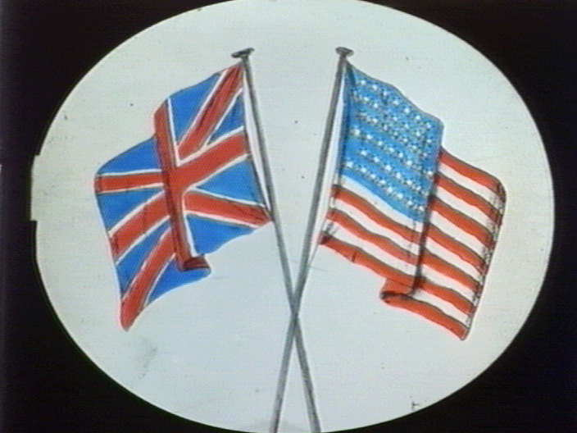
The War of 1812
America’s Second Revolution

Slide 2
Causes of War
- Embargo act of 1808: Britain was seizing American ships bound for Europe to prevent Napoleon from getting American goods
- The British continued to seize American ships and the problem was passed to Madison

Slide 3
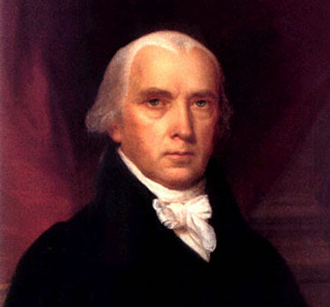
Madison
In 1808 James Madison is elected
Madison is known as the author of the Constitution
He does not want war with Britain, but events spiral out of his control

Slide 4
The Road to War
During Jefferson’s administration relations between Britain and the U.S. deteriorated.
Those in Jefferson’s and Madison’s cabinet who wanted war were known as War Hawks and they pressured both presidents toward war.
The U.S. complained about Freedom of the Seas
The U.S. claimed it should have the right to trade with anyone while it was neutral, both Britain and France Blockaded each other and would not allow US ships through.
In the late 1700’s and early 1800’s Britain was at war with France. Britain needed sailors and so it would Impress U.S. sailors claiming that they were really British citizens.

Slide 5
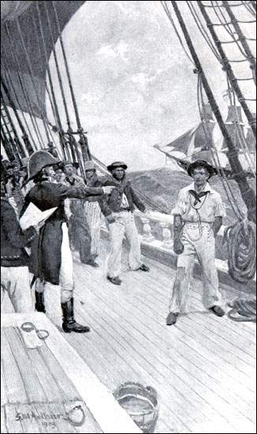

Slide 6
Battle of Tippecanoe
(cause of war) The U.S. believed that Britain was supplying encouraging the Indians to attack the U.S
Many felt this was confirmed by the Battle of Tippecanoe in modern day Indiana where General William Henry Harrison fought off an Indian surprise attack
The attack was by Tecumseh who was trying to form an Indian confederacy to resist American westward expansion

Slide 7
Goals of the War
Different groups had different goals in the war
Westerners wanted Canada and to punish the Indians for attacking pioneers
Southerners wanted war because they were angry at impressment and they knew the war would be fought in the north
Federalists did not want war at all seeing that it would damage trade and cost them money
The country was unprepared for war and divided so the early part of the war was met with failure

Slide 8
WAR!
The Republic was unprepared with a small army and no navy
The U.S. fails to take Canada
Britain invades the Western U.S.
British invade NY
Washington D.C. was captured and burned
After Washington was taken the British attempt to take Baltimore
To make matters worse, Napoleon is defeated and the British can focus completely on the U.S.

Slide 10
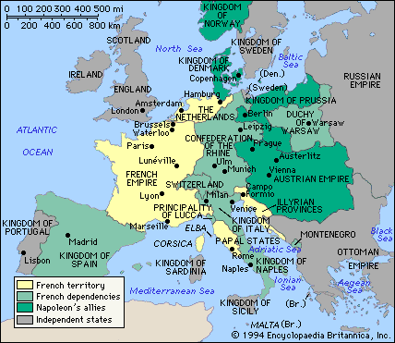

Slide 12
Turning Point
The U.S. Defeats the British in Baltimore and American poet Francis Scott Key writes the Star Spangled Banner about the battle
American’s in the west drive the British back into Canada
Napoleon escapes captivity
America and Britain sign the Treaty of Ghent which ends the war status quo ante bellum, which means as they were before the war

Slide 13
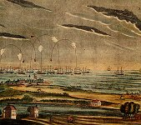

Slide 14
New Orleans
It takes months for America to find out the war is over, and before people found out there was one more great battle
The British decide to attack New Orleans and seize the port and the colony of Louisiana
General Andrew Jackson will stop them inflicting the greatest defeat on the British and becoming a national hero, this will increase nationalism in the young U.S.

Slide 15
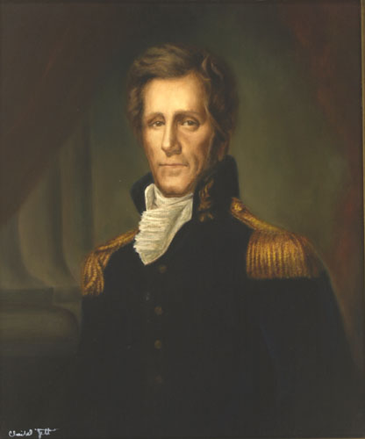

Slide 16
The War Ends
Treaty of Ghent ends the war with nothing changing
Put in perspective of Global politics at the time 500,000 to 5000
During the War the Federalists will discuss secession when they gathered at the Hartford Convention
They decide not to, but the Federalist party is criticized for this and never regains power
Never again will the U.S. and Britain fight a war

Slide 17
Results
At first it may seem as if the war accomplished little
American patriotism increased dramatically
After the war there was an explosion of American art, culture and a sense of unity
The War of 1812 will define who we thought we were in the early 19th century
The American identity changed from a country trying to experiment with republicanism to a country of rugged individualists out to conquer the west.

