Slide 1
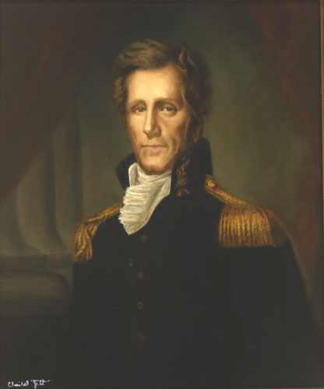
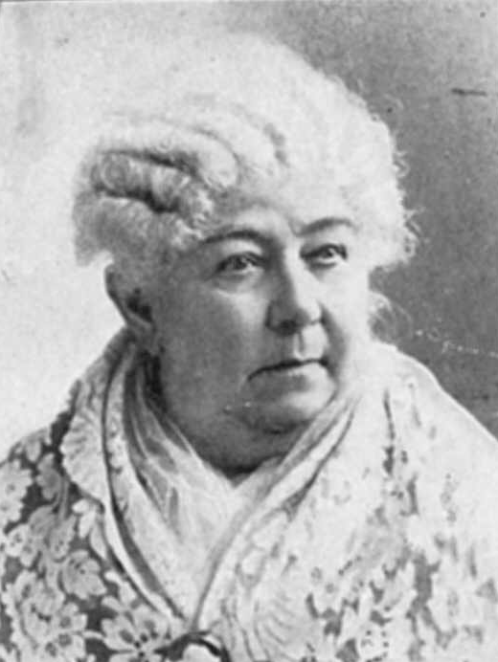
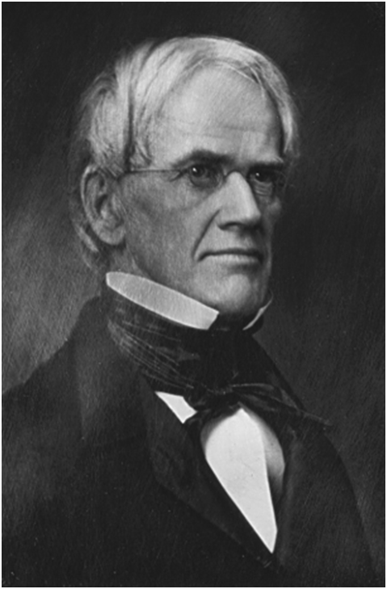
Unit 4.1: Era of Good Feelings

Slide 2
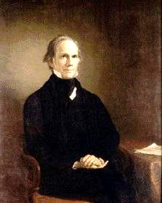
The American System
Purpose: develop the country
Tariff of 1816
Second Bank of the U. S.
Internal improvements at federal expense. - National Road
Proposed by Henry Clay
Henry Clay, “The Great Compromiser”

Slide 3
The American System
WEST → got roads, canals, and federal aide. EAST → got the backing of protective tariffs
SOUTH → ??

Slide 4
Panic of 1819
During 1812 European Markets were closed to the U.S. After the war they were opened and the farming sector profited
Manufacturing however suffered with an influx of British goods
The Bank of the U.S. expanded credit tremendously
Not enough gold to cover the money
Banks failed, the U.S. had a recession

Slide 5
The
Market
Revolution

Slide 6
A New Economy in the Nation
Economic changes
Colonial era
Innovations: transportation and communication
Roads and Steamboats
Toll roads (Turnpikes)
Improvement of water technology
Steamboat: Robert Fulton
The Erie Canal
1825 upstate New York
The Daguerreotype
Early form of photography: Recording of events, people, life.
Robert Cornelius’ Self-Portrait: The First Ever “Selfie” (1839)

Slide 7
Communication: Railroads and the Telegraph
Railroads
Opening of new areas
Stimulated coal mining
Iron manufacturing
1828: Baltimore and Ohio- work on first railroad
1860: 30,000 miles long
What Railroads Represent
Time and Space
Settlement of Railroads
“Bells and Whistles”
Carving out indigenous lands
Telegraph
Samuel F. B. Morse (1830s)

Slide 8
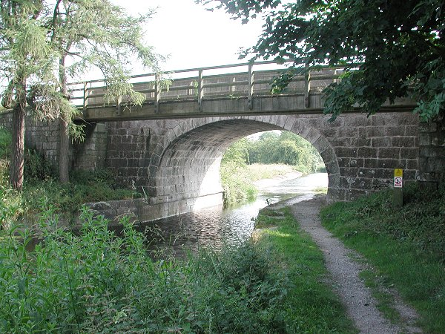
First Turnpike- 1790 Lancaster, PA
By 1832, nearly 2400 mi. of road connected most major cities.

Slide 9
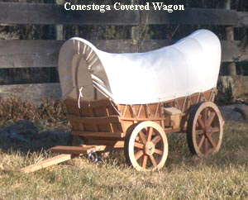
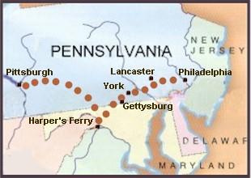
Conestoga Covered Wagons
Conestoga Trail, 1820s

Slide 10
Erie Canal
The U.S. wanted to expand west, but it was difficult to get goods to market from the northwest (midwest)
Rivers are the highways of the time, and the great lakes could not connect with the Atlantic by river
NY decided to build the Erie Canal which will connect the Hudson River with Lake Erie

Slide 11
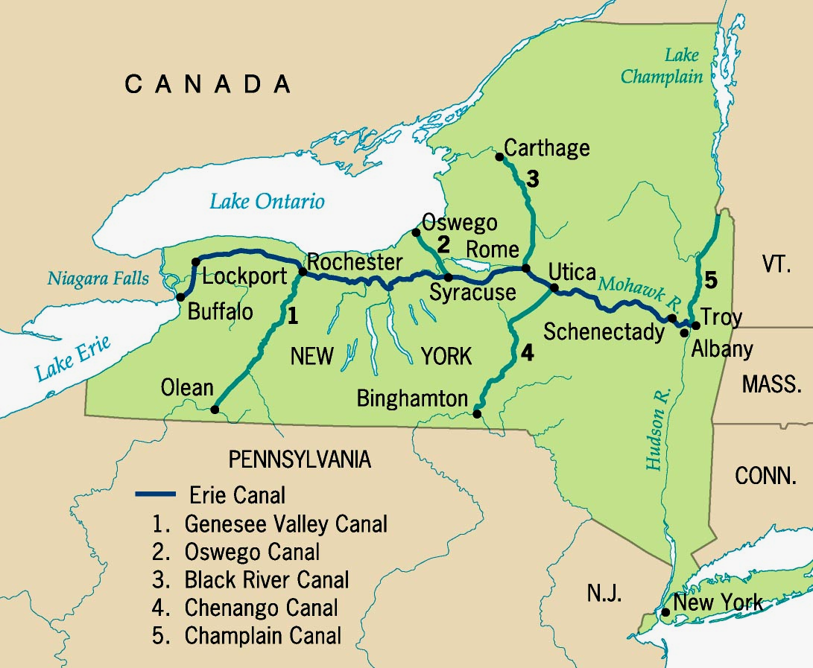
Erie Canal System

Slide 12
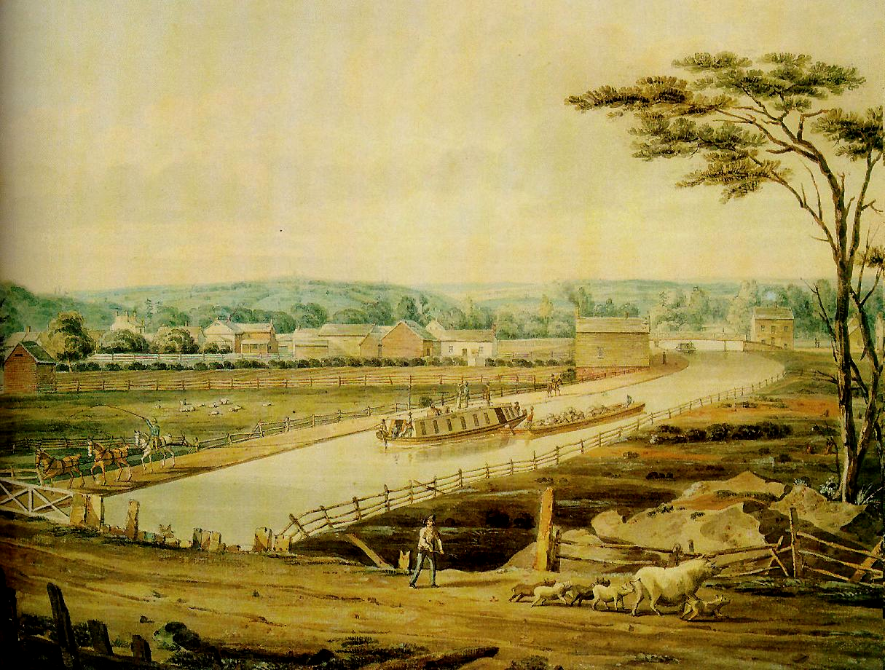
Erie Canal, 1820s
Begun in 1817; completed in 1825

Slide 13
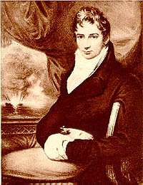
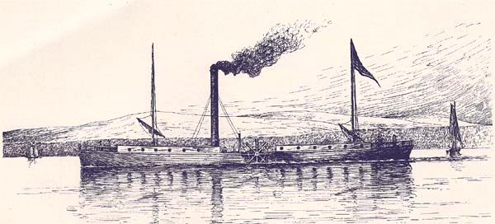
Robert Fulton & the Steamboat
1807: The Clermont

Slide 14
Robert Fulton and the Steamboat
- Robert Fulton will be the first person to develop a boat that is steam powered.
- This has an advantage over sailing ships because it doesn't depend on the wind
- It also allows for more goods to be brought up river cheaper than poling a river.

Slide 15
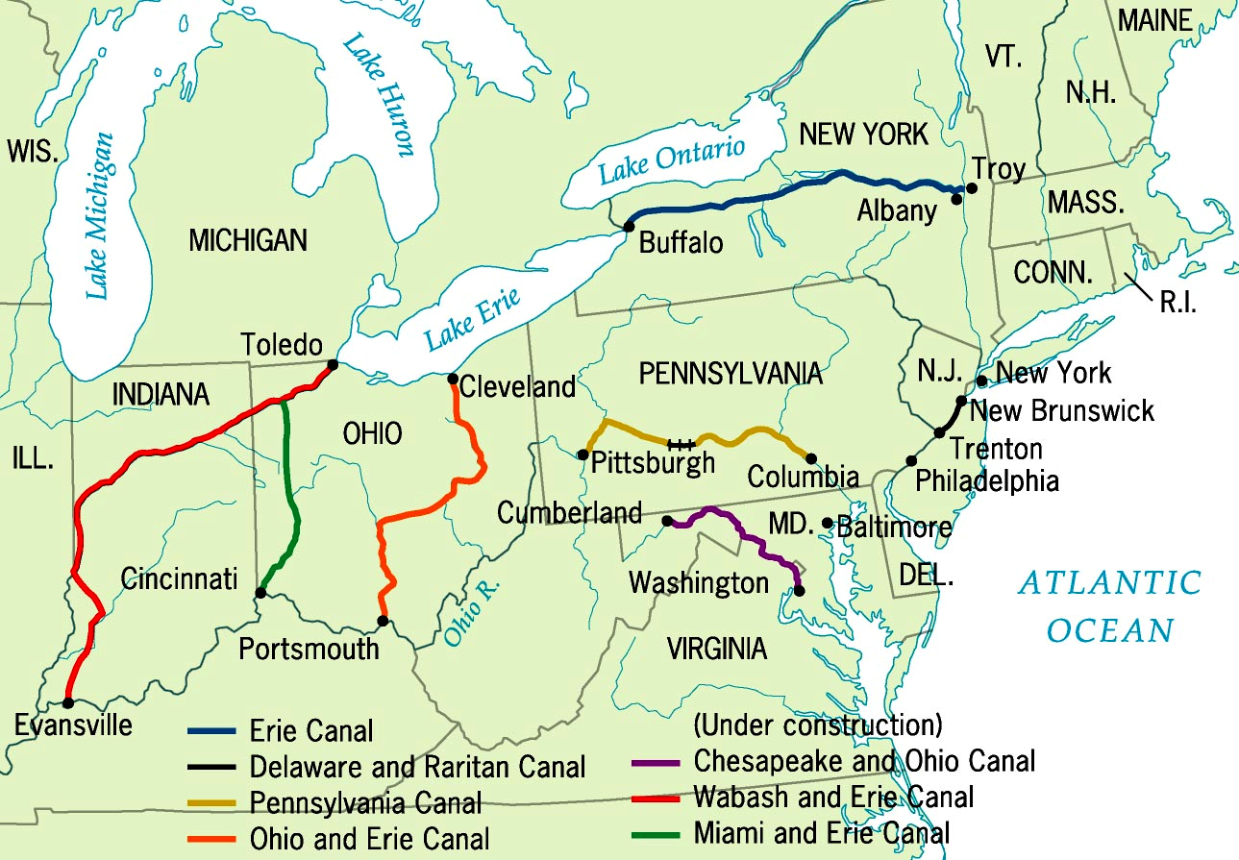
Principal Canals in 1840

Slide 16
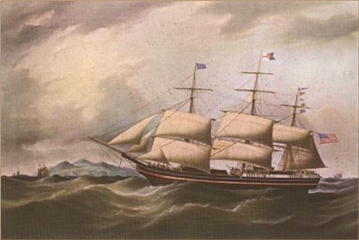
New Modes of Transportation
The National Road will make travel easier within the U.S.
The invention of the Railroad will revolutionize land travel
The fastest sailing ships ever made would increase transoceanic trade

Slide 17
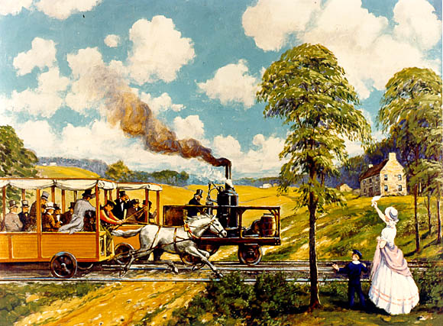
The “Iron Horse” Wins! (1830)
1830 → 13 miles of track built by Baltimore & Ohio RR By 1850 → 9000 mi. of RR track [1860 → 31,000 mi.]

Slide 18
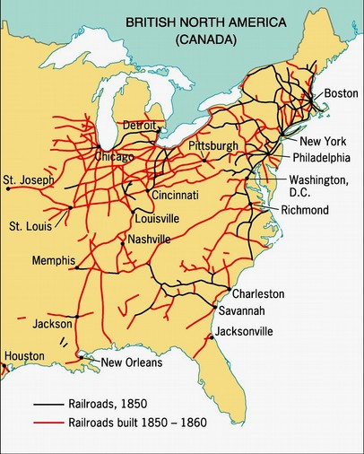
The Railroad Revolution, 1850s
Immigrant labor built the No. RRs.
Slave labor built the So. RRs.

Slide 19
The Economics and Politics of Cotton
The Cotton Kingdom
Patent of the Cotton Gin
Industrial Revolution in England
Cotton textile factories-North
Southern soil: Single Crop economy
Strengthened the institution of enslavement
Tobacco to Cotton: Increase in production
1820 Missouri Compromise
1808: The Unfree Westward Movement
Creation of Internal Slave Trade
Upper South to Deep South: New Orleans (2nd largest slave trading port)
Deep South: Mississippi, Louisiana, Georgia, Alabama
1800-1860- 1 million.
12-Years-A-Slave. Solomon Northrup
Jefferson:
Vision verses Reality of cotton
Basis of the empire- Economic liberty & Enslavement

Slide 20
Exclusion from the Market Economy: Black Responses to Inequality
Enslavement and the Economy
South- strong influence on U.S. politics and economy
New York: shipping and manufacturing
Barriers to participation: discrimination, strengthen communities
“In the Shadow of Slavery: Claiming Space in the North
American Society of Free People of Color
Abolitionist organizations
Pennsylvania Abolition Society (1775)
New York Manumission Society (1785)
Organization of schools
Abolition of Enslavement in Northern states
Vermont (1777); all states north of the Ohio River and Mason-Dixon Line (by 1804)
Racial Restrictions
Ohio Black Codes 1804
1816: The American Colonization Society- Liberia/ unofficial colony of the U.S.
Economics- desired to recreate single-crop economies

Slide 21
Market Society
Commercial Farmers
North- market revolution & westward expansion=changes
Shift from isolation- transportation, credit, sold more goods, cash.
Purchase land, new agricultural machines (steel plow and the reaper)
Increase in agricultural productivity
The Growth of Society
Intersection of Inter-regional trade: Cincinnati, St. Louis
Chicago: Great Lakes: center for collection of shipment of western farm products
Cities: merchants, bankers, craftsmen
The Factory System
Transformation of work: large workshops/ supervisors-pressure to make goods
Comparison: South-single-crop economy/not diversified/transportation & banking support plantation economy.
North: use of power-driven machinery. Rhode Island, 1790. Spinning-jenny
New England: Massachusetts, 1814. Industrial Towns. Use of water for power
“The American system”: mass production of interchangeable parts

Slide 22
Labor and the Market Society
The Industrial Worker
Clock Time: regulate life/labor
Long work-day
Native born- refused to work
The “Mill Girls”: Transient labor force
Built entire towns.
The Growth of Immigration: 1840s- 4 million
Modernization of Agriculture, Industrial Revolution, Transportation
Irish and German Newcomers
Irish: Great Famine- 1845-1851- low-skilled workers
Germans: Skilled workers: Artisans, shopkeepers
The Rise of Nativism
Anti-Immigrant sentiment. Anti-Catholic sentiment
Transformation of Law
Supported entrepreneurs
Corporations and the Supreme Court
Convictions: Strikers and Unions

Slide 23
The Growth of the West
The Rise of the West
1790-1840. 4.5 million
After War of 1812
New States: 1815-1821
Indiana, Illinois, Missouri, Alabama, Mississippi, Maine
Types of Settlers
Small farmers
Planters with slaves
Slave Society: Cotton Kingdom- Antebellum period
Farm Families- (Ohio, Indiana, Illinois)
New Englanders (Michigan and Wisconsin)
National Boundaries
Settlement in Florida, later- Texas, Oregon
Andrew Jackson: Spanish Florida 1819
The West and Freedom
Growth: By 1840- 7 million

Slide 24
The Free Individual
Identifying Freedom
Absence of restraints
New definition of “Pursuit of Happiness,”
The Transcendentalists
New England intellectuals
Individual judgment- Ralph Waldo Emerson. Henry David Thoreau
Individualism
Associated with self-interests/ dependence on self/no matter costs to public good
Private self- no interference
The Second Great Awakening
Celebration of self-improvement, self-reliance, self-determination
Religious revivals; Charles Grandison Finney (New York)- good works
The Impact of the Awakening
Democratized American Christianity- mass enterprise.
Smaller evangelical sects: Methodists and Baptists
Evangelicalism: Controlled individualism, industry, sobriety, self-discipline

Slide 25
The Limits of Prosperity
Liberty and Prosperity
Right to compete for economic advancement
Success stories: Opportunities- Idea of “Self-made man”
Creation of a new middle class: clerks, teachers, lawyers*, doctors*
The Cult of Domesticity
No opportunities
Private sphere: no competition from market economy
Virtue: Frail, dependent on men, minimized participation in public life
The Southern mistress
The Middle Class
Loss of Freedom: Recession (1819), Depression (1837) - unemployment
The Early Labor Movement
Workingmen’s Parties.
1830 Union & Strikes
Concept of “wage-slavery”: Problematic comparison to enslavement

