Slide 1
American History

Slide 2
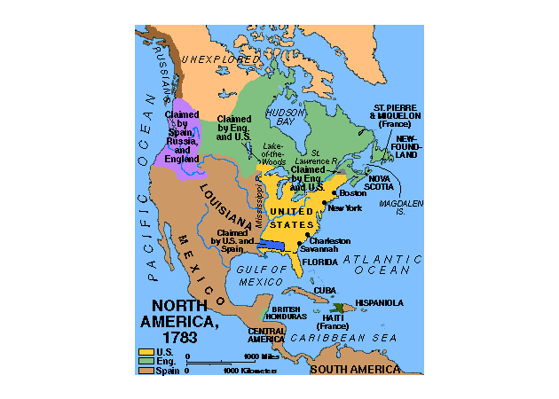

Slide 3
The Federalist Era
Washington’s Presidency

Slide 4
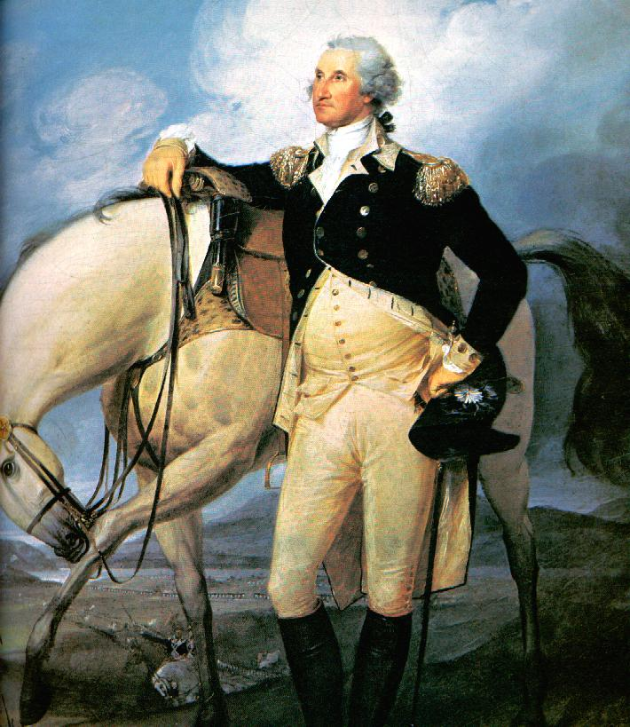
George Washington
A Revolutionary War hero and wealthy planter he was respected by all Americans
He set all early precedents some of which are still followed today
His goal was to steer America away from war and help it build up strength

Slide 5
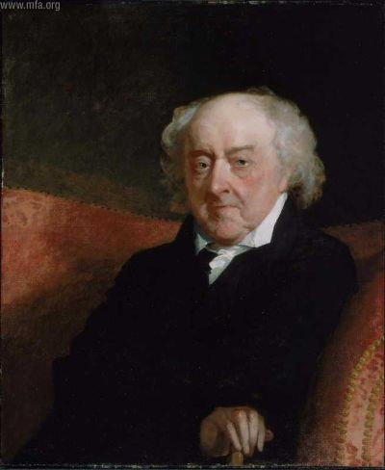
John Adams
Vice President of U.S.
Early revolutionary
Disliked by many of his contemporaries

Slide 6
The Cabinet
The People Who Advise the President

Slide 7
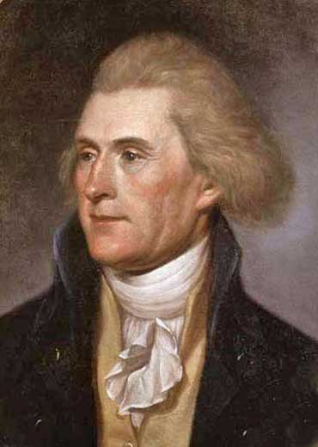
Thomas Jefferson
Secretary of State
He is in charge of the State Department which oversees diplomats, ambassadors and all international affairs
Thought that the people should have the most control over the government

Slide 8
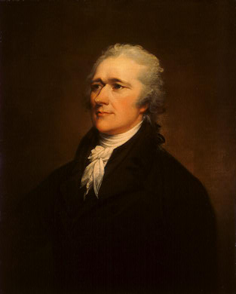
Alexander Hamilton
Secretary of the Treasury
In charge of all of the financial institutions of the U.S.
Wanted a Bank of the U.S.
Did not like Jefferson

Slide 9
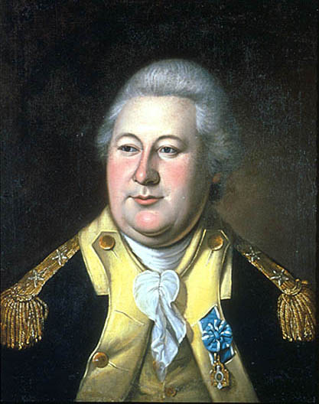
Henry Knox
First Secretary of War

Slide 10
Problems with the Cabinet
Jefferson and Hamilton did not get along, they disagreed on interpretation of the constitution.
Strict interpretation→ Jeffersonian Democrats→ congress had only the powers that were expressly stated in the Constitution. (If it doesn’t say you can do it in the Constitution, you can’t)
Loose construction→ Hamiltonian Federalists→ believed that congress could use the elastic clause to make any law it deemed “necessary” to run the government. (if it doesn’t say you can’t do it in the Constitution, you can)

Slide 12
Vive La Revolution
The French will have their own revolution in 1789
King Louis XVI will be executed during the terror that sweeps France
Most of Europe will declare war on France, France will ask us for help
American’s were split on who to support
Federalists supported Britain as our biggest trading partner
Democrats supported the French and had visions of a worldwide democratic revolution
Washington believed we were too weak to be in a war and began a policy of Neutrality or not taking a side in a conflict
THIS WAS THE FIRST MAJOR POLITICAL CONFLICT IN AMERICA!!!!!!!

Slide 13
Jay’s Treaty
A Treaty between the U.S. and Britain
The results will be:
1. Democrats will believe that America is being pushed toward Britain
2. Relations between France and the U.S. deteriorate beginning the Quasi War
The Quasi War is the undeclared naval war between the U.S. and France between 1794-1800

Slide 14
Pinckney’s Treaty (1795)
Dealt with Spain
Terms:
1. Established a boundary between the U.S. & Spanish Florida
2. Allowed the U.S. free navigation rights of the Mississippi River
3. Allowed the U.S. the use of the port of New Orleans

Slide 15
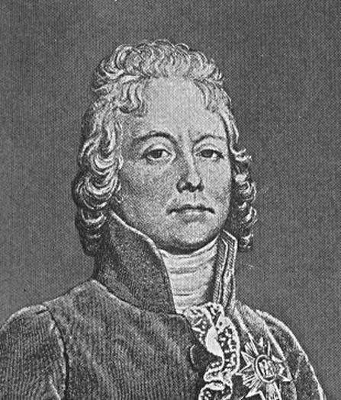
XYZ Affair (1797)
Delegation sent to France to meet with French Foreign Minister Charles Talleyrand
Three French delegates X, Y, & Z demanded $12 million loan & a cash bribe just for a meeting
Americans insulted & came home
Report published & started Anti-French sentiment at home

Slide 16
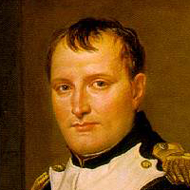
Convention of 1800
France did not want another enemy
Napoleon now in charge
Forced Talleyrand to try to create a treaty with the U.S.
Adams sent a delegation and a treaty was signed
Terms:
Ended Franco-American Alliance
All ships seized by both sides would be returned

Slide 17
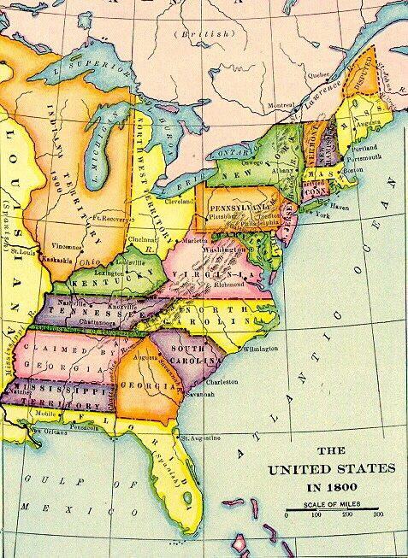

Slide 18
Domestic Policy of Washington’s Presidency

Slide 19
Bill of Rights
One of the first acts agreed to by Congress is the Bill of Rights, which is the first 10 amendments of the constitution

Slide 20
Amendments
1. RAPPS Religion, Assembly, Petition, Press, Speech (5 basic freedoms)
2. Right to bear arms
4. Due process
5. To not self incriminate
10. All powers not in Constitution go to the states

Slide 21
Judiciary Act of 1789
Congress will establish the federal courts with the Judiciary Act of 1789

Slide 22
Hamilton’s Financial Plan
Hamilton was a financial genius and came up with a plan to help the economy
His plan was
1. Government revenue should meet the expenses of the government, no deficit spending
2. Should be a 25% excise tax on whisky
3. Federal government should assume state debts (assumption)
4. Encourage industry and manufacturing by raising the Tariff
5. Establish a national bank (bank of the U.S.), which would give loans to the U.S. when in need

Slide 23
Result of the Financial Plan
First Party System- The Democratic-Republicans will form to attempt to prevent this plan from taking place.
Eventually the south agrees to assumption, but got to have the capitol in return
The Whisky Rebellion
Manufacturing eventually eclipses agriculture as the main industry of America

Slide 24
Whisky Rebellion
Hamilton issues a tax on whiskey
The farmers revolt, this is known as The Whiskey Rebellion
Washington will federalize 13000 militia to put down the rebellion
This demonstrates that Washington will enforce laws and that the federal government can nationalize state militias

Slide 25
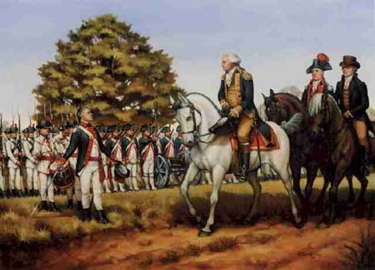
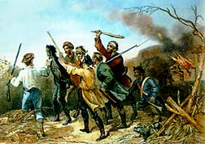
Federalized Militia|Tar and Feather

Slide 26
Washington’s Farewell Address
As Washington leaves office he gives a farewell address.
In this letter he warns against foreign entanglements, and political parties
He says America should remain neutral and avoid all alliances

Slide 27
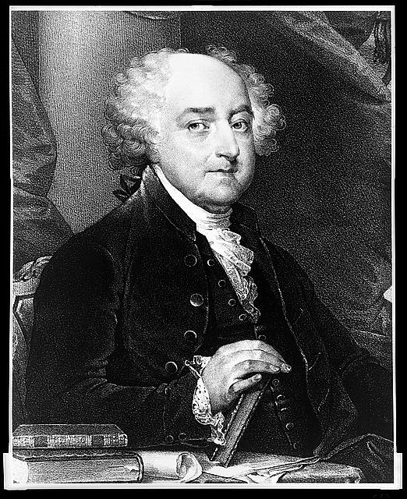
Adam’s Presidency

Slide 28
Election of 1796
1795 Washington said he would not seek a third term, this was important because many Americans thought he would rule for life like a king.
The election of 1796 was Jefferson vs Adams
Adams wins

Slide 29
Alien and Sedition Acts
2 Acts put in place by the Federalist to help prevent the Democrats from winning elections
Alien Act- All immigrants must wait 14 years before they can vote (most immigrants were Democrats)
Sedition Act- Anyone who speaks out publicly against the government can be thrown in jail
The Sedition Act was unconstitutional, but there was not a way to get rid of an unconstitutional law yet because the Supreme Court had not assumed that power.

Slide 30
Problems with A-S Acts
They are unconstitutional, they violate the 1st amendment
In response Madison and Jefferson will pass resolutions in the Virginia and Kentucky legislatures known as the Virginia-Kentucky resolutions
The V-K resolutions say that a state has the right to nullify a law that it finds unconstitutional, this is known as nullification.

Slide 31
The Federalists Legacy
Built enduring political and financial foundations for the new government
Diplomats kept the U.S. out of war and signed advantageous treaties with Br, Fr, & Sp.
Preserved democratic gains of the Revolution
Opposition resulted in creation of two-party system

Slide 32
Jefferson’s Presidency

Slide 33
Election/Revolution of 1800
Adams vs. Jefferson & Burr
First time 2 men ran as a team
Jefferson wins, but he and Burr tie, so the Federalists give Jefferson the presidency when they vote in the House of Representatives
Burr never forgives Hamilton and will eventually kill him in a duel
This is the first time the presidency will pass between parties
It is a major shift in American politics and often considered a “Revolution”

Slide 34
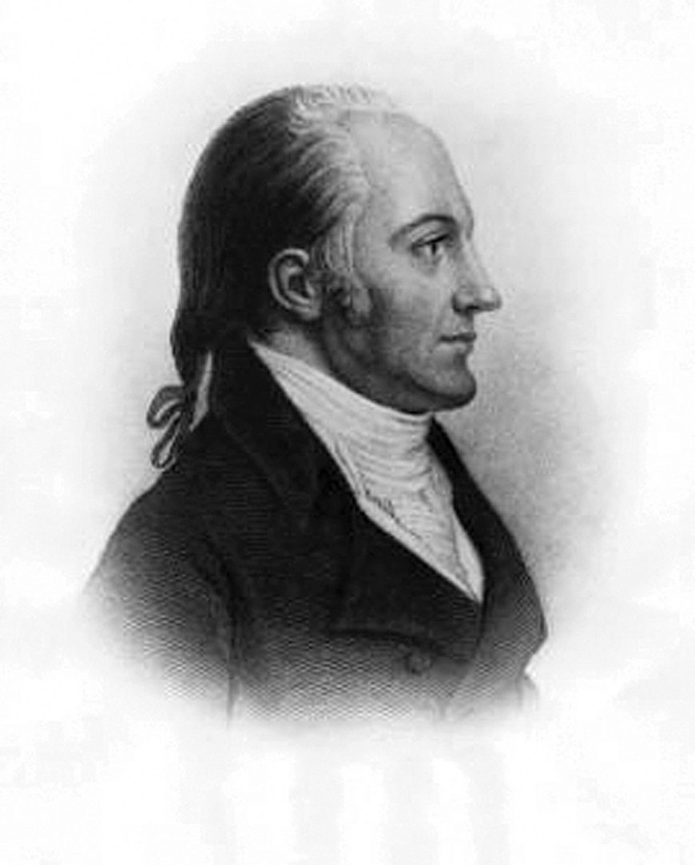
Aaron Burr

Slide 35
Midnight Judges
- After Jefferson is elected, the Democratic-Republicans will be taking power from the Federalists
- This will be the first transition of power from one political party to another
- Adams wants to make sure the Federalists maintain one branch of government after the D-R victory
- Adams makes a bunch of judicial recess appointments at midnight the night before he leaves office

Slide 36
Marbury v Madison
Just after Jefferson is elected William Marbury sues James Madison over his judicial appointment not being approved
The court declared that the law that Jefferson used to deny him was Unconstitutional
This established Judicial Review

Slide 37
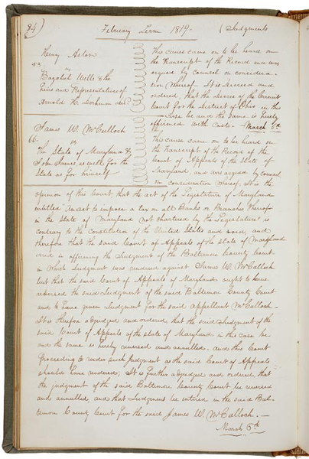
What Marbury v. Madison Did
Marshall broadened federal power at the expense of the states
1819- McCulluch v. Maryland- The Court held that Congress is allowed to do more than the Constitution expressly authorizes it to do (allows for loose construction)
1824- Gibbins v. Ogden- The Court held that federal law takes precedence over state law

Slide 38
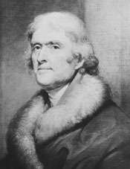
Jefferson’s Ideas
Jefferson believed a large federal government threatened liberty
He believed states could better protect freedom
Jefferson wanted to reduce the power and size of the government
These ideas were similar to the French philosophy known as laissez-faire
“Let people do as they choose”

Slide 39
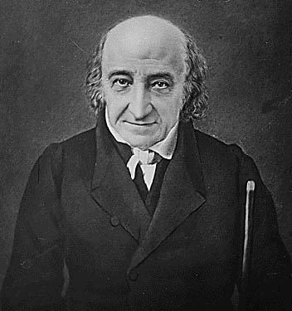
Cutting Costs
Jefferson reduced the national debt
Scaled down military expenses
All federal internal taxes, including the whiskey tax, were repealed
Government funds would come from customs duties (taxes on imported goods)
Also from sale of western lands
Jefferson also limited the number of federal government workers to a few hundred people

Slide 40
Jefferson’s 2nd Term
Jefferson deals with the impressment issue by asking for an embargo, or block of trade, against both Great Britain and France.
Congress passes the Embargo Act of 1807. The main victim of the law was neither Great Britain nor France—it was the U.S. merchants who could no longer trade with either country.

Slide 41
Jefferson’s 2nd Term
The Embargo Act proves EXTREMELY unpopular and Jefferson’s popularity suffers as a result.
Eventually, Congress repealed the Embargo Act
American merchants and ship owners suffered greatly.
Jefferson leaves office with a loss of respect.

Slide 42
Louisiana Purchase
In 1803 Jefferson wanted to buy New Orleans off of Napoleon so the U.S. would have control of the mouth of the Mississippi river
Napoleon offered the entire territory under France for 15 million (really cheap), Jefferson was torn though because it went against his idea of strict construction
We agreed
This will double the size of the country and give us control of the Mississippi River Valley

Slide 43
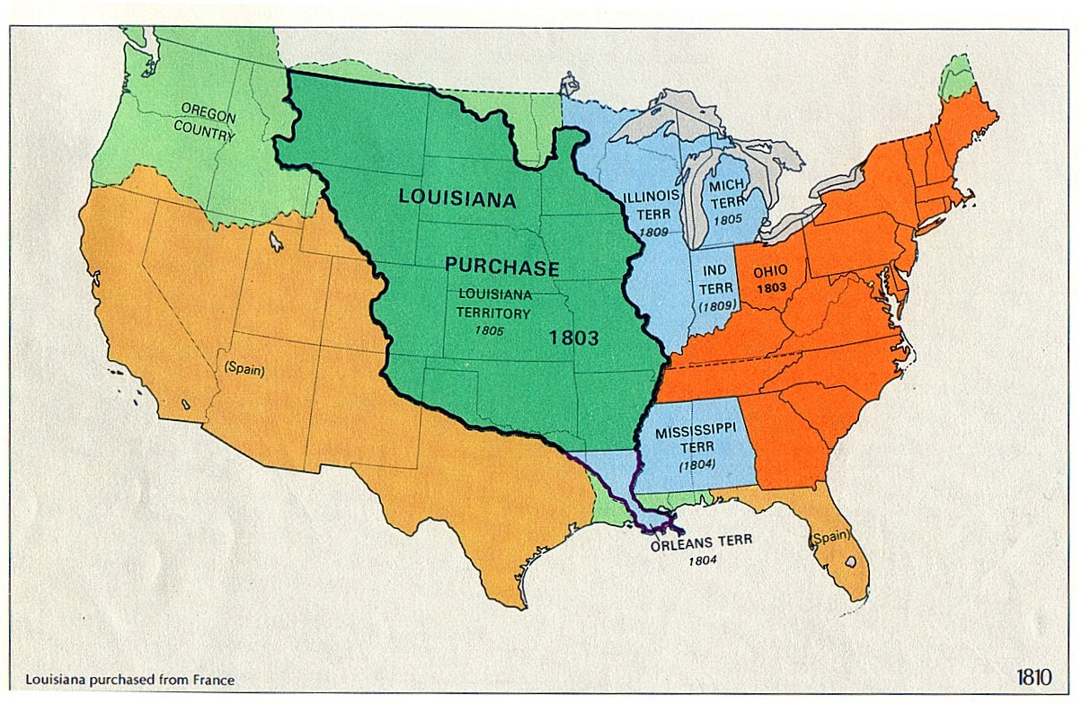

Slide 44
Lewis and Clark Expedition
Meriwether Lewis and William Clark were selected to gather a team and explore this newly bought territory
They will be helped by the Indian Sacajawea to explore and claim the new land
The goal was to
1. Lay claim to the territory
2. Explore, map, and find any navigable rivers
3. Bring back animal and plant samples for study

Slide 45
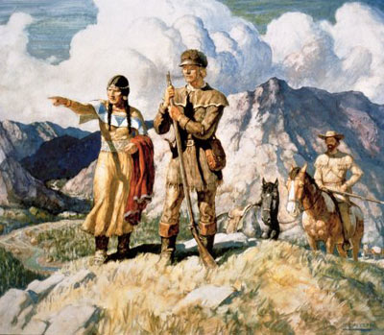

Slide 46
12. Jefferson after the Presidency
Jefferson renews his friendship with his long-term friend and political rival, John Adams.
Jefferson and Adams exchange tons of letters with each other.
Thomas Jefferson and John Adams both die on the same day: July 4, 1826. It was the 50th anniversary of the Declaration of Independence which both men help write.

