Slide 1
Going West Unit 11 Westward Expansion and the Populist Movement

Slide 2
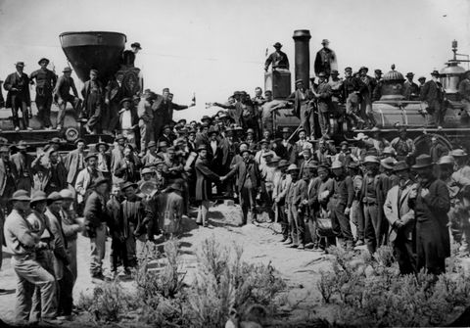
Railroads

Slide 3
How The West Was Won
On May 10th 1869 the first transcontinental railroad was completed when East and West lines met at Promontory Point Utah.
A Golden spike was driven in at the point where they met.
After the Civil War, America moved West developing ranching, mining, farming, and the railroad industries
NOTHING WAS MORE IMPORTANT TO THE DEVELOPMENT OF THE WEST THAN THE RAILROAD

Slide 4
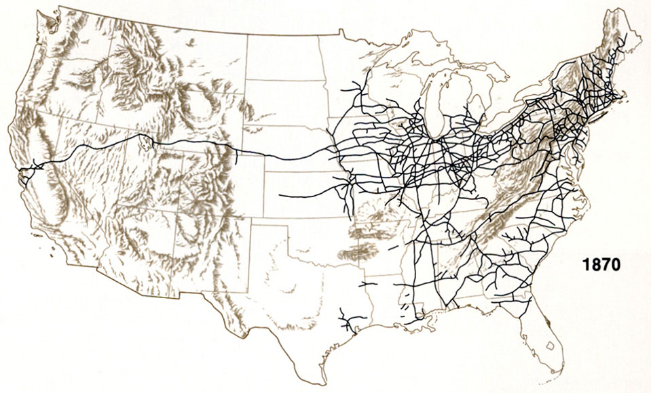
Railroads to the West

Slide 5
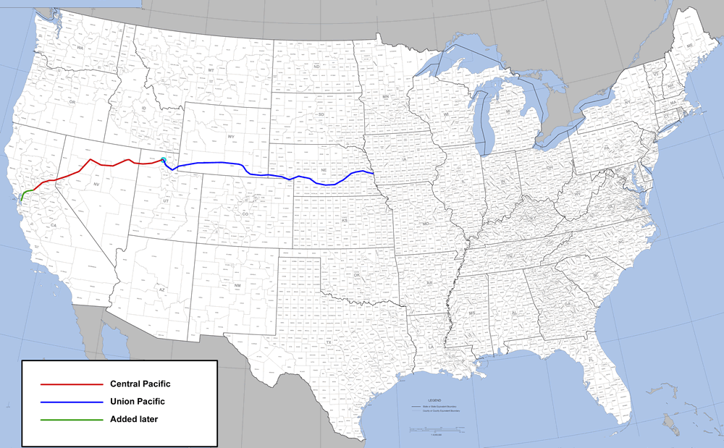
Transcontinental Railroad

Slide 6
Impact of the Railroad
The movement west by railroad would cut through Indian lands and bring an unlimited amount of American Settlers to take the land.
Finally it made it easier for soldiers to move across country to fight the Indians.

Slide 7
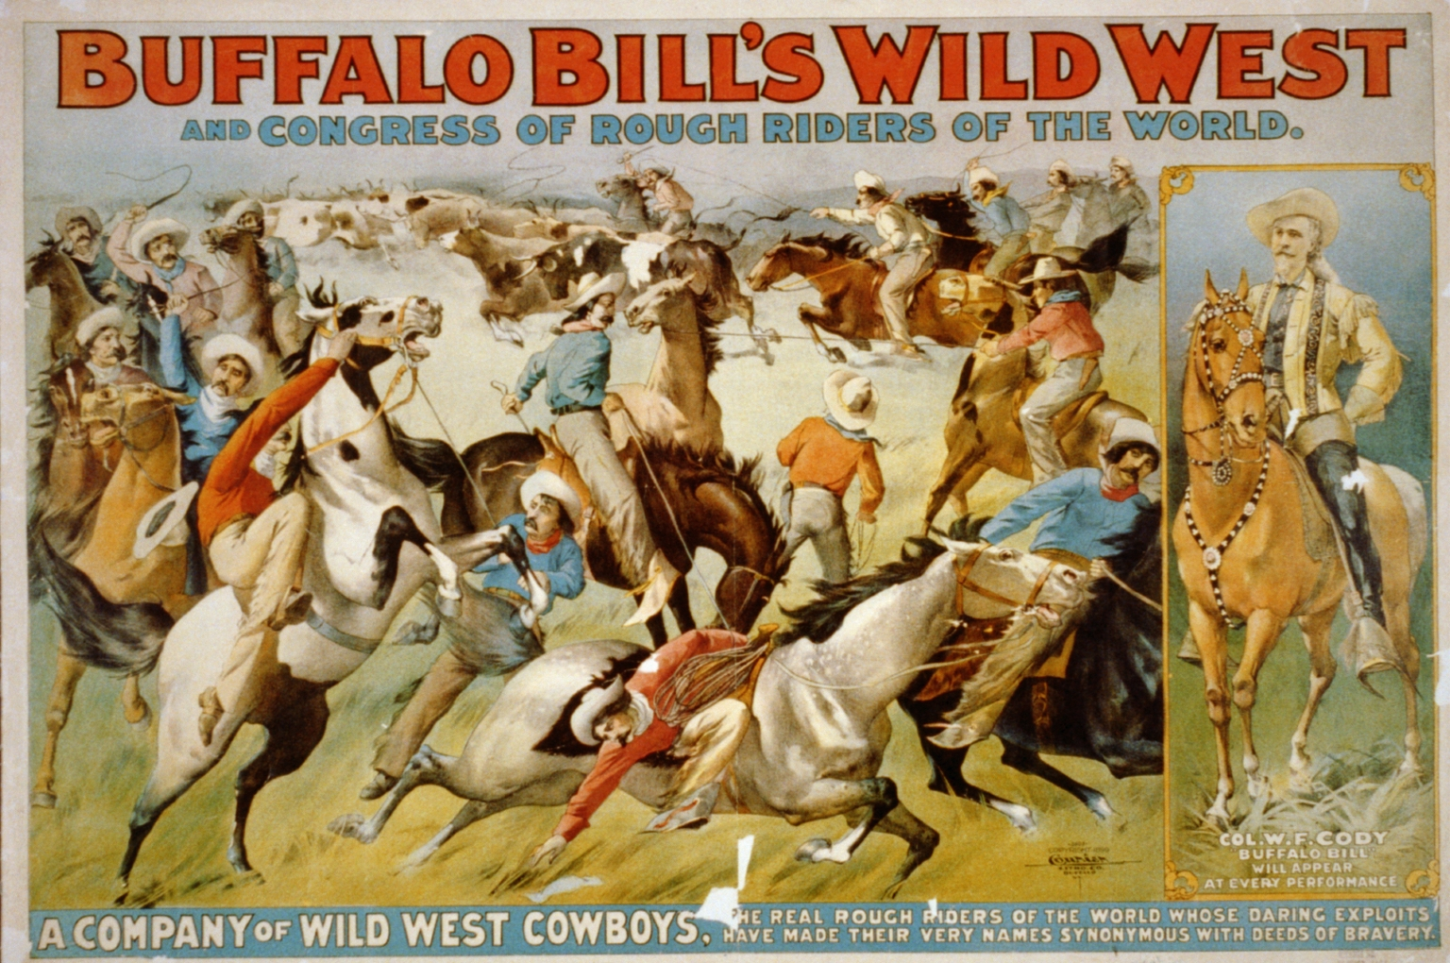
The Myth

Slide 8
Western Migration
Section 1

Slide 9
Why People Went West
- Mining
- Farming
- Ranching
- Railroad Building
- Freedom
- Religious Freedom
- Freedom From Jim Crow

Slide 10
Migrating for Freedom

Slide 11
Others Who Went West For Freedom
Women enjoy greater freedom and flexibility
The Chinese were essential in building the railroad as it pushed East but were distrusted and discriminated against
The Irish worked on the Railroad as it pushed West and were often discriminated against
African American’s often went west to escape discrimination and for better opportunities they became Exodusters, cowboys, or soldiers, the most famous being the Buffalo Soldiers

Slide 12
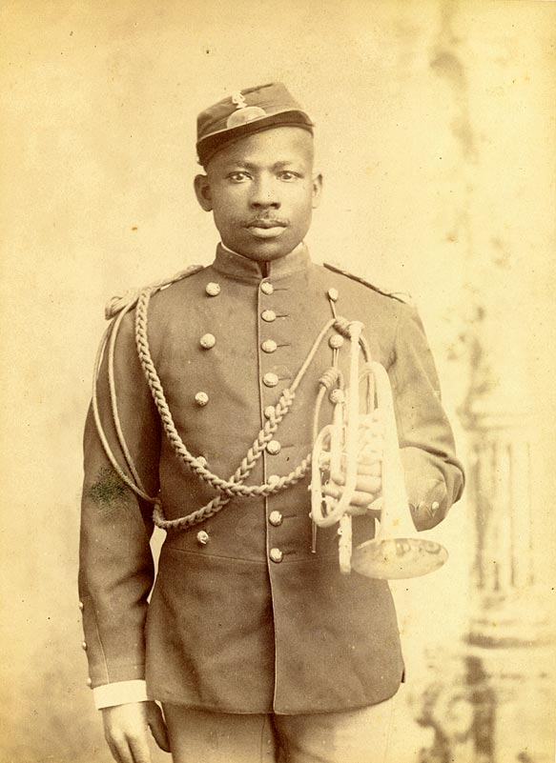
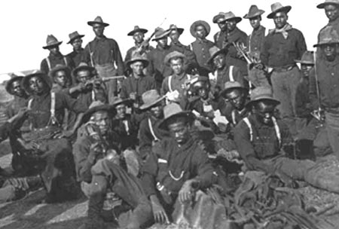

Slide 13
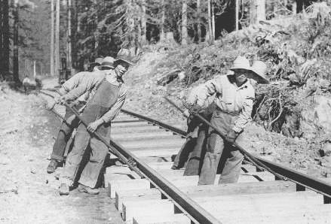

Slide 14
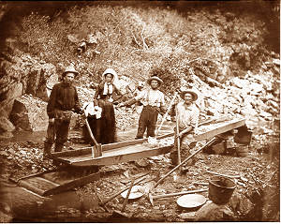
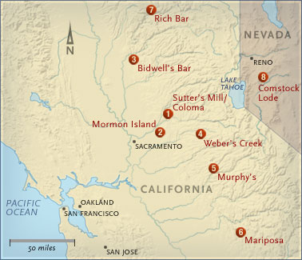
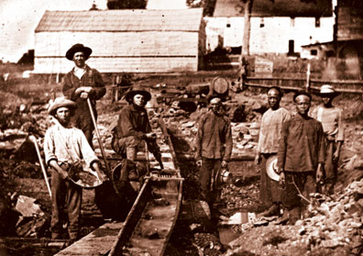
Mining

Slide 15
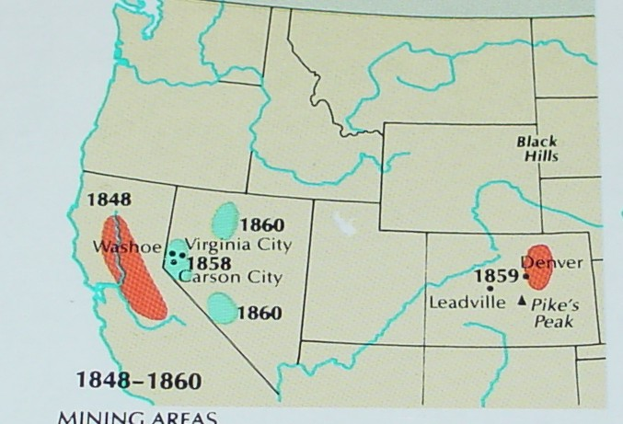
Mining
1849 Gold Rush
The Comstock Lode, the largest discovery of silver was found in Nevada in 1859 thousands went there to try to strike it rich
This led to conflicts with the native Americans who believed that no one could own the land

Slide 16
Farming In The West

Slide 17
Land Grants: Homestead Act
The Homestead act of 1862 made free land available in the prairie
In order to get these 30 acres, you had to move to the land “improve the land with a structure” and farm the land
This was very appealing to poor tenant farmers
You had to maintain the land for 5 years in order to get the deed
This will lead to a lot of foreign settlers, and poor farmers migrating to the prairie
This was supported by the development of the railroad

Slide 18
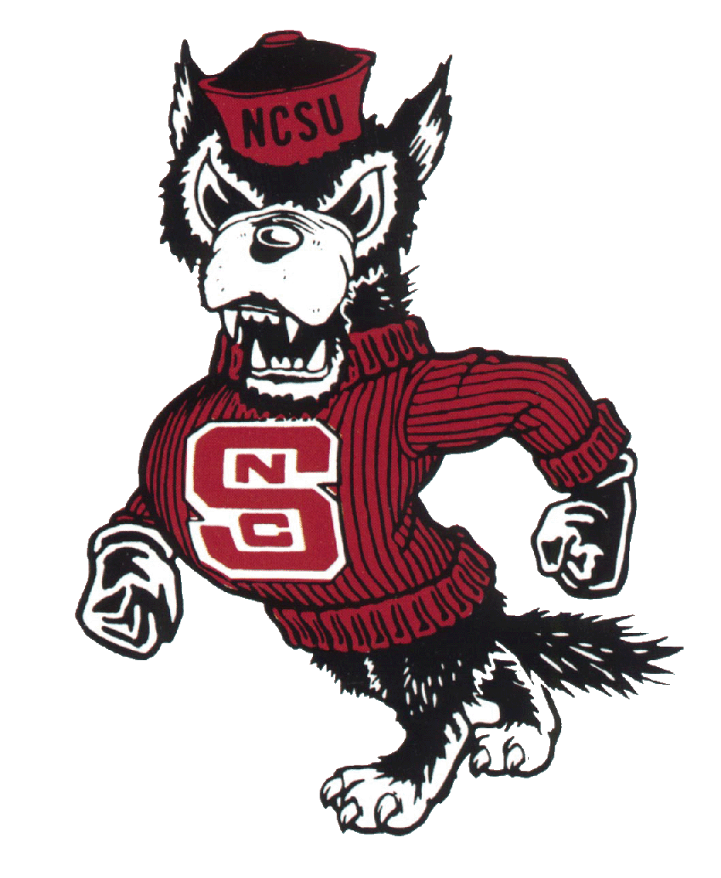
Morill Land-Grant: The federal government gave land to the states in order to create technical and agricultural colleges

Slide 19
Oklahoma Land Rush
- Oklahoma Land Rush:
- Indian Territory was opened to settlers
It was a race to see who could claim the land that began at 12:00pm 4/22/1889
Some rode horses, bicycles, wagons, and walked to claim land

Slide 20
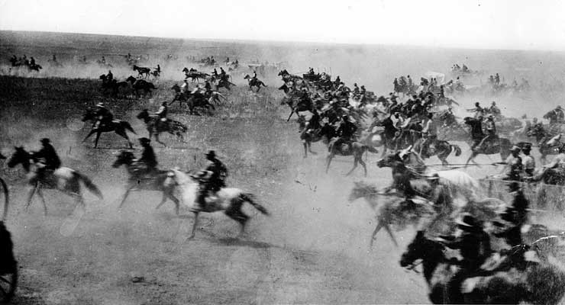
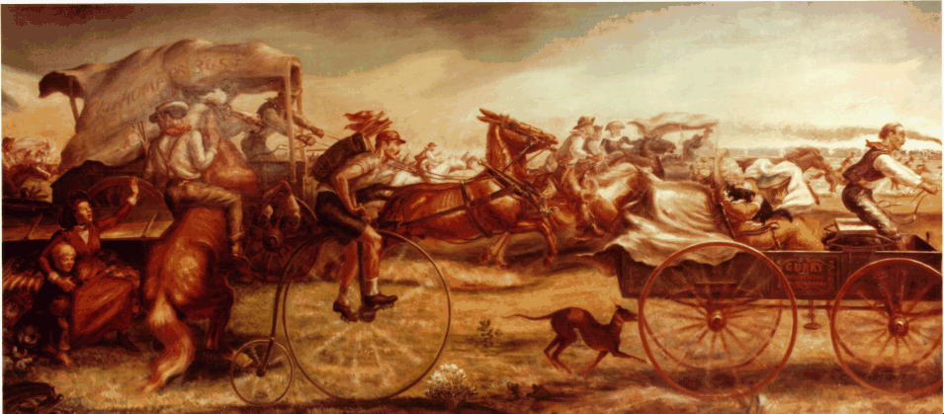

Slide 21
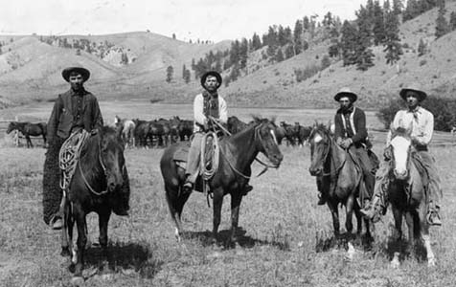
Ranching

Slide 22
Ranching
- Ranching became popular particularly in Texas and New Mexico
- Most ranchers either raised sheep or cattle
- The cattle ranchers and sheep ranchers generally hated each other, even fighting and killing over grazing land
- This grazing land was open government land and it was free to anyone who wanted to graze their animals on it
- As time went on the government sold the land and eventually the new owners put up cheap barbed wire fences taking away the “open range”

Slide 23
The Long Drive
- Part of the myth of the west is the lone cowboy on the prairie driving cattle as far as the eye can see.
- This reflects the “long drive” which was when cattle were driven from Texas to Kansas in order to be shipped by rail to markets further east.
Most drives occurred between 1866 and 1886 and the cowboy became an iconic image around the world.
This was made possible because the land on the drive was owned by the government and considered “open range” and free to use.
- The building of the railroad into Texas brought an end to the drive.

Slide 24
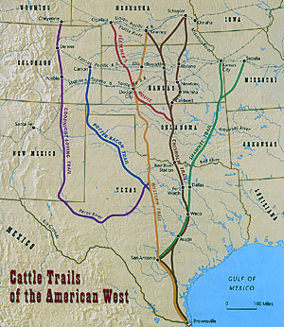
The Long Drive

Slide 25
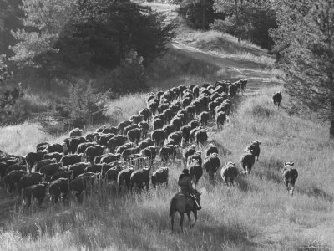
Cowboys

Slide 26
Conflicts With Natives
Section 2

Slide 27
Sand Creek Massacre
In 1864 the first of many western Massacres happened in Colorado on the Sand Creek River
Arapaho and Cheyenne Indians came to Fort Lyon Colorado to negotiate peace with the White Settlers
After negotiating a peace the Indians ran an American Flag up on their camp and men went away to hunt
The women, children, and old men who stayed back were attacked by Militia members and killed

Slide 28
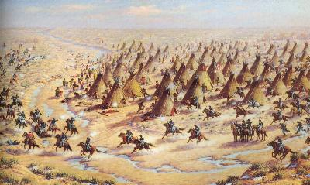
Sand Creek Massacre

Slide 29
Battle of the Little Big Horn
In 1868 the Treaty of Ft Laramie was signed giving the Black Hills in South Dakota to the Sioux
Soon after gold was discovered and men rushed to the black hills violating the treaty
The Indians will attack the settlers and miners, so Gen George Armstrong Custer was sent to protect the settlers
In 1876 the Indians won the battle of Little Big Horn, where thousands of Lakota Indians would surround and kill General George Custer’s cavalry brigade at the Little Big Horn River

Slide 30
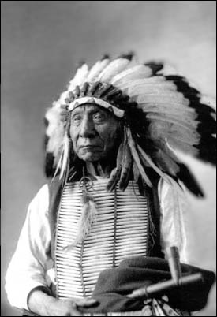
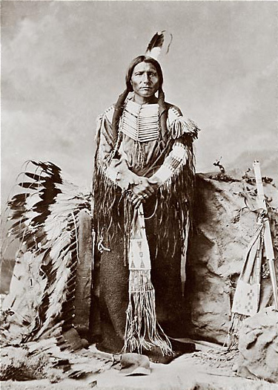
Chief Red Cloud
Chief Crazy Horse

Slide 31
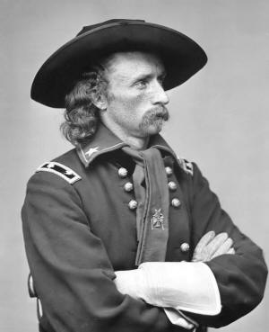

Slide 32
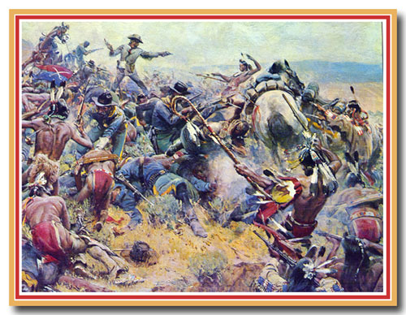

Slide 33
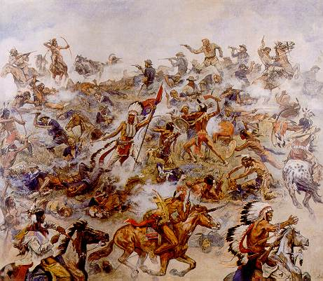

Slide 34
System of Destroying a People
Shortly after the Civil War a system to destroy the Indians was developed it involved
1. Destroying the Buffalo,
Since it was their chief source of food and materials destroying the buffalo would hurt the Indians greatly

Slide 35
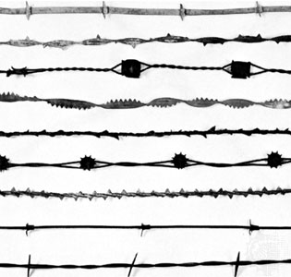
2. Barbed Wiring the land: Barbed wire prevented easy movement for Indians and animals making it harder to continue a nomadic lifestyle
3. War: The Americans would kill Indians outright and force them into captivity

Slide 36
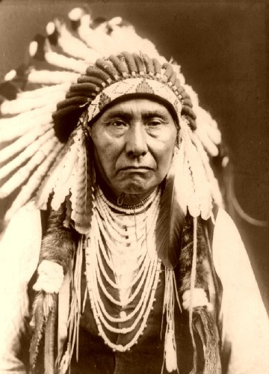
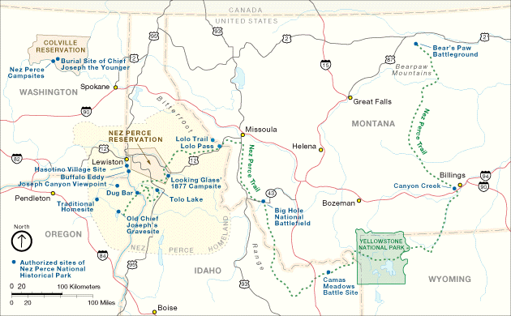
Chief Joseph and the Nez Perce Indians

Slide 37
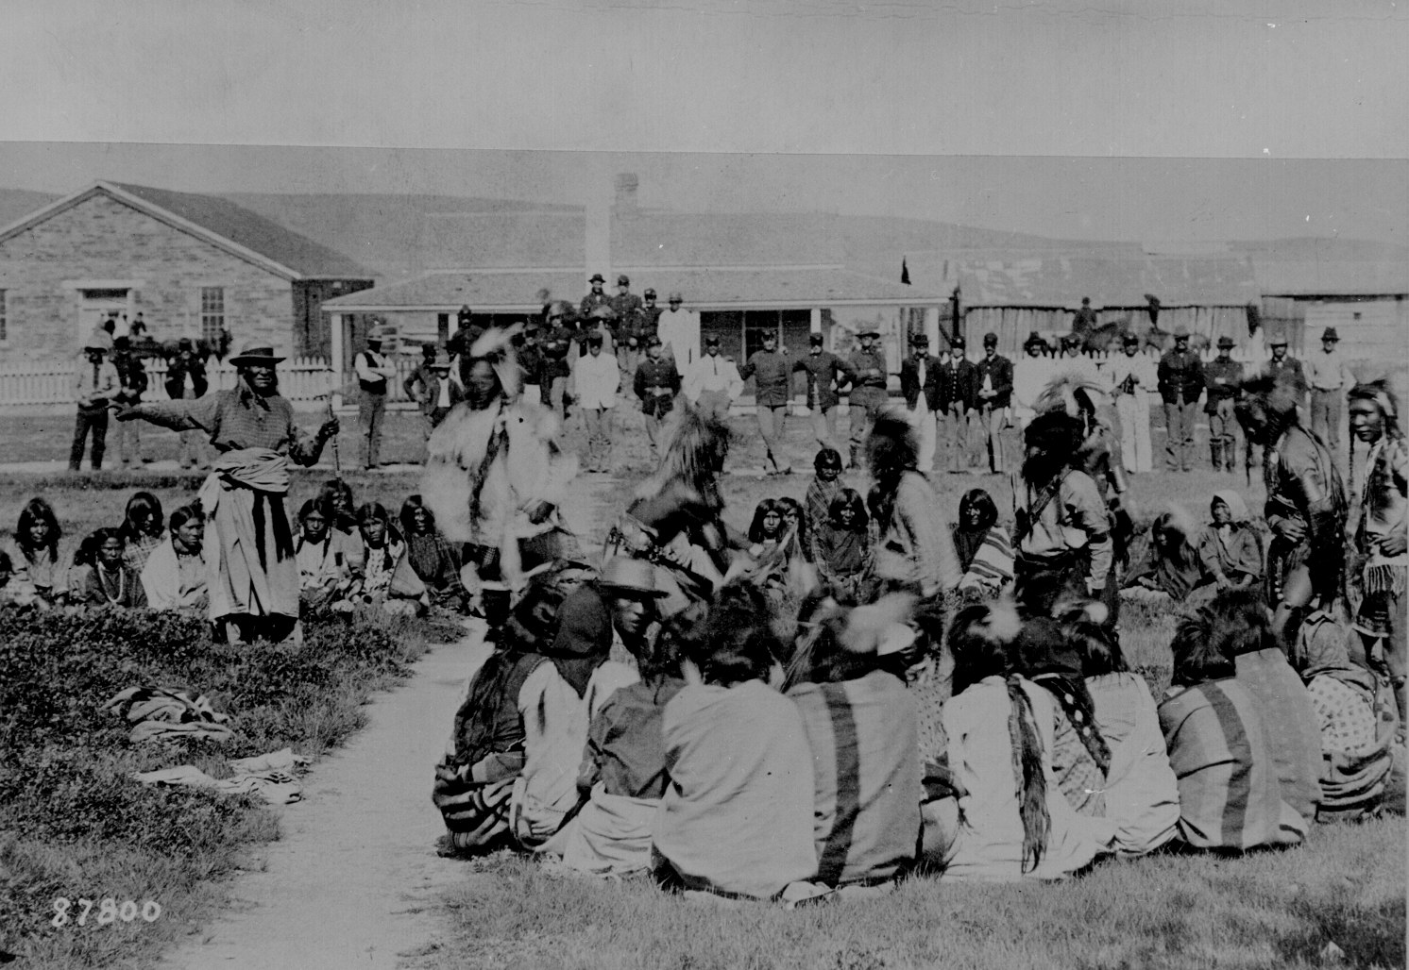
4. Reservations
Reservations were places that Indians could be concentrated and controlled
Usually they were on worthless pieces of land, too small for the people living there,
Because they could not farm the Indians became dependent on the government food handouts
The Army would watch over the Indians there and would attempt to “Assimilate” them into white culture
Reservations were full of Alcohol and disease and did as much to destroy the Indians as any war

Slide 38
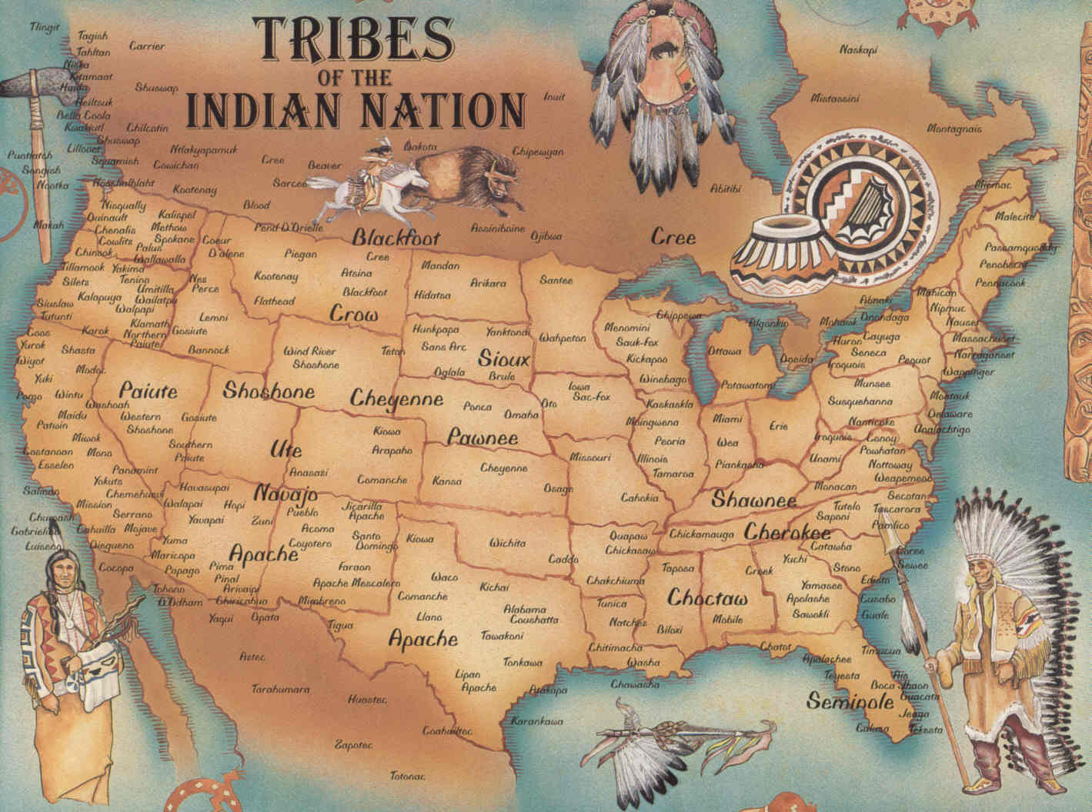
Native Americans 1492

Slide 39
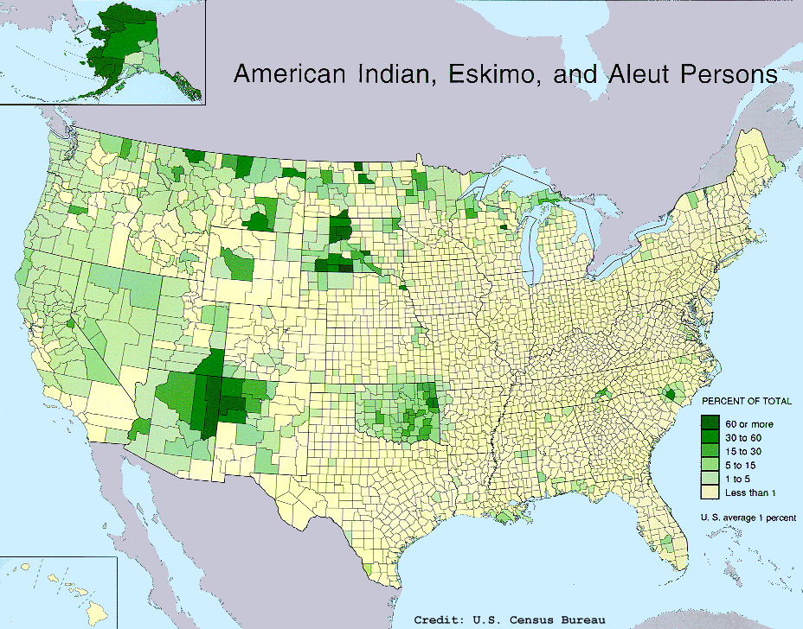
Percentage of Population

Slide 40
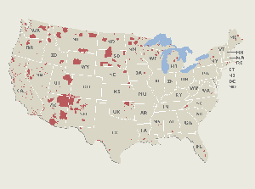
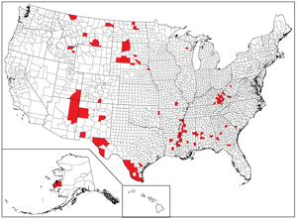
Indian Reservations Today

Slide 41
Wounded Knee
The final event of the Indian Wars was the Massacre of Wounded Knee
In 1890 350 Sioux Indians camped at Wounded Knee Creek where they were surrounded by U.S. cavalry whose job it was to arrest their leader
Some Indians practiced the “Ghost Dance” that some believed could bring back the dead, already Chief Sitting Bull had been killed in an attempt to arrest him to stop the dances
When the Indians began a Ghost Dance at wounded knee nervous soldiers attempted to stop them, the result was the Soldiers killing 300 Indians, this ended the Ghost Dance movement and the Indian Wars

Slide 42
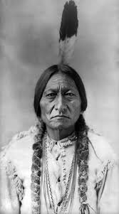
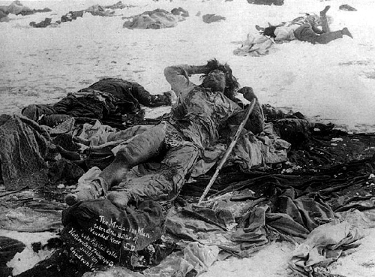
Battle of Wounded Knee
Chief Sitting Bull

Slide 43
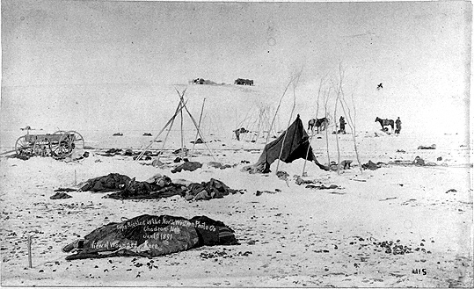

Slide 44
A Century of Dishonor
Dawes Act: passed to assimilate Native Americans into mainstream culture
Ends the treaty system that treated the tribes as their own nations (this had been around since the revolution) and divided reservations and gave each Indian family land
Population decreased due to poverty and disease
The Dawes General Allotment Act destroys what is left of tribal society
This act will cost the natives over 70% of their land as speculators came in and bought the land from native families who didn't know how much the land was worth

Slide 45
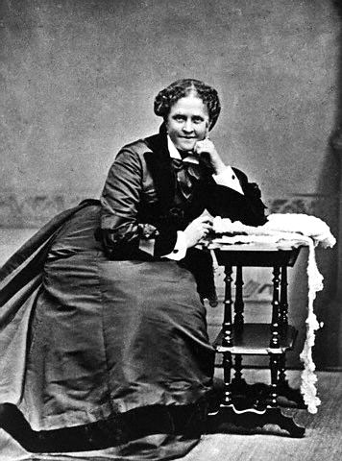
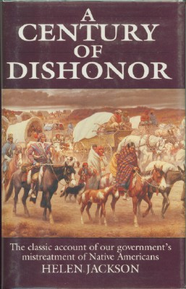
Helen Hunt Jackson

Slide 46
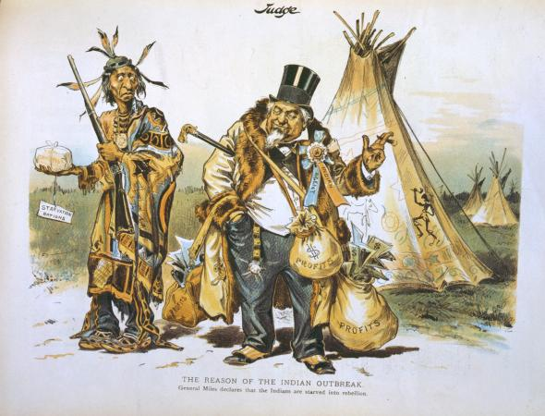

Slide 47
The Rise of Populism
Section 3

Slide 48
Farming Out West
The transcontinental railroad will open up western farmers to eastern markets
Technology makes farming easier
Steel plow→ John Deere
Windmills→ farmers could harness wind power to pump water
Barbed Wire→ cheap way to fence in livestock, led to the end of the buffalo
Railroads→ transport goods
The tractor increased yields
Fertilizer increased yields
How could mechanization hurt the farmer

Slide 49
Plight of the Farmer
In the late 1800’s farmers found themselves in large financial troubles
America is too good:
We did such a good job increasing farm production with new inventions that we started to overproduce, driving prices down.
Railroads and banks will take advantage of farmers

Slide 50
The Grange
Goal: to improve the lives of farmers in a small, local way
Pooling of savings as an alternative to dependence on corrupt banks
Cooperative grain elevators to hold non-perishable crops until the optimal times to sell
An effort to manufacture farm equipment; this depleted the Granger organization's funds and was why it declined
In the end the movement never addressed the key problem, overproduction
The power of the grange peeked in 1875 then declined, it still exists today but it is more of a social club

Slide 52
Farmer’s Alliances
National Farmers Alliance (NFA): a national attempt to unite farmers and combat corrupt banks and railroads
The goal was to promote higher prices for the crops and make sure that the farmers got fair treatment
Started in 1876 it grew in power until the mid 1880’s when it was destroyed, however the populist party will rise from it

Slide 53
Populist Party
- The Populist Party was a political party meant to help the poor farmers in America receive better treatment
Farmers were being treated poorly by banks, and by railroad companies
The problem is there are not enough farmers anymore to be a large party, more people live in the cities for the first time in American History
The populist party will be led by William Jennings Bryan who will run for president 3 times

Slide 54
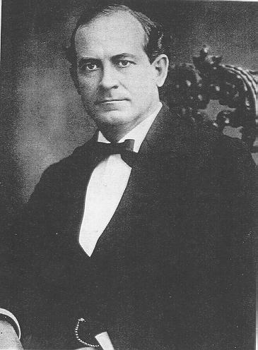
William Jennings Bryan

Slide 55
Bimetalism (free silver)
In the 18th and 19th century all of American money will be backed by gold. This was known as the gold standard
This would help prevent inflation by making sure there was always a stable money supply and the government could back up its promise.
Farmers hated this because it would often lead to deflation, making their debts harder to pay back.
Farmers therefore supported Bimetalism, where gold and silver back up paper money, this would create inflation
If inflation was increased the farmers could pay their debts back easier because they would get more money for their crops

Slide 56
Interstate Commerce Act (1886)
State laws could really only regulate the short-hauls, not across state lines
Wabash v. Illinois (1886): individual states could not regulate interstate commerce
Established the Interstate Commerce Commission: power to investigate and prosecute pool and rebates
RR rates had to be “reasonable and just”

Slide 57
Ocala platform
National Alliance
Attacked major parties as being subservient to Wall Street and big business
Supported direct election of U.S. senators
Lower tariff rates
Graduated income tax
New banking system regulated by the federal government
Treasury notes and silver be used to increase the amount of money in circulation
Wanted to create inflation and raise crop prices
Many of these ideas would become part of the Populist movement in 1892 and 1896

Slide 58
Court Cases
Munn V Illinois: Stated that the government could regulate railroads as a public utility, allowed for the Interstate Commerce Act
Wabash V Illinois: Stated that the states could not regulate trade between states, only the federal government has that right. However states could set safety standards and other “indirect burdens”

Slide 59
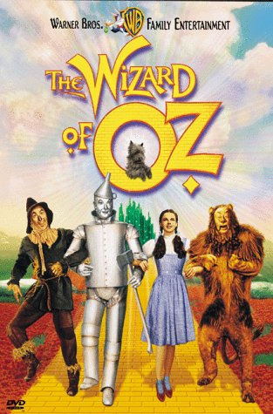

Slide 60
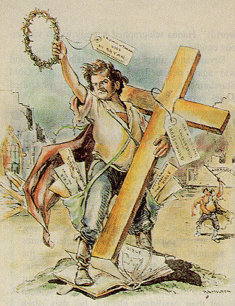

Slide 61
The New South

Slide 62
Economic Progress
Birmingham, AL: leading steel center
Memphis, TN: growing lumber industry
Richmond, VA: center of tobacco industry
Cheap labor allowed GA, NC, and SC to become chief producers of textiles
Southern RR companies converted to standard gauge

Slide 63
Continued Poverty
Remained largely agricultural
Northern investors controlled ¾ of the southern railroads and by 1900 had control of the steel industry
Industrial workers (94% were white) in the S. earned ½ the national average
Most remained in traditional roles of sharecropping and farming

Slide 65
Why did the South remain poverty-stricken?
South’s late start at industrialization
Poorly educated workforce
Failed to invest in technical and engineering schools
Political leadership provided little support for the education of either poor whites or African Americans

Slide 66
Agriculture
Remained tied to cotton; 1870-1890 cotton acres more than doubled
Overproduction caused cotton prices to decline by more than 50% by the 1890s
Per capita income declined and farmers lost their farms
By 1900, over ½ of white farmers and ¾ of black farmers were tenants (sharecropping)

Slide 67
Attempt at Diversification
George Washington Carver
African American scientist at the Tuskegee Institute in Alabama promoted the growing of peanuts, sweet potatoes, and soybean

Slide 68
Segregation
After Reconstruction Jim Crow Laws were introduced by “redeemers” who felt they were redeeming the South for white rule.
White southerners at the time did not accept the idea of socially equal African Americans.
Plessey v Fergusson in 1898 was an attempt by African Americans to sue in court for equal rights.
The court responded by saying it was legal to have “separate but equal” facilities.

Slide 69
Loss of civil rights
Voter registration dropped
Ex.: 130,334 registered in LA in 1896 and only 1.342 in 1904
Literacy tests, poll taxes, “whites-only” primaries, grandfather clauses
Barred from serving on juries
Stiffer penalties for crimes committed by African Americans
Lynch mobs killed over 1400 men in the 1890s
Remained in farming jobs and low-paying domestic work

Slide 70
Responding to segregation
International Migration Society
Booker T. Washington
Established Tuskegee Institute
Largest and best-known industrial school in the nation
Organized the National Negro Business League
Racial harmony and economic cooperation
Would rise up through education (W.E.B. Du Bois would later argue against this)

Slide 71
Tuskegee Institute

