Slide 1
The New Frontier and The Great Society

Slide 2
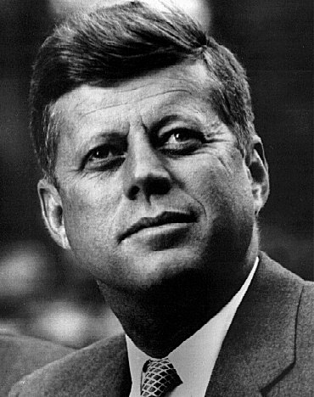
SECTION 2: THE NEW FRONTIER
Kennedy initiated his vision in a program he called “The New Frontier”
The economy, education, medical care for the elderly and the poor, and space exploration were all part of his vision

Slide 3
THE PEACE CORPS
One of the first programs launched by JFK was the Peace Corps
The Peace Corps is a volunteer program to assist developing nations in Asia, Africa and Latin America
Even though it was ridiculed at first (called Kennedy’s Kiddie Corps)The Peace Corps has become a huge success

Slide 4
SECTION 3: THE GREAT SOCIETY

Slide 5
BUILDING THE GREAT SOCIETY
In May of 1964, LBJ summed up his vision for America in a phrase: “The Great Society”
By the time he left the White House in 1969, Congress had passed 206 of LBJ’s Great Society legislative initiatives

Slide 6
JOHNSON’S DOMESTIC AGENDA
As soon as Johnson took office, he urged Congress to pass the tax-cut bill that Kennedy had sent to Capital Hill
The tax cut passed and $10 billion in cuts took effect

Slide 7
CIVIL RIGHTS ACT OF 1964
In July of 1964, LBJ pushed the Civil Rights Act through Congress
The Act prohibited discrimination based on race, color, religion or national origin, and granted the federal government new powers to enforce the law
LBJ signs the Civil Rights Act as Martin Luther King watches

Slide 8
VOTING RIGHTS ACT 1964
Part of the Civil Rights Act was to insure voting rights for all Americans
The act prohibited literacy tests or other discriminatory practices for voting
The act insured consistent election practices
"By the way, what's the big word?"

Slide 9
THE WAR ON POVERTY
Following his tax cut and Civil Rights Act successes, LBJ launched his War on Poverty
In August of 1964 he pushed through Congress a series of measures known as the Economic Opportunity Act
The Act provided $1 billion in aid to the inner city

Slide 10
ECONOMIC OPPORTUNITY ACT
THE EOA legislation created:
The Job Corps
Project Head Start for underprivileged preschoolers
The Community Action Program which encouraged the poor to participate in public works program
Project Head Start is still going strong

Slide 11
EDUCATION
Johnson considered education “the key which can unlock the door to the Great Society”
The Elementary and Secondary Education Act provided $1 billion to help public schools buy textbooks and library materials
This Act represented the first major federal aid package for education ever

Slide 12
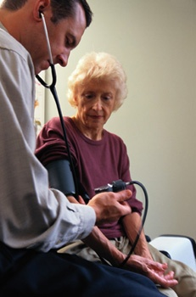
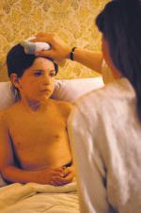
HEALTHCARE
LBJ and Congress enhanced Social Security by establishing Medicare and Medicaid
Medicare provided hospital insurance and low-cost medical care to the elderly
Medicaid provided health benefits to the poor

Slide 13
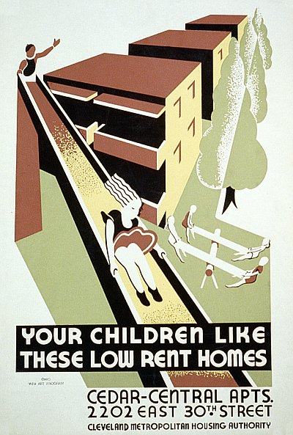
HOUSING
Weaver
LBJ and Congress appropriated money to build 240,000 units of low-rent public housing
Established the Department of Housing and Urban Development (HUD)

Slide 14
IMMIGRATION REFORM
The Great Society also brought reform to immigration laws
The Immigration Act of 1965 opened the door for many non-European immigrants to settle in the U.S.

Slide 15
THE ENVIRONMENT
LBJ also actively sought to improve the environment
The Water Quality Act of 1965 required states to clean up their rivers and lakes

Slide 16
CONSUMER PROTECTION
Consumer advocates also made gains during the 1960s
The first laws regulating auto safety were passed

Slide 17
SUPREME COURT REFORMS SOCIETY, TOO
Warren
The Judicial Branch led by the Supreme Court and Chief Justice Earl Warren did much to protect individual rights

Slide 18
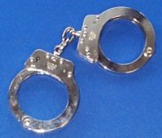
WARREN COURT AND SUSPECT’S RIGHTS
In Mapp v. Ohio (1961) the Supreme Court ruled that illegally seized evidence could not be used in court
In Escobedo v. Illinois the court ruled that the accused has the right to have an attorney present when questioned by police
In Miranda v. Arizona the court ruled that all suspects must be read their rights before questioning

Slide 19
IMPACT OF GREAT SOCIETY
The Great Society and the Warren Court changed the United States
No president in Post-WWII era extended the power and reach of the federal government more than LBJ

