Slide 1
The Cold War Part II
1963-1991

Slide 2
Race Relations in the Late 60’s

Slide 3
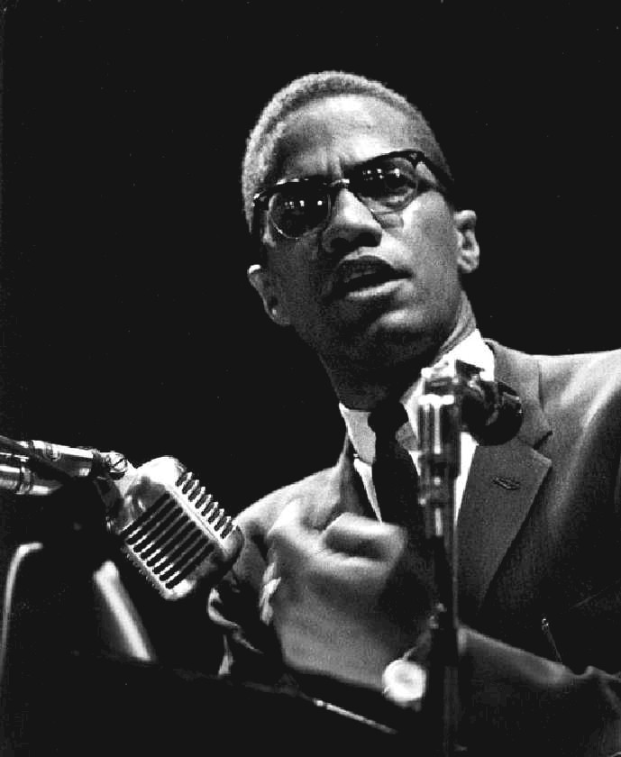
Malcolm X
Malcolm X did not believe in nonviolence and believed African Americans should fight and defend themselves
He also believed that Africans should return to Africa and in the meantime have their own nation in North America
He later converts to Sunni Islam and goes on the Hajj, it is there that he sees people from all over the world working together and he believes integration could work
As time goes on however he rejects violence and is assassinated for turning against the Nation of Islam

Slide 4
Johnson’s Race Policy
Lyndon B Johnson will take over for the slain Kennedy and begin his “Great Society” a continuation of Kennedy’s New Frontier
Johnson was a southerner who will reshape American politics by signing the Civil Rights Act of 1964 and the Voting Rights Act of 1965
Results
African Americans gained more freedoms
The South left Johnson’s Democratic party and joined the Republican party
Tension did not end, at the assassination of King in 68 cities (including Raleigh) will have race riots

Slide 5
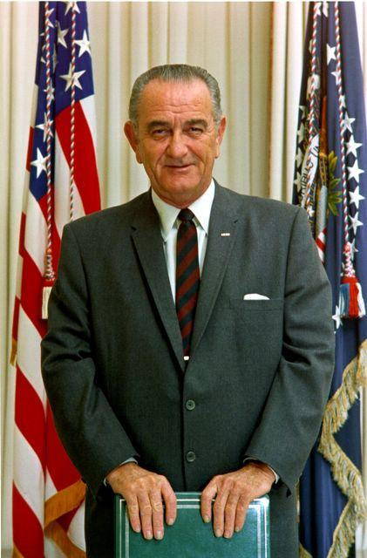
Lyndon B Johnson

Slide 6
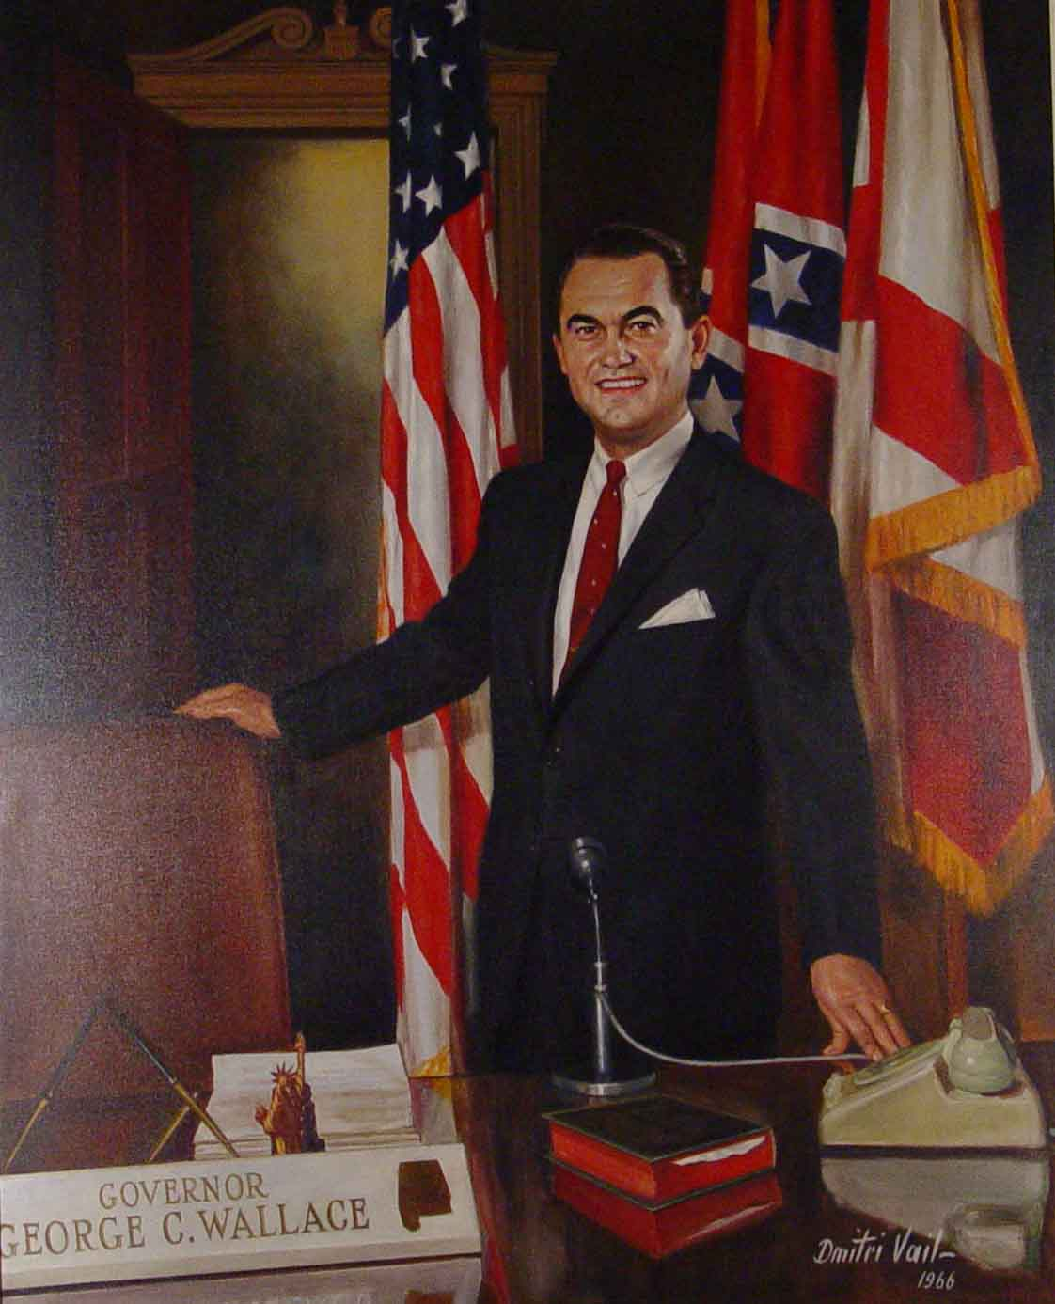
George Wallace
“In the name of the greatest people that have ever trod this earth, I draw the line in the dust and toss the gauntlet before the feet of tyranny, and I say segregation now, segregation tomorrow, segregation forever.”

Slide 7
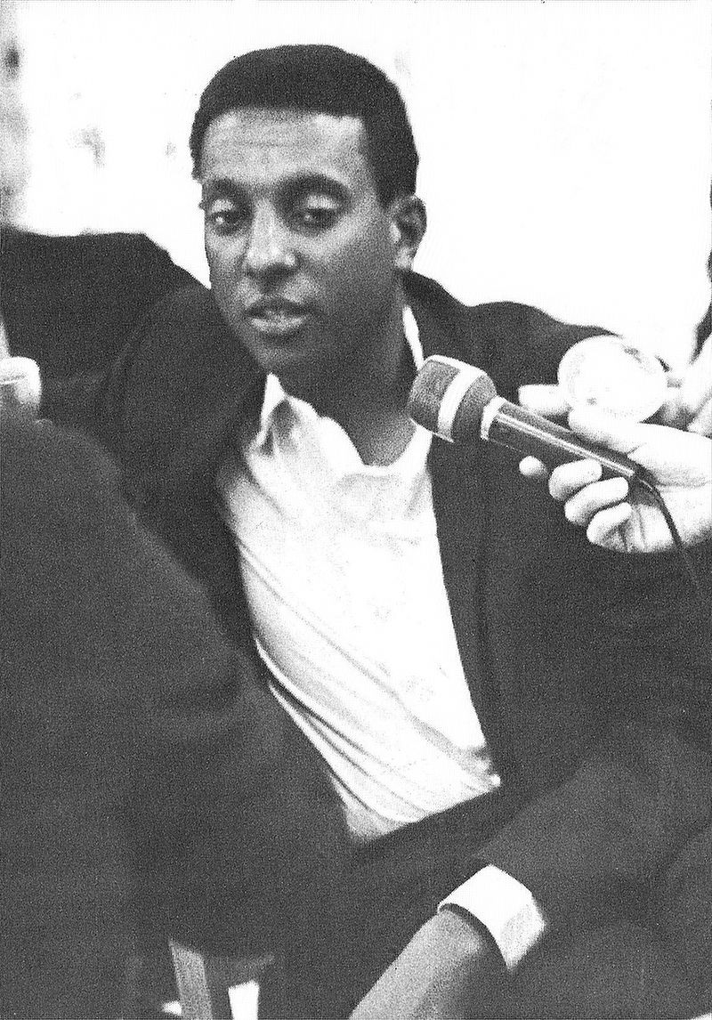
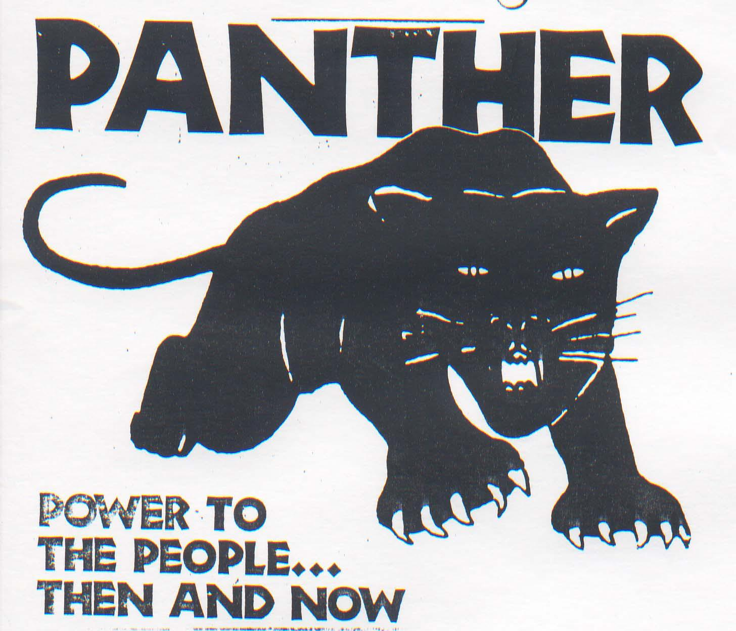
Stokely Carmichael and the Black Panther Party
Stokely Carmichael was a former leader of SNCC and a Freedom Rider
As time went on he became more radical and came to believe that whites could not help African Americans achieve equality and that they had to seize their own power (This is the Black Power movement)
Stokely will eventually leave SNCC and join the more radical Black Panther Party that believed African Americans must take up arms to defend themselves, and in some cases start a revolution

Slide 8
Vietnam
1952-1974

Slide 9
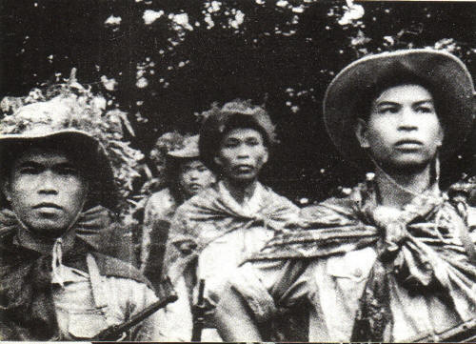
Vietcong
The organized N. Vietnamese Guerilla Army that was based in S. Vietnam
Effective at staging guerilla attacks
Difficult to defeat, so Diem (South Vietnam) began to look to US for more help in fighting the Vietcong (VC)
Notes:
9

Slide 10
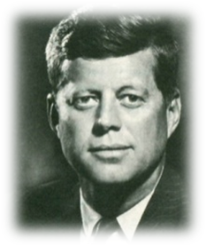
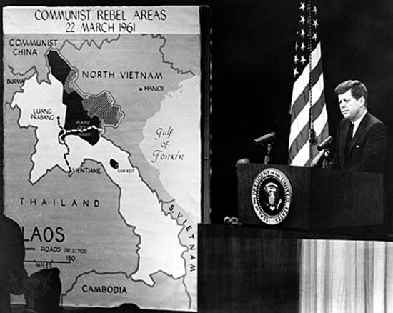
John F. Kennedy Becomes President
Kennedy needed to appear tough on communism, so he increased aid and advisors to Vietnam
He also urged Diem to make democratic reforms to increase his popularity
These reforms had little effect
JFK explaining the Vietnam situation to reporters shortly after being elected.
Notes:
10

Slide 11
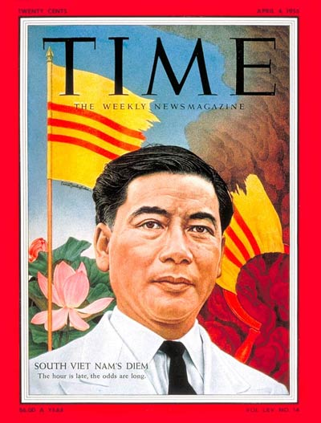
Diem’s Unpopularity
Diem was a Catholic and persecuted the Buddhists
As a response some Buddhist monks committed self-immolation as a form of protest.
Notes:
11

Slide 12
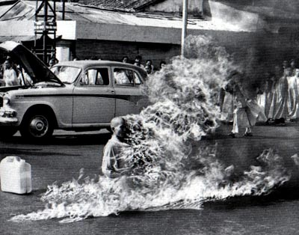
Self-Immolation

Slide 13
Gulf of Tonkin Incident
Johnson wanted to escalate the Vietnam war because he believed that if one country in the region fell to communism others would follow, this is known as the Domino Theory
Johnson invents the Gulf of Tonkin Incident
Johnson told the people a destroyer was fired on by the North Vietnamese, congress then authorizes a use of force to let Johnson use “whatever means necessary”
The U.S. Ship was fired on, but only after it fired on the Vietnamese

Slide 14
U.S. sends more troops
Through the late 60’s America will begin to draft young men (18-25) to send to Vietnam to combat the Vietcong, and hold North Vietnam from attacking South Vietnam
The Vietcong will resist this using expert guerilla tactics

Slide 15
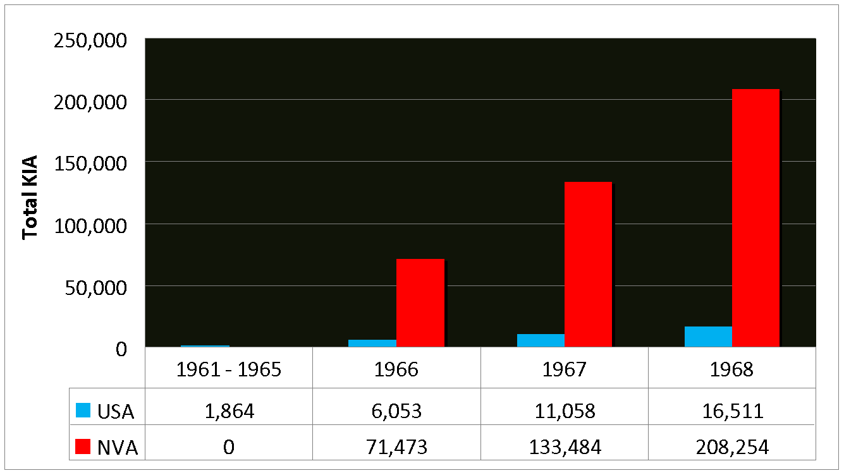
Killed in Action 1961 - 1968
Note: KIA figures for the NVA are unknown from 1961 - 1965
Notes:
Source: http://www.rjsmith.com/kia_tbl.html
15

Slide 16
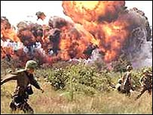
US Response to VC tactics
Destroy landscape to get rid of VC cover
Napalm
Jellied gasoline that explodes and sticks to surfaces. It is very difficult to extinguish
Agent Orange
a chemical that destroys the foliage so the US could see troop movement from the sky
Notes:
16

Slide 17
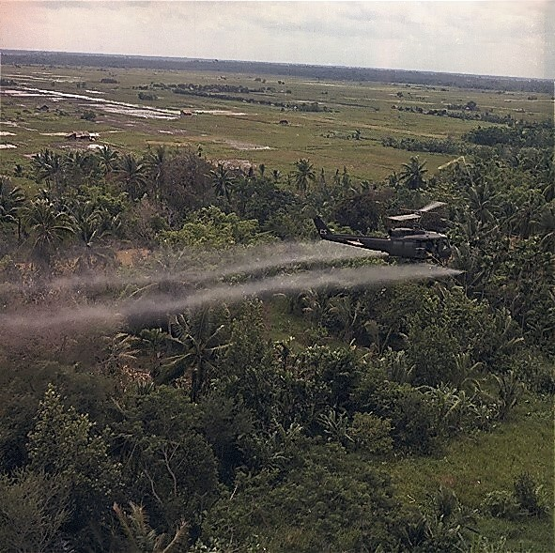
Agent Orange being sprayed from a helicopter

Slide 18
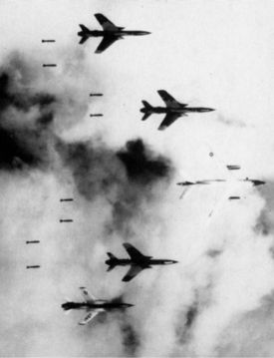
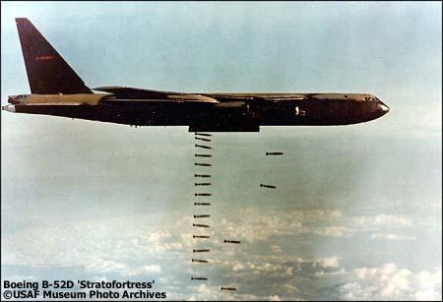
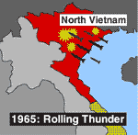

Slide 19
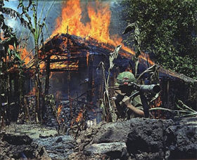
Increasing Difficulties
The VC did not surrender despite our tactics
They were not going to give up their homeland easily and they were willing to accept massive amounts of casualties
The US also refused to invade N. Vietnam because we didn’t want a full scale war with China again.
Notes:
19

Slide 20
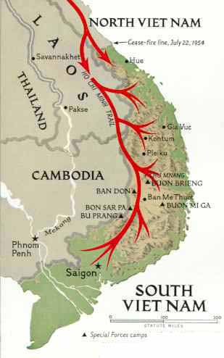
Ho Chi Min Trail
The N. Vietnamese’s series of jungle supply paths
Passed through the countries of Laos and Cambodia
Because Laos and Cambodia weren’t involved in the war, LBJ refused the order to bomb the trail
Notes:
20

Slide 21
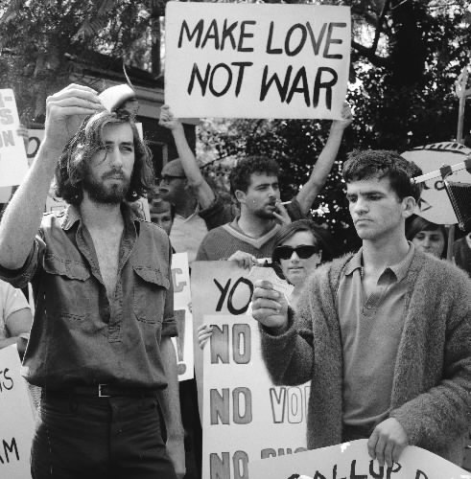
Anti-War Movement
The anti-war movement was heavily influenced by the Civil Rights Movement it involved protests and civil disobedience
Notes:
21

Slide 22
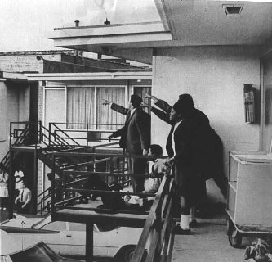
1968
Dr. Martin Luther King
Dr. King is assassinated in Memphis by James Earl Ray.
Robert Kennedy
JFK’s younger brother and Democratic presidential candidate is killed by Sirhan Sirhan.
Riots in Chicago
at the Democratic National Convention in Chicago, police and protesters clashed in a highly publicized riot
Assassination of Dr. King
Notes:
22

Slide 23
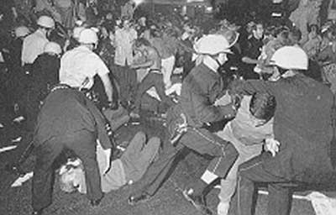
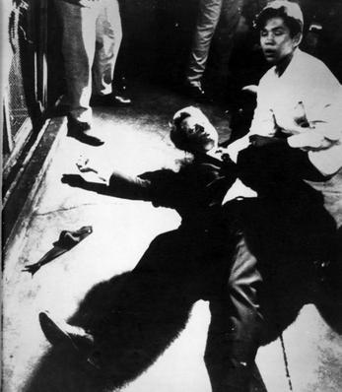
Clashes at the Democratic National Convention in Chicago
Robert F. Kennedy’s Assassination
Notes:
23

Slide 24
Tet Offensive 1968
The Tet Offensive began when the Viet Cong launched an all out surprise attack on U.S. forces.
Although it was a total military failure for the Viet Cong it will turn many Americans against a war they thought was won

Slide 25
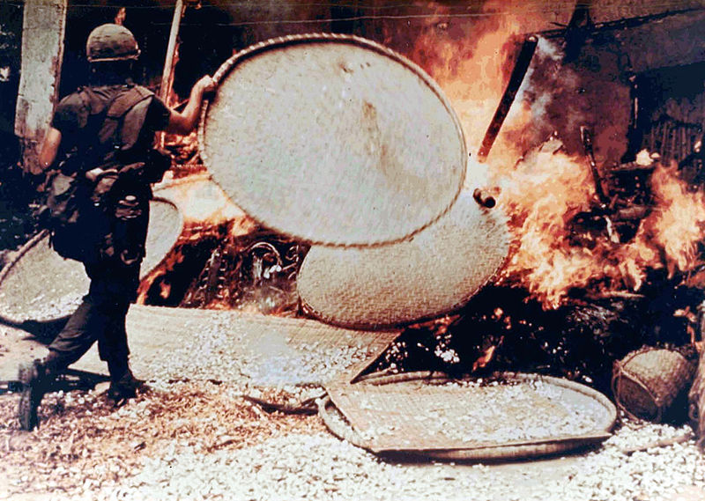
My Lai Massacre
March 16, 1968
US Soldiers killed 347 to 504 unarmed citizens in South Vietnam
When the incident became public knowledge in 1969, it prompted widespread outrage around the world. The massacre also reduced U.S. support at home for the Vietnam War.

Slide 26
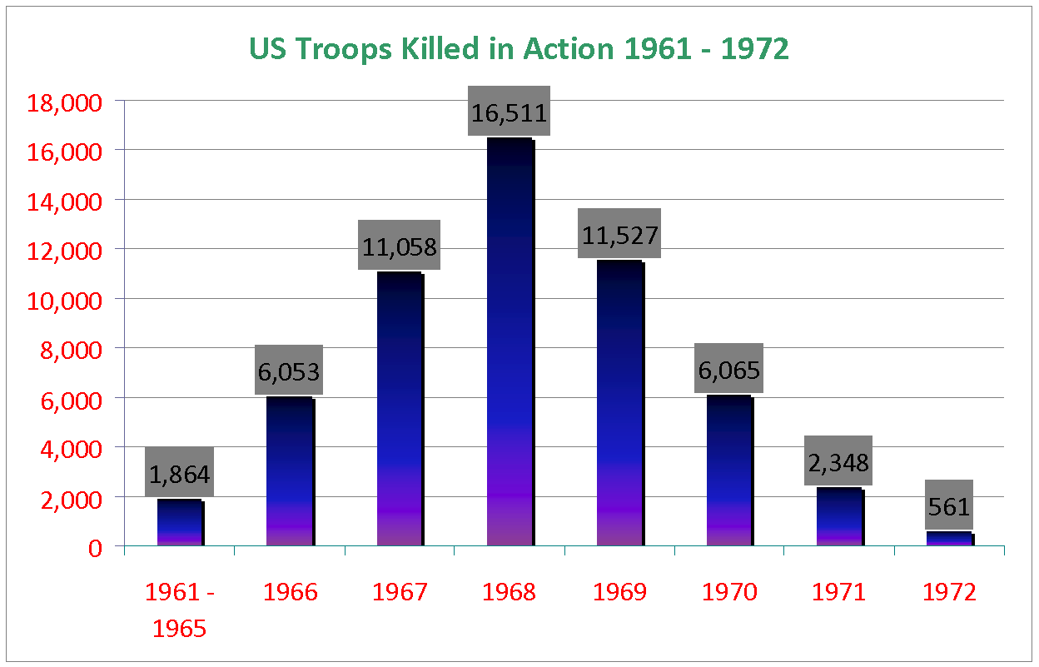

Slide 27
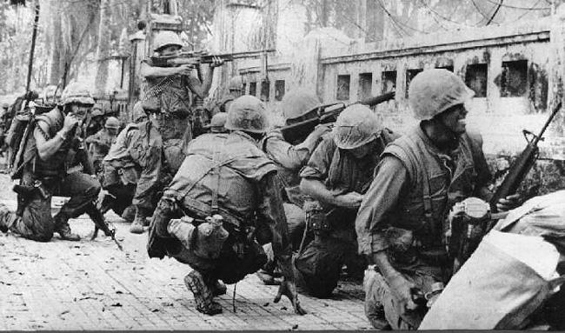

Slide 28
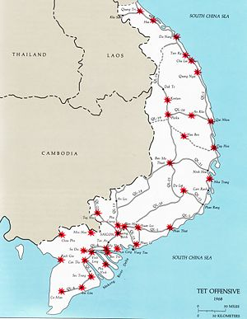

Slide 29
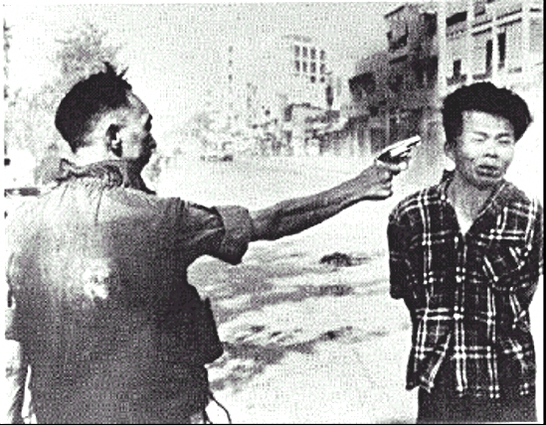

Slide 30
Johnson Exits
Due to Vietnam’s unpopularity he will not run for office in 1968
His Great Society did work in passing Medicaid and improving Social Security

Slide 31
1968 Election
The 1968 election the Democrats will be split and the Republicans will run Richard Nixon
Also running will be George Wallace, a segregationist, who will be the most successful 3rd party candidate since T. Roosevelt
Richard Nixon will win the election of 1968

Slide 32
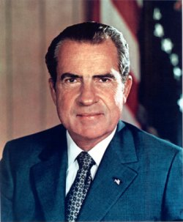
Nixon

Slide 33
Nixon and Vietnam
Vietnamization
Nixon’s strategy for “peace with honor”
a gradual withdrawal of US troops from Vietnam
Turn control of the war over to the S. Vietnamese
Nixon announces he will send forces into neighboring Cambodia in order to find and kill the VC and NVA and stop the H.C.M. Trail
Students will protest around the country, at Kent State in Ohio 4 students will be killed by national guard soldiers who fired into the crowd

Slide 34
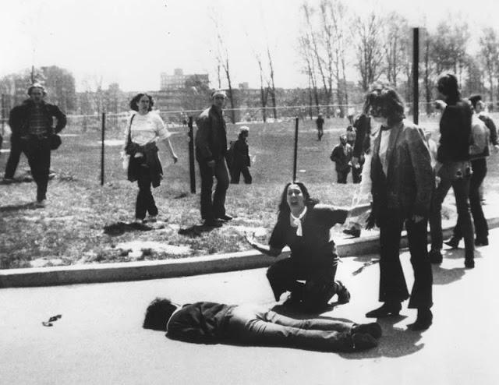

Slide 35
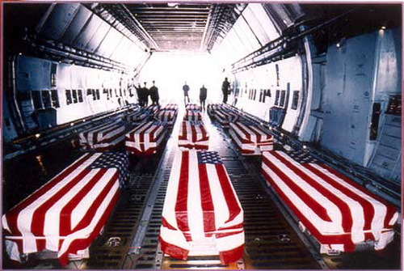
Legacy of ‘Nam
Cost $150 Billion
Over 58,000 American Deaths
Over 3 million total Vietnamese deaths (civilians/military)
Considered by many to be the first US military defeat
Disrespect of troops upon returning home
“That was the feeling in the air that we were unclean.” – Jan Scruggs, founder of Vietnam Veterans Memorial

Slide 36
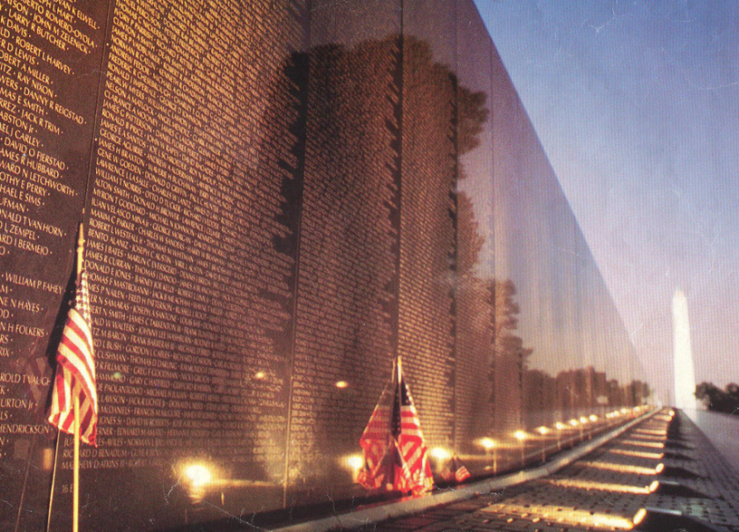
Legacy of ‘Nam
Americans became more distrustful of government
Pentagon Papers: Secret study of US involvement in Vietnam that was leaked to the NY Times revealing that American leaders lied to Congress and the American people regarding Vietnam
War Powers Act
limited President’s powers, had to get consent from Congress before sending troops

