Slide 1
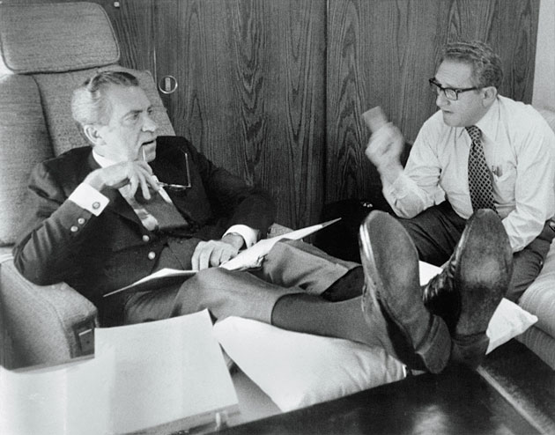
Nixon and the ’70s
By Brad Harris,
Grand Prairie HS

Slide 2
The Election of 1968
The 1968 presidential election marked a shift to the right in American politics.
The 1960's began as an era of optimism but the events of the decade led to public trust in the government and produced a backlash against liberal movements and the Democratic party.

Slide 3
The Election of 1968
Nixon campaigned as a champion of the “Silent Majority"
The “Silent Majority” were Americans who paid taxes, did not demonstrate, and desired a restoration of "law and order.”

Slide 4
The Southern Strategy
Since the Election of 1968, the South has been a Republican stronghold in elections
Nixon gained the South’s support by promising several things:
To oppose court-ordered busing of students to integrate schools
To choose a vice-presidential candidate who was from the South
To only appoint conservatives to federal courts
To appoint a Southerner to the Supreme Court

Slide 5
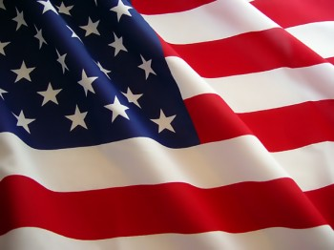
New Federalism
Nixon’s domestic policies became known as “New Federalism”
It called for eliminating several federal programs and giving more control to state and local governments
Nixon claimed that this would give the government agencies that were the closest to the people the opportunity to address problems
Although “revenue sharing” was suppose to give state and local governments more power, the federal government became more powerful

Slide 6
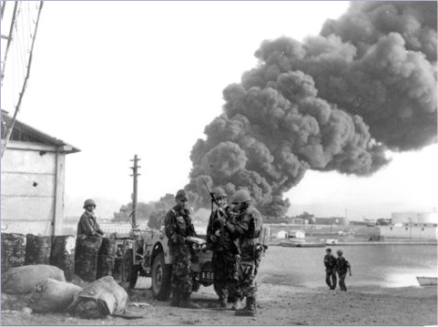
Crisis in the Middle East
Tensions in the Middle East escalated in 1956 when Egypt nationalized the Suez Canal
This led to a war over control of the canal between Egypt, Israel, the UK and France

Slide 7
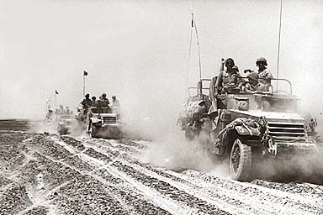
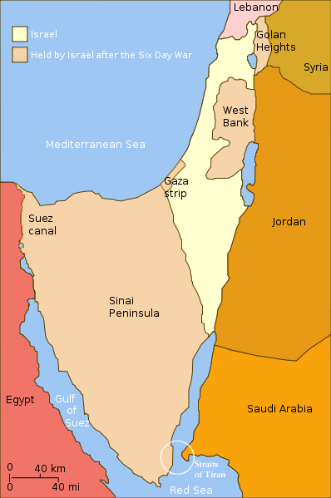
The Six-Day War
The Six-Day War was fought in 1967 between Israel, Egypt, Jordan and Syria over control of land in the Middle East
The conflict led to Israel taking control over the Sinai Peninsula, the Golan Heights, the West Bank and the Gaza Strip

Slide 8
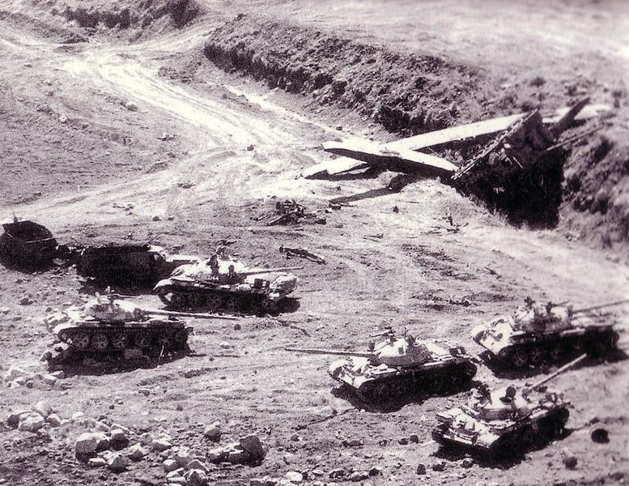
Yom Kippur War
In 1973, Egypt and Syria retaliated against Israel in a conflict known as the Yom Kippur War
The Arabs were initially successful but eventually the Israelis drove them back

Slide 9
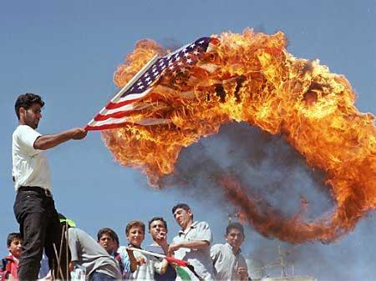
U.S.-Israeli alliance
The conflicts in the Middle East strengthened the ties between the U.S. and Israel
These ties have led to tensions between the U.S. and some Arab nations

Slide 10
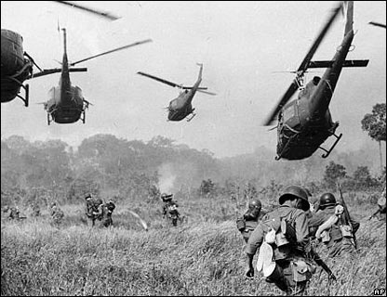
Nixon and Vietnam
The biggest foreign policy issues Nixon had to deal with during his presidency was dealing with the Vietnam War

Slide 11
Nixon and Foreign Affairs
Secretary of State, Henry Kissinger

Slide 12
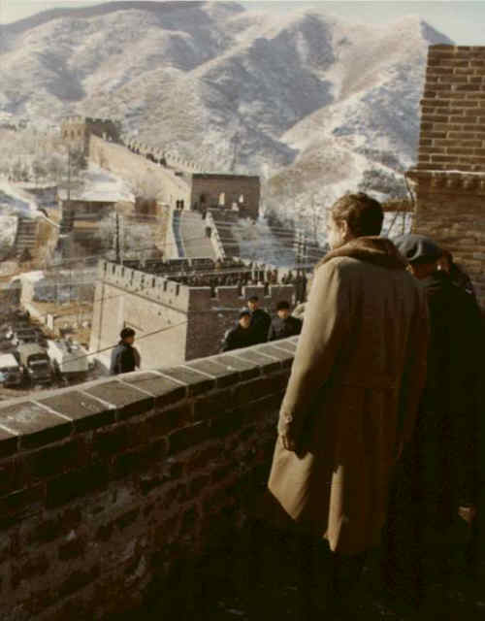
Détente with Russia, China
One of Nixon’s foreign affairs goals was friendlier relations with China and the Soviet Union
Nixon and Kissinger developed a foreign affairs policy known as détente, which means cooperation
President Nixon tours the Great Wall of China

Slide 13
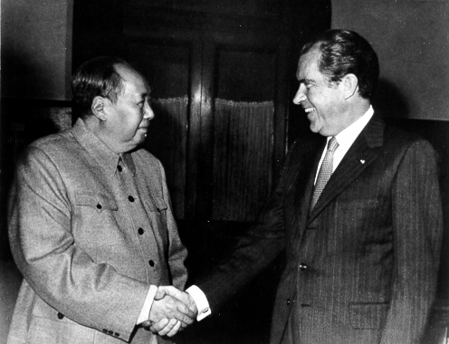
Mao Tse-tung greets Nixon
Nixon opened U.S. relations with China and became the first U.S. president to visit China

Slide 14
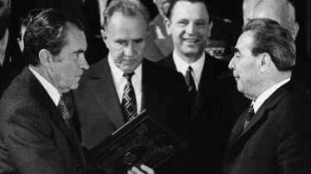
Strategic Arms Limitations Talks
Nixon also strengthened relations with the Soviet Union, including holding a historic meeting -- SALT
Summit meeting between U.S. and Soviet Union when the two countries agreed to limit nuclear arms

Slide 15
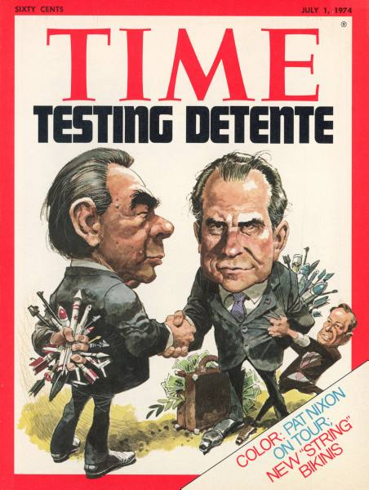
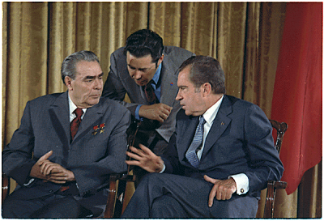
Détente with Russia
From 1972 to 1974, tensions between the U.S. and the Soviet Union eased

Slide 16
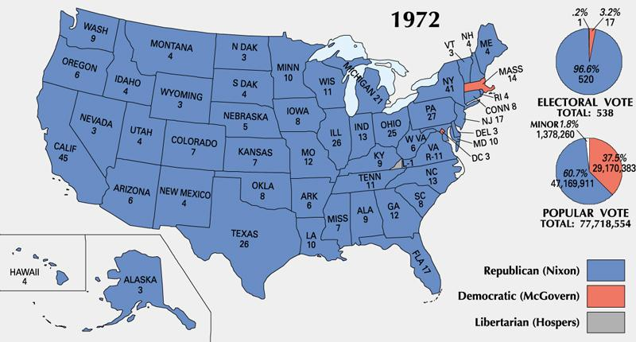
Election of 1972
Nixon re-elected in a rout

Slide 17
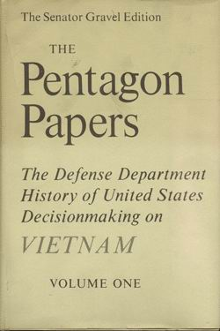
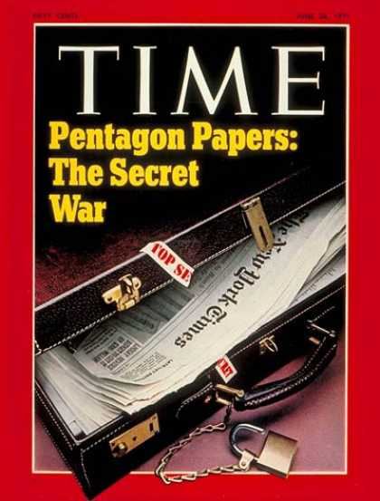
The Pentagon Papers
In 1971, a former Defense Department worker leaked what were known as the Pentagon Papers to the New York Times
The documents showed how our leaders had deceived Congress, the media, and the public about how the war was going
The government had not been honest with the American people

Slide 18
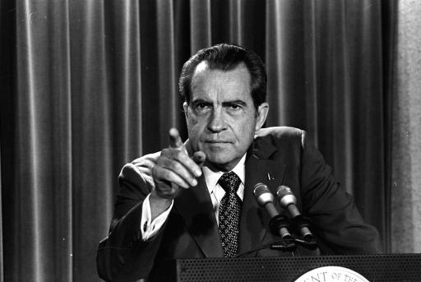
The release of the Pentagon Papers to the New York Times angered Nixon
He thought others were out to sabotage his presidency and undermine him, leading to…

Slide 19
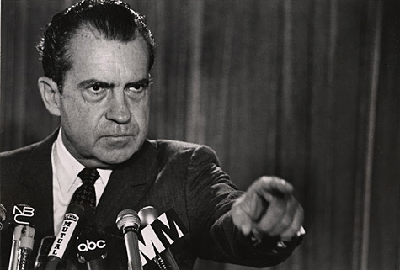
Watergate

Slide 20
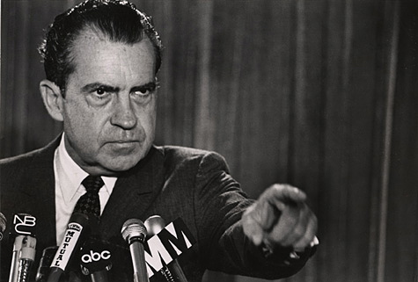
What was Watergate?
Watergate was one of the largest political scandals in the history of the United States

Slide 21
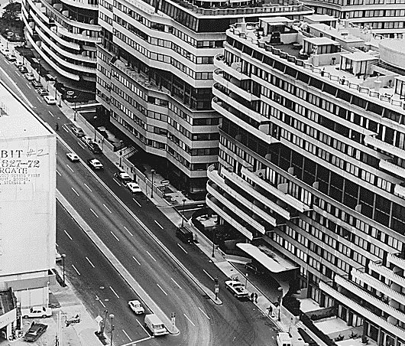
What was Watergate?
The Watergate scandal occurred when the Republicans were caught spying on the Democrats at the Democratic Headquarters

Slide 22
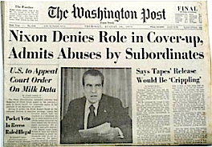
What was Watergate?
Watergate became a major scandal when President Nixon lied about his role in the break-in and tried to cover it up

Slide 23
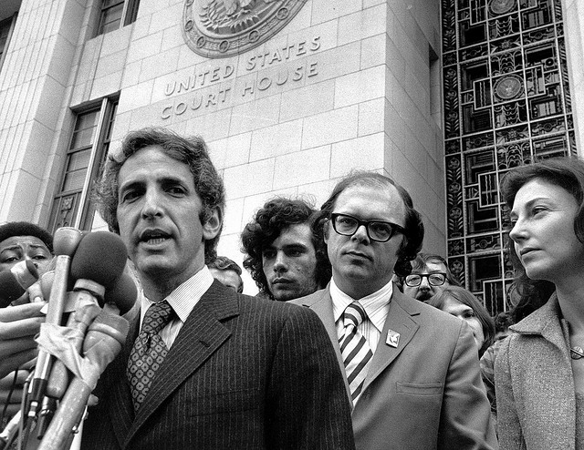
Roots of Watergate
When the New York Times and Washington Post began to publish the Pentagon Papers, the Nixon Administration sued them.

Slide 24
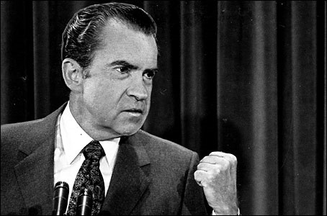
Roots of Watergate
It was Richard Nixon’s paranoia that his enemies wanted to ruin his presidency that was at the root of the Watergate scandal

Slide 25
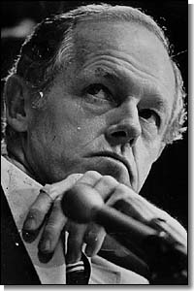
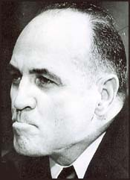
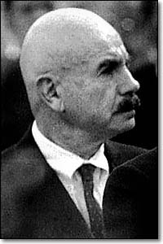
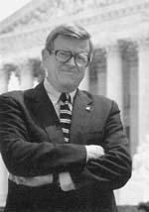
The White House Plumbers
After the release of the Pentagon Papers, the White House created a unit to ensure internal security.
Howard Hunt
James McCord
G. Gordon Liddy
Chuck Colson
This unit was called the “Plumbers” because they were put in charge of stopping information “leaks”.

Slide 26
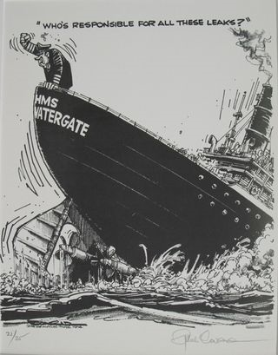

Slide 27
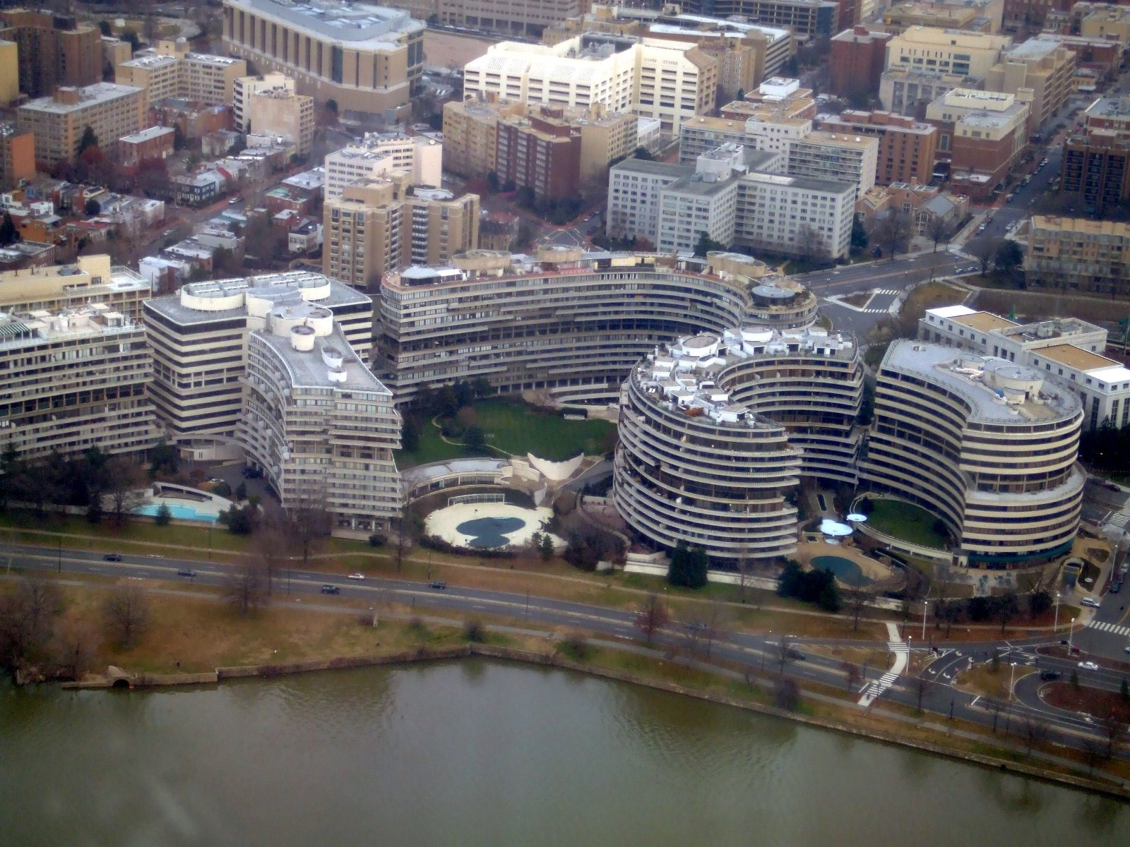
The Watergate Break-in
When initial polls showed Nixon only slightly ahead in the Election of 1972, the Plumbers turned their activities to political espionage.

Slide 28
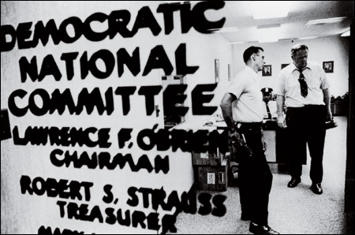
The Watergate Break-in
On June 17, 1972, 5 men were arrested attempting to bug Democratic headquarters inside the Watergate building in Washington D.C.

Slide 29
The Washington Post
Watergate came to public attention largely through the work of Bob Woodward and Carl Bernstein, investigative reporters from the Washington Post

Slide 30
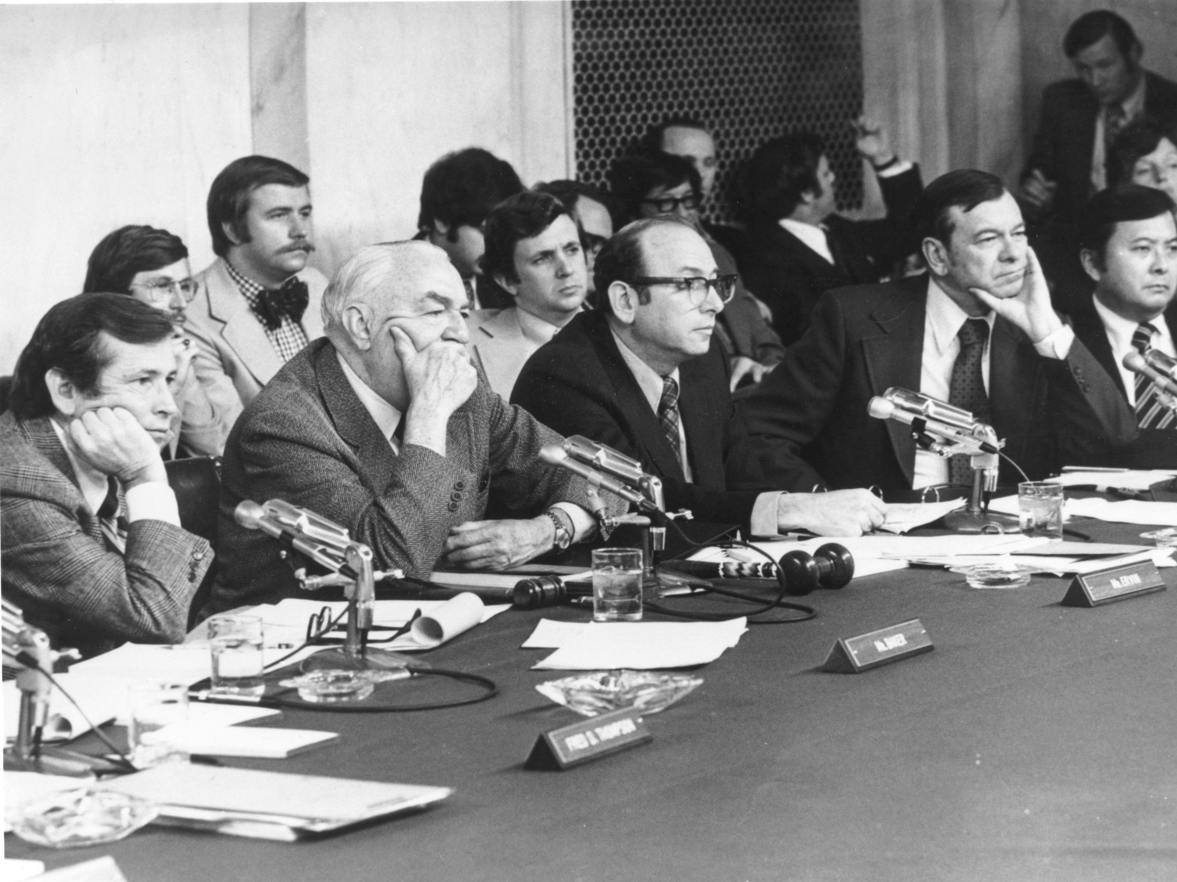
Congressional Hearings
Congress began hearings to investigate the scandal and found that Nixon’s Attorney General, John Mitchell, controlled a fund to pay for espionage operations

Slide 31
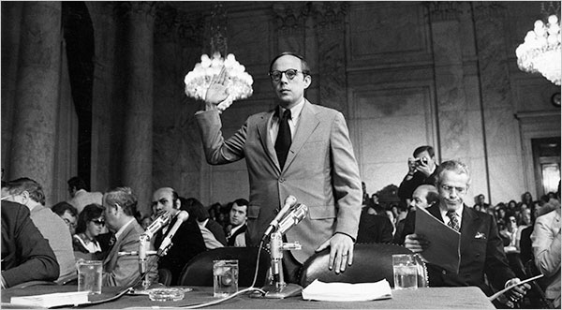
Congressional Hearings
In June 1973, former White House legal counsel John Dean delivered testimony that implicated Nixon from the earliest days of Watergate

Slide 32
The Oval Office Tapes
In an effort to discredit Dean’s testimony, the White House announced that Nixon had secretly been tape-recording conversations. These tapes would become the focus of the investigation.

Slide 33
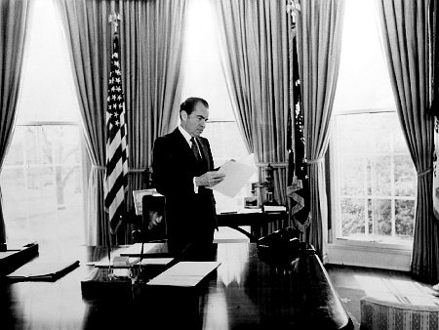
The Smoking Gun Tapes
When the Supreme Court forced Nixon to surrender the tapes, he refused invoking “executive privilege”

Slide 34
The Saturday Night Massacre
The Administration reached an agreement with the Senate Watergate Committee that its Chairman would be allowed to listen to tapes and provide a transcript to the Committee and to Special Prosecutor Archibald Cox.
The deal broke down when Cox refused to accept the transcripts in place of the tapes.
Since the Special Prosecutor is an employee of the Justice Department, Nixon ordered Attorney General Elliot Richardson to fire Cox.
Archibald Cox

Slide 35
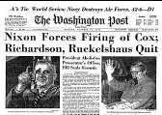
The Saturday Night Massacre
When Richardson refused, he was fired.
Nixon ordered Deputy Attorney General William D. Ruckelshaus to fire Cox.
When he refused, he was fired.
Nixon then ordered Solicitor General Robert Bork (who was later nominated for the Supreme Court by Reagan) to fire Cox and he complied.
The Washington Post reported on the “Saturday Night Massacre.”
Robert Bork

Slide 36
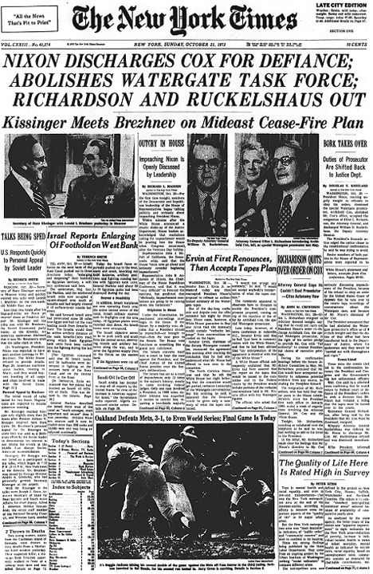

Slide 37
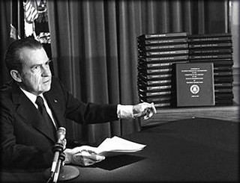
The Oval Office Tapes
On October 23, 1973 Nixon agreed to turn over White House tape recordings requested by the Watergate special prosecutor to the Judge.

Slide 38
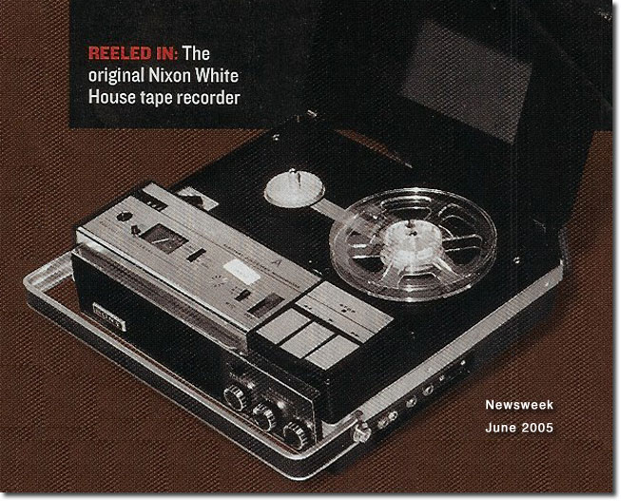
The Smoking Gun Tapes
Many of the conversations on the tapes indicate Nixon’s knowledge of the Watergate break in and the following cover-up. One tape had an 18½ -minute gap that people questioned.

Slide 39
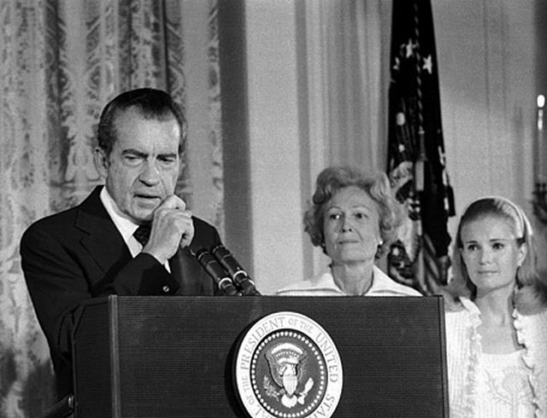
Nixon’s Final Days
On July 27, 1974, the House Judiciary Committee approved Articles of Impeachment against Nixon. The House was set to vote on the matter.

Slide 40
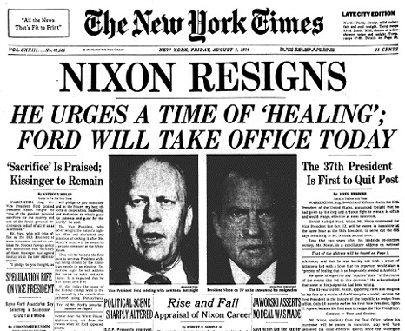
On August 5, 1974, when the “smoking gun tape” became public, Nixon was told that he would not survive the vote in the Senate

Slide 41
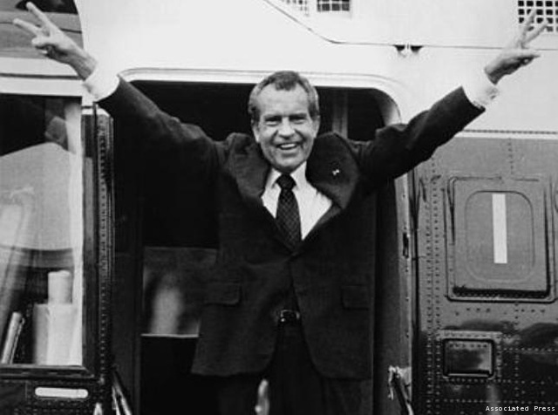
Nixon Resigns
On August 9, 1974, Richard Nixon became the first American president to resign

Slide 42
Aftermath of Watergate
Gerald Ford became the nation’s 37th president.
More than 30 government officials went to prison for their role in Watergate. Nixon was not one of them.
In September 1974, Ford gave Nixon a full pardon.
There was a public distrust of the government that continues to this day.

