Slide 1
U.S. Imperialism
1900-1914

Slide 2
Reasons for Imperialism
Colony: When a country settles another area of the world in order to
1. Exploit natural resources
2. Bring religion
3. have strategic military bases
By 1900 much of the world had been carved up by Western Europe
There were economic, social, and military reasons for imperialism

Slide 3
Social Reasons
One social reason was many felt in Europe and America that it was the “White man’s burden” to “Civilize” the world
Europe believed that colonizing Africa and Asia would allow them to teach the natives how to be “civilized”
Another social reason in America was that by 1900 the frontier is considered closed and Imperialism was seen as the new frontierso Imperialism is seen as a way to expand the frontier

Slide 4
Economic Reasons
Mercantilism is the belief that in order for a country to gain wealth they must
Gain raw materials by colonizing Asia and Africa
Industrialize
Export raw materials to countries that do not have them
Have a high tariff to force your people to buy what your country makes
Sell finished good to your colonies and prevent them from buying from other countries

Slide 5
Military Reasons
Strategic areas around the world were taken in order to
protect trade
provide coal refueling areas for warships
T. Roosevelt felt that the U.S. should strengthen the navy by building modern warships
He oversaw the construction of the Great White Fleet
Roosevelt ordered the fleet to sail around the world to demonstrate America’s global reach

Slide 6
European Imperialism

Slide 7
Scramble for Africa
Britain, France, Belgium, Italy, and Portugal will colonize Africa for its natural resources
This was made possible because of the development of the machine gun and quinine
Germany will eventually begin to colonize Africa as well in order to demonstrate their strength
Britain and France will oppose German expansion and this will lead to tension

Slide 9
Dividing of China
Russia, Germany, Japan, Britain, and France will seize ports in China and demand that their citizens have special privileges in these trading ports.
The Chinese emperor became a puppet in the hands of these foreign powers which led to hatred of foreigners among the Chinese
Eventually the Chinese will rebel against the powers, this is known as the Boxer Rebellion
The Boxers will massacre 300 foreigners, this will lead to an allied army made up of all foreign groups (including Americans) to attack and kill the rebels

Slide 10
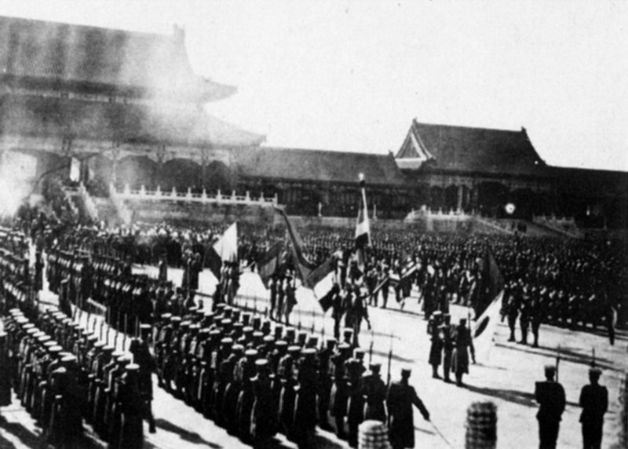
Boxers

Slide 11
Open Door Policy
America wanted to protect new territories in the Philippines and its citizens in China
America also wanted to trade with China and not be pushed out by European powers
The Open Door Policy was the American plan it stated
Was created by a note sent from Secretary of State John Hay, known as the Open Door Note
China may trade with the U.S. and other nations and not be carved up like Africa
China was still exploited by European nations and the U.S. for resources and markets

Slide 12
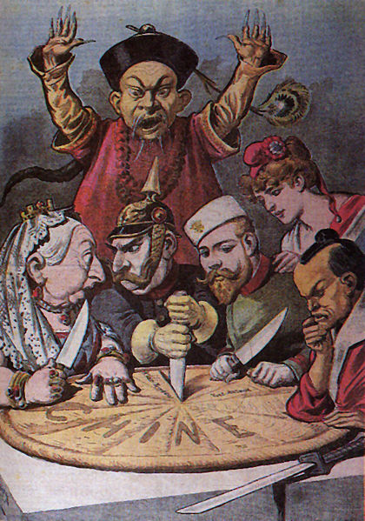
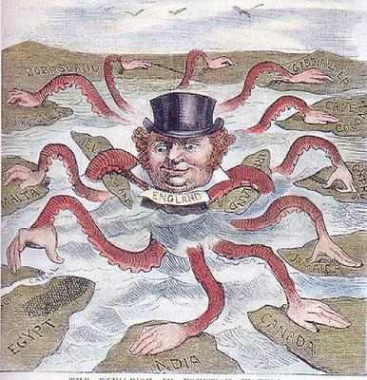
Imperialism
Notes:
Europeans set the example…

Slide 14
American Imperialism

Slide 15
Early U.S. Imperialism
In 1867 secretary of state William Seward purchased Alaska from the Russians in what was known as “Seward’s Folly” because everyone thought it was worthless
Seward laughed last however when there was gold discovered and later oil.

Slide 17
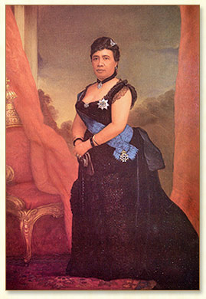
Hawaii
In 1898, before the Spanish American War, Hawaii was ruled by Queen Liliuokalani
Hawaii was a key place for American Ships to stop for provisions on the way to Asia
However because of a U.S. sugar tariff the American Planters deposed her and asked America to annex Hawaii
Cleveland was reluctant, but McKinley will annex the island
America will use Pearl Harbor, the best natural harbor in the pacific to base its Pacific Fleet

Slide 18
The Spanish American War

Slide 19
Causes of the Spanish-American War
Cubans will rebel against poor Spanish rule
Spain sent 150,000 troops
Moved Cubans to concentration camps
Yellow Journalists such as Joseph Pulitzer, and William Randolph Hearst exaggerated the stories of Spanish atrocities
Many wanted the U.S. to take a tougher stance against Spain
The U.S. sent the Battleship Maine to observe events in Cuba
When the Maine exploded in Havana Harbor in Cuba the U.S. blamed Spain, even though it was an accident, soon after war is declared

Slide 20
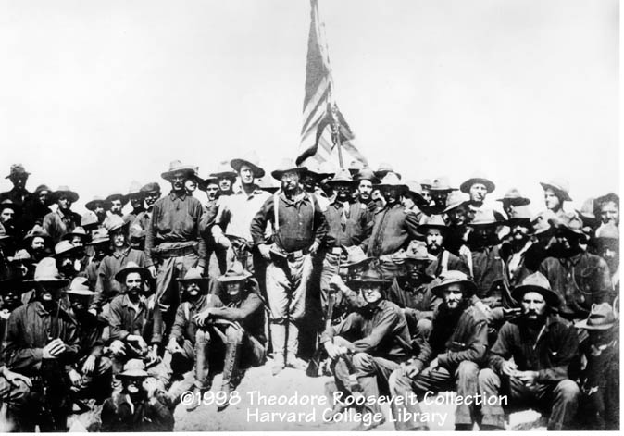
American troops were sent to Cuba and easily defeated the unprepared Spanish
The most famous battle will be the Battle of San Juan Hill in which Teddy Roosevelt and his Rough Riders will storm the hill giving him fame and war experience
- This will be the first post Civil War conflict for America and many will see it as an example of America moving past the Civil War and unifying again

Slide 21
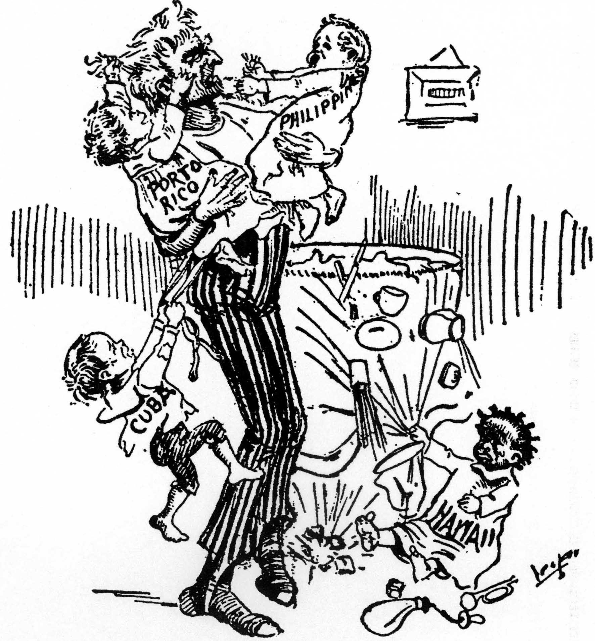
Spheres of Influence

Slide 22
Philippines
Commodore Dewey was sent to the Philippines even before the war started and quickly destroyed the Spanish navy in Manila Bay
With this destruction Spain lost its final colonies in the Pacific and the Caribbean ending 400 years of colonialism
The U.S. will seize the Philippines making it a U.S. territory
The Filipinos will rebel after their promised self-rule never happened

Slide 23
The End of the War
The U.S. forced Spain to sign the treaty of Paris 1898 which gave Cuba its independence and the Philippines, Guam, and Puerto Rico to the U.S.
Some wanted to annex Cuba, but the Teller Amendment was added to McKinley’s war message which said the U.S. could not annex Cuba
There were many who felt it was unsafe for Cuba to be on its own so the U.S. would maintain a naval base in Guantanamo Bay Cuba

Slide 24
America’s Foreign Policy After the Spanish American War

Slide 25
Big Stick Diplomacy
Roosevelt believed in big stick diplomacy (speak softly and carry a big stick)
This was the idea that all of America’s actions should come with a threat of force
Examples include the Venezuela incident in 1902 where Britain and Germany blockaded Venezuela over debts owed
America added the Roosevelt Corollary to the Monroe Doctrine which stated
“The United States will intervene in conflicts between European countries and Latin American countries to enforce legitimate claims of the European powers, rather than having the Europeans press their claims directly.”
In the end the European nations backed down

Slide 26
Panama Canal
To get the land for the Panama canal we will ask Columbia, they will say no.
So we will encourage a revolution in Panama, after they form a new government we get the land in payment.
In 1904 we will begin the project and it will be complete in 1914.
This will greatly strengthen the U.S. position in the world because we will be in control of the canal

Slide 28
Russo-Japanese War
In 1908 Japan will attack Russia in order to gain land and better access to Manchuria (northern China)
No eastern nation had ever defeated a western nation
Roosevelt feared that would upset the balance of power in Asia
Roosevelt arbitrates the dispute, Japan is given land and Roosevelt gets a Nobel Peace Prize

Slide 29
Dollar Diplomacy
This is the idea that American will use its economic power to give money and guarantee loans in Latin America and Asia in order to get friendly governments
This sometimes involved using American military to overthrow unfriendly governments first like in Nicaragua

Slide 30
Moral Diplomacy
This was the idea promoted by Wilson that the U.S. would only support nations whose moral beliefs were similar to America’s
Generally it was used to support nations with democracies and oppose un-democratic nations
This was supported by the idea of American Exceptionalism
This will help lead to a minor conflict with Mexico during the Mexican Revolution
This conflict will lead to Poncho Villa attacking New Mexican towns and the American army under general Jack Pershing entering Mexico to hunt down Villa

