Slide 1
Roaring 20’s
1921-1929

Slide 2
Harding and Coolidge
1921-1929

Slide 3
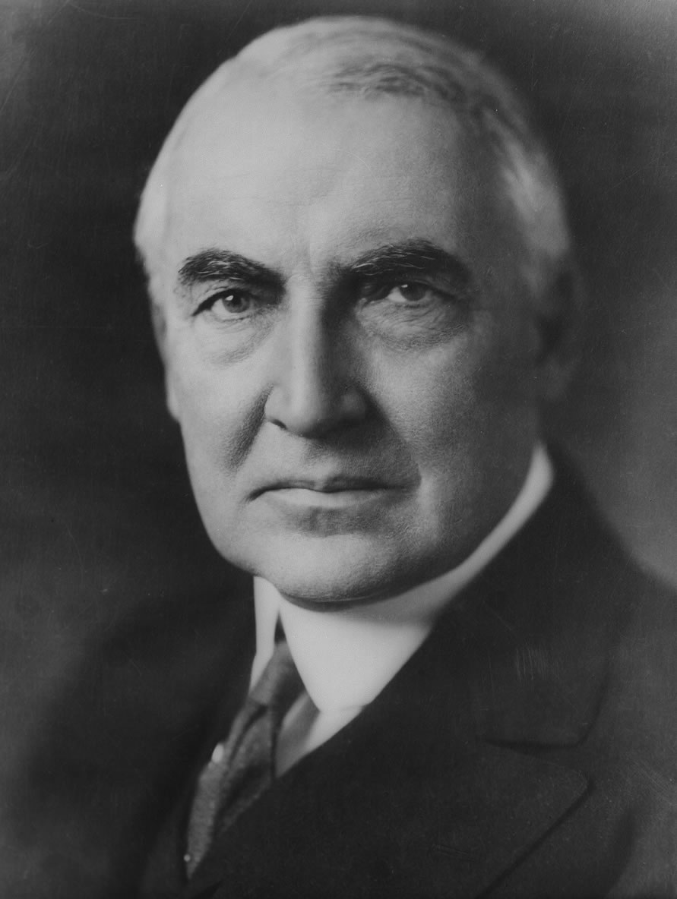
Election of 1920
Warren Harding, Ohio senator, Republican
Ran under the slogan “A return to normalcy”
won a large victory

Slide 4
Harding’s Presidency
Returned RR to their owners
Gave “bonus” to each veteran (20 year endowment policy)
Washington Conference
Limited size of navy (Japan, France, & Italy)
US & Britain maintain largest navies
Scandals
Teapot Dome Scandal
Veteran’s Bureau Graft
Liquor permits and pardons

Slide 5
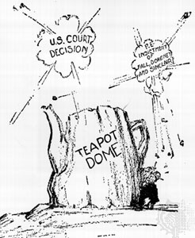
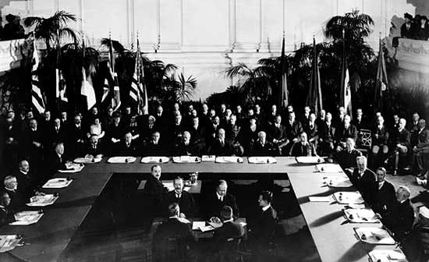

Slide 6
Coolidge’s Presidency
Laissez-faire economy, favored big businesses
Did nothing to relieve farmers
International Debts
Kellogg-Briand Pact
62 nations signed
In favor of peaceful settlement of disputes, instead of war

Slide 7
International Debt
Germany paid war
Reparations to
Britain and France
Britain and
France Repaid
war debt to
The U.S.
United States loaned
Germany money
Dawes Plan

Slide 8
Economic and Social Developments
1921-1933

Slide 9
Prosperity & New Industry
Standard of living improved
More leisure time (cars, radio, movies)
Installment buying
Automobile
Most families owned a car
Related industries needed
Highway construction increased
Gasoline needed

Slide 10
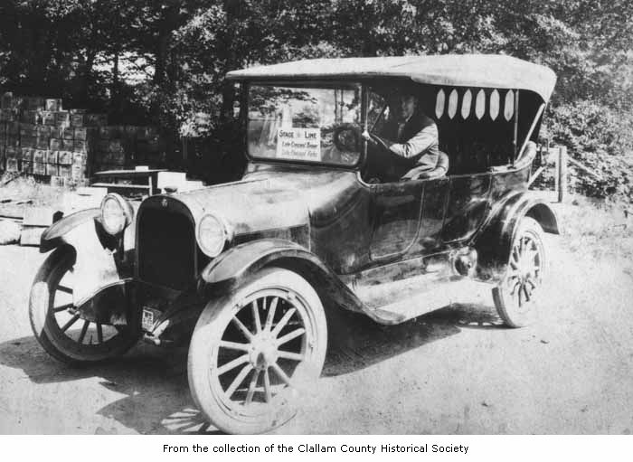
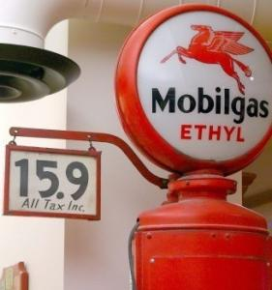

Slide 11
Farm Problems
Needed fewer crops after the war
New technology increased production
Overproduction, keeps prices low
Unable to pay for land purchased during the war
Notes:
Diets had changed, ate less meat & wheat
Needed fewer exports to overseas territories

Slide 12
Social Developments
Prohibition
Alcohol causes: crime, it is unhealthy, and a waste of resources
Problems during: speakeasies, organized crimes (gangsters), illegal liquor traffic, disrespect for the law
Repealed 1933
Red Scare
Bomb exploded at the home of Attorney General Palmer after he conducted raids to find socialists (The Palmer Raids)
Bomb on Wall Street killed 38

Slide 13
Sacco and Venzetti Trial
2 Italian Socialist Immigrants who were accused of murder
Very little evidence against them, and all of it was circumstantial
The 2 were still convicted and executed most likely because they were immigrants and socialist during the Red Scare

Slide 14
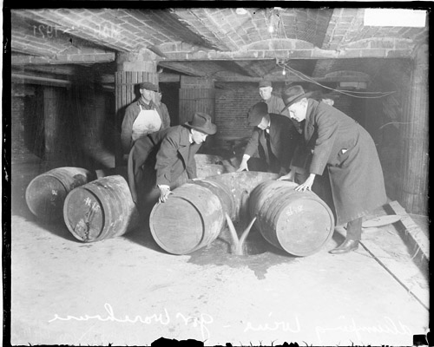
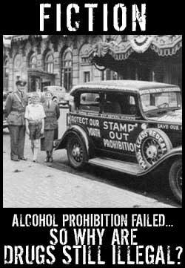

Slide 15
Immigration Act of 1924
Created annual quota
Limited to 150,000 per year
Life in the 20s
“Jazz Age”
Flappers, short dresses, bobbed hair, wore makeup, smoked
High school & college education increased
Scopes Trial
John Scopes taught evolution in his classroom
TN did not allow evolution to be taught, taken to trial
Scopes found guilty, but fundamentalists lost support

Slide 16
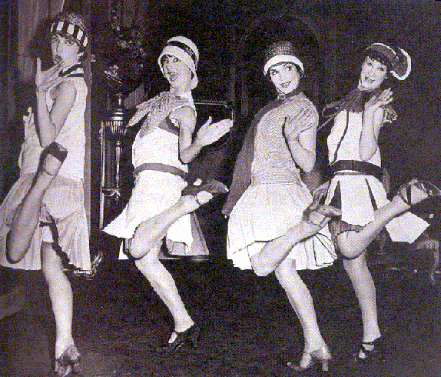
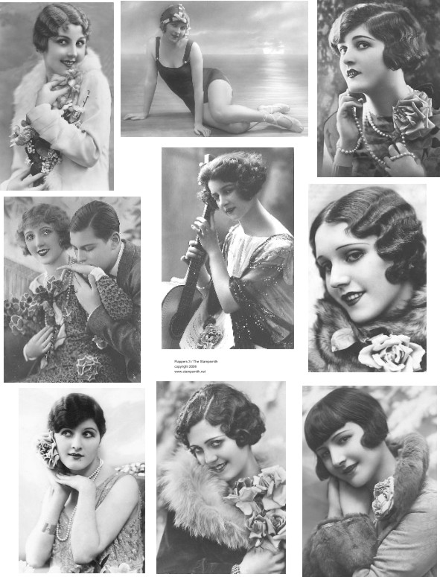

Slide 17
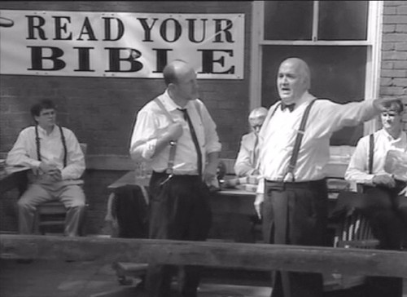
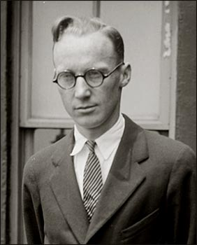

Slide 18
Writers of the 20’s
The generation after the war was known as “The Lost Generation” referring to the innocence lost during the war.
The writing demonstrated the depressed feeling.
F Scott Fitzgerald was a famous writer whose most famous work was “The Great Gatsby” his writings spoke to life being meaningless
Earnest Hemingway spoke of depression and how little in life mattered. He had a HUGE impact on modern writing for his simplified writing

Slide 21
Charles “Lucky” Lindbergh
Lindbergh will become a worldwide hero for being the first man to fly across the Atlantic solo in his plane “The Spirit of St. Louis”
He will become rich from the 25,000 prize money and will become a very influential person in the U.S.

Slide 23
African Americans in the 20’s
Langston Hughes will be a major African American poet and one the greatest poets in American History
Hughes will speak about The Great Migration during the 20’s and 30’s six million African Americans will move north to the cities for better working conditions and to avoid segregation
Many will move into Harlem New York and the culture that will come out will be known as the Harlem Renaissance

Slide 25
Hoover and the Great Depression
1928-1933

Slide 26
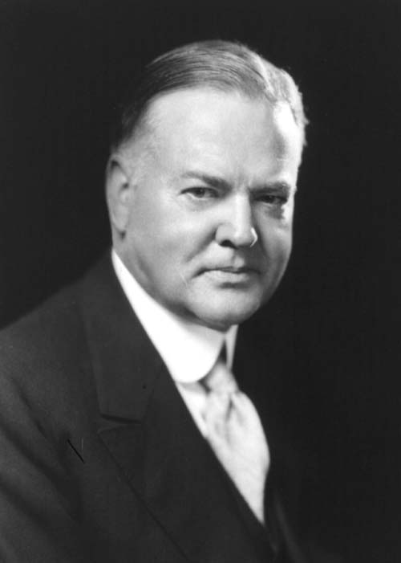
Election of 1928
Herbert Hoover, engineer, Republican
Republicans won an overwhelming victory

Slide 27
Hoover’s Presidency
Federal Farm Board
Discouraged production
Purchased surpluses
Hawley Smoot Tariff
Raised consumer prices
Protected inefficient businesses
Limited foreign markets buying U.S. exports

Slide 28
Panic and Depression
Causes:
Overexpansion of agriculture
Overexpansion of industry
Machines
Too much money in the hands of a few
Over speculation and buying stocks on credit
Tariff barriers
Hoover’s steps to fight depression
Laissez-faire
Thought it would be short lived, wanted the market to correct itself

Slide 30
The Banks
Over 5000 banks closed in the first three years of the depression
This is the major cause for the continuation of the depression
When banks close there was no insurance so people lost everything, so did businesses, this started the downward spiral
Banks called in loans, calling thousands of people to lose their homes and farms to foreclosure

Slide 31
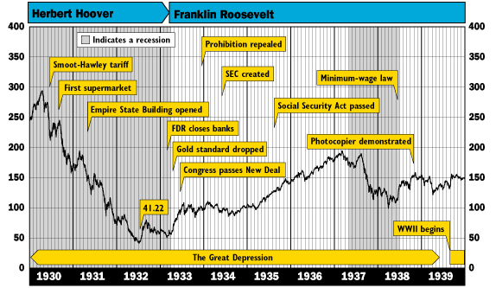

Slide 32
Bonus Army
The government promised to pay WWI vets a bonus in 1945
About 20,000 people (the Bonus Expeditionary Force) will go to congress to demand their entire bonus
They camped in Washington and waited for a bill, when it failed they refused to leave and rioted
Hoover ordered the army to evict them, and their camps were burned and the people pushed out through bayonet and tear gas
This will only further hurt Hoover in the ‘32 election

Slide 33
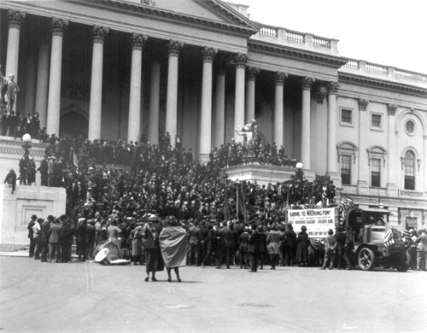
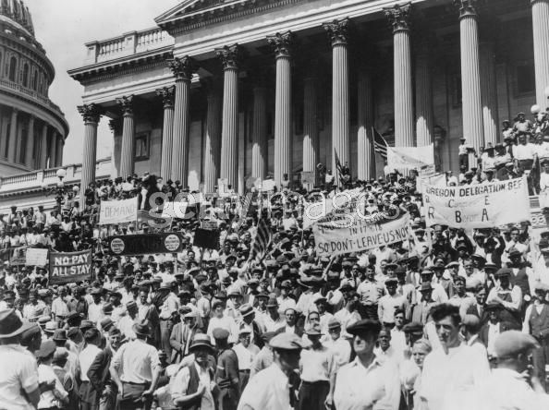
Bonus Army March

Slide 36
Hooverville

Slide 38
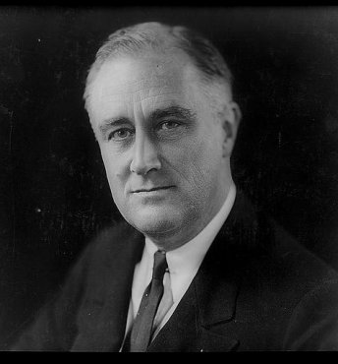
Election of 1932
FDR, governor of NY, Democrats
Hoover, Republicans
FDR won the election
Lowest point in the depression

Slide 39
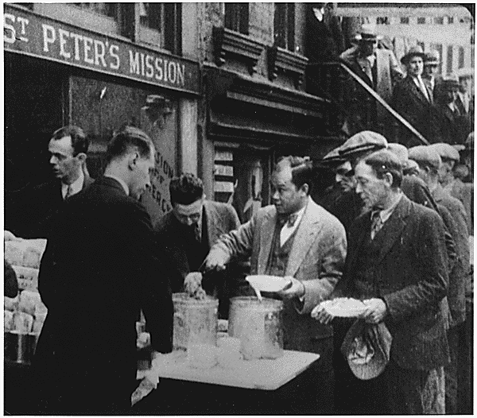
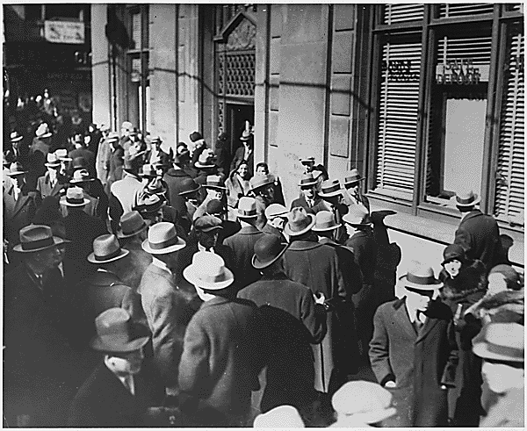
Soup Kitchens & Homeless Shelters

Slide 40
The New Deal
1933-1939

Slide 41
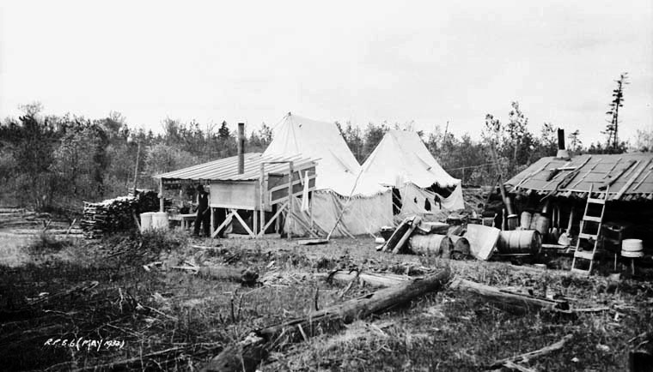
Philosophy of the New Deal
Relief, recovery, & reform
Put money in the hands of the “forgotten man”

Slide 42
100 Days
Emergency Banking Act
Bank Holiday
One week where banks were closed and weak banks consolidated into stronger banks
CCC- Civilian Conservation Corps: A job program that would give people government jobs to help build national parks and other infrastructure that would help the natural environment
WPA- Work Projects Administration: Largest New Deal Program in which people could work on infrastructure projects like libraries and post offices

Slide 43
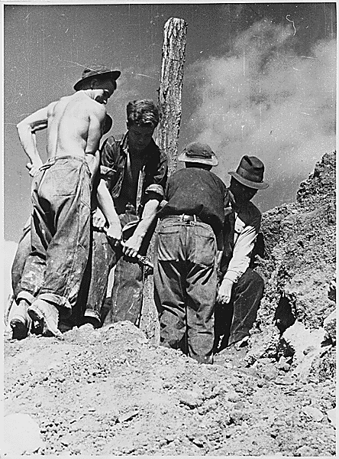
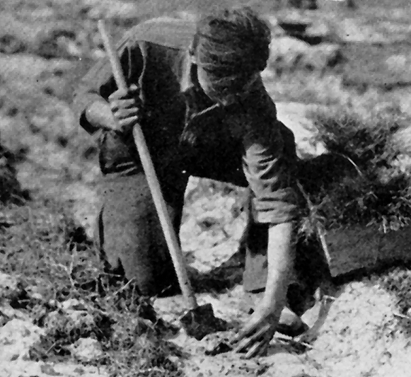

Slide 44
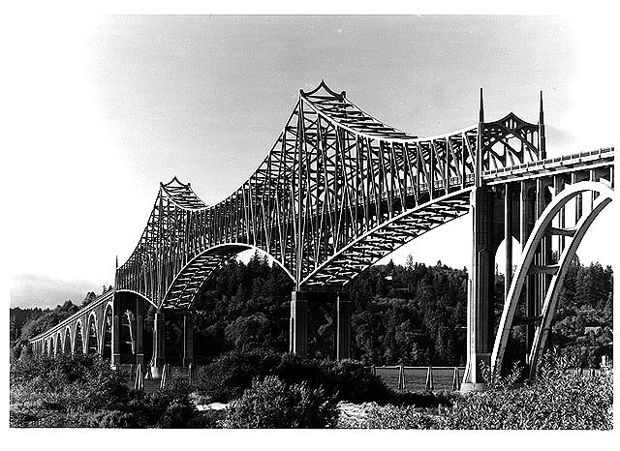
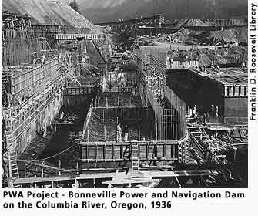

Slide 45
WPA Workers

Slide 46
Hoover Dam, A WPA Project

Slide 47
Agriculture Reform
Agricultural Adjustment Administration: Paid farmers to leave their fields fallow (not plant)

Slide 48
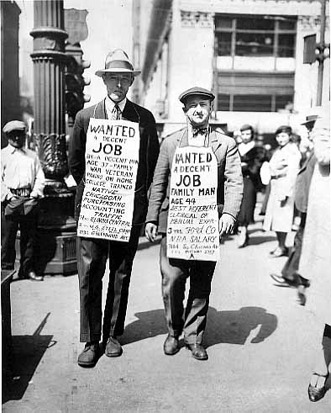
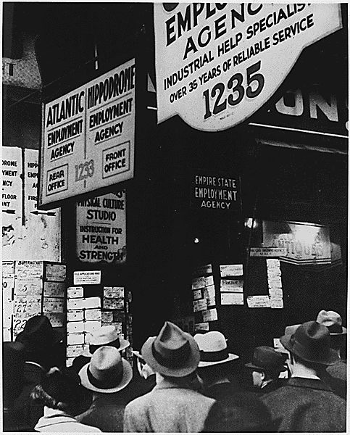

Slide 49
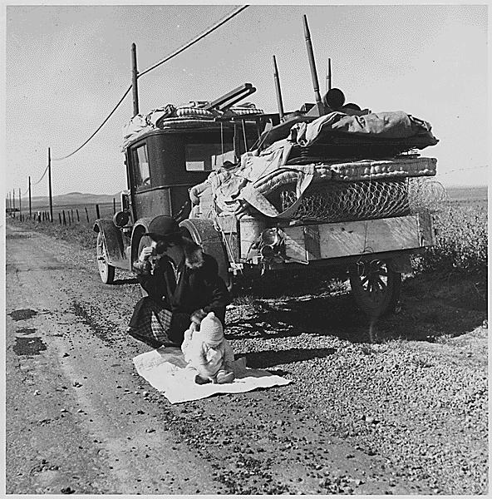
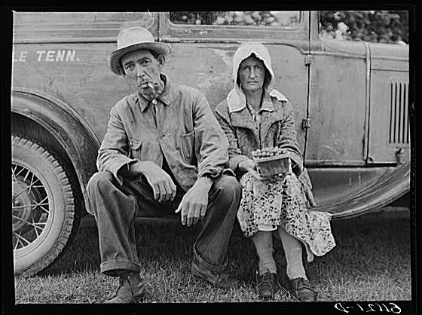
Dust Bowl
The Dust Bowl will be the greatest natural disaster in American History
Brought on by over-farming of the west, it led to the topsoil eroding from large areas of the great plains
This led to massive dust storms that swept across the country
Many will flee the failed farms of the plains and head to California, since many of these people were from Oklahoma they were all called “Okies”

Slide 50
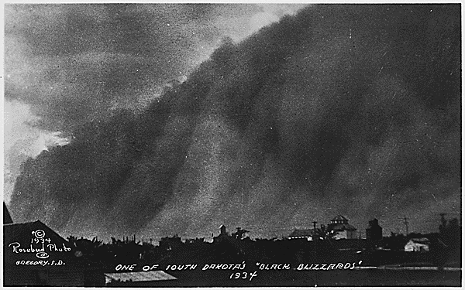
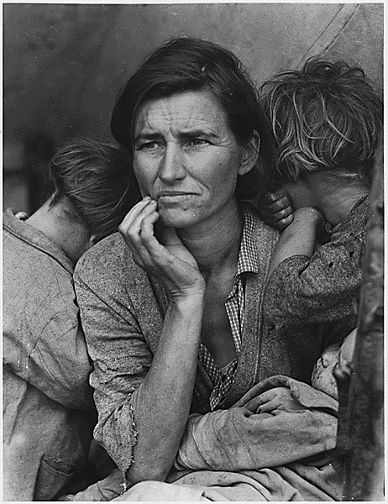
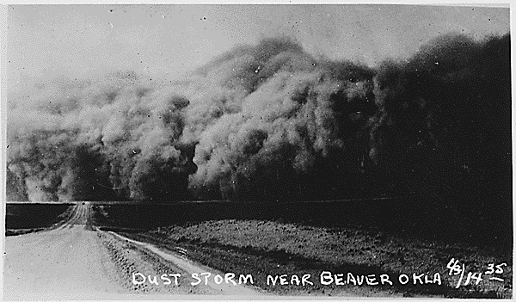

Slide 51
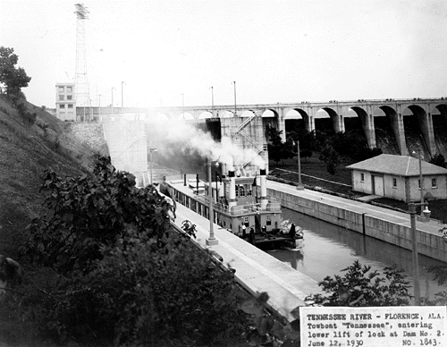
Labor
TVA: Tennessee Valley Authority
Build dams on the Tennessee River
Low-cost electricity
Prevent annual floods

Slide 53
Election of 1936
New Deal was increasing national debt
New Deal had violated the Constitution
Supreme Court: Roosevelt tried to add 6 justices, called “court packing” because the Supreme Court ruled some New Deal programs unconstitutional
FDR still wins

Slide 54
Reforms/ Second New Deal
FDIC: Insured bank deposits up to 5,000 dollars
Social Security: Provided funding for those age 65 and older

Slide 55
Long Term Effects of the New Deal
1. People’s relationship with government changed.
Before the New Deal, the government was not involved in peoples lives
After the New Deal, people looked to government to solve the problems of society
2. Government debt increased dramatically because of deficit spending
3. Although the depression was eased it really wasn’t solved until WWII
4. Many of the reforms are still around today such as the FDIC, SEC, Social Security, and TVA

