Slide 1
The Eighteenth Century: An Age of Enlightenment
1

Slide 2
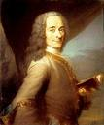
Overview
The Scientific Revolution’s “natural philosophers” effected but a small elite
But a group of intellectuals used the discoveries to examine all aspects of life
Voltaire
Voltaire
2

Slide 3
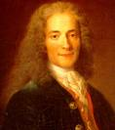
Overview
Paris was the cultural capital of Europe
Parisian women took a lead in bringing together thinkers of many disciplines to cross-talk discoveries and new philosophies
3

Slide 4
Overview
Marie-Therese de Geoffrin hosted distinguished foreigners, philosophers, and artists
These gatherings stimulated wide-ranging discussions and ideas
Ideas generated were so significant that historians refer to the 18th century as the Age of Enlightenment
4

Slide 5
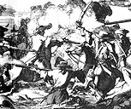
Overview
“Enlightenment” included a rejection of traditional Christianity
Religious wars and intolerance of 16th and 17th centuries alienated intellectuals
5

Slide 6
Overview
Intellectuals and scientists of the 17th century were open to new ideas of science. Both saw science as exalting God
The 18th century intellectuals saw it differently
Rejected Christian orthodoxy and secularism emerged as dominant mentality in Western mentality ever since
6

Slide 7
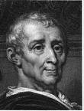
Overview
Reason and materialism were beginning to replace faith and reason
Although, there was an outburst of religious sensibility manifested in art and music
Not all artistic and intellectual hearts were captured by secularism
Montesquieu
7

Slide 8
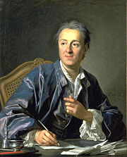
Focus Questions
Who were the leading figures of the Enlightenment, and what were their main contributions?
Diderot
8

Slide 9
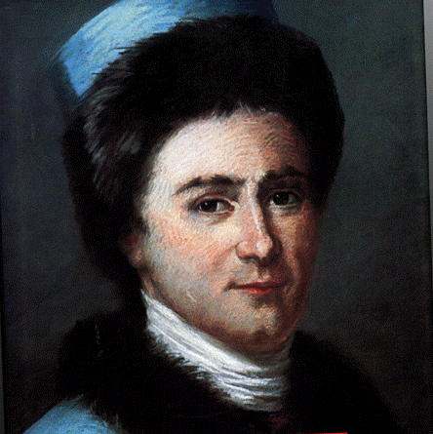
Focus Questions
In what type of social environment did the philosophers thrive, and what role did women play in that environment?
Rousseau
10/13/2017
9

Slide 10
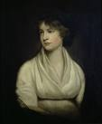
Focus Question
What innovations in art, music, and literature occurred in the 18th century?
Wollstonecraft
10/13/2017
10

Slide 11
Focus Question
How did popular culture differ form high culture in the 18th century?
10/13/2017
11

Slide 12
Focus Question
How did popular religion differ from institutional religion in the 18th century?
10/13/2017
12

Slide 13
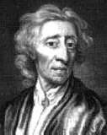
Critical Thinking Question
What is the relationship between the Scientific Revolution and the Enlightenment?
Locke
10/13/2017
13

Slide 14
The Enlightenment
Overview
10/13/2017
14

Slide 15
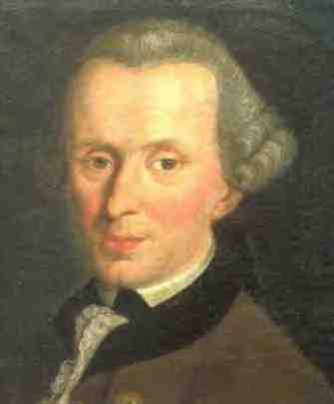
Overview
German philosopher Emmanuel Kant defined Enlightenment as “man’s leaving his self-caused immaturity”
Kant: “Dare to know! Have the courage to use your own intelligence.”
Emmanuel Kant
10/13/2017
15

Slide 16
Overview
As laws were discovered regulating nature, then laws could be found to regulate human society
Buzz words: reason, natural law, hope, progress
10/13/2017
16

Slide 17
Overview
Philosophers and scientists thought that if only people could throw off the shackles of old beliefs, particularly religious, the world be a better place
10/13/2017
17

Slide 18
Overview
If Newton can discover the natural laws of science that govern the universe, the laws of how to govern a society could be discovered as well
10/13/2017
18

Slide 19
The Paths to Enlightenment
Influenced by 17th century thinkers, what changes occurred with 18th century thinkers that culminated in the Enlightenment?
10/13/2017
19

Slide 20
The Popularization of Science
Spread of scientific information was not direct from scientist to people.
Books were tough to read—written by the best brains of the time—and tough to get
Much was done through education by “popularizers” or philosophers themselves
The link to the people is the scientific discoveries of the philosophers
10/13/2017
20

Slide 21
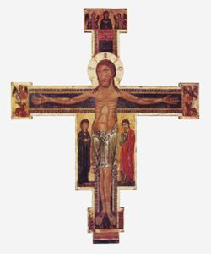
A New Skepticism
As scientific discoveries spread, more men and women questioned long-held religious truths and values
10/13/2017
21

Slide 22
A New Skepticism
Skepticism and secularism was evident in the works of Pierre Bayle (1647-1706)
Attacked religious intolerance, superstition, and dogmatism
Compelling people to believe a certain set of religious ideas was wrong—as Louis XIV was doing at that time
Pierre Bayle
10/13/2017
22

Slide 23
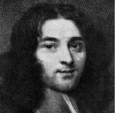
A New Skepticism (cont)
Bayle believed
that individual conscious should determine one’s action
the existence of many religions would benefit rather than harm a state
the Bible should not be exempt from criticism
Pierre Bayle
10/13/2017
23

Slide 24
A New Skepticism
In Bayle’s most famous work, Historical and Critical Dictionary, he wrote of King David in a very different way
David was portrayed as a sensual, cruel, treacherous, and evil man
The “Dictionary” attacked traditional religious practices and heroes
One critic of Dictionary called it the “Bible of the eighteenth century”
10/13/2017
24

Slide 25
The Impact of Travel Literature
Skepticism about religion and European culture was nourished by travel reports
Traders, missionaries, medical practitioner, and explorers—all wrote travel books
Geographical discoveries, e.g. Tahiti, New Zealand, and Australia by James Cook
Aroused much enthusiasm
10/13/2017
25

Slide 26
The Impact of Travel Literature
Exotic peoples, such as natives from Tahiti, presented an image of “natural man”
The idea of the “noble savage” would impact the work of some philosophers
10/13/2017
26

Slide 27
The Impact of Travel Literature
The literature also demonstrated there were highly developed cultures in other parts of the world
China and Confucian morality were singled out
Europeans began to evaluate their culture compared to others
Confucius
10/13/2017
27

Slide 28
The Legacy of Locke and Newton
The intellectual inspiration for the Enlightenment were Locke and Newton
Intellectuals believed that by following Newton’s laws of reasoning, they could discover the natural laws that governed politics, economics, justice, religion, and art
10/13/2017
28

Slide 29
The Legacy of Locke and Newton
Newton frequently singled out
“the greatest and rarest genius that ever rose for the ornament and instruction of the species”
“God said, ‘Let Newton be, and all is light’”
Philosophers enchanted by Newton’s world machine
10/13/2017
29

Slide 30
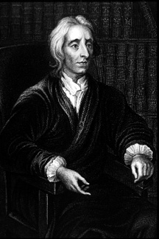
The Legacy of Locke and Newton
Lock denied Descartes’ belief in innate ideas. Locke argued that every person was born with a tabula rasa, a blank mind
10/13/2017
30

Slide 31
The Legacy of Locke and Newton
Our mind is developed from our environment, not from heredity; from reason, not from faith
People molded through experiences they received through their senses from their surrounding world
John Locke
10/13/2017
31

Slide 32
The Legacy of Locke and Newton
By changing the environment, peoples and societies can be changed
Reason enabled enlightened people to discover natural laws to which all institutions should conform
The philosophers were enamored with Locke and Newton. Taken together, their ideas seem to offer the hope of a “brave new world” built on reason
10/13/2017
32

Slide 33
The Philosophers and Their Ideas
Philosophs were intellectuals and not all philosophers
Literary people, professors, journalists, statesmen, economists, political scientists, and social reformers
Came from the nobility and middle class, some poor
International and cosmopolitan movement
Dominated by French culture and Paris considered the capital of the Enlightenment
10/13/2017
33

Slide 34
The Philosophers and Their Ideas
Philosophers had different circumstances, but the many common threads
The role of philosophy was to change the world, not just discuss it
Reason was scientific method, an appeal to facts and experiences
Rational criticism was to be applied to everything, including religion and politics
10/13/2017
34

Slide 35
The Philosophers and Their Ideas
Philosophers had to deal with censorship
State censors were ever present
Seizure of books and imprisonment of authors, publishers and sellers was very possible
10/13/2017
35

Slide 36
The Philosophers and Their Ideas (cont)
Although bound together by common bonds, philosophers often disagreed
Each succeeding generation became more radical
A few people tended to dominate the landscape
Three French giants stood out
Montesquieu, Voltaire, and Diderot
10/13/2017
36

Slide 37
Montesquieu and Political Thought
Charles de Secondat, the Baron de Montesquieu
From French nobility
Received a classical education then studied law
His first book, “Persian Letters”
Two Persians traveling in Paris and criticizing French institutions, especially Catholic Church and French monarchy
Much of French Enlightenment: attack on traditional religion, advocating religious toleration, denunciation of slavery, use of reason to liberate humans beings
10/13/2017
37

Slide 38
Montesquieu and Political Thought
“The Spirit of the Laws” distinguished three basic kinds of governments
Republics, suitable for small states and based on citizen involvement
Monarchy, appropriate for the middle-size states and grounded in the ruling class’s adherence to law
Despotism, apt for large empires and dependent on fear to inspire obedience
10/13/2017
38

Slide 39
Montesquieu and Political Thought (cont)
Praised England’s constitution which led to his most lasting contribution to political thought, the importance of checks and balances created through the “separation of Powers”
England had separate executive, legislative, and judicial powers
Limited control of each other
Served as greatest freedom and security for a state
He wanted the nobility of France to play and active role in the running of the French government
10/13/2017
39

Slide 40
Voltaire and the Enlightenment
Francois-Marie Arouet known as Voltaire
Greatest figure of the Enlightenment
Classical education in Jesuit school
Hailed as successor to Racine for his tragedy CEdipe and his epic on King IV
Well liked by Parisian intellectuals, a quarrel with a nobleman forced him abroad to England for 2 years
10/13/2017
40

Slide 41
Voltaire and the Enlightenment
Very impressed with England
His “Philosophic Letters on the English” (1733)
Expressed deep admiration for English
Liked freedom of press, political freedom, and religious toleration….”there are thirty religions and they live together peacefully and happily
Indirectly, he criticized France, especially absolute royalty, lack of religious toleration, and freedom of thought
10/13/2017
41

Slide 42
Voltaire and the Enlightenment
Voltaire returned to France but, at this point, had to live near the eastern border for security
Lived with his mistress the marquise de Chatelet
An early philosopher, she had published a translation of Newton’s “Principia”
The two collaborated about a book on the natural philosophy of Newton
10/13/2017
42

Slide 43
Voltaire and the Enlightenment
Eventually settled on magnificent estate in Ferney, in France near the Swiss border
Had become wealthy through writing, investments, and inheritance
Had the leisure time to write pamphlets, novels, plays, letters, and histories
He was especially well known for his criticism of traditional religion and strong support of religious toleration
10/13/2017
43

Slide 44
Voltaire and the Enlightenment
Accepted Deism
Accepted by most philosophers
Built on the Newtonian world machine theory
The mechanic—God—created the universe
God had no direct involvement in the world and let it run according to its own natural laws
God did not extend grace nor answer prayers
Jesus might be a “good fellow,” as Voltaire called Him but he was not divine as Christianity claimed
10/13/2017
44

Slide 45
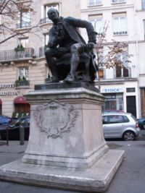
Diderot and the Encyclopedia
Condemned Christianity as fanatical and unreasonable—considered it the worst religion
“the most absurd and…atrocious in its dogma”
Diderot
10/13/2017
45

Slide 46
Diderot and the Encyclopedia (cont)
The purpose of the encyclopedia was to “change the general way of thinking”
Became a weapon against the old French society
Attacked religious superstition and promoted toleration
Sought social, legal, and political improvements
Sought more cosmopolitan, tolerant, humane, and reasonable society
Ideas of the Enlightenment spread even further
10/13/2017
46

Slide 47
The New “Science of Man”
Newton’s scientific methods were thought to be useful to address the natural laws of social man
Could the scientific process be used to solve the inherent problems and challenges of society?
Eighteenth century movement called the “science of man” or the “social sciences”
Philosophers arrived at natural laws they believed to be universal
10/13/2017
47

Slide 48
The New “Science of Man”
Scottish philosopher David Hume thought that a science of man was possible
“A Pioneering social scientist”
Wrote “Treatise on Human Nature”
Experimental method of reasoning with reference to moral subjects
Observation and reflection grounded in “systemized common sense” made conceivable a science of man
10/13/2017
48

Slide 49
The New “Science of Man”
The Physiocrats and Adam Smith
Founders of economics
Physiocrat leader was Francois Quesnay, French court physician
Claimed they could discover natural economic laws
Land constituted only source of wealth, their first principle
Agriculture was only means to increase wealth—all other activities were sterile and unproductive
Revenues should come from a single tax on the land
Rejected mercantilism, their second principle, and the idea of money—gold and silver
10/13/2017
49

Slide 50
The New “Science of Man”
The second principle of the physiocrats was the rejection of mercantilism
Emphasized the natural economic forces of the supply and demand
Individuals should pursue their own economic self interests—all society will benefit
Government should leave the system alone. Don’t regulate
Doctrine became known as laissez-faire (noninterference—let people do as they choose)
10/13/2017
50

Slide 51
The New “Science of Man”
Wrote The Wealth of Nations
Three basic principles of economics, including an attack on mercantilism
First principle--condemned the use of tariffs. Better to purchase a product from another nation rather than try to produce it if the other nation produces it cheaper
10/13/2017
51

Slide 52
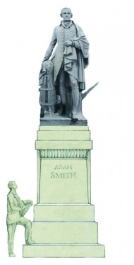
The New “Science of Man
Second principle, labor theory of value
Gold and silver do not constitute true wealth
Labor of individuals—farmers, artisans, merchants, etc., constitute the true wealth of nations
Adam Smith
10/13/2017
52

Slide 53
The New “Science of Man”
Third Principle, Government should not interfere with economic management
Adam Smith
10/13/2017
53

Slide 54
The New “Science of Man”
Adam Smith
Principle three (cont)—government only has three jobs
To protect society from invasion
To defend individuals from injustice and oppression
To keep up certain public works, such as roads and canals, that private individuals could not afford
10/13/2017
54

Slide 55
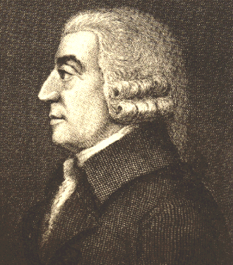
The New “Science of Man”
Between the Physiocrats and Adam Smith, they laid the foundation of 19th century economic liberalism
Government: stay out
Economic liberty
Adam Smith
10/13/2017
55

Slide 56
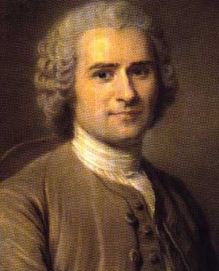
Rousseau and the Social Contract
Rousseau’s political beliefs in two major works, Discourse on the Origins of the Inequality of Mankind and The Social Contract
Jean-Jacques Rousseau
10/13/2017
56

Slide 57
Rousseau and the Social Contract
Discourse…
Humans were happy in their primitive state—no laws, judges, equality--but then they made changes
To preserve private property, people adopted laws and governments
“…rushed headlong not to liberty but into chains”
Government is an evil, but a necessary one
10/13/2017
57

Slide 58
Rousseau and the Social Contract
He wrote, The Social Contract
Tried to harmonize individual liberty with government authority
Society agrees to be governed by their general will
Individuals compelled to abide by the general will
People should be forced to be free
General will is community’s highest aspirations
What is good for all is good for each individual
10/13/2017
58

Slide 59
Rousseau and the Social Contract
“This means nothing less than that he will be forced to be free”
What was best for all was best for the individual
True freedom is adherence to laws that one has imposed on oneself
10/13/2017
59

Slide 60
Rousseau and the Social Contract
The creation of laws could never be delegated to a parliamentary institution—or legislature
“Any law which the people has not ratified in person is void; it is not law at all”
“…as soon as Members are elected, the people is enslaved; it is nothing.”
The ultimate statement of participatory democracy
10/13/2017
60

Slide 61
Rousseau and the Social Contract
He wrote, Emile
Important work on education
Education should foster children’s natural instincts
Saw a necessary balance between feelings and reason
Importance of promptings of the heart
Precursor of the intellectual movement called Romanticism—emphasis on the heart, that dominated Europe at the beginning of the nineteenth century
10/13/2017
61

Slide 62
Rousseau and the Social Contract
Rousseau was described in three ways:
The father of romanticism
A prophet of democracy
An apologist for totalitarianism
Which was he?
10/13/2017
62

