Slide 1
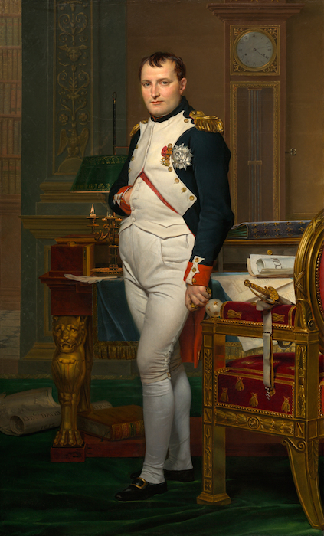
The Rise of Napoleon
Notes:
1

Slide 2
Young Napoleon
Was born in Corsica
Went to a military school
Was an excellent artilarist
Favored the revolution and became a Jacobin in order to end privilege and gain promotion
In 1793 took Toulon from the British gaining fame

Slide 3
The Coup
May 1799 Sieyes was elected a Director and started to plot against the government
“confidence from below, power from above”
In October Napoleon appeared on French soil
By December the Consulate ran the country and Napoleon was in charge

Slide 4
The Consulate

Slide 5
The Concordat of 1801
Pope recognized the sale of church land and the governments. right to appoint bishops
Pope gained an acknowledgment of Catholicism as the main religion of France - but not state religion
Church was allowed to hold services
State pays salaries
1802 Organic Acts stated the state was supreme over the Church
Napoleon wanted to separate the Church from the Monarchists
May have been the height of Napoleon’s career
Protestants and Jews had freedom of religion
Notes:
5

Slide 6
Napoleonic Code
Civil Code of 1804 reasserted two principles of the Revolution: a) equality for all male citizens b) absolute security for wealth and property
Very rationalistic: strengthened laws on property, religious toleration, equality before the law for all- except women, strengthened the rights of employers
1807 the Civil Codes became the Napoleonic Codes
Notes:
6

Slide 7
National Reforms
1800 Bank of France created
1801 government discusses Civil Codes
1802 educational reform
1802 issues amnesty to émigrés a) swear an oath of loyalty b) had no claim on lost property
Old Regime was dead and most were very happy
Consulate suggested Napoleon be made consul for life.
Notes:
7

Slide 8
The Napoleonic Wars

Slide 9
End Of the War of the First Coalition
In March 1795 France signed a treaty with Prussia
In June Spain dropped out of the coalition
Napoleon had sweeping success in Italy
In April 1796 defeated the Austrians
The British had problems: social unrest, rebellion in Ireland, cost of the war, naval mutinies and started talks with the French
The French demanded more concessions and the talks stopped
October 1797 the Hapsburgs signed the Treaty of Campo Formio, which left only Britain at war
November 1797 Napoleon returned to Paris a hero, and planned to invade Britain

Slide 10
Invasion of Egypt
He persuaded the Directory to let him invade Egypt to cut Britain off from India
August 1, 1798 Admiral Nelson annihilated the French fleet at Abukir
In Egypt he lost to the British but kept his reputation
Dec. 1798, Tsar Paul I signed with Britain to create the Second Coalition, later Austria and the Ottomans joined

Slide 11
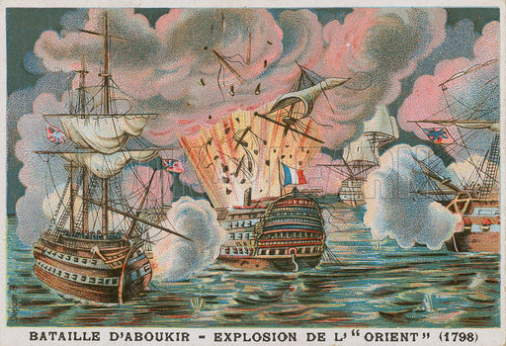

Slide 12
War of the 2nd Coalition
Napoleon offered King George III peace but Britain refused to negotiate
June 1800 at Marengo he crushed the Austrians
1801 Treaty of Luneville expanded French control over Italy and western Germany
1802 Peace Amiens with Britain restored peace to Europe
Napoleon could now focus on France
Created a new administrative system run by prefects
Notes:
12

Slide 13
Expanding Empire
Napoleon becomes involved with Switzerland
May 1803 Britain declares war on France
French troops prepare to invade Britain, sold Louisiana to gain money (15 cents an acre)
December 1804 Senate declare him “First Consul of the Republic” became Napoleon I
In 1804 Napoleon loses Haiti in another revolution “damn sugar, damn coffee, damn colonies”
Notes:
13

Slide 14
War of the 3rd Coalition
1801 Alexander I becomes Tsar of Russia and opposes Napoleon
July 1805 Russia, Austria, Britain form the Third Coalition
At Ulm Napoleon defeats the Austrians
October 1805 The Battle of Trafalgar, one of the most decisive naval battles in history: The French loses combined French and Spanish fleet, this prevents an invasion of Britain
October 1805 Napoleon defeats Austria at Austerlitz (favorite victory)
1806 The Treaty of Pressburg with Austria gave Napoleon full sovereignty over Italy
Notes:
14

Slide 15
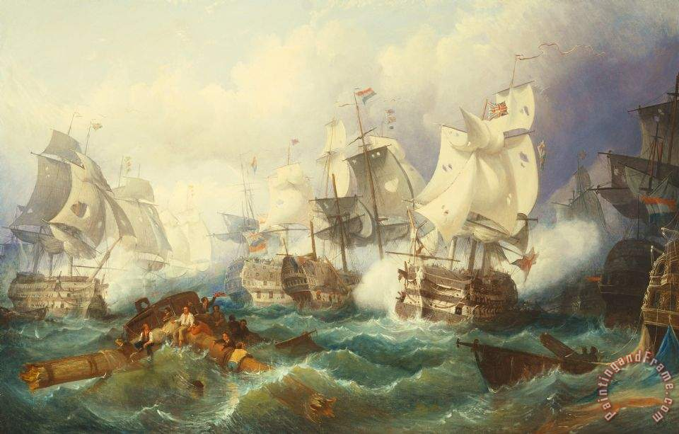

Slide 16
War of the 4th Coalition
1806 Napoleon forms the Confederation of the Rhine and dissolves the Holy Roman Empire
1806 Prussia goes to war against France alone and is crushed
Russia tries to come to Prussia’s aid but is then also crushed, lesson: don’t go it alone against Napoleon
October of 1806 Napoleon occupies Berlin
Denmark-Norway declares war on Sweden and Britain after Britain attacks Denmark fearing their fleet would join Napoleon
The Kingdom of Poland is created by Napoleon, then recruited 200,000 Poles into the Grande Armee

Slide 17
Continental System
Napoleon saw Britain as a “nation of shopkeepers”
1806 Berlin Decree closed continental ports to British ships
1807 Milan Decree - ships not complying would be treated as hostile
President Jefferson - passes the Embargo Acts
Needs Russia to cooperate
Britain responds with the Orders In Council
Notes:
17

Slide 18
Treaty of Tislit
- Russian army defeated at the Battle of Friedland in June 1807 Napoleon meets with Tsar Alexander I on a raft in Tislit
- The Treaty of Tislet gives Prussian territory to Westphalia and creates The Grand Duchy of Warsaw
- The Tsar agrees to close ports to Britain
- Through establishing satellite states and defeating his enemies Napoleon is now master of Europe...except Britain

Slide 19
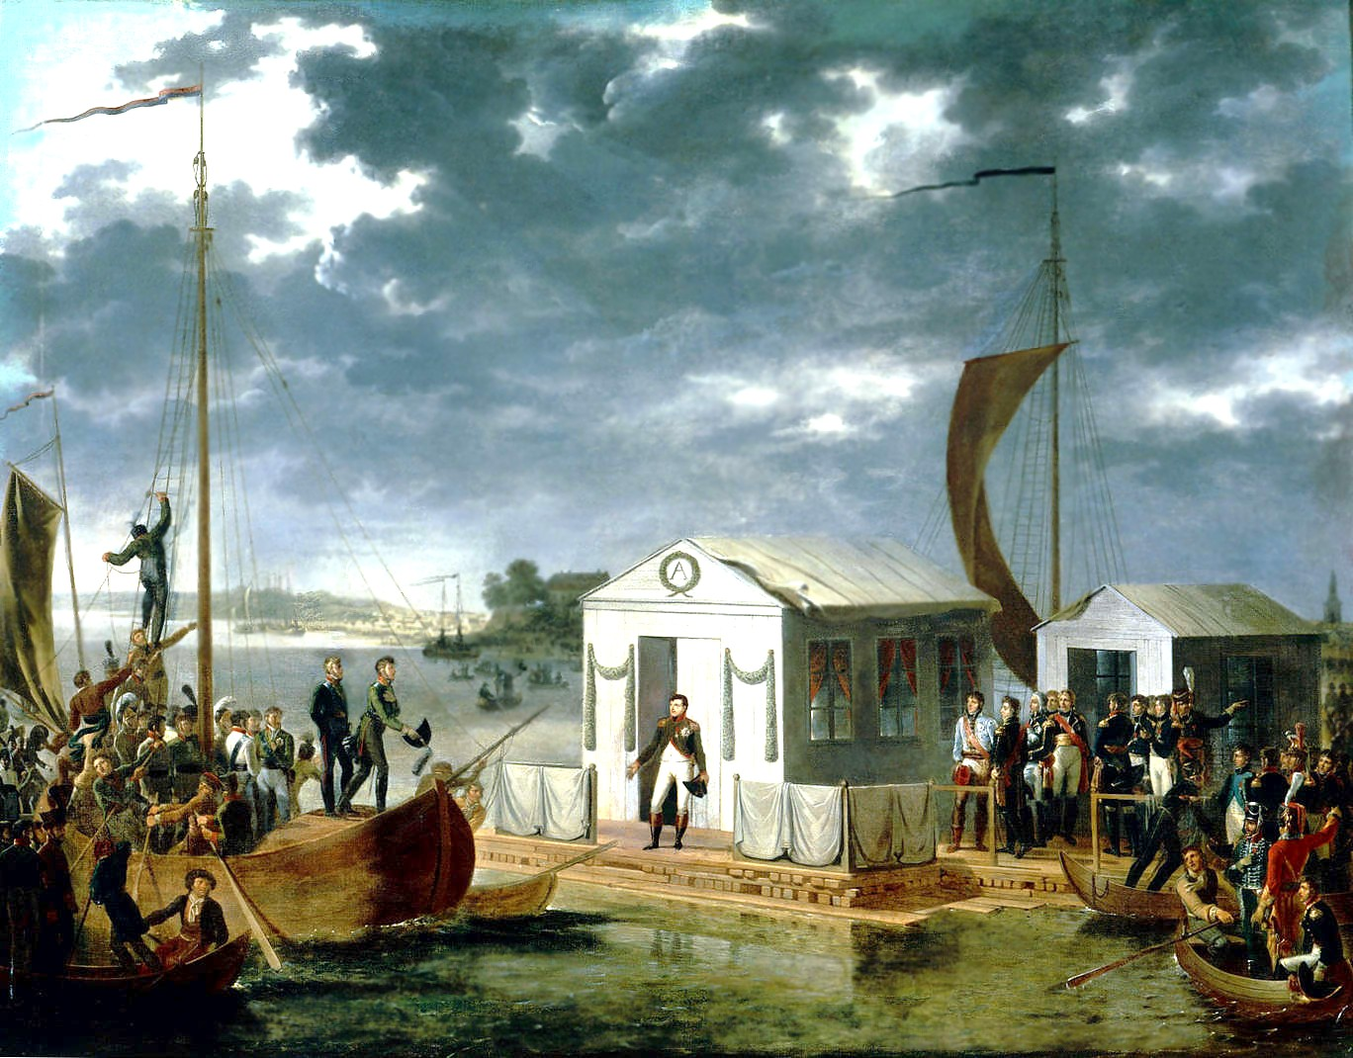

Slide 20
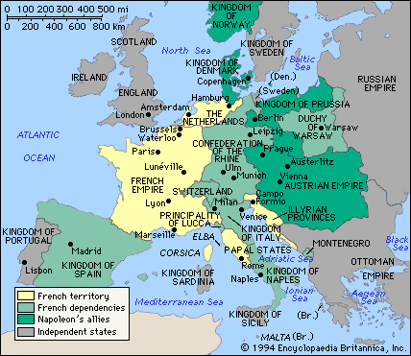

Slide 21
The Fall of Napoleon

Slide 22
Causes of the Fall
French rule of other nations generated resistance
The continental system failed in destroying the British economy
Spain became a “bleeding ulcer”
A rise of German nationalism began
Prussia and Austria reformed their military
The Grand Army was destroyed

Slide 23
Failure of the Continental System
Smugglers made this difficult to enforce
Economic hardship on the continent made local leaders ignore the system
France lacked raw materials necessary to carry out the system
British Orders in Council forced all ships to purchase a license with Britain and the Milan Decrees did nothing to change this
By 1811 the system was in shambles
In 1812 Britain went to war with America over the Orders in Council but it was too late to have an effect on the Napoleonic Wars
Tory governments in Britain were determined to defeat Napoleon at any cost

Slide 24
Peninsular War

Slide 25
Occupation of Spain
1808 Napoleon forced the king of Spain to abdicate making his brother Joseph king
Napoleon also used Spanish conscripts in his wars
Both are resented by the Spanish and a civil uprising forces Joseph to flee
Napoleon has to send and army to help Joseph
Napoleon found himself in a guerrilla war against Spain (supported by Britain)
Wellesley (Wellington) drove the French from Portugal
1813 Napoleon forced from Spain
“It was the Spanish ulcer that ruined me”
Notes:
25

Slide 26
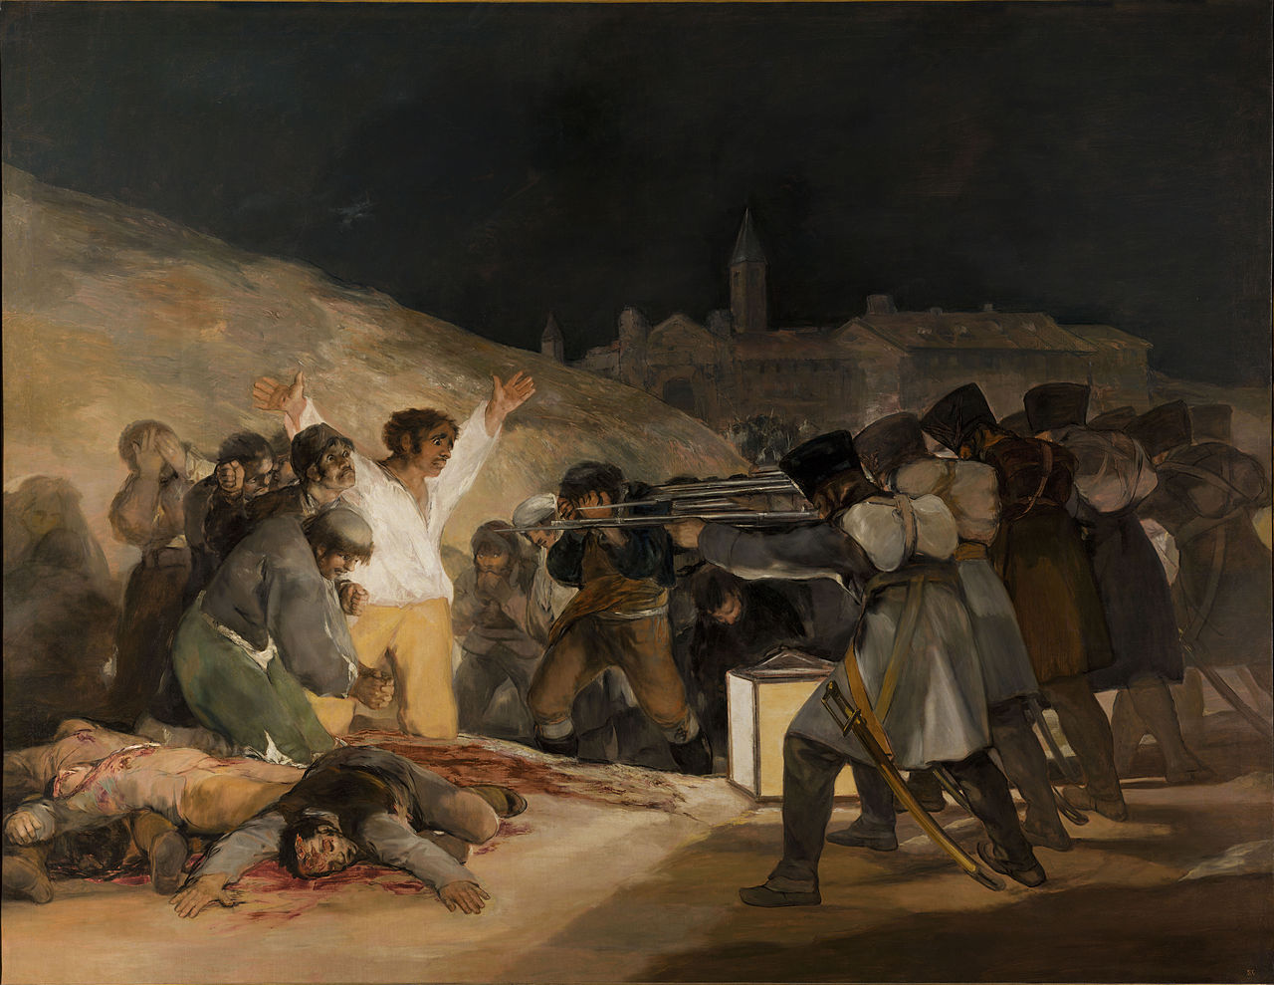

Slide 27
Napoleon's Empire
Napoleon’s empire had three parts: i) The core - France ii) dependent satellite kingdoms iii) independent, but allied states
1809 Austria rose against France but crushed at Battle of Wagram - Treaty of Schonbrunn
Notes:
27

Slide 28
Resentment of the Conquered

Slide 29
Reform and Nationalism
Germany and Italy gain a level of nationalism resisting French rule
This came mostly from a unified struggle against the French
This struggle came from resentment of resources and conscripts being used in French wars
French tactics were often brutal and repressive which created a greater feeling of nationalism and anger
In eliminating tiny German states to create the Confederation of the Rhine, Napoleon removed an obstacle to German unity
At the same time Prussia and Austria reformed their armies to look more like the French armies
Prussia also reformed its society, eliminating serfs in order to gain loyalty

Slide 30
The Invasion

Slide 31
Signs of Weakness
Already the French were growing resentful of the wars
Deserters were becoming more common
There was more defiance among the monarchists who were angry at the treatment of the church
Talleyrand begins to negotiate with the Austrians about a restoration

Slide 32
Invasion of Russia
But neither Russia nor France trusted the other, Napoleon marring a Hapsburg did not help
France had occupied Holland and not helped Russia fight the Ottomans
Napoleon blamed Russia for the failure of the Continental System
June 24 1812 the Grande Armee of 300,000 invades Russia
Most of the Army are conscripts, the best soldiers were in Spain
The Russians continue to retreat pulling the French further east
Battle of Borodino, France wins a costly victory, bloodiest battle of war, 68,000 dead
September 14 Napoleon occupies Moscow
Five weeks later he retreats to France, only about 30,000 men escaped one of the greatest military disasters in history
Prussia deserts France to join the Russians
Notes:
32

Slide 33
The Grand Alliance

Slide 34
The Alliance Joins
Austria joins the Grand Alliance - subsidized with British money
Napoleon would not negotiate, but France no longer wanted war
Until now Napoleon has prevented the four great powers from joining
In the Battle of Leipzig (Battle of the Nations) France is defeated
Talks start about abdication
Allies could not all agree on terms
Problem was: a) future of Napoleon b) borders of France
Napoleon abdicated and attempts suicide (fails)
Notes:
34

Slide 35
Exile
Nov. 1813 Frankfort Proposals were drawn up by Prussia, Russia, Austria, and agreed to by Britain: a)France would return to her natural borders; b) Napoleon would still be emperor; c) Prussia would be compensated
Napoleon wanted better terms - so allies refused
March 9, 1814 Treaty of Chaumont created the Quadruple Alliance to last for 20 years
Napoleon offered the Island of Elba
Napoleon was allowed to keep his title and a pension of 2m. francs a year
The allies wanted to restore the Bourbon monarchy
Notes:
35

Slide 36
The Hundred Days

Slide 37
Abdication
May 3 Napoleon abdicated, Louis XVIII became king of a constitutional monarchy
May 30 “first’ Peace of Paris signed with plans for Congress in Vienna in September

Slide 38
Congress of Vienna
Goals:
a) Not punish France: but make sure she could not wage war again b) Restore the balance of power c) Compensation: States should be compensated for the loss of land or people d) Legitimacy: Restore the monarchs that ruled prior to Napoleon, if possible e) Victors should be rewarded
Prince Karl von Metternich of Austria was in charge he believed in conservatism not liberalism
A system will be put in place to prevent further revolutions (fire dept)
Notes:
38

Slide 39
Waterloo
Quadruple Alliance: Britain, Austria, Prussia, Russia agreed to meet to review the situation
March 1, 1815 Napoleon escapes Elba and reenters France beginning The Hundred Days
He did not have overwhelming support, but still many in the army followed him
Napoleon invaded Belgium
At Waterloo he met the Duke of Wellington and was defeated for the last time

Slide 40
End of the Napoleonic Wars
The “Second” Treaty of Paris - much harsher a) borders would the same as 1790 b) indemnity of 700 million francs to be paid by France (sets an important precedent) c) 150,000 troops occupy France for 3 to 5 years d) renewed the Quadruple Alliance
Napoleon is exiled to St. Helena
Russia persuaded Austria and Prussia to form the Holy Alliance to rule under Christian principles
Quadruple Alliance later admitted France

