Slide 1
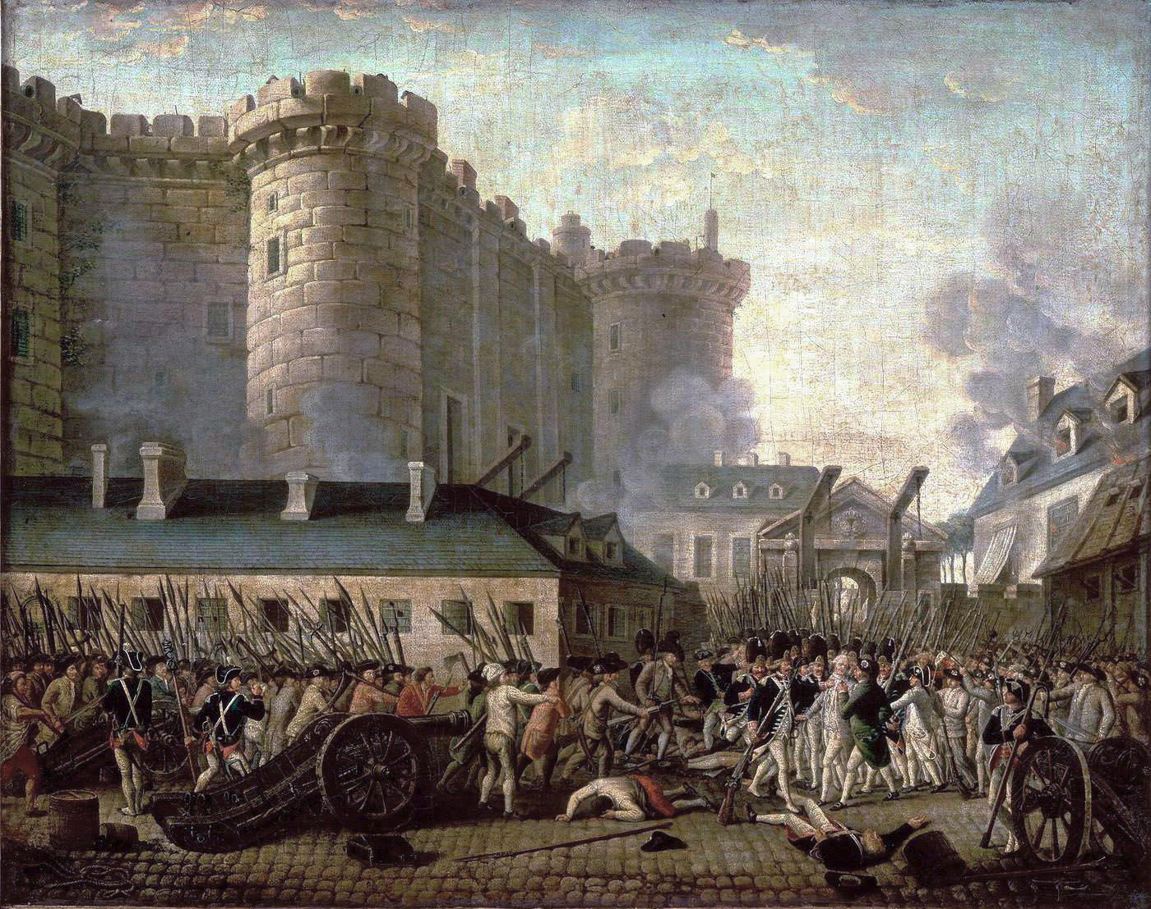
The French Revolution

Slide 2
Long Term Origins of the Revolution:
- The Enlightenment and its language of equality before the law and absolutism vs despotism
- Failure to call any representative body and exiling the Parliament of Paris
- Overlapping layers of privileges, rights, traditions etc. from the feudal system was still in place
- Despite the privileges wealthy commoners and nobles had never been closer in wealth and prestige, this was aided by the selling of titles
- Due to lack of agricultural reforms harvests were chronically bad through the 1770's and 80's
- Ironically attempts at reform in the 1770's led to riots and anger amongst the people and the nobles

Slide 3
Short Term Origins of the Revolution
- The Seven Years War, the War of Austrian Succession, and the American Revolution drained the coffers of France
- ¼ of expenses went to military maintenance
- The old fiscal system was inadequate, tax heavy on peasants, no national bank
- Louis XVI was a very weak king, naive and unable to make decisions
- Marie Antoinette was disliked by the people and this further weakened the monarchy
- More loans were taken out than could possibly be repaid

Slide 4
Eve of Revolution
- In 1787 Louis summoned an Assembly of Notables which he believed would be amenable to financial reform
The notables rejected the reform and forced the king to sack the finance minister
The king tried to use an edict for reform, but the parliaments refused to register them, this became known as the Revolt of the Nobility
- In response Louis ordered the edicts registered anyway without parliament's approval “It is legal because I will it”
- This was seen as a step to far into despotism
- People rioted and Louis agreed to call the Estates General in 1789
- Many see this as the first act of the Revolution

Slide 5
Ideas of the Revolution

Slide 6
Liberty and Equality
Political revolutionaries were fueled by the ideas of liberty and equality
Liberty was a call for human rights Liberals protested governmental controls: a) an end to censorship b) freedom of religion c) freedom of speech and expression
Equality meant all citizens were equal with the nobility having no extra rights
It was call for a new kind of government
People were sovereign

Slide 7
Liberalism
Liberals believed that men and women were not equal. Women should not have the same rights
People were not economically equal
Classic liberalism reflected the Enlightenment a) human dignity b) human happiness
Attracted the well-educated and rich
Representative government did not mean democracy - because those who could vote would own property

Slide 8
Problems With Liberalism
Liberalism lacked popular support: 1. comfortable Liberals did not have to worry about food 2. traditional practices and institutions that the Liberals wanted to abolish were important to the peasants
French Revolution was a direct consequence of the American Revolution, but it was more radical and more controversial.
Chateaubriand - “The patricians began the Revolution, the plebeians finished it”

Slide 9
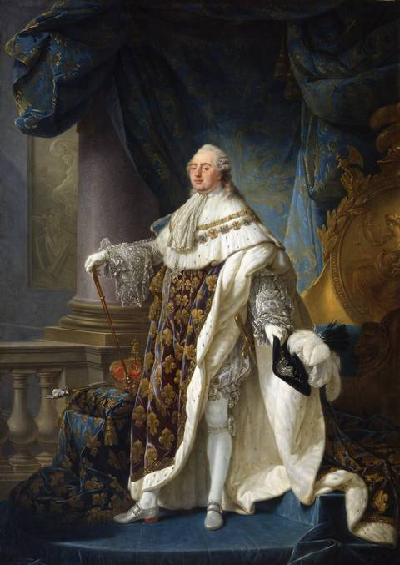
Louis XVI
- Old Regime (ancien regime)
- Absolute monarch
- Weak monarch
- Most of the debt held by the nobles

Slide 10
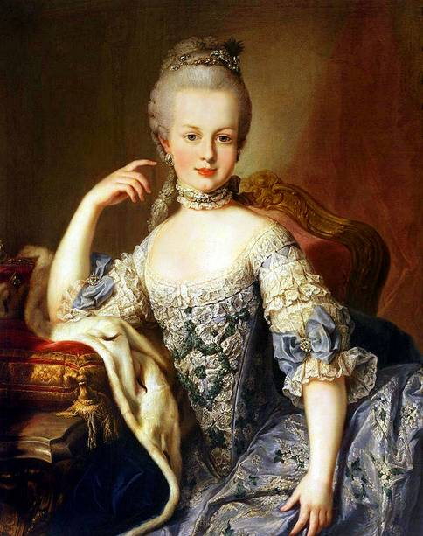
Marie Antionette
- Wife of Louis XVI
- Daughter of Maria Theresa
- Sister of Austrian King
- Older then Louis
- Unhappily Married
- Spend extravagant amount of money
- Not liked by people

Slide 11
SOCIAL PROBLEMS

Slide 12
The Estates General
25 million people divided into 3 Estates
First Estate - Clergy - 300 seats
Divided into:
Upper: bishops and abbots - sold offices - usually wealthy
Lower: priests who were usually poor
Owned 10% of land
Paid “voluntary tax once every five years”
Could levy a 10% tithe on landowners

Slide 13
Second Estate
Nobility- 300 seats
Nobility of the Sword - lineage
Nobility of the Robe - appointed offices
400,000 noblemen
owned 25% of land
owed labor dues (corvee)
could tax peasants for privileges, i.e. wine press or mill.
supported the philosophes - but criticized by them
wanted a constitutional monarchy to limit the king

Slide 14
Third Estate
The rest: 600 seats
The peasants, middle class, and urban workers
Some commoners were educated and rich bourgeoisie
They wanted status which was not recognized through wealth
Felt frustration with the second estate
Wanted positions in the church, government, and army open to the most qualified

Slide 15
Financial Problems
Population
Debt
Food shortages
Inflation
Disease
Recession in textiles
Nobility demanded more power
The main cause of the revolution was the financial problems: 50% interest 25% military 6% Versailles

Slide 16
Agrarian Problems
Four-fifths of the population were rural
Foreign trade had increased five fold between 1713 and 1789
Consumer prices rose 65%; wages rose 22% between 1730-80
The participants were motivated by economic distress

Slide 17
The Stage is Set
In July 1788 Louis was forced to call the Estates General first time since 1614- absolutism was collapsing
People started to elect representatives and organize their demands
Two-thirds of the clergy delegates were commoners by birth; one-third of the nobility were committed to liberalism; but no delegates were actually poor.
The Estates wanted: a) absolutism to give way to constitutional monarchy b) liberties would have to be guaranteed

Slide 18
But how would they vote?
The old system virtually guaranteed control by the first and second estates
The government “doubled” the Third Estate but still useless as long as they voted as estates.
May 1789 the Estates General met at Versailles
June 13: delegates from the Third Estates refused to transact business, a few clergy moved into the Third Estate
June 17 Third Estate declares itself “The National Assembly”
Louis locks the doors and bans the group from meeting
…It was already too late

Slide 19
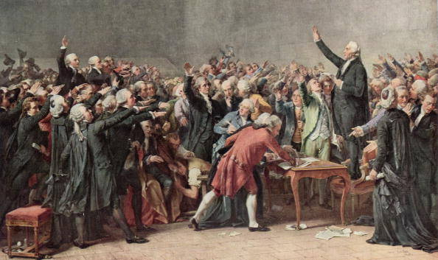
Tennis Court Oath
Moved to an indoor tennis court and pledged not to disband until they had written a new constitution
Louis allied with the nobility
The king moved the army to Versailles and dismissed the Liberals

Slide 20
The Bastille

Slide 21
The Bastille
By 1789 almost half the people needed relief
There was a great fear that swept through France that the aristocracy would try and ban the Third Estate
July 14th 1789 the peasants storm the Bastille
The Bastille was a symbol of power that only had 7 prisoners

Slide 22
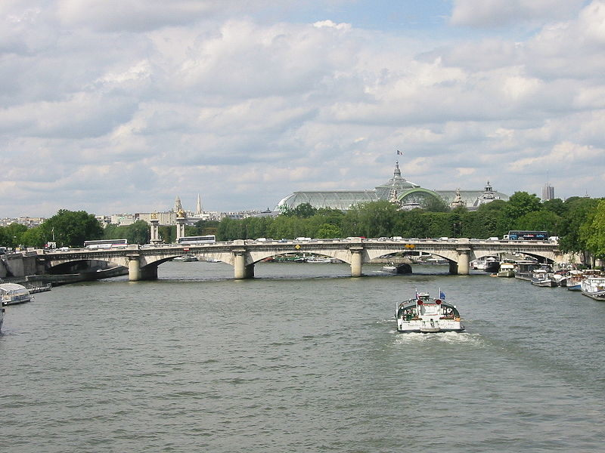

Slide 23
Declaration of the Rights of Man and Citizen
August 1789
“All men are born free and equal”
Natural rights guaranteed: liberty, property, security freedom from oppression, innocent until proved guilty
Didn’t guarantee economic equality
October 1789 7,000 women marched to Versailles to protest the price of bread, slaughtered the Swiss Guard
King, queen and National Assembly taken to Paris

Slide 24
Reforms of the Assembly
The National Assembly passed major reforms
July 1790, Louis agreed to a constitutional monarchy.
New laws increased opportunities for women, but still no vote.
Reorganized the provinces into 83 departments
Weights and measures were standardized (metric), guild restrictions lifted.
Customs tax on internally transported goods was lifted
Subordinated the church to the state

Slide 25
Other Reforms
The clergy was required to take an oath of loyalty to the state. Only half did.
The Assembly declared the Revolution over!
Louis made several concessions to the Assembly but he never intended to keep them
The people still loved the king and blamed his ministers for the problems
Abolition of special privileges for the nobility
Wrote a constitution which limited the monarchy
Torture was abolished, citizen juries introduced, sale of offices was abolished

Slide 26
The Flight
But in June 1791 Louis and his family had tried to escape to Austria, “flight to Varennes” (Leopold was Marie’s brother)
Louis was captured and returned to Paris
August 1791: Declaration of Pillnitz - Austria and Prussia to show support for the king

Slide 27
Radicalization
By September 1791 the National Assembly announced its work completed, Louis accepted the constitution.
By 1792 the Revolution had turned radical because of: a) a counter revolution led by the king, church, and Catholic peasants b) economic, social, and political discontent among the peasants, artisans, and wage earners (sans-culottes)

Slide 28
First Revolutionary Wars
In April 1792 France declared war on Austria
July 25, Brunswick Manifesto: Austria and Prussia promise revenge if the monarch is hurt
Prussia joined Austria to create the First Coalition
The French were easily defeated, but the leaders of the Coalition argued amongst themselves
Gradually the French the gained the upper hand and a wave of patriotism swept the country

Slide 29
The Second Revolution
The sans-culottes insisted it was the duty of the government to protect them
Wanted the government to increase wages, fix prices, and end shortages
They wanted to prevent extremes of wealth
Wanted a democratic republic liked the ideas of Thomas Paine
In August 1792 they attacked the palace and killed several hundred guards

Slide 30
The second phase was much more radical
By September Paris was in turmoil
“September Massacres” slaughtered prison inmates
On September 1st, 1792 France was declared a Republic
The king was imprisoned and tried in December - executed by one vote
After the execution the Assembly became the National Convention

Slide 31
British Prime Minister Pitt said France had to leave Belgium
February 1, 1793 France declares war on Britain, Holland, Austria, and Prussia (later Spain)
Members of the National Convention were republican and Jacobins
Jacobins divided into two groups: Girondists from western France, and the Mountain led by Robespierre and Danton
Both advocated war
In the spring France was pushed from Belgium

Slide 32
National Constitutional Convention
Republican armies captured Nice, invaded the Rhineland and occupied Austrian Netherlands
Girondists and Mountainist became very suspicious of each other
May 31 1793, the Commune, under sans-culottes pressure, has the Girondists arrested
Sans-culotte emerge as the most powerful group in Paris

Slide 33
Robespierre (disciple of Rousseau) formed the Committee of Public Safety to ensure success of the revolution
Mandated economic controls, but too weak to enforce, except the price of bread
Nationalized the war effort
Arrested thousands of suspected counter-revolutionaries
Robespierre wanted to create a Republic of Virtue
To ensure his ideals he implemented the Reign of Terror (1793-4)

Slide 34
Reign of Terror
Leaders of the Girondins were executed including Danton
Revolutionary courts tried enemies of the state
Dictatorship
40,000 executed, 300,000 imprisoned
Levée en masse
Abolished feudalism

Slide 35
Robespierre tried to De-Christianize the country
New calendar with no Christian holidays or Sundays - Sept. 1, 1792 was day one, year one.
Each month had 30 days, with 10 day weeks
June 1794 Robespierre introduced the cult of the Supreme Being in which the Republic acknowledged the existence of God
Alienated Catholics

Slide 36
Marie Antoinette
Beheaded Oct. 16
“Terror is the order of the day”
1794 French armies successful on all fronts
1795 Spain and Prussia quit
1796 Austria quit leaving only Britain

Slide 37
Thermidorean Reaction
Robespierre wanted an ideal democratic republic without rich or poor
Through despotism and the guillotine he eliminated all opposition
Robespierre was arrested by the Convention and executed (July 28, 1794) by fearful middle class who really benefited from his removal
Inflation increased, self-indulgence increased, people turned to religion
National Convention abolished economic controls and wrote a new constitution

Slide 38
The Directory
1795 leadership passed to five Directors, but same old leaders - people who had survived - dominated by bourgeoisie
Lowered prices; alleviated hunger; reorganized the tax system; won military victories; wrote a constitution which incorporated Belgium
Faced revolts from the left and right

Slide 39
1795 Louis “XVII” died, the Count de Provance claimed to be Louis “XVIII”
Declaration of Verona: a) restore the Old Regime b) return all confiscated land c) restore old privileges, taxes, and dues
18 Fructidor (Sept 4, 1797) three Directors occupy Paris and stage a coup
They annulled the elections, imposed censorship, and exiled troublemakers
Napoleon sent deputy to Paris to ensure the success of the coup

