Slide 1
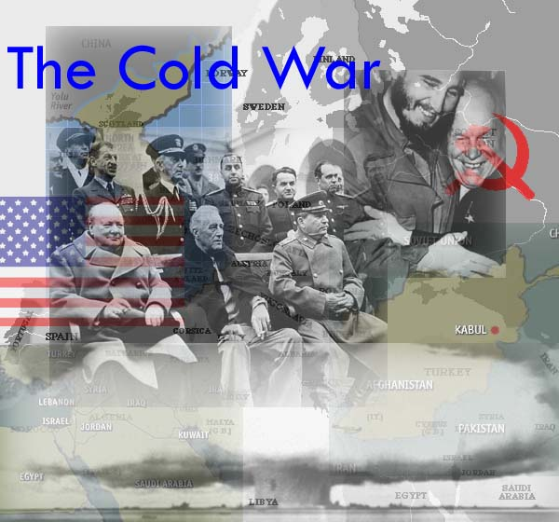
Part 1 1945-1963

Slide 2
The Ideological Struggle
Soviet & Eastern Bloc Nations
[“Iron Curtain”]
US & the
Western Democracies
GOAL → spread world-wide Communism
GOAL → “Containment” of Communism & the eventual collapse of the Communist world.
[George Kennan]
METHODOLOGIES:
Espionage [KGB vs. CIA]
Arms Race [nuclear escalation]
Ideological Competition for the minds and hearts of Third World peoples [Communist govt. & command economy vs. democratic govt. & capitalist economy] → “proxy wars”
Bi-Polarization of Europe [NATO vs. Warsaw Pact]

Slide 3
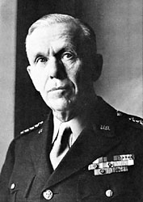
Marshall Plan [1948]
“European Recovery
Program.”
Secretary of State,
George Marshall
The U. S. should provide
aid to all European nations
that need it.
$12.5 billion of US aid to Western Europe extended to Eastern Europe & USSR, [but this was rejected].

Slide 4
Why does each side mistrust the other?
U.S. doesn’t trust the Soviets because…
Stalin’s purging campaigns… will he do the same to Eastern Europe?
USSR did not ensure free elections in Poland
USSR did not Allow for self-determination in Eastern Europe
Soviet Union developing atomic weapons (how?)
USSR doesn’t trust the U.S. because…
US cut off lend-lease aid in 1945
Spent millions of lives in WW2
US avoided opening 2nd front in Western Europe to aid them
Claimed US and Britain had “frozen out” Soviets when developing atomic weapons

Slide 5
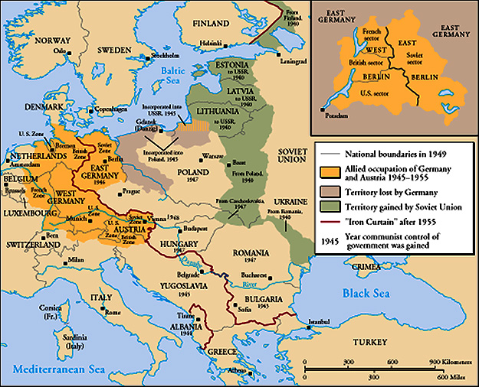
The “Iron Curtain”
From Stettin in the Balkans, to Trieste in the Adriatic, an iron curtain has descended across the Continent. Behind that line lies the ancient capitals of Central and Eastern Europe.
-- Sir Winston Churchill, 1946

Slide 6
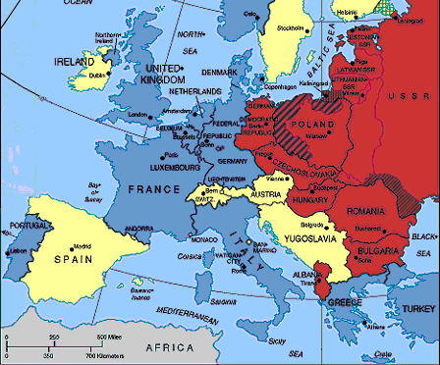
The Truman Doctrine 1947
Truman’s doctrine: The U.S. should support free peoples throughout the world who were resisting takeovers by armed minorities or outside pressures…
We agree to give money and aid to any country resisting communism
The U.S. gave Greece & Turkey $400 million in aid

Slide 7
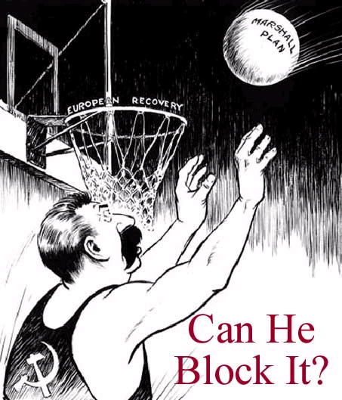
Soviet Response
Felt Germany should be punished for WWII
Strips East Germany of its industry (for punishment and “protection”)
Orders the Soviet Army to block all Aid to Berlin in an attempt to push out the Americans

Slide 8
Berlin Airlift
In response the U.S. and Britain begin to airlift supplies to the Berliners

Slide 9
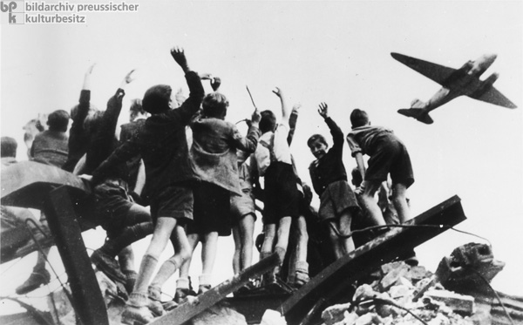
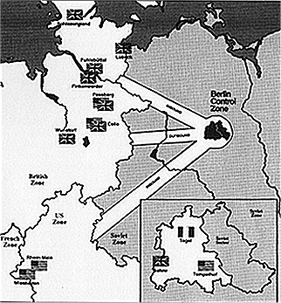
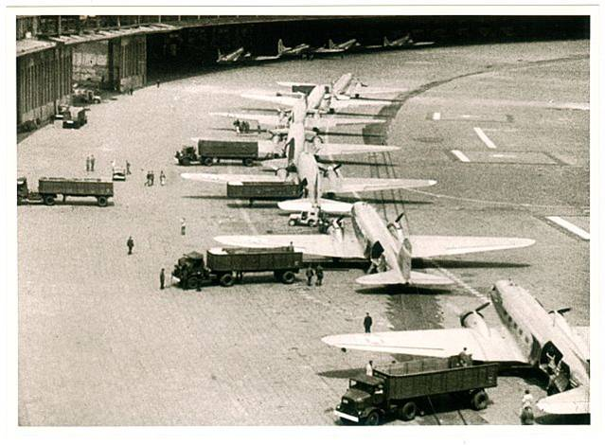
Children hope for chocolates during Berlin Airlift
Three air corridors used by the Allies during airlift
Waiting in Line for Takeoff

Slide 10
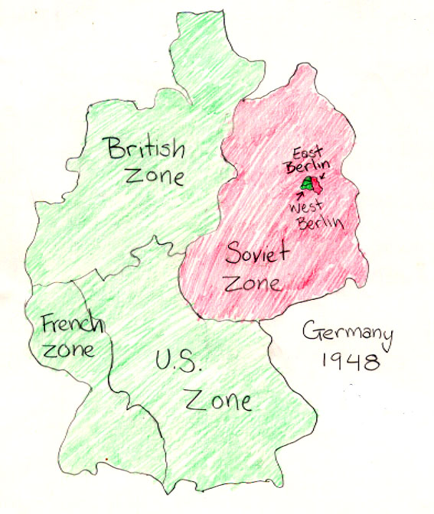
Map of the Zones of Occupation, location of Berlin.

Slide 11
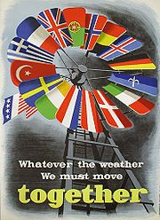
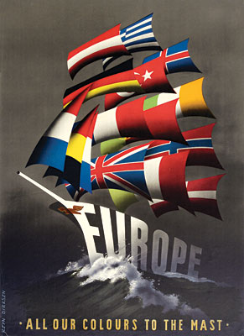
Marshall Plan Propaganda
Who is sending money to the European countries?

Slide 12
Fighting for Protection
NATO
  Policy of collective security
  12 Original Member Nations
  Western Europe: USA
Warsaw Pact
  Policy of collective security
  Eastern Europe: USSR

Slide 13
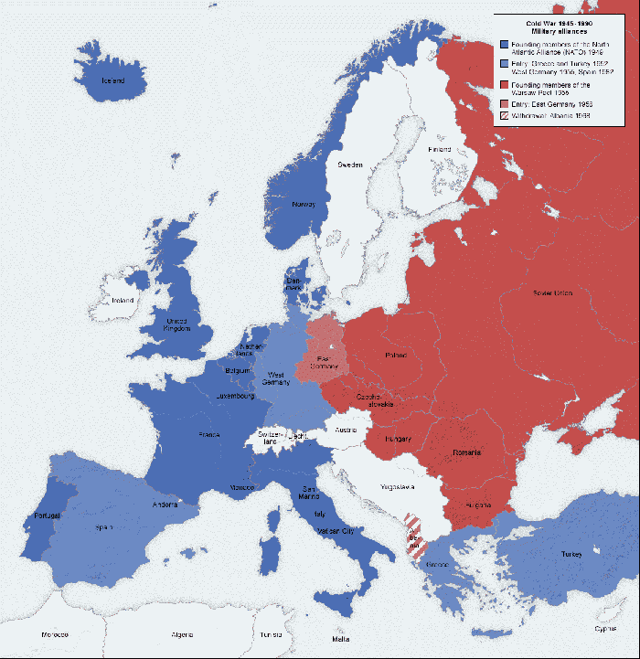
Red: Soviet Controlled, Warsaw Pact
Blue: NATO Countries, Lighter Blue Later Joined NATO
Albania: withdrew from Warsaw Pact 1968

Slide 14
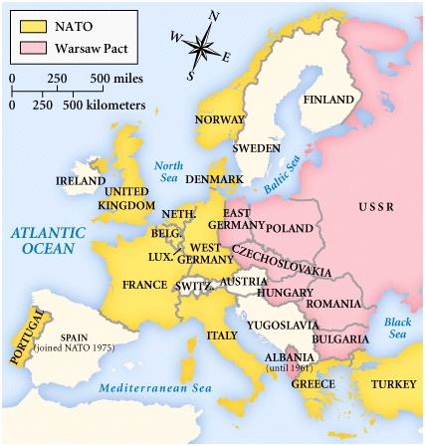

Slide 15
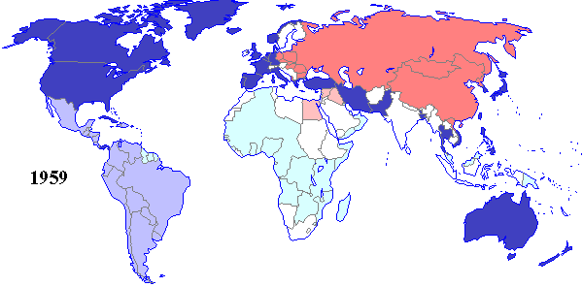

Worldwide Influence

Slide 16
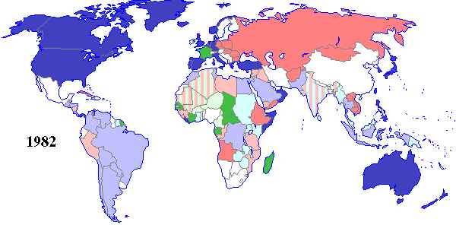

Slide 17

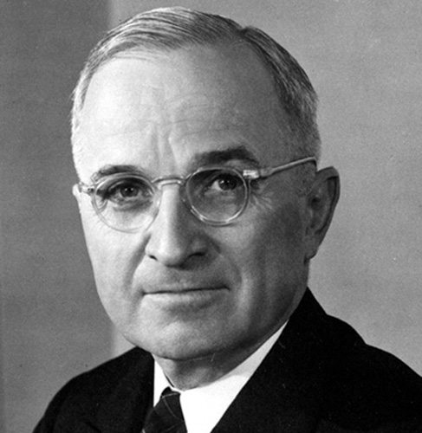
Truman’s Domestic Policy
Truman will offer America a “Fair Deal”, a continuation of the New Deal, focusing on housing for the poor
Integrates Army

Slide 18
China
In 1949 the Communists win the Chinese Civil War (150 million dead)
Mao Zedong (Tse Tung) becomes to Communist leader of China and pursues the “great leap forward” its goal is to modernize China
It results in another 100 million deaths
This is seen as a defeat for America who had supported Nationalist China under Chang Ky Shek
“Nationalist China” is now Taiwan
→ Most of Asia is communist

Slide 19
The Korean War
The Forgotten War
1950-1953

Slide 20
How Did It Start?
At the end of WWII the Communist Soviet Union attacked Japanese controlled Korea and took what is modern day North Korea
From 1945-1950 North Korea and South Korea tried to re-unite, but North Korea wanted a Communist government and South Korea wanted a Democracy

Slide 21
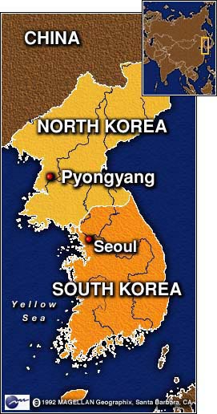

Slide 22
The Beginning
In 1950 the War begins when North Korea, invades South Korea
North Korea is successful and corners the U.S. and S. Korean troops in the SE corner of the peninsula

Slide 23
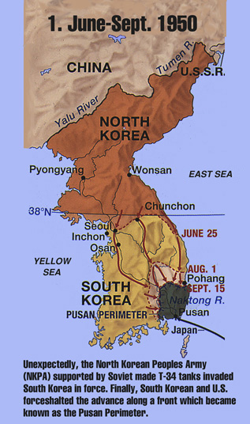

Slide 24
The U.N. Responds
The U.N security council orders a “police action” to contain N. Korea

Slide 25
McArthur Strikes Back
General McArthur leads the U.N. forces and lands troops at Inchon a city on the west coast of the peninsula, this cuts off the N. Koreans and forces many N. Koreans to retreat and surrender
The U.N troops then take all the land that was lost

Slide 26
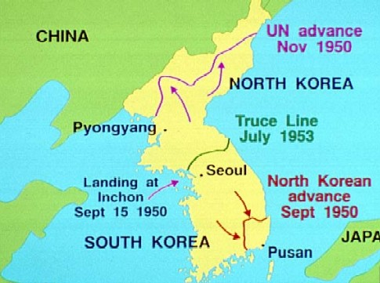

Slide 27
The U.S. Moves to Pyongyang
The U.S. moves on and attacks N. Korea trying to conquer it in 1950
As the U.S. approaches the Chinese border China warns the U.S. to stop approaching, but the U.S. does not recognize communist China so Truman ignores China.
As the U.S. approaches, the Chinese attack, and force the U.S. to retreat back toward S. Korea
After this the war settles into a stalemate while the diplomats try get a peace treaty
No peace treaty has ever been signed between North and South Korea and 23,000 U.S. troops are still stationed there
President Eisenhower will eventually get the NK to sign an armistice

Slide 28
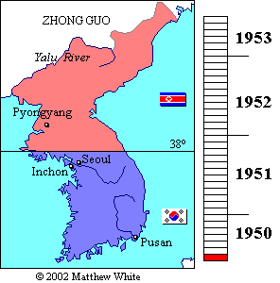

Slide 29
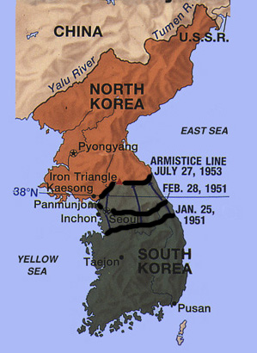

Slide 30
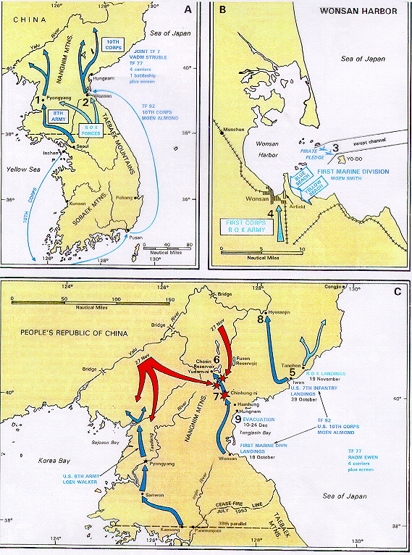

Slide 31
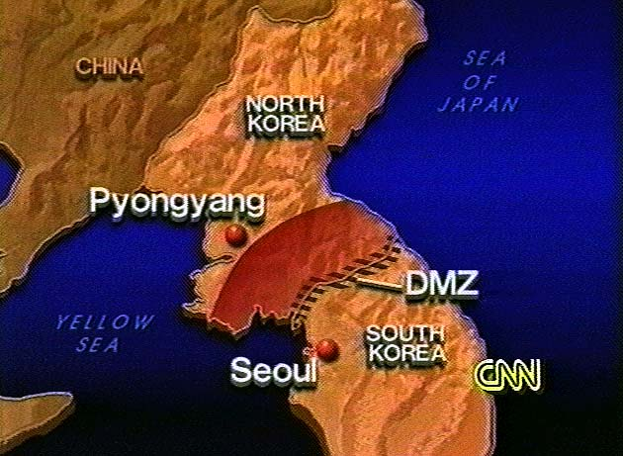

Slide 32
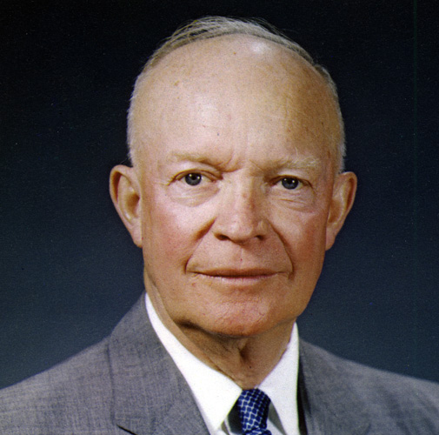
The Eisenhower Administration
National Highway Act- created our highway system, he copied it from the German Autobahn
New Look Policy: Eisenhower’s attempt to re-approach Latin America and try to repair relations that had been damaged in the early part of the century.

Slide 33
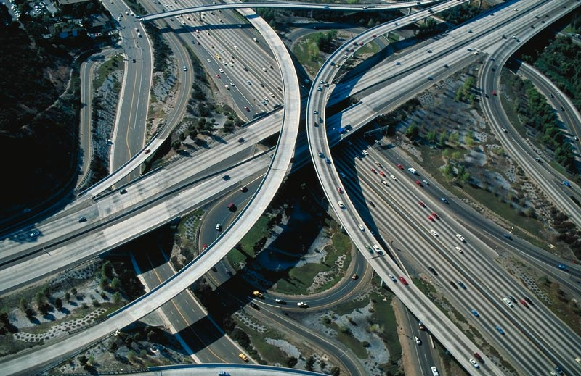

Slide 34
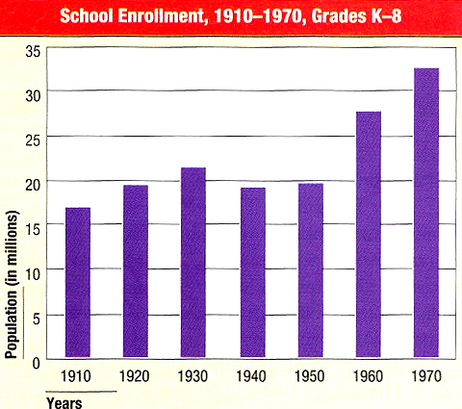
Baby Boom
The Baby Boom occurs because The GI Bill gave cheap home loans and free college to returning vets. This allowed a new middle class to rise

Slide 35
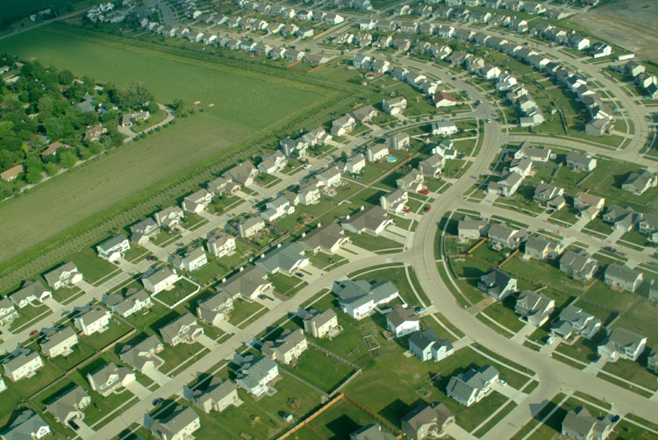
Suburban Living
Levittown “The American Dream”
1949 → William Levitt produced
150 houses per week.
$7,990 or $60/month with no down payment.

Slide 36
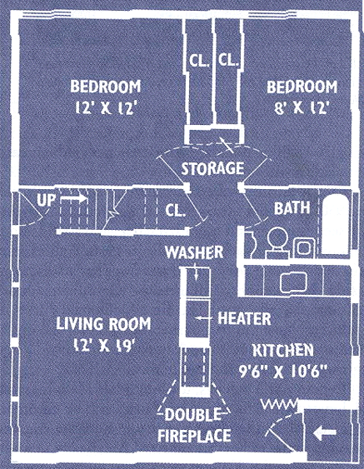
Suburban Living:
The New “American Dream”
1 story high
12’x19’ living room
2 bedrooms
tiled bathroom
garage
small backyard
front lawn
By 1960 → 1/3 of the U. S. population in
the suburbs.

Slide 37
2B. Suburban Living
SHIFTS IN POPULATION
DISTRIBUTION,
1940-1970
1940 1950 1960 1970
Central Cities 31.6% 32.3% 32.6% 32.0%
Suburbs 19.5% 23.8% 30.7% 41.6%
Rural Areas/ 48.9% 43.9% 36.7% 26.4%
Small Towns
U. S. Bureau of the Census.

Slide 38
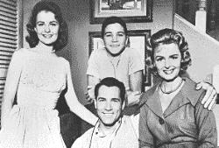
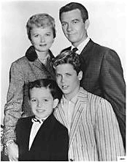
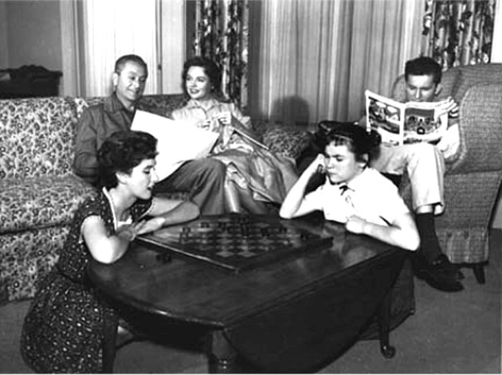
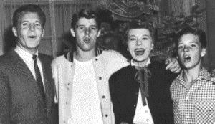
Suburban Living:
The Typical TV Suburban Families
The Donna Reed Show
1958-1966
Leave It
to Beaver
1957-1963
Father Knows Best
1954-1958
The Ozzie & Harriet Show
1952-1966

Slide 39
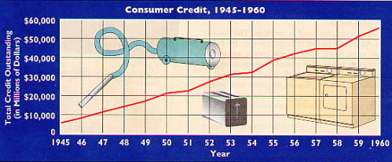
Consumerism
Your self identity is tied to what you own
All babies were potential consumers who spearheaded a brand-new market for food, clothing, and shelter.
-- Life Magazine (May, 1958)

Slide 40
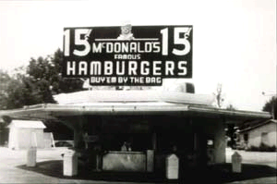
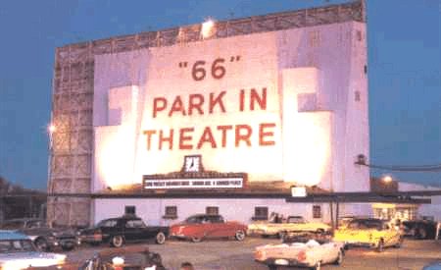
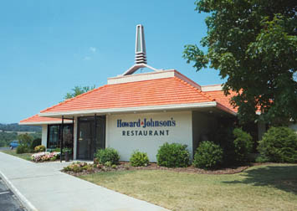
The Culture of the Car
America became a more homogeneous nation because of the automobile.
First McDonald’s (1955)
Drive-In Movies
Howard Johnson’s

Slide 41
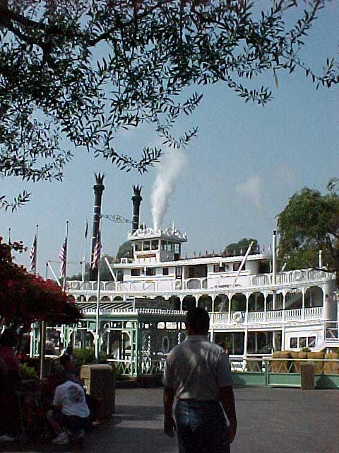
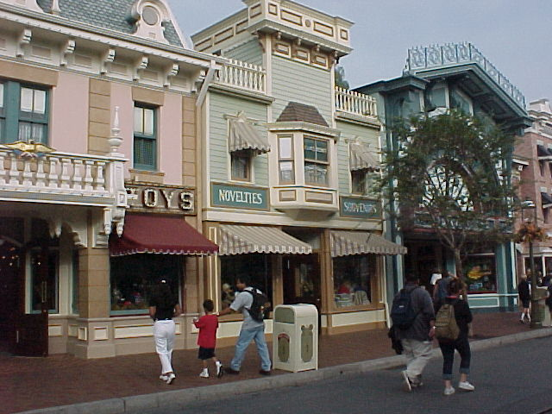
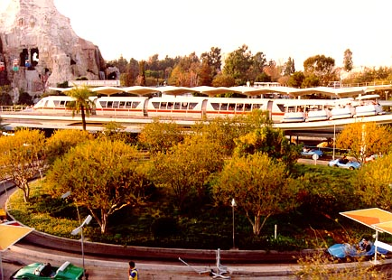
The Culture of the Car
The U. S. population was on the move in the 1950s.
NE & Mid-W → S & SW (“Sunbelt” states)
1955 → Disneyland opened in Southern California.
(40% of the guests came from outside
California, most by car.)
Frontier Land
Main Street
Tomorrow Land

Slide 42
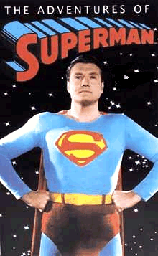
Television
1946 → 7,000 TV sets in the U. S.
1950 → 50,000,000 TV sets in the U. S.
Television is a vast wasteland. → Newton Minnow, Chairman of the Federal Communications Commission, 1961
Mass Audience → TV celebrated traditional
American values.
Truth, Justice, and the American way!

Slide 43
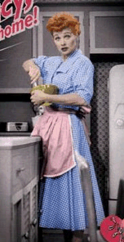
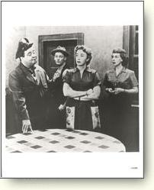
Television - Family Shows
Glossy view of mostly
middle-class suburban life.
But...
I Love Lucy
The Honeymooners
Social Winners?... AND… Losers?

Slide 44
Teen Culture
Behavioral Rules of the 1950s:
  Obey Authority.
  Control Your Emotions.
  Don’t Make Waves → Fit in
  with the Group.
  Don’t Even Think About Sex!!!

Slide 45
In Summary
The 50’s was a time of prosperity for white, middle class, former GI’s
With access to cheap loans from the GI Bill home ownership increased and unemployment decreased
The culture became more homogenous and teens became more important as they made up a greater amount of money spent

Slide 46
McCarthyism and the Fear of Communism

Slide 47
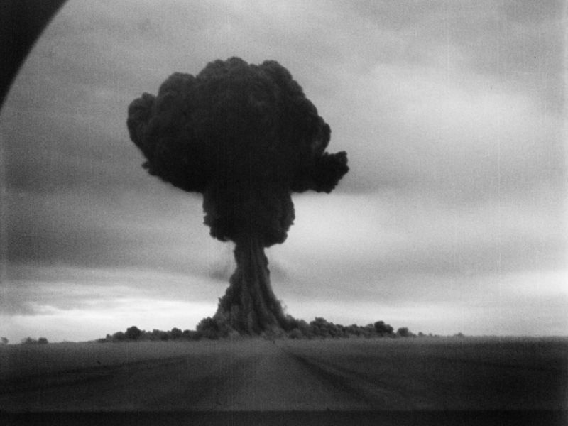
Paranoia Sets in…
Fear of Communism spread thru the U.S. after WWII
Result of:
  Economic Recession
  Fear of Soviet Expansion
  Fear of spies & nuclear
  warfare
  Politicians

Slide 48
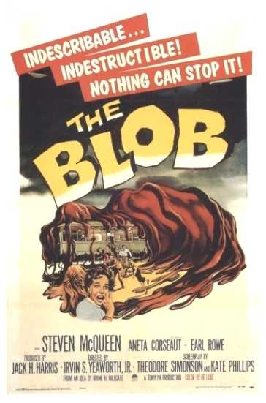
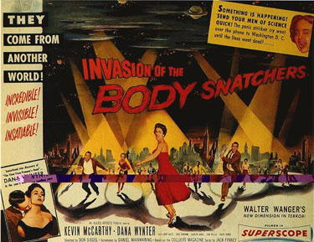
B. The Government Responds

Slide 49
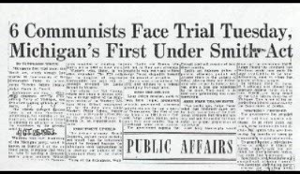
Smith Act (1940)
Made it illegal to advocate the overthrow of the U.S. government
Used to convict members of the Communist Party
11 in NY were sent to jail

Slide 50
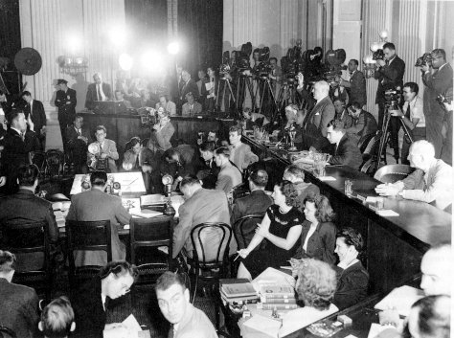
House Un-American Activities Committee (HUAC)
Investigative Committee in the HOR
Investigated Communist influence in the United States
Focused on the film industry – believed there was propaganda in movies

Slide 51
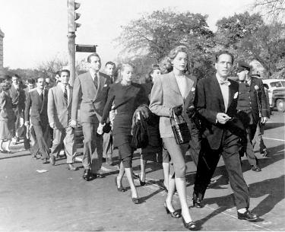
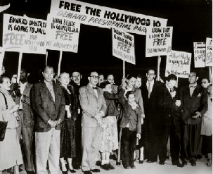
Blacklisting
Hollywood Ten – refused to cooperate with the HUAC
Industry responded by blacklisting 250 people

Slide 52
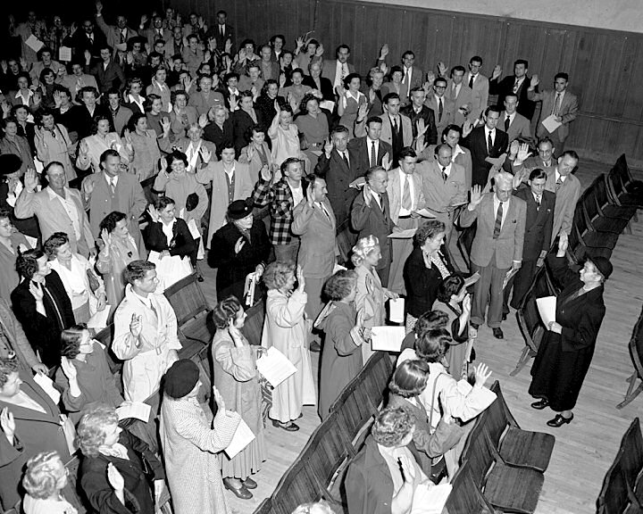
Truman’s Loyalty Program
Executive Order 9835: March 1947
Designed to root out Communism from Federal Departments
Investigate 3 million employees
Employers began demanded loyalty oaths

Slide 53
McCarran Internal Security Bill (1950)
Communist organizations had to register & activities were regulated
Subversive activities could result in the de-naturalization of citizens
Vetoed by Truman – Congress over-rode
Later overturned by the SC

Slide 54


C. The Spies

Slide 55


Alger Hiss
Accused by Whittaker Chambers of spying
Richard Nixon & HUAC investigate
He is convicted of perjury in 1948
Sentenced to 5 years in prison

Slide 56

Julius & Ethel Rosenberg
American Communists
Accused of supplying secrets
of the atomic bomb to the
Soviets
Convicted spy Klaus Fuchs
accused them
Convicted in 1951
Executed in 1953

Slide 57


Slide 58
Cold War:
Fear of Communism (Domino Theory)
Domino Theory → if one country in a region falls to communism the rest will fall as well.
House of Un-American Activities Committee (HUAC)
  created in 1938 as a means to investigate and weed out Communists and Communist supporters from American society

Slide 59

“The Hollywood Ten”
    1947, appeared before HUAC
    Invoked first amendment and refused to speak
    All served up to one year in prison
The Hollywood Ten
(picture from “The Hollywood Ten”)

Slide 60


Joseph McCarthy
Feb 20, 1950, Senator Joseph McCarthy says he had the name of 205 Communists in the State Department
"I have here in my hand a list of 205—a list of names that were made known to the Secretary of State as being members of the Communist Party and who nevertheless are still working and shaping policy in the State Department."

Slide 61

Tydings Committee
Senate Committee investigations into accusations
Began a 4 year long witch hunt for communists
Red-Baiting: people began accusing others of being Communists

Slide 62
The Hearings (cont.)
Who was summoned to hearings?
    Those sympathetic to communist cause
    Those who had connections to Russia
    Particular interest to people in artistic community
      Playwrights
      Screenwriters
What did those summoned have to do?
    Explain involvement
    Recant beliefs
    Name former friends and associates in communist cause
What happened to them?
  “Blacklisted”
    No one would purchase their services for fear of being linked to communism

Slide 63

Downfall of McCarthy
Americans lived in a state of fear that they would be accused and would go on trial
McCarthy’s downfall came when he accused the U.S. Army of supporting communism

Slide 64
Kennedy Election
In 1960 John F. Kennedy ran against Richard M. Nixon (Ike’s VP)
The election was famous for having the first televised debate
Some thought this would give an advantage to Nixon because he was already knows as being a “television candidate”
Instead the good looks and charisma of Kennedy helped him win a narrow election (some say through fraud)
Nixon will never forget this…
Kennedy was seen as a young, vibrant candidate and his presidency was often called “Camelot” in reference to Arthur

Slide 65


Kennedy’s Foreign Issues
In the late 1950’s Cuba had become communist and was led by Fidel Castro
Kennedy approves a covert invasion of Cuba and the Bay of Pigs Invasion is the result
The Invasion was a total failure and Kennedy publicly apologizes for it

Slide 66


Slide 67
Berlin Crisis
Many East Berliners were escaping to the West
In response East Germany created the Berlin Wall, which was a manned barrier to prevent East Berliners from fleeing to the West
Kennedy will oppose it and will travel to Berlin in order to show that he was with them
In the end the wall will remain and be re-enforced

Slide 68
Oct 15 – Oct 28 the Scariest Days in Human History
Cuban Missile crises began on Oct 15 1962 when a U-2 spy plane found Soviet nuclear missiles in communist Cuba
The U.S. will respond by “quarantining” the island from Soviet ships
Both countries will put their militaries on alert while a Soviet ship approached the Cuba, at the last minute it will turn back and the Soviets agreed to remove the missiles
What people did not know was that Kennedy and Soviet Premier Nikita Khrushchev had agreed that the U.S. would pull missiles out of Turkey and assure that America would not invade Cuba
Neither side wanted war due to the policy of mutually assured destruction

Slide 69


Slide 70


Slide 71



Slide 72


Slide 73
Assassination
Kennedy was assassinated by Lee Harvey Oswald in Dallas this tragedy will change Americans forever and begin an era of political and social upheaval

Slide 74


Slide 75

Space Race
Sputnik will be the first satellite launched into space and it will be launched by the Soviets, this will scare Americans
Kennedy challenges America to land on the moon by the end of the 60’s
NASA (National Aeronautics and Space Administration) will be founded to lead the U.S.
The Russians will win round 2 when Yuri Gagarin will become the first man in space
The First American in space is Alan Shephard
However the Soviets will fall behind, and in 1969 Neil Armstrong and Buzz Aldrin will be the first men to walk on the Moon.

Slide 76


Slide 77


Slide 78


Slide 79


