Slide 1
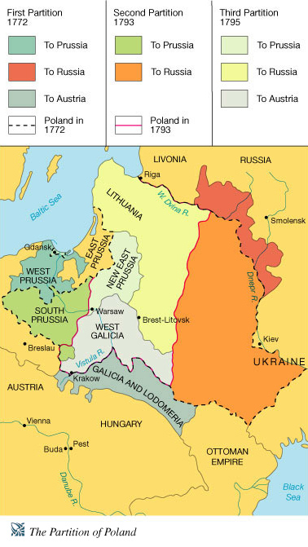
The Partitions of Poland

Slide 2
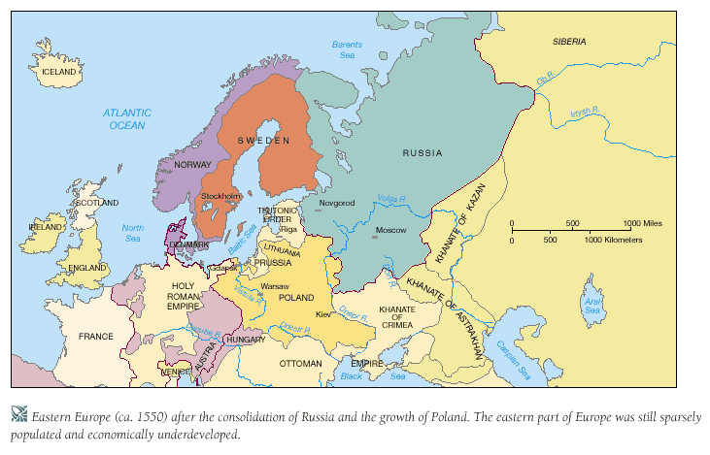
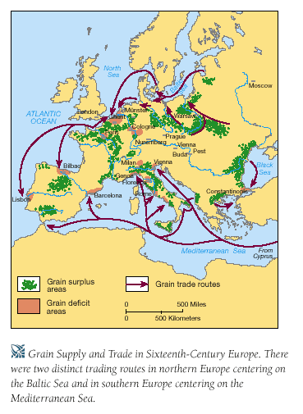
Introduction
Poland
  largest European state previous to partitions (1772)
Government
  remained older political structure
  failed to develop modern systems
No army, no revenues, no administration, and no unity

Slide 3
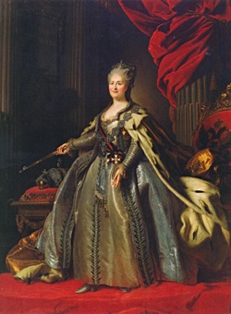
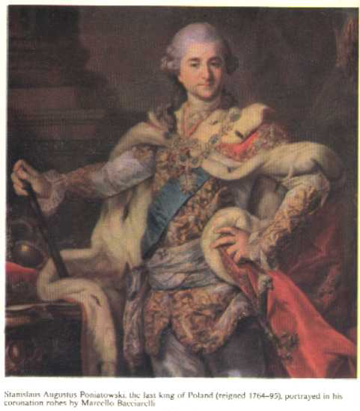
External interference
War of Polish Succession (1733)
two Polish kings were Germans
infighting led to weakness and call for reform
  Wanted to end liberum veto
most notorious outside interest Catherine the Great
1763 Catherine supports Russian puppet in Poland
  Stanislas Poniatowski is named king
  Declares herself the protector of Polish liberties
  Internally divided Poland leaves opportunity for Russian influence the whole country

Slide 4
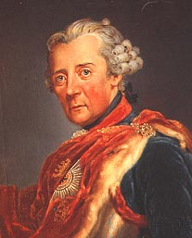
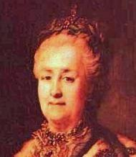
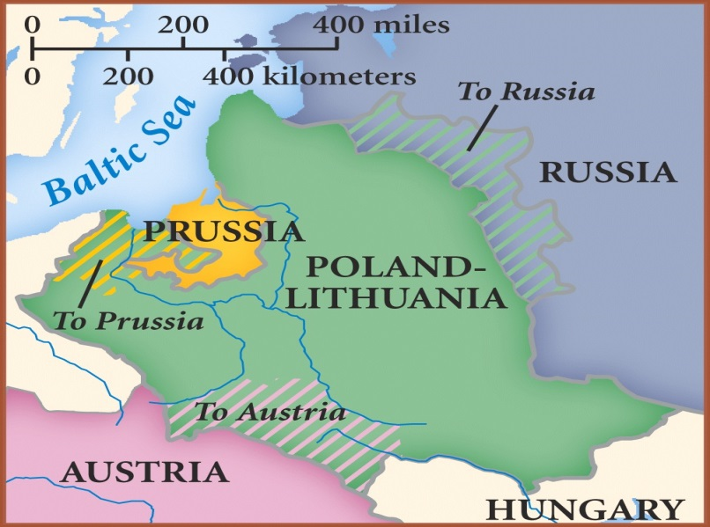
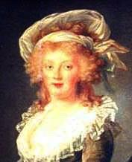
The first partition
1772 Russia earns a stunning victory against Ottomans
Fear of balance of Power shifting to Russia causes Prussia to propose a partition of Poland (making Prussia contiguous with Brandenburg)
  Russia, Prussia, and Austria agree to partition to avoid war between Russia and Austria
    Ottoman Turks are spared (weakening of empire is evident)
    Poland is sacrificed

Slide 5
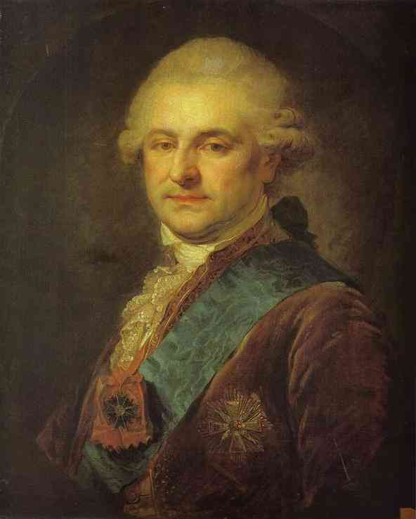
The first partition
Poles redouble efforts at internal reform (elite class)
  Poniatowski urges reforms as King
    New constitution is issued
      King is hereditary not elected strengthens monarchy
      Reduced the power of the landed gentry
      Increased the power of the burghers in the towns

Slide 6
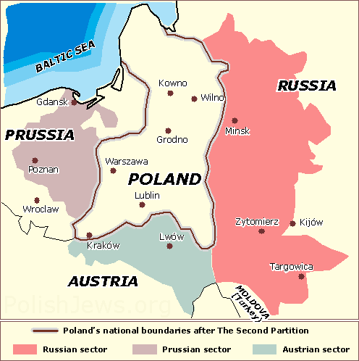
Final Slices
The second partition
By 1791 fears of the French Revolution spreading in Europe leads Russia to intervene in Polish reform efforts (called the reformers Jacobins)
1791 Catherine sends in Russian army with support of displaced nobles
1793 Catherine and Prussia take another slice of Poland for each

Slide 7
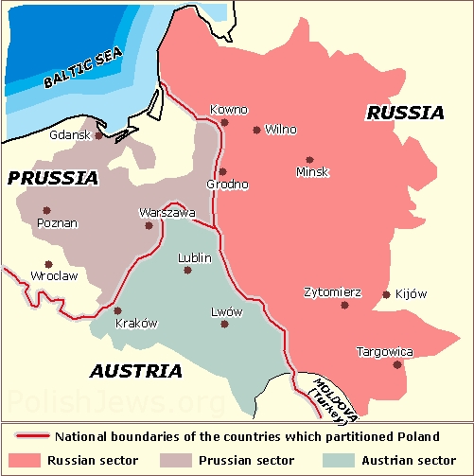
Final Slices
The third partition
1794 Liberal reform effort led by Thaddeus Kosciuszko
Proposed the abolition of serfdom
Reform effort is crushed in the wake of counterrevolution
1795 Prussia and Russia invade with armies and divide the remainder of Poland between Prussia, Austria, and Russia

Slide 8
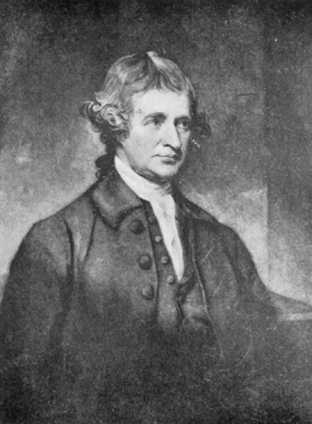
Evaluation of Poland’s Partitioning
At the time the partitions of Poland were praised as an end of an old nuisance and an affirmation of enlightened rulers (enlightened despots)
  War was prevented in Europe by diplomatic means
  Replaced anarchy with solid government
  Partitions fell around ethnic lines
Edmund Burke of England
  Saw the partitions as the beginning of the end for the old order in Europe
    Balance of power was traditionally used to preserve states
    In Poland balance of power was used to destroy a “state”

Slide 9
Evaluation of Poland’s Partitioning
Alarming that a state could disappear through cold diplomatic calculation
  No established rights seem safe
  Lesson: It is dangerous not to be strong around giant states
Partitions changed the balance of power overall in Europe
  France loses an ally in the east against Germany
  Save the Poles becomes the nationalist rallying cry
  Three great monarchies are drawn together in common opposition to national liberation
    Agrarian economic base accentuated division between east (reactionary) and west (liberal)
  Eastern empires in Europe control territories until WWI
  Fall under control of Soviet Union after WWII
  1980s Poland re-establishes its national identity

Slide 10
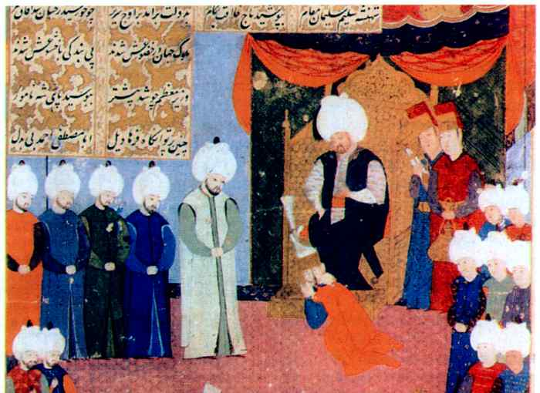
THE OTTOMAN EMPIRE

Slide 11
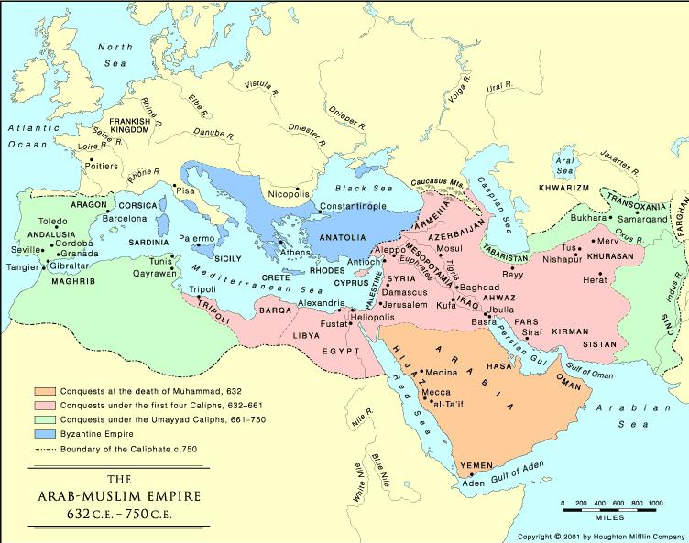
Islam Map

Slide 12
ORIGINS of the Ottoman Empire
It was one of the largest & longest lasting empires in history
It was an empire supported & inspired by Islam
It replaced the Byzantine Empire (former Roman Empire) as the major power in the Eastern Mediterranean.

Slide 13
Religion
Founded on the principles of Islam
United by Islamic beliefs
Churches were converted into mosques
Tolerant of other religions, especially Christians and Jews
Encouraged loyalty from other religious faith groups
Notes:
, especially

Slide 14
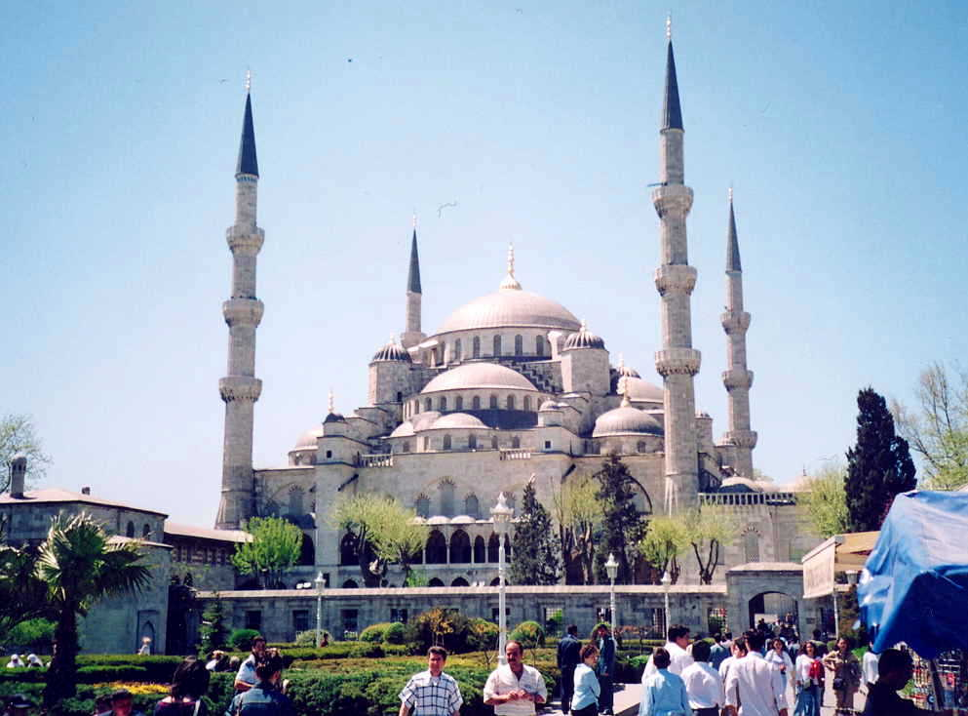
Mosque in Istanbul

Slide 15
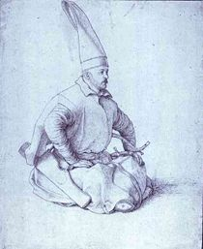
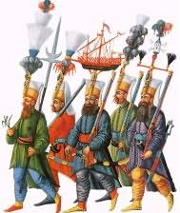
The Janissaries
Group of soldiers loyal to the sultan (king)
Army of slaves & Christian converts to Islam
Helped to expand the empire
Became so powerful that the sultans feared them

Slide 16
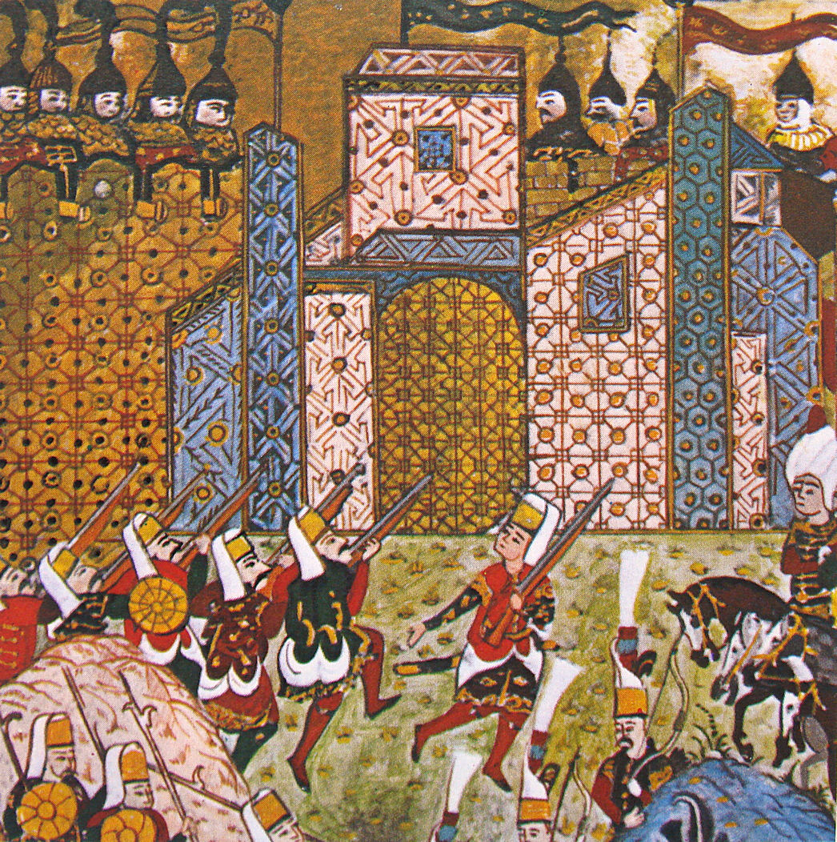
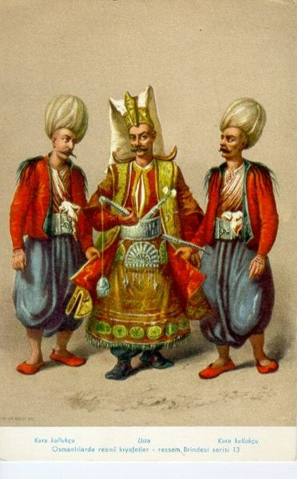
Janissaries Pic

Slide 17
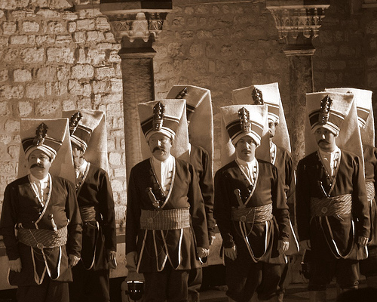
Janissaries Photo

Slide 18
Origins cont.
1352 A.D. sultans able to cross over into Europe
1453 A.D.-Ottoman soldiers known as Janissaries conquered Constantinople (Istanbul) from the Byzantine empire, thus ending the Roman Empire.
1517 A.D. Ottomans had control of Egypt & extended control to most of North African coast.
1520-1566: peak of power during rule of Suleiman (“The Magnificent”)

Slide 19
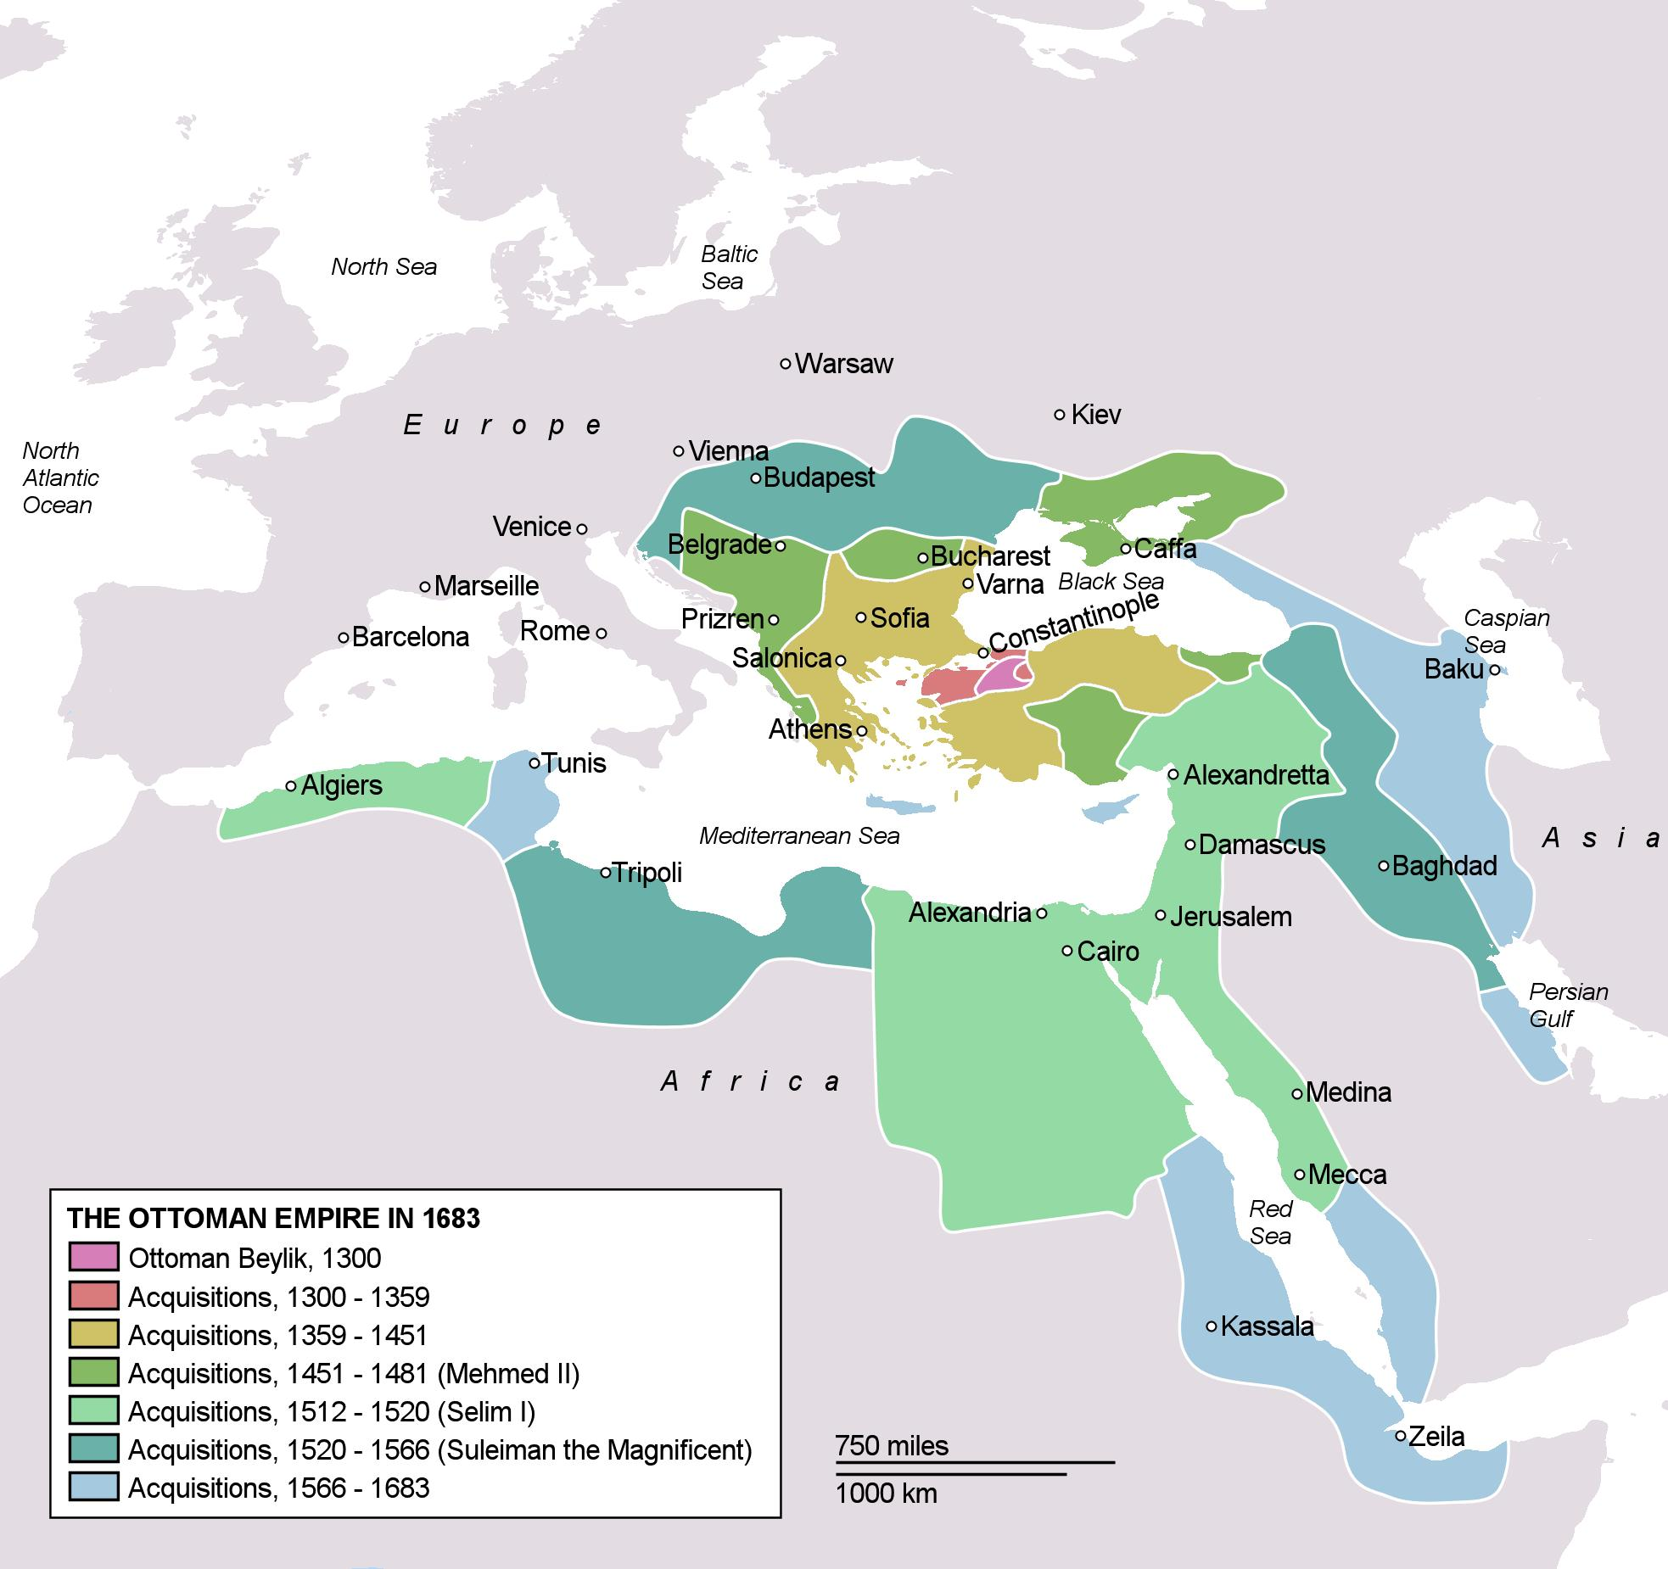
Ottoman Map 2

Slide 20
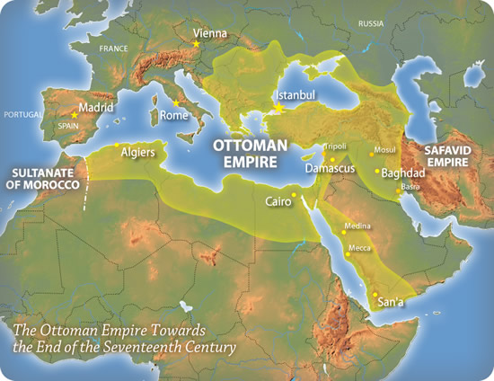
Ottoman Map 1

Slide 21
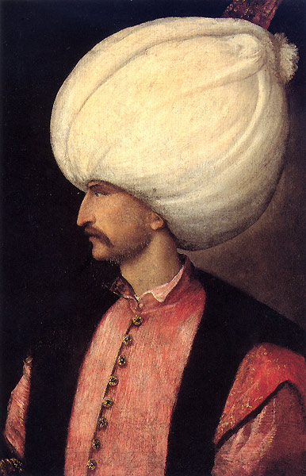
Suleiman
Ruled from 1520-1566
Made Ottoman Empire the richest & most powerful empire in Europe and Southwest Asia at the time

Slide 22
Suleiman
Greatest Ottoman leader of all time
Brought justice & harmony by publishing a code of laws (“The Lawgiver”)
Feared & respected by Europeans
Turned Constantinople into a great center of art, music, writing, and philosophy
Wrote some of the most beautiful poetry of his time

Slide 23
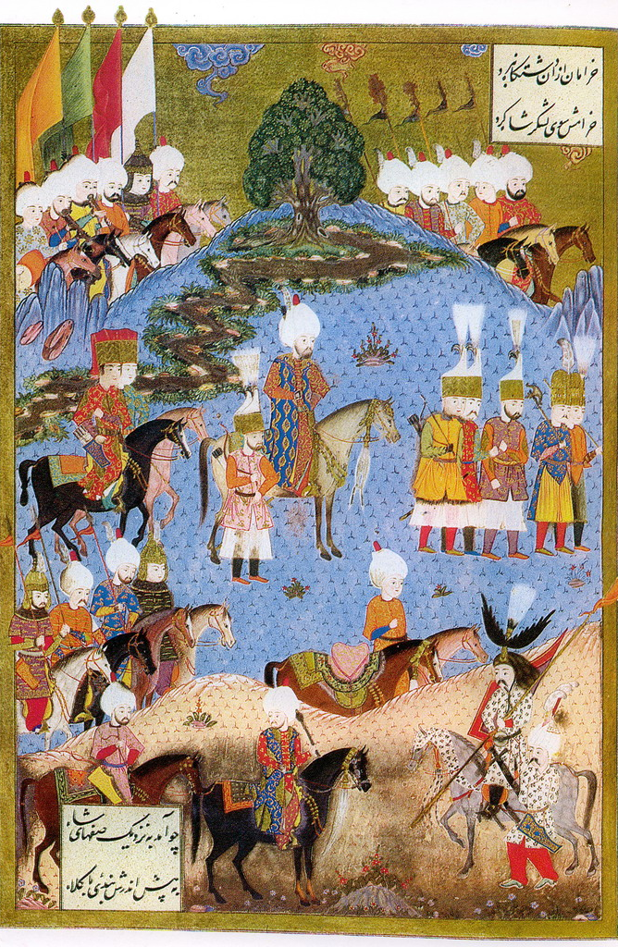
Suleiman Pic

Slide 24
Expansion
Suleiman believed that the entire world was his possession as a gift of God.
Vast amounts of Islamic territories were annexed or invaded.
Very strong military
Expert in developing gunpowder as a military tool

Slide 25
The Muslim Ottoman Empire eventually controlled what is now:
Turkey
Egypt
Greece
Bulgaria
Romania
Macedonia
Hungary
Palestine
Jordan
Lebanon
Syria
Much of the coastal strip of North Africa
Parts of Arabia

Slide 26
Trade
Located on major trade routes between Europe & Asia
Some goods traded were:
Silk & other cloth
Rhubarb
Porcelain from China
Spices such as pepper
Dyes such as indigo

Slide 27
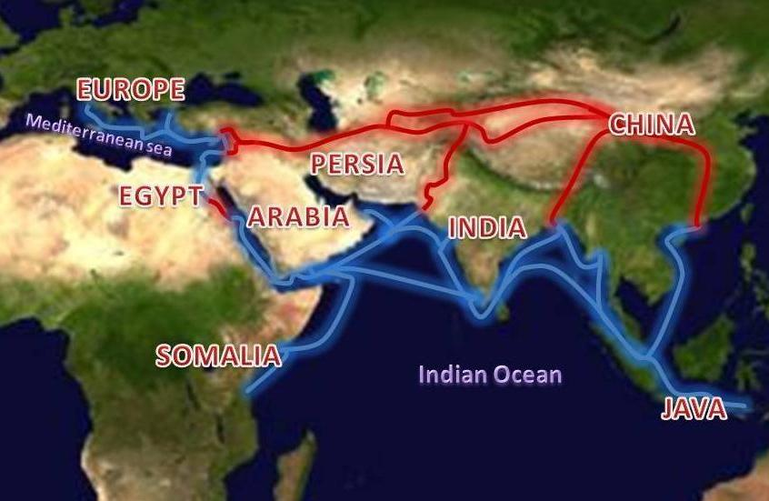
Trade map

Slide 28
THE BREAKUP OF THE OTTOMAN EMPIRE
1571 A.D. – decline began after several military defeats
1683 A.D.-failed invasion of Vienna, Austria
Economic problems
1. trade competition from Americas
2. cheap products from India & Far
East
3. development of other trade routes
4. rising unemployment & near
bankruptcy

Slide 29
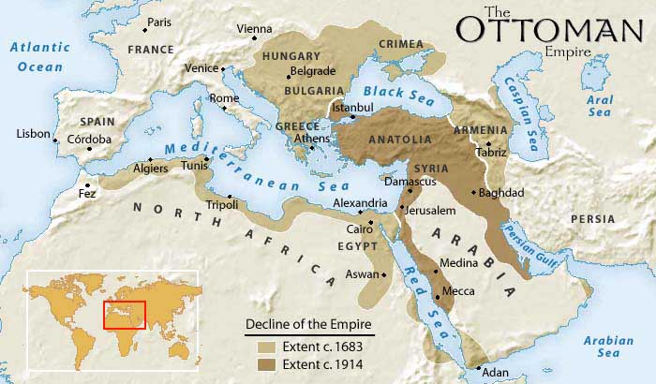
Decline Map

