Slide 1
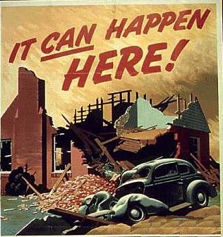
WWII Part II
1942-1945

Slide 2
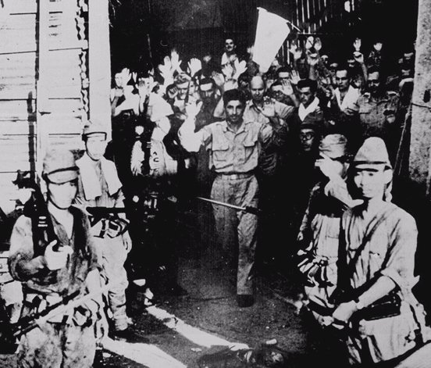
Japan Takes American Islands
1942 would start out poorly for the U.S. as Japan took many islands including the Philippines, Guam, and Wake Island.
The defeat in the Philippines was humiliating for the Americans
U.S. Surrenders at Corregidor, the Philippines [March, 1942]

Slide 3
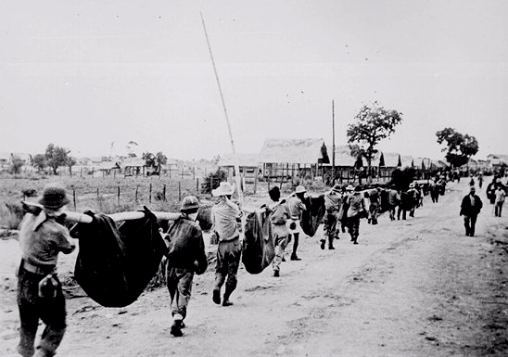
Bataan Death March: April, 1942
76,000 prisoners [12,000 Americans] Marched 60 miles in the blazing heat to POW camps in the Philippines.

Slide 4
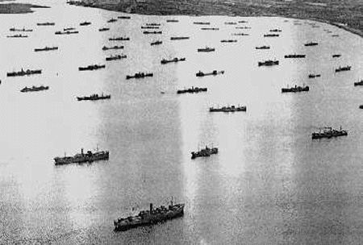
The Battle of the Atlantic
In the Atlantic there was the Battle of the Atlantic where America tried to keep Britain supplied through German U-Boats
U-boats had gotten smarter and now were hunting convoys in Wolfpacks which were groups of U-Boats that would hunt together
The U.S. and Britain would win the battle of the Atlantic through the invention of SONAR and using planes with RADAR

Slide 5
Midway
By June of 1942 the U.S. broke the Japanese message code making it so we could read their messages to each other.
The U.S. learned that Japan was going to attack the island of Midway and the U.S. set a trap.
When Japan attacked, the U.S. sprung the trap and sank 4 Japanese Aircraft carriers.
The Battle of Midway is the turning point in the pacific war.

Slide 6
El Alamein
In August of 1942 the British will gain their first victory over Germany in Africa
British troops will defeat German troops at the battle of El Alamein the turning point in North Africa
After the Americans invade North Africa the next year the Germans surrender

Slide 7
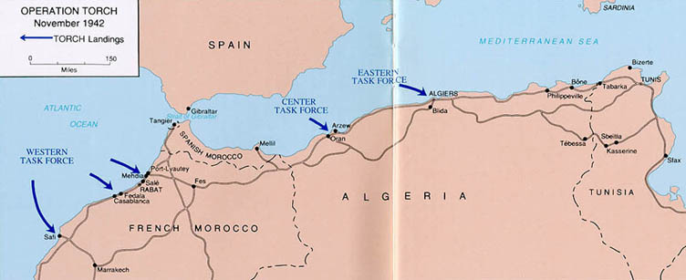
Operation Torch
The Americans will land troops in North Africa.
This will be the first time American troops fight Germany and will give them valuable experience

Slide 8
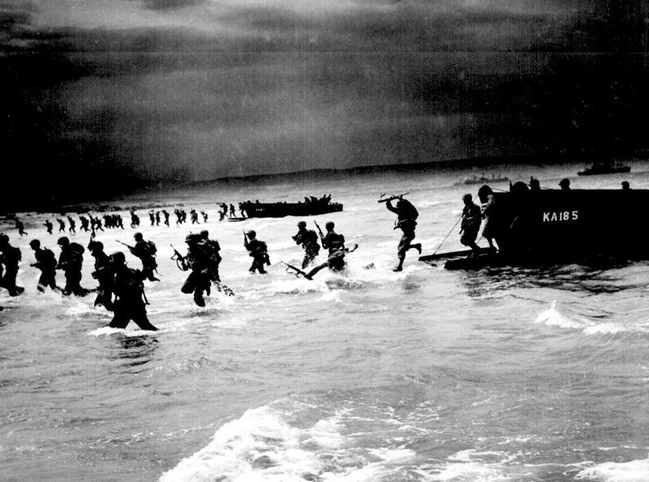
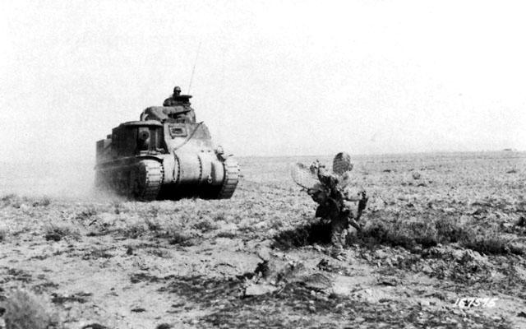
Oporation Torch

Slide 9
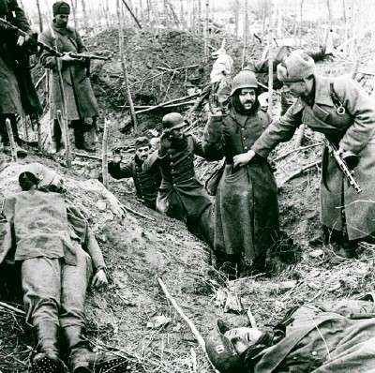
Stalingrad
From August 21 1942 to February 2 1943 the Germans and Soviets will fight over the city of Stalingrad in Southern Russia.
If the Germans take the city they will have access to Soviet Oil.
In early 1943 the Soviets will surround the Germans and force them to surrender an entire army making it the greatest German defeat in the war
The Battle of Stalingrad is the turning point in the eastern front

Slide 10
1943
In 1943 the Allies will invade and defeat Italy but were unable to advance into the Alps.
Mussolini is arrested, will escape, but be murdered by his own people.
The U.S. will begin to retake islands in the Pacific Ocean using a plan known as Island Hopping where they skip islands that are not as important and take larger, more important islands like Guadalcanal.
The allies will decide at the Casablanca Conference that Germany and Japan will have to surrender unconditionally
The Allies met later that year at the Tehran conference and agreed to open a western front in Europe in 1944, this will be known as operation Overlord

Slide 11
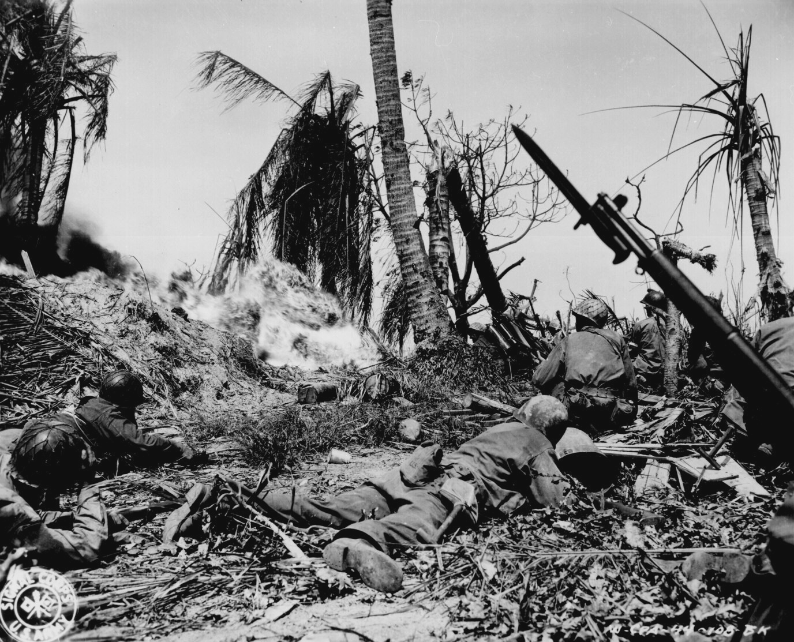
“Island-Hopping”: US Troops on Kwajalien Island

Slide 12
War Time Conferences
The allies will decide at the Casablanca Conference that Germany and Japan will have to surrender unconditionally
The Allies met later that year at the Tehran conference and agreed to open a western front in Europe in 1944, this will be known as operation Overlord.

Slide 13
Operation Overlord
On June 6 1944 the U.S., British, and Canadians will invade Normandy France .
This will be known as Operation Overlord or D-Day.
The effort will be led by the supreme commander of the allied forces Dwight D. Eisenhower.
The invasion will force Germany to fight on two fronts and will be a complete success.

Slide 14
Battle of the Bulge
After Normandy the Allies quickly took France and were preparing to invade Germany.
To prevent this, Hitler decided to launch a surprise assault against the Allies to retake France.
This attack will be halted creating a “bulge” in the front lines.
General George S. Patton pushed the Germans back to close the bulge.
It was the longest battle of the war, but it will hasten the end of Hitler’s Germany.

Slide 15
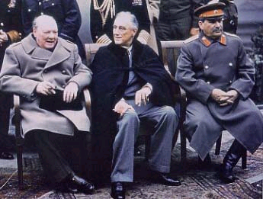
Yalta Conference- Feb. 1945
Stalin promises that Poland (with a new boundary that favored the USSR), Romania, and Bulgaria will have free elections
Plans made for post-war United Nations
Stalin promises to attack Japan- after Germany is defeated
Yalta was the first moment where it became clear that
the US and USSR had drastically different post-wartime goals, and were going to be drastically different peacetime powers.

Slide 16
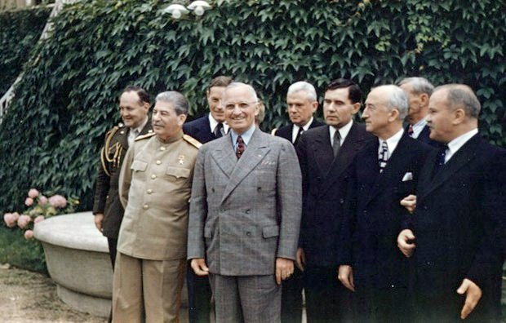
Potsdam Conference
Last conference of the war, Roosevelt had died so Truman represented America in the big 3.
During the conference he is informed of the success of the Manhattan Project.
Truman tells Churchill, but not Stalin, this will create tension later.
An ultimatum is issued to Japan for unconditional surrender.
The powers agreed to divide Germany after the war into four zones.

Slide 17
V-E Day
The Russians take Berlin
V-E day (victory in Europe) occurs on May 8th, after Hitler’s suicide.
As promised the Soviet Union attacked Japan after the defeat of Germany taking the northern part of Korea.

Slide 18
V-J Day
As the American’s approached Japan, Americans will invaded traditionally Japanese territory; the islands of Iwo Jima and Okinawa.
The Americans suffered enormous casualties over very small territory, this will factor in the decision to drop the atomic bomb.
On August 6 1945, the 1st atomic bomb on Hiroshima.
On August 9th, after the Japanese refused to surrender, a second atomic bomb was dropped on Nagasaki Japan.
After the 2nd bomb, on September 2nd the Japanese will surrender, ending WWII.

Slide 19
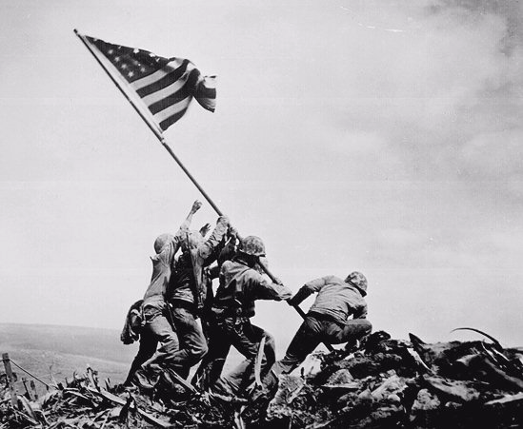
US Marines on Mt. Surbachi, Iwo Jima [Feb. 19, 1945]

Slide 20
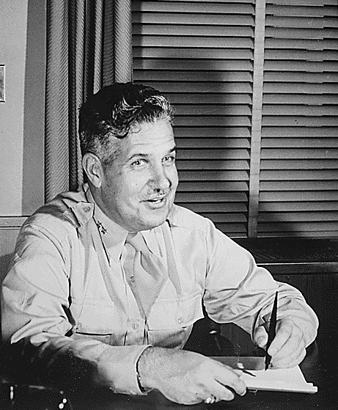
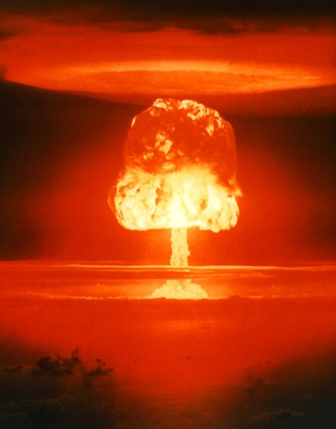
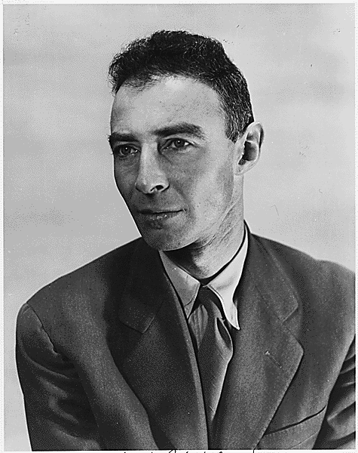
The Manhattan Project: Los Alamos, NM
I am become death, the shatterer of worlds!
Major General Lesley R. Groves
Dr. Robert Oppenheimer

Slide 21
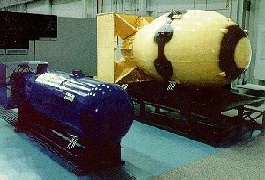
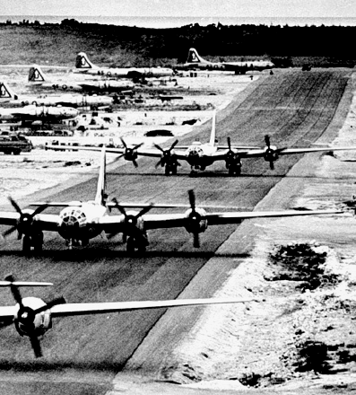
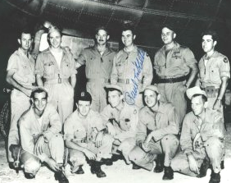
Tinian Island, 1945
Little Boy Fat Man
Enola Gay Crew

Slide 22
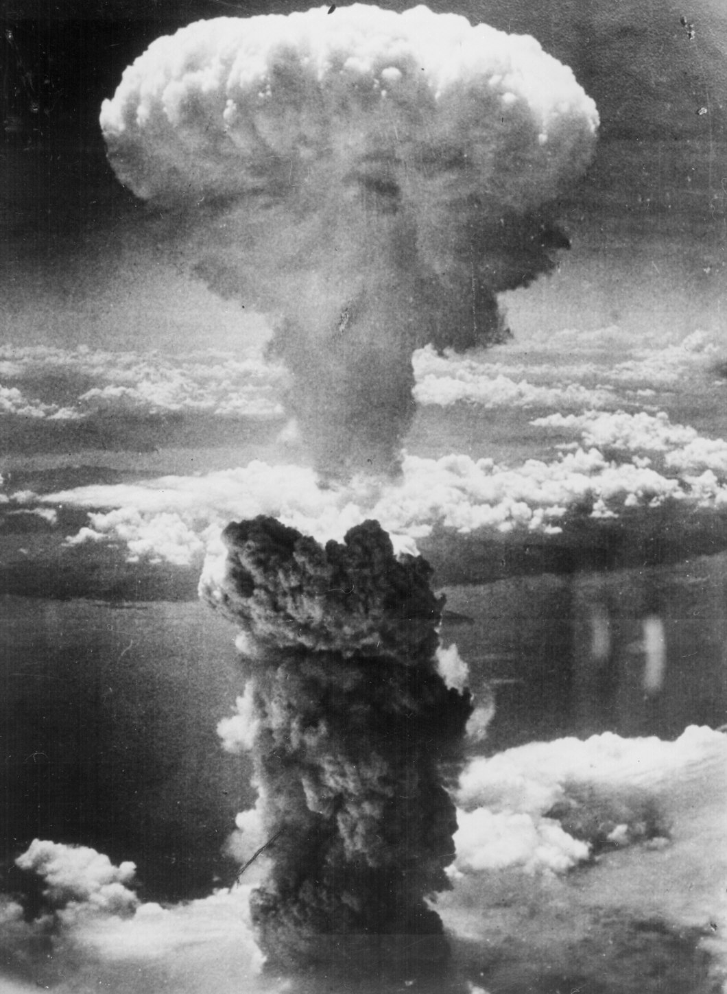
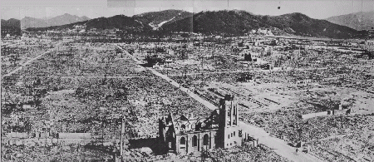
Hiroshima – August 6, 1945
70,000 killed immediately.
48,000 buildings. destroyed.
100,000s died of radiation poisoning & cancer later.

Slide 23
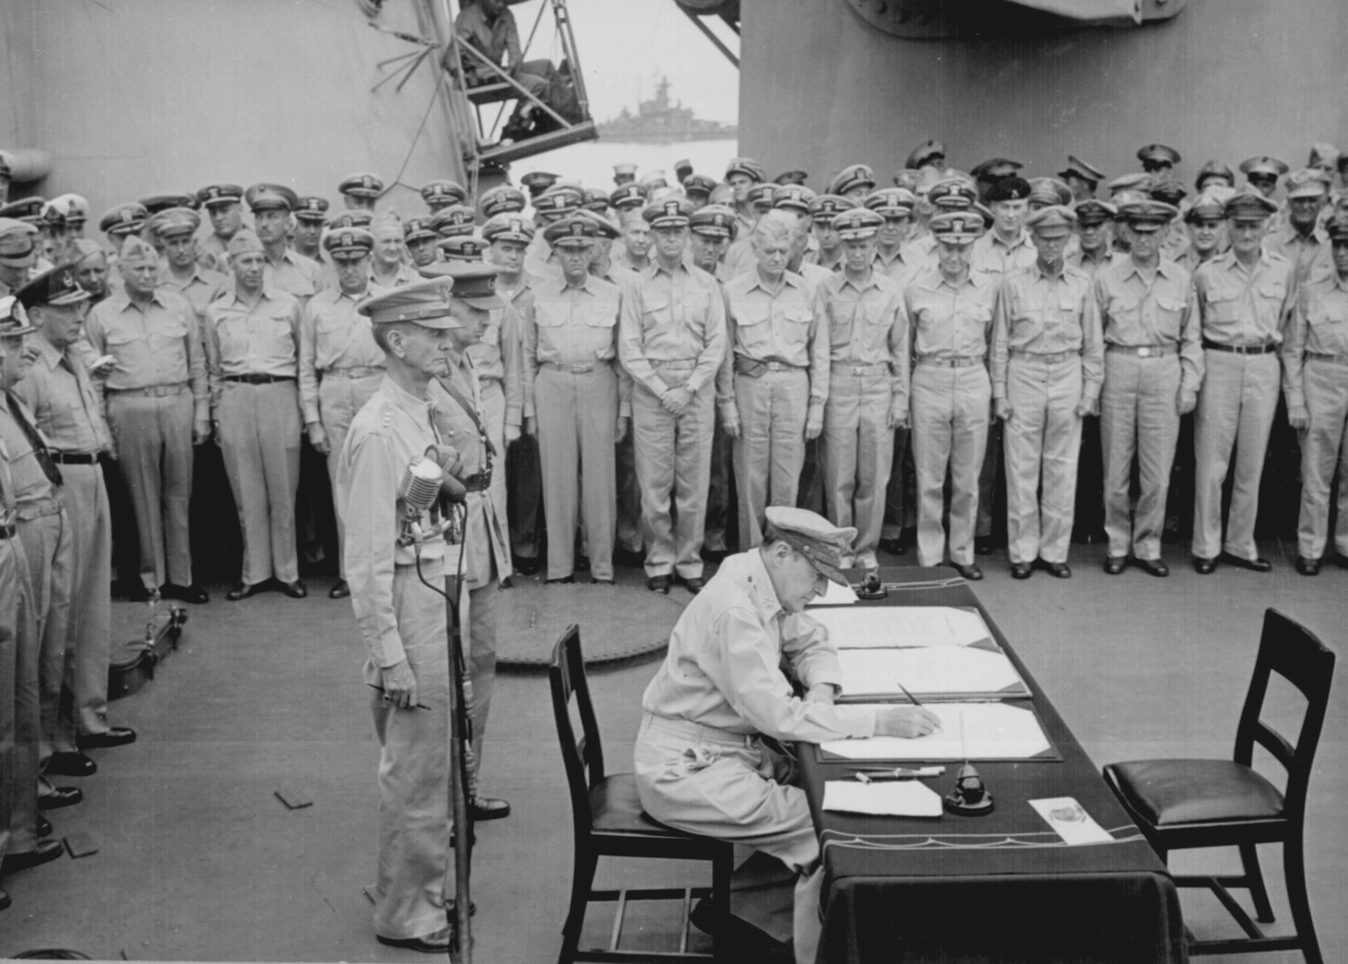
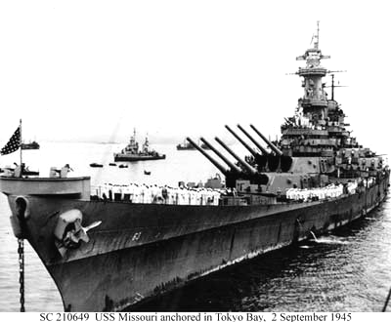
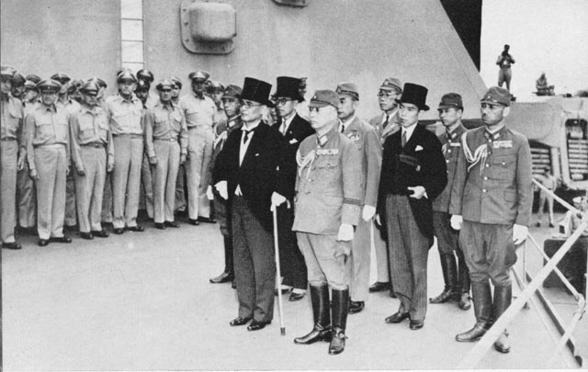
V-J Day (September 2, 1945)

Slide 24
The Holocaust
From 1933-1945 Nazi Germany was committed to a policy of genocide toward all Jews, gypsies, homosexuals and anyone else Hitler considered an “undesirable.”
Millions were rounded up into camps, forced to do slave labor, starved, and murdered either by gas, or being shot.
In the end around 12 million people were killed, half of them Jews.
As the Americans and Russians find the camps they are sure to take many pictures, and show the horrors of them as often as possible to demonstrate the horror of Nazi Germany

Slide 25
Country | Estimated Pre-War Jewish population | Estimated Jewish population annihilated | Percent killed
Poland | 3,300,000 | 3,000,000 | 90
Baltic countries | 253,000 | 228,000 | 90
Germany & Austria | 240,000 | 210,000 | 90
Bohemia & Moravia | 90,000 | 80,000 | 89
Slovakia | 90,000 | 75,000 | 83
Greece | 70,000 | 54,000 | 77
Netherlands | 140,000 | 105,000 | 75
Hungary | 650,000 | 450,000 | 70
Byelorussian SSR | 375,000 | 245,000 | 65
Ukrainian SSR | 1,500,000 | 900,000 | 60
Belgium | 65,000 | 40,000 | 60
Yugoslavia | 43,000 | 26,000 | 60
Romania | 600,000 | 300,000 | 50
Norway | 2,173 | 890 | 41
France | 350,000 | 90,000 | 26
Bulgaria | 64,000 | 14,000 | 22
Italy | 40,000 | 8,000 | 20
Luxembourg | 5,000 | 1,000 | 20
Russian SFSR | 975,000 | 107,000 | 11
Finland | 2,000 | 22 | 1
Denmark | 8,000 | 52 | <1
Total | 8,861,800 | 5,933,900 | 67

Slide 26
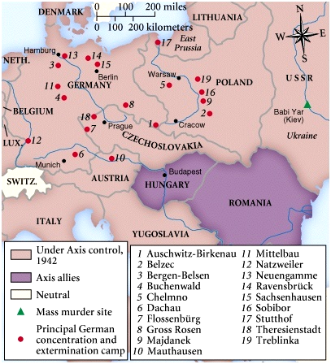
Horrors of the Holocaust Exposed

Slide 27
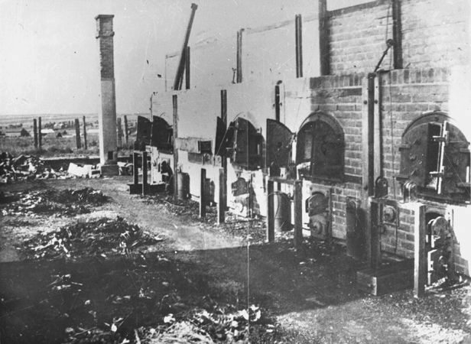
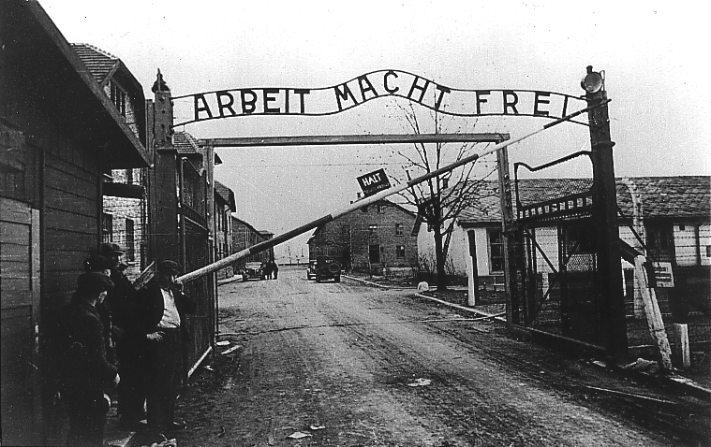
Horrors of the Holocaust Exposed
Entrance to Auschwitz: Work Makes You Free
Crematoria at Majdanek

Slide 28
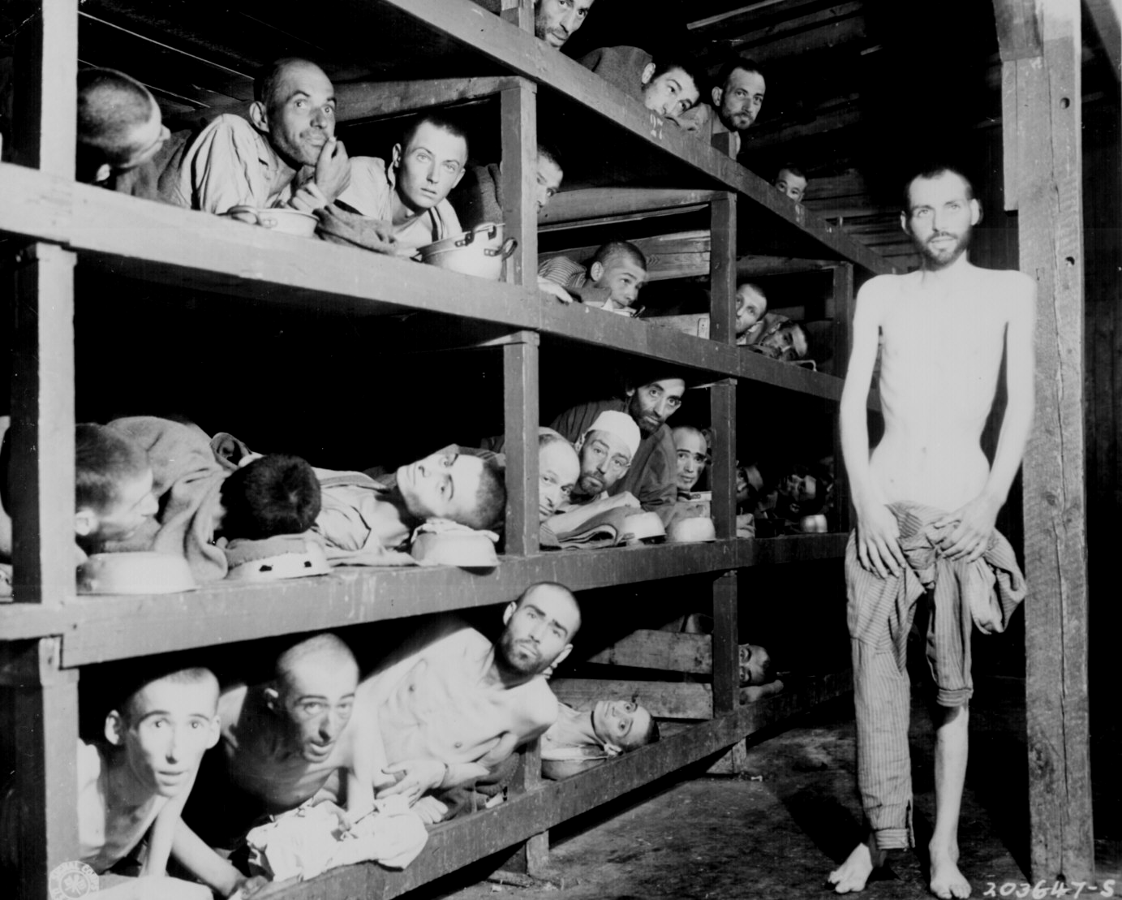
Horrors of the Holocaust Exposed
Eli Wiesel
Slave Labor at Buchenwald

Slide 29
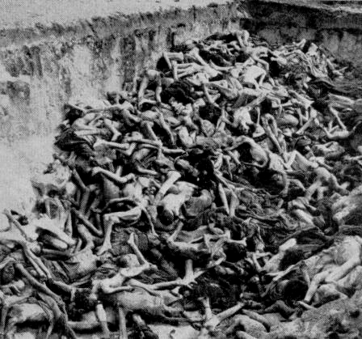
Horrors of the Holocaust Exposed
Mass Graves at Bergen-Belsen

Slide 30
The Aftermath of the War

Slide 31
The U.S. & the U.S.S.R. Emerged as the Two Superpowers of the later 20^{c}

Slide 32
Country | Men in war | Battle deaths | Total Killed
Australia | 1,000,000 | 26,976 | 40,500
Austria | 800,000 | 180,000 | 120,000
Belgium | 625,000 | 8,460 | 88,000
Brazil² | 40,334 | 943 | 2,000
Bulgaria | 339,760 | 6,671 | 25,000
Canada | 1,086,343⁷ | 42,042⁷ | 45,400
China³ | 17,250,521 | 3-4,000,000 | 10-20,000,000
Czechoslovakia | — | 6,683⁴ | 325,000
Finland | 500,000 | 79,047 | 97,000
France | — | 217,568 | 576,600
Germany | 20,000,000 | 3,250,000⁴ | 8,680,000
Greece | — | 35,024 | 805,290
Hungary | — | 300,000 | 580,000
India | 2,393,891 | 87,000 | 1.5-2.5,000,000
Italy | 3,100,000 | 301,400⁴ | 457,000
Japan | 9,700,000 | 2,120,000 | 3,120,000
Netherlands | 280,000 | 17,500 | 301,160
New Zealand | 194,000 | 11,625⁴ | 11,625
Norway | 75,000 | 3,000 | 9,500
Poland | — | 664,000 | 5,820,000
Romania | 650,000⁵ | 350,000⁶ | 800,000
U.S.S.R. | — | 10,700,000⁴ | 26,600,000
United Kingdom | 5,896,000 | 357,116⁴ | 450,900
United States | 16,112,566 | 416,800 | 418,800
Total | 1,995,537,400 | 25,487,500 | 79,184,700
Yugoslavia | 3,741,000 | 305,000 | 1,025,000
WW II Casualties
Civilians only.
Army and navy figures.
Figures cover period July 7, 1937 to Sept. 2, 1945, and concern only Chinese regular troops. They do not include casualties suffered by guerrillas and local military corps.
Deaths from all causes.
Against Soviet Russia; 385,847 against Nazi Germany.
Against Soviet Russia; 169,822 against Nazi Germany.
National Defense Ctr., Canadian Forces Hq., Director of History.

Slide 33
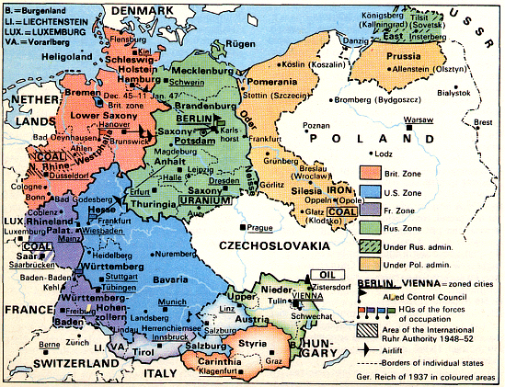
The Division of Germany: 1945 - 1990

Slide 34
Creation of the U.N.
The United Nations is created to try and maintain peace and stability
At its core is the security council that can vote to send in troops and makes all decisions about punishing countries
Britain, France, USSR, China, and the U.S. are the five permanent members of the council and have veto powers over its actions

Slide 35
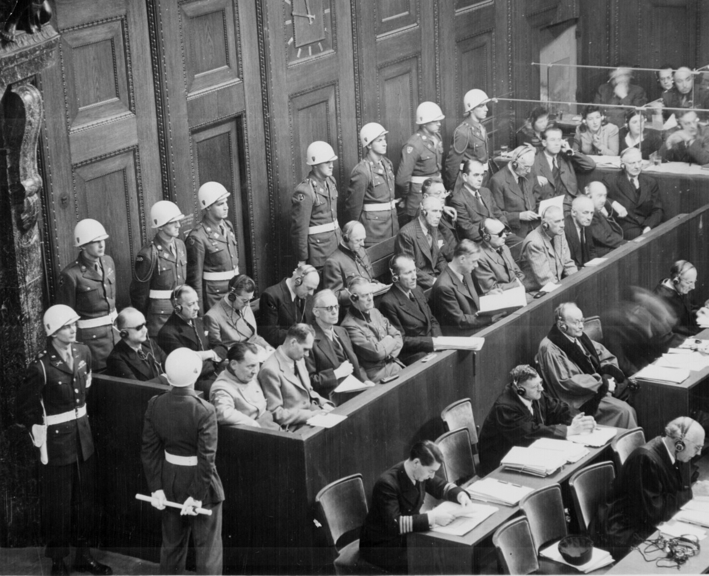
The Nuremberg War Trials: Crimes Against Humanity
Nazi leaders are tried for Crimes Against Humanity.
People are responsible for their actions even during war, you cannot hide behind orders.

