Slide 1
Empire, War, & Colonial Rebellion

Slide 2
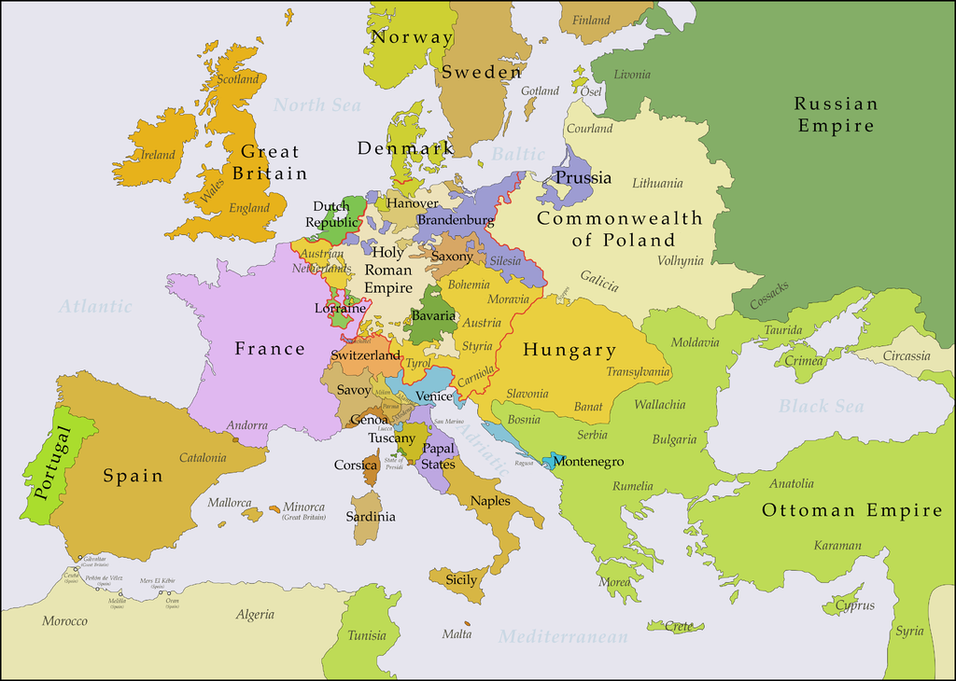

Slide 3
18th Century Empires
European countries during the 18th century used empires to promote mercantilism, and improve their economic status.
Trade rivalries developed causing great strain among the European powers.
Boundaries of empires established in the Treaty of Utrecht in 1713.
The rise of Russia and Prussia brought dynastic war to Central Europe

Slide 4
Source of Conflict
There were three major zones of conflict:
Central Europe (Hapsburgs and Hohenzollerns)
Eastern Europe (Russian growth at expense of Ottomans and Poland)
Colonies (British vs. French rivalry in north America and India)

Slide 5
French & British Rivalry
North America was a major source of conflict between France and Britain.
Competition among colonists
Conflict over fishing rights and fur trade.
Competition among each other to gain alliances with Native American tribes.
India was another source of conflict.
Competition for trade between the British East India Company and French trading companies.

Slide 6
Rivalry in India
The Mughal government of India was weakening during the 18th century.
France and Britain both saw it as an opportunity to expand their control of the region.
Both countries attempted to gain control of the government in India.
Joseph Dupleix of France
Robert Clive of England
Each country attempted to stop the other from government control of India.

Slide 7
Mid 18th Century Wars

Slide 8
Pragmatic Sanction (1713)
Designed to ensure that the Austrian throne and Habsburg lands would be inherited by Emperor Charles VI's daughter, Maria Theresa.

Slide 9
War of the Austrian Succession 1740 - 1748
In 1740, Frederick the Great of Prussia seized the Austrian province of Silesia.
Claimed he was not bound to the Pragmatic Sanction.
Silesia had rich farmland along with large iron deposits.
Its population was largely German speaking
Had a powerful army complemented by a capable centralized bureaucracy able to raise money through taxes
The seizure of Silesia began the War of the Austrian Succession.

Slide 11
European War
France sided with Prussia (Feared a strong united Germany under Hapsburg rule)
Britain, Russia, and the Dutch Netherlands sided with Austria.
Austria was hindered by a rebellion in Bohemia and the many different ethnic groups and privileges of the Habsburg Empire
The Bohemian Revolt was put down with Hungarian troops

Slide 12
Results of Austrian Succession
Treaty of Aix-La-Chapelle - 1748
Frederick kept Silesia which guaranteed another war
Status quo maintained
The Balance of Power continues to be the driving force in Europe

Slide 13
Diplomatic Revolution -1756
While Maria Theresa prepared for another war her prime minister Count von Kaunitz worked to separate Prussia from France
Austria forged an alliance with ancient Bourbon rival…France
This was done through the marriage of Maria's Daughter, Marie Antoinette to Louis XVI of France
Russia saw Prussia as hindrance to expansion and allied with Austria and France
Great Britain allied with Prussia in order to maintain the balance of power

Slide 14
Reforms of Maria Theresa
Centralized tax collection
Tripled size of army
Founded Military Academy and Engineering Schools.
Promoted primary education
Promoted smallpox vaccination
Outlawed torture and capital punishment
Goals was to get support of people to retake Silesia which failed.

Slide 15
The Seven Years War 1756-1763
Involved almost every European country.
Fought not only in Europe but also India and the Americas.
The French and Indian Wars
At one time, Prussia was surrounded by enemies in Europe.
With British aid, Frederick was able to hold off invasion.
Complexion of war changed when Russia changed sides and joined Prussia.
The Treaty of Paris 1763 ended the war.
Prussia allowed to keep Silesia and balance of power maintained
This is the first major global war
This is the first war where most sides were considered nation states and not just following a monarch

Slide 17
India
France vs. Great Britain
British under Robert Clive decisively defeat the French
Britain became the dominant European power in India.

Slide 18
French and Indian War 1756-1763
William Pitt the Elder (PM) “The Battle for North America was won on the fields of Europe”
Major victory for Great Britain over France

Slide 19
Treaty of Paris 1763
Britain gets all colonies east of Mississippi River (French Canada and Spanish Florida)
Britain gets control of India
France got control of some sugar islands in the Caribbean
THIS IS ONE OF THE MOST IMPORTANT TREATIES YOU WILL HAVE TO KNOW THIS YEAR!

Slide 20
In North America (known as French and Indian War) it left British colonists free of French threats.
It made the British want to force the colonists to pay for the cost of the war---which lead to the American Revolution.
It established the hatred of Prussia and Austria as rivals for German superiority.
Set the stage for the French Revolution (France is in major debt).
Britain now in charge of India sets out to destroy the Mogul Empire and a series of events that will change both nations.

Slide 21
Britain became the world's dominant naval and economic power

Slide 22
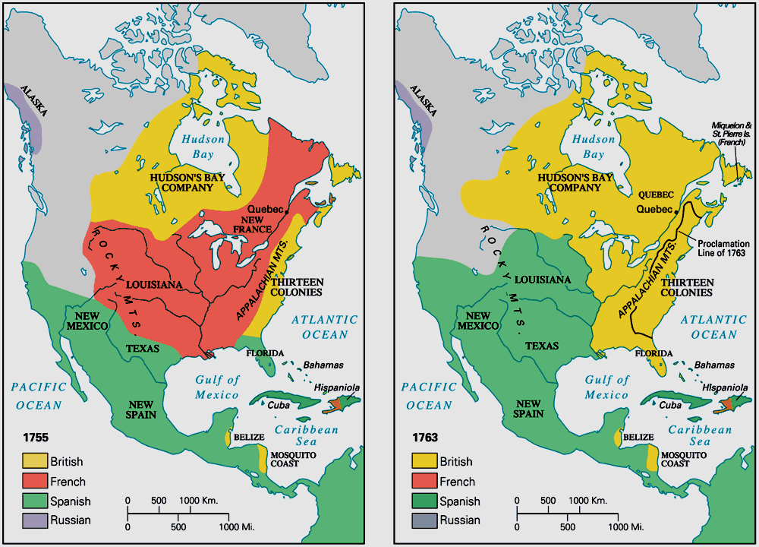
European Claims in North America Before and After the Seven Years' War (1756–1763)

