Slide 1
Power and Politics of the 18th Century

Slide 2
Beginnings
of the
Industrial Revolution

Slide 3
Agricultural and Production Changes in Europe
The Industrial Revolution begins in England in the 18th Century
It wasn't clear right away what was happening
It began from greater profits from agricultural goods that was then invested in manufacturing

Slide 4
Agricultural Revolution
Began in the Netherlands and England
Scientific Agriculture based on fertilizers and crop rotations
Charles “Turnip” Townsend popularized the use of turnips, clover, alfalfa----fodder crops
The Potato
Large family could sustain itself on less than 1 acre of land.
Main source of diet in Ireland, Russia and Prussia

Slide 5
New farming practice called Terracing allows for reclaiming swamps, bogs and hills
Jethro Tull---the seed drill, Cultivator
Selective Breeding awards for fattest cattle in England.
For efficiency—old farming methods ended & introduced Enclosure Acts
Forced unskilled workers to the cities

Slide 6
Results
- By 1750 15% of English crops are exported (even though people are starving)
- By 1790 England is producing 2.5 times more food per acre
- By 1770 agriculture was 40% of British GDP
- Half of English landowners were forced from their lands due to enclosure and rising rents
- The profits from this were used to invest in manufacturing

Slide 7
The Continent
- Along the Mediterranean poor farming techniques continued
- Peasants lacked draft animals and any incentive to increase production
- 1/3 of all arable land remained fallow
- However, more land was brought under cultivation
- Better weather helped everyone
- The Dutch used terracing and reclaimed land from the sea
- Most Eastern Europeans rejected the new crops from the new world

Slide 8
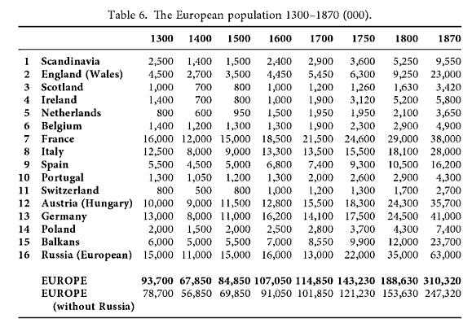

Slide 9
Commercial Revolution II
East India companies began to fall from favor
Joint Stock Companies to spread risk became popular
Triangular Trade was the new gold mine.
Started by Portuguese—after War of Spanish Succession it was controlled by the British
60,000 slaves brought to the New World
British capitalism is created by the slave trade and investments from rising agricultural goods
Most slaves were for the French and British on the Sugar islands

Slide 10
New Goods
- This sugar was needed for the NEW beverages that came from the east---Coffee and Tea
- New cloth---calico, a cheap cotton-like material
- Porcelain will become more common in households
- Cotton will slowly begin to replace wool, though this is resisted at first

Slide 11
Cottage Industry Expands
- During the 18th century most work was still done in workshops
- With the rise in the cottage system and more food population expanded leading the Thomas Malthus writing Principle of Population (1798) Which stated the Malthusian Trap
- Malthusian Trap: Although food production will rise arithmetically, population will rise exponentially
- With more people and the guilds controlling the cities the early capitalists turned to cottage industries (putting out system)

Slide 12
New Inventions
- Most new inventions were in England
- Not as important as investment
- Most important was Watt's Steam engine
- Darby → Cast Iron → Cheaper iron
- Cort → Wrought Iron → strongest iron
- Cay → Flying Shuttle → Made weaving faster
- Hargreaves → Spinning Jenny → Faster spinning
- Arkwright → Water Frame → Made better yarn
- This all was put together in the first factory systems where owners could monitor their workers and employ more of the new inventions by using capital investment

Slide 13
British Advantages
- Centralized government but limited monarchy
- Good roads
- Coal
- Iron
- Respected banks
- Monoculture
- Water transportation
- Safe from invasion

Slide 14
Consumer Revolution
- The new wealthy had more time to do what they wish and improved their cities
- Cafe's appeared and so did the 3 corner hat
- The consumer revolution extended to the poor
- Utensils and changes of clothes became common
- However, if you were very poor you still lived in the street

Slide 15
Social Issues of the 18th Century
- The middling sort aspired to an aristocratic lifestyle
- Many purchased noble titles
- 1715-1789 double nobility in France
- Could not purchase in England
- Entry in the British elite was more merit based through “country gentlemen”
- Old nobles and new nobles had tensions
- Nobles wanted their old privileges protected
Most people were more worried about starvation

Slide 16
Social Issues of the 18th Century Continued
- Life was tough, if young and healthy marriage could increase your chances of survival
- Makeshift economy
- By 1800 30% of England was in poverty
- Beggars (often victims of enclosure) would wander searching for work
- Children and the elderly bore the brunt of poverty
- Undernourishment was a problem
- Diet did improve during the century

Slide 17
Social Issues of the 18th Century Continued
- Charity helped, but not enough in France it was 5% of what was needed
- The upper class wanted to control the lower class by passing laws such as the Combination Act of 1721 which banned unions
- Many laws were made to protect property
- Examples: Marriage Act, Black Act, 50 new property capital offenses
- The French tried to confine the poor to teach them a trade
- The British eventually replaced workhouses with poorhouses
- Most believed the poor were at fault for their poverty and should be punished

