Slide 1
Age of Absolutism 1650-1720

Slide 2
Absolutism
In 17th Century Europe, absolutism was tied to the idea of the divine right of kings
Divine right = belief that the authority to rule comes directly from God
“The principal point of sovereign majesty and absolute power is to consist principally in giving laws unto the subjects in general, without their consent.” Jean Bodin.
Thomas Hobbes believed absolutism was the only way to prevent society from lapsing into “a state of nature” because people would obey only when they are scared of the consequences.
Absolute does NOT mean arbitrary, the idea was that no one could coerce the sovereign and therefore they were independent to make to right decisions for the country.
Absolute monarchs were still expected to consult representative bodies and listen to petitions of redress.

Slide 3
Absolutist States
Strong, ambitious dynasties whose goal was to enhance domain
Nobles that were guaranteed rights and privileges in return for loyalty
Central Europe had a weak middle class and much greater oppression of serfs.
Exception: Poland-Lithuania where the king was limited by the nobles.
After the turmoil of the wars of religion, nobles were willing to give monarchs more power.

Slide 4
Peasants
Peasants were free in the West and serfs in the East.
In the East the lucrative grain trade with the West made keeping a constant labor supply very importance, hence as feudalism ended in the West it was strengthened in the East.
The Ottomans and Russians were the most despotic with their peasants having the least amount of freedoms.
New state offices that appeared due to the centralization of the state were closed to the peasants.

Slide 5
War and Religion
Both titles and monopolies were sold in order to raise money that was often invested into the military
Kings did not want to depend on nobles for troops (as those troops could be used against the king.)
Military spending took up half of the budget in most European states.
The Church within an absolute state worked with the monarch to maintain control.
However, often the absolutist rulers would confiscate lands of the church in order to raise funds.
The Ottoman Empire was a theocracy.

Slide 6
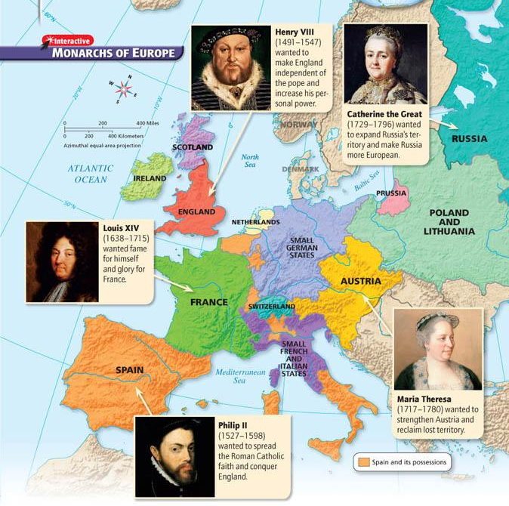

Slide 7
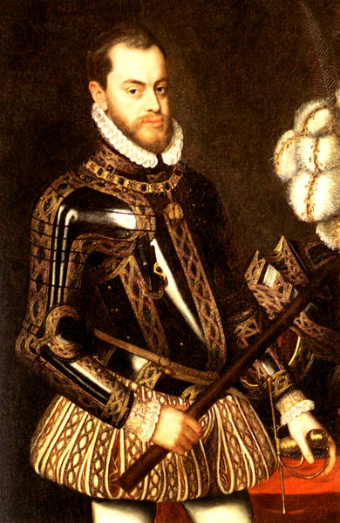
Spain
Philip II
(r. 1527-1598)
“Advancing Catholicism and Increasing Spain’s Power”

Slide 8
Background: Charles V
King of Spain & Ruler of the Holy Roman Empire
Ruling two empires involved Charles in constant warfare
As a devout Catholic, he sought to suppress Protestantism in the HRE (he was eventually forced to allow the German princes to choose their own religion.)
The empire proved to be too scattered for any one person to rule effectively so Charles divided it up between his brother, Ferdinand (HRE) and his son, Philip (Spain.)

Slide 9
Philip II
Reigned as an absolute monarch
Devoted most of his time to government work (unlike many other monarchs)
Defended the Catholic Church and turned back the rising Protestant tide in Europe
Fought many wars in an attempt to advance Spanish Catholic power (e.g., the Netherlands)

Slide 10
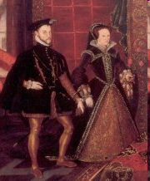
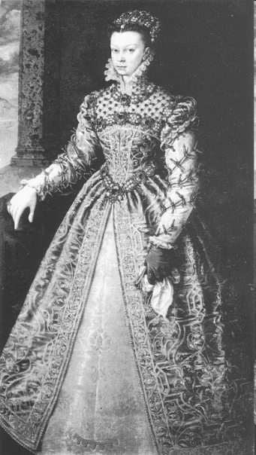
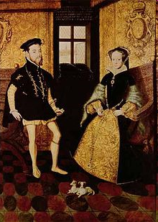
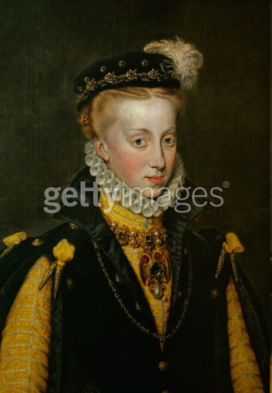
Tools to Extend Spanish Power
Marriage: Built alliances and pacified enemies
Maria – Alliance: Portugal
Mary Tudor – Alliance: England
Elizabeth Valois – Alliance: France
Anna – Alliance: Austria
War: Gained control of Portugal
Wealth: Silver and gold from colonies in the Americas fueled the Spanish economy and ensured Spanish power

Slide 11
Philip II’s Historical Significance/Legacy
Under Philip II, Spain reached the peak of its power
Established the first trans-Pacific trade route between America and Asia
Commenced settlements in the Philippines (the Philippines was named after him)

Slide 12
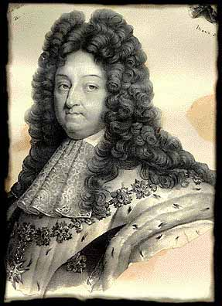
France
Louis XIV
(r. 1643-1715)

Slide 13
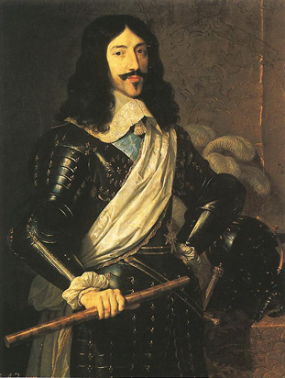
Louis XIII
Son of Henry IV
Inherited throne at age 9
Cardinal Richelieu appointed chief administer
Focused on strengthening the central government (extending royal power)
Sought to destroy the Huguenots and the nobles, two groups that did not bow to royal authority
Hand-picked his successor, Cardinal Mazarin

Slide 14
Louis XIV
Son of Louis XIII
Inherited throne at age 4
Believed in his divine right to rule
Took the sun as the symbol of his absolute power: just as the sun stands at the center of the solar system, so the Sun King stands at the center of the nation
The Estates General, the medieval council made up of representatives of all French social classes, didn’t meet once during Louis XIV’s reign and therefore played no role in checking royal power

Slide 15
The Fronde
In 1648 the Nobles of the Sword (ancient nobles) tried to regain influence lost during Louis XIII
Mazarin had lessened their power fearing “overmighty subjects”
In 1649 the Louis was forced to flee Paris.
The Frondeurs were eventually defeated and private armies were disbanded but this made Louis have disdain for elected bodies since the Parliament of Paris helped spark the rebellion

Slide 16
Louis XIV’s Policies
Expanded the bureaucracy and appointed intendants, royal officials who collected taxes, from the middle classes
Cemented his ties with the middle classes
Checked the power of nobles and Church
Recruited soldiers
French army became strongest in Europe
Army was used to enforce his policies at home and abroad
Use mercantilist policies to bolster the economy
New lands cleared for farming, encouraged mining and other basic industries, and built up luxury trades
Imposed high tariffs on imported goods to protect French manufacturers

Slide 17
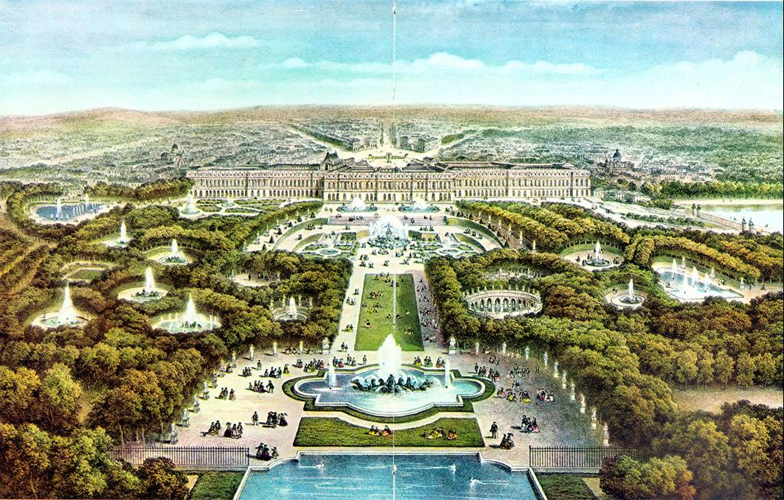

Slide 18
Versailles
Louis XIV spared no expense to make this the most magnificent building in Europe
Was the perfect symbol of the Sun King’s wealth and power
Served as the Louis XIV’s home and the seat of the government
Each day began in the King’s bedroom with a major ritual known as the levee, or rising
High-ranking nobles competed for the honor of holding the royal washbin or hand the king his diamond-buckled shoes
Purpose: These nobles were a threat to the power of the monarchy; thus, by luring nobles to Versailles, Louis XIV turned them into courtiers angling for privileges rather than rivals battling for power

Slide 19
Weakening France’s Economy
How did Louis XIV’s actions weaken France’s economy?
Waging war to expand France’s borders drained his treasury (other European nations wanted to maintain the balance of power = a distribution of military and economic power among European nations to prevent any one country from dominating the region)
Expelling Huguenots, whom Louis XIV saw as a threat to religious and political unity, removed some of his most productive subjects

Slide 20
Louis XIV’s Accomplishments
Strengthened royal power, the army, the economy, and the arts to make France the leading power of Europe
Prevented dissent from within by keeping the nobles busy in the king’s court instead of battling for power (levee)
Versailles became a symbol of royal power and wealth
Did not allow Estates General to meet which will lead to a crisis.

Slide 21
Louis XIV’s Historical Significance/Legacy
Louis XIV’s efforts (political, military, and cultural achievements) placed France in a dominant position in Europe
His efforts didn’t, however, bring prosperity to the common people of France – his numerous wars and extravagant palaces effectively bankrupted the nation

Slide 22
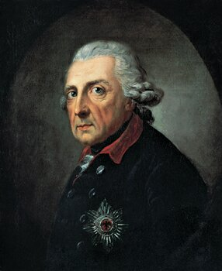
Prussia
Frederick II the Great
(r. 1740-1786)

Slide 23
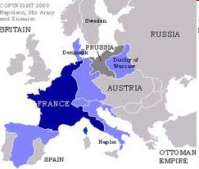
Prussia
While Austria was molding a strong Catholic state, Prussia emerged as a new Protestant power
The Hohenzollern rulers set up an efficient central bureaucracy

Slide 24
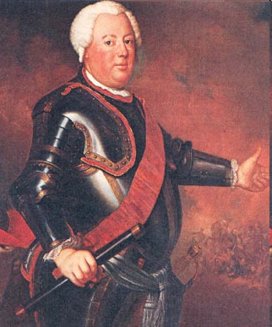
Frederick William I (r. 1713-1740)
Frederick William I gained the loyalty of Prussian nobles by giving them positions in the government and army, which reduced their independence and increased his own control
He also placed great emphasis on military values and forged one of the best-trained armies in Europe
Frederick William made sure that from a young age, his son Frederick was trained in the art of war

Slide 25
Rise of Frederick William (1640-1688)
In the Thirty Years’ War Prussia was destroyed by invading armies
The power of the Estates (the Junkers) was weakened and elector Frederick William (Great Elector) assumed absolute control
He wanted to unite 3 areas: Prussia, Berlin, and the Rhine
To pay for standing armies soldiers doubled as tax collectors and policemen

Slide 26
Creation of Prussia
There are 2 reasons he was successful
The wars between Sweden and Poland and the wars of Louis XIV seemed to create a sense of permanent crisis
The Junkers were unwilling to join the commoners against the crown
By 1688 Prussia was one state

Slide 27
Frederick II the Great (r. 1740-1786)
Frederick II’s harsh military training had an effect – he wasted no time using his army when he came to power in 1740
Seized Silesia and sparked the War of the Austrian Succession
Brilliantly used his army in several other wars, forcing all to recognize Prussia as a great power and earning himself the title of ‘Frederick the Great’
By 1750, the great European powers included Austria, Prussia, France, Britain, and Russia
These nations formed various alliances to maintain the balance of power
Two basic rivalries persisted: Prussia vs. Austria and Britain vs. France
These rivalries sometimes resulted in worldwide conflict

Slide 28
Frederick II the Great’s Accomplishments
Further consolidated power in Prussia
Seized Silesia in Austria, thus extending Prussia’s territory
Built a strong army and used that army to build a strong state (forced other nations to recognize Prussia as a great power)
“Prussia is not a state which possesses an army, but an army which possesses a state”

Slide 29
Frederick II the Great’s Historical Significance/Legacy
Brought Prussia from a state of general weakness to that of great power and wealth
Military successes and domestic reform brought land and prosperity to Prussia
He was an absolute ruler but he lived under the principle that he was the ‘first servant of the state’ – he always ruled under the guidance of what was most beneficial for Prussia, and expected his people to possess the same devotion

Slide 30
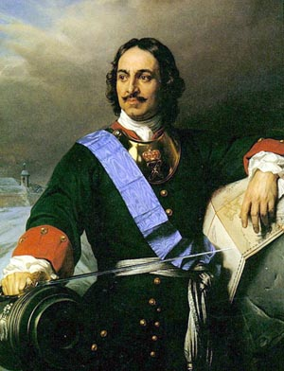
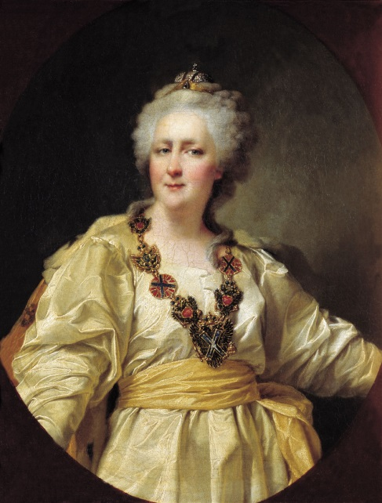
Russia
Peter I the Great
(r. 1682-1725)
&
Catherine II the Great
(r. 1762-1796)

Slide 31
Russia
The Mongols ruled the eEastern slavs for more than 200 years
Mongol rule was absolute and violent, uprisings were brutally suppressed
The Mongol Khan was supreme ruler
Mongols used local princes to collect taxes and as servants
Through cooperation, Moscow became the most loyal city

Slide 32
Rise of the Tsars
The prince of Moscow was the Tsar and he was an absolute rule
Ivan III no longer acknowledging the khan as a supreme ruler After the fall of Constantinople (1453) the tsars saw themselves as heirs to the Caesars and Orthodox Christianity
All the other kings of Europe were heretics
1505 the tsar of Moscow became ruler of all Russia

Slide 33
Ivan Consolidates Power
The tsar claimed a God-given right to rule
Ivan III (1462-1505) confiscated 80% of Novgorod. Kept half and gave the rest to his nobles, causing a rise in service nobility
Ivan IV “the Terrible” (1533-1584) claimed all nobles had to serve the Tsar in order to hold office
His purges depopulated much of Russia
Ivan believed he owned all the trade and industry
Contrasts with capitalism in western Europe

Slide 34
The Time of Trouble
The “Time of Trouble” (1604-13) followed the death of Ivan the Terrible
Peasant rebellion caused problems for the aristocracy
Social confusion and possible war brought the nobles to their senses.
In 1613 Michael Romanov was elected the new Tsar.
The tsar relaxed obligations of nobility, but increased pressure on the peasants.
By 1649 Serfdom became official 90% of peasants became serfs.

Slide 35
Peter I the Great
Took the throne at age 10 (1682)
Took control of the government in 1689
Traveled to the West in 1697 to learn about Western ways for himself – brought technical experts, teachers, and soldiers he recruited back to Russia
Peter I then embarked on a policy of westernization = the adoption of Western ideas, technology, and culture
Persuading Russia people to change their way of life was difficult
To impose his will, Peter I became the most autocratic of Europe’s absolute monarchs.

Slide 36
Peter I’s Goals
Strengthen the military
Expand Russian borders
Centralize royal power
Westernize Russia
Actions to Accomplish his Goals:
Brought all Russian institutions under his control
Forced the boyars (landowning nobles) to serve the state in civilian or military positions while allowing them to maintain control over their land (which forced peasants into serfdom)
Forced changes in social customs and pushed reforms (imported technology, improved education, etc.)

Slide 37
Modernizing Russia
Using autocratic methods, Peter I pushed through social and economic reforms
Imported Western technology
Improved education
Improved waterways and canals
Developed mining and textile manufacturing
Backed new trading companies
To pay for these reforms, Peter I adopted mercantilist policies, such as encouraging exports

Slide 38
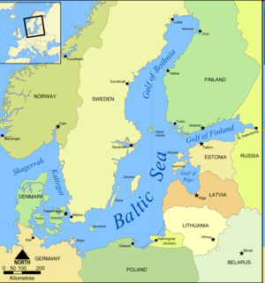
Warm-Water Port
Russia’s seaports, located along the Arctic Ocean, were frozen over during the winter.
To increase Russia’s ability to trade with the West, Peter wanted a warm-water port – one that would be free of ice all year. Pe
ter I tried to gain access to a warm-water port in the Black Sea but was unable to defeat the Ottoman Empire.

Slide 39
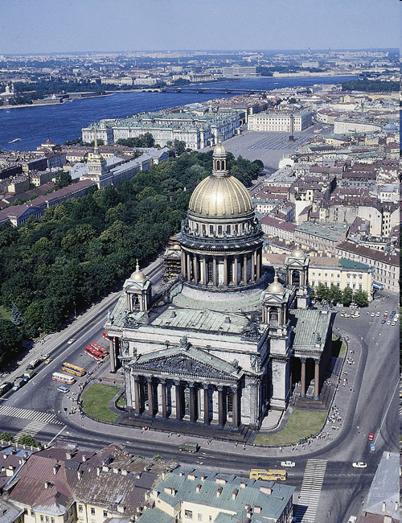
Expanding Russia’s Borders
The Great Northern War (1700-1709)
Against Sweden (dominated the Baltic region)
Russia suffered humiliating defeats – but after rebuilding the army, Peter I defeated the Swedes and won territory along the Baltic Sea
Used land to build a new capital = St. Petersburg
‘Window on the West’ – Italian architects designed palaces, etc.
Became a symbol of Peter’s effort to forge a modern Russia

Slide 40
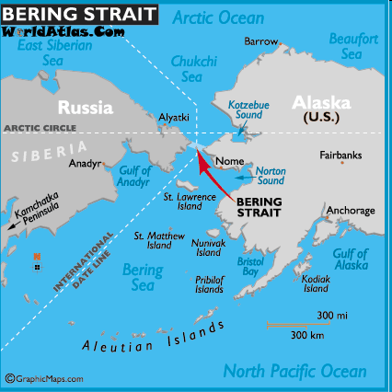
Trails to the Pacific
Expanded empire to the east by traveling across the plains and rivers of Siberia
Signed a treaty with China that recognized Russia’s claim to lands north of China
Hired a Danish explorer, who discovered the Bering Strait (made Russia the largest country in the world)

Slide 41
Peter I the Great’s Accomplishments
Using autocratic methods, Peter the Great:
Strengthened Russia’s military
Expanded Russian territory (defeated Sweden and created a new capital in St. Petersburg)
Ended Russia’s long period of isolation
Centralized royal power
Pushed through social and economic reforms to Westernize Russia

Slide 42
Catherine the Great
Capable and ruthless absolute monarch
Reorganized the provincial government
Codified laws
Began state-sponsored education for both boys and girls
Embraced Western ideas and worked to bring Russia fully into European cultural and political life
Allowed boyars to increase their hold on peasants, thus forcing even more peasants into serfdom. When the peasants rebelled, Catherine took firm action to repress them.
Waged the Russo-Turkish War against the Ottoman Empire, which gained her a warm-water port on the Black Sea in 1774

Slide 43
The Habsburgs
War and the threat of war aided the absolute monarchies
Would-be absolutists gained power in 3 areas: a) imposed and collected permanent taxes without consent b) maintained permanent armies c) conducted relations with other states as they pleased

Slide 44
Holy Roman Empire
Since 1556 the Habsburgs had been the Duke of Austria and Holy Roman Emperor
After the Treaty of Westphalia (1648) the Holy Roman Empire was in decline containing over 300 states that could conduct their own foreign policy
The Habsburgs were exhausted after the Thirty Years’ War, but they remained emperors of the Holy Roman Empire
The imperial army was small and slow to mobilize and was no longer the source of power for the Habsburgs, so they turned to marriage

Slide 45
The Habsburgs and Europe
The Habsburgs through marriage will inherit Austria, Hungary, Bohemia, Spain, The Netherlands, and part of Italy
Ferdinand III (1637-1657) centralized the government of the German-speaking provinces
This led to problems with a diverse population and the serfs
3 days of unpaid labor a week were demanded from serfs, many serfs worked everyday except Sunday (the Corvee)

Slide 46
Difficulties of Habsburg Rule
The Habsburgs controlled many different cultures and religions that all wanted autonomy
These different groups and lands impeded Habsburg absolutism
In 1679 Hungarian protestants started an insurrection that spread to Moravia, Silesia
King Leopold I (1658-1705) gave concessions to Hungarian landowners but other protestants called on the Turks for help
In 1683 the Turks laid siege to Vienna

Slide 47
The War of the Holy League 1686-1687
The siege was broken by the King of Poland on crusade
In response Poland-Lithuania and Austria formed the Holy League
The Habsburgs turned to fight the Ottomans, who under Suleiman the Magnificent ruled the most powerful empire in the world
Habsburg armies will recapture Hungary, Transylvania, and Croatia from the Turks
The Peace of Karlowitz (1699) brought and end to the Ottoman threat to Europe and will begin a long period of Ottoman decline that will last for 219 years

Slide 48
Habsburg Post 1700
The Habsburg state had 3 parts: a) Austria b) kingdom of Bohemia c) kingdom of Hungary
1713, Charles VI issues the Pragmatic Sanction, Habsburg possessions would never be divided even if it meant a female heir. b) Charles VI restored the rights of the aristocracy of Hungary

Slide 49
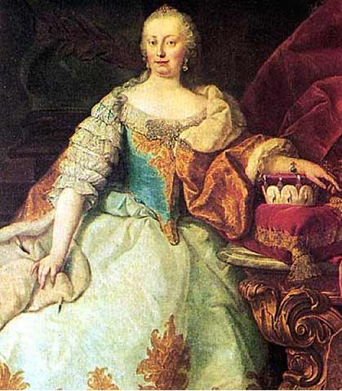
Austria
AUSTRIA: MARIA THERESA & JOSEPH II
MARIA THERESA (r. 1740-1780)
Strengthened central power of crown
Limited autonomy of regions
Aimed at making govt. more efficient
Limited burden on peasants, reduced ROBOT
Main concern = healthy pool of military recruits

Slide 50
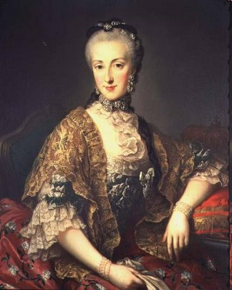
Maria Theresa & the War of the Austrian Succession
Daughter and successor of the Austrian emperor, Charles VI
No woman had ruled Hapsburg lands in her own name
Frederick II of Prussia seized the Hapsburg province of Silesia, which sparked the 8-year War of the Austrian Succession
With support from Britain and Russia, Maria Theresa preserved her empire and strengthened Hapsburg power by reorganizing the bureaucracy and improving tax collection (Britain and Russia didn’t want Prussia to upset the balance of power by gaining new lands)

Slide 51
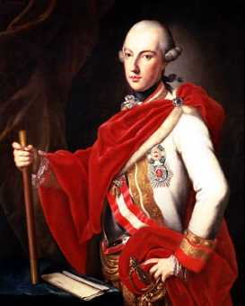
AUSTRIA: MARIA THERESA & JOSEPH II
JOSEPH II (r. 1765-1790)
Continued strengthening central authority
Asserted royal authority over church
Promoted religious toleration
Tried to improve economic conditions

Slide 52
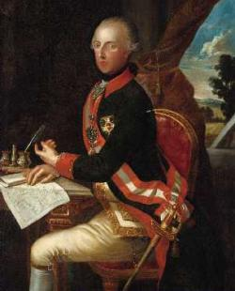
AUSTRIA: MARIA THERESA & JOSEPH II
JOSEPH II (r. 1765-1790)
Reformed judicial system & rationalized laws
Enacted far-reaching reforms of rural social structure
Abolished serfdom & robot

Slide 53
The Partitions of Poland
1770s – Russia, Prussia, and Austria eyed Poland
To avoid fighting one another, the three countries agreed in 1772 to partition, or divide up, Poland (not until 1919 would a free Polish state reappear)

Slide 54
Catherine the Great’s Accomplishments
Further Westernized Russia
Defeated the Ottoman Empire in the Russo-Turkish War and gained a warm-water port on the Black Sea

Slide 55
Peter the Great & Catherine the Great – Historical Significance/Legacy
Used terror to enforce absolute power
Westernized Russia
Expanded Russia’s borders through war, treaties, and exploration
Policies contributed to the growth of serfdom, which served only to widen the gap between Russia and the West (exactly the opposite of what Peter and Catherine wanted to do)

Slide 56
Looking Ahead
By the mid-1700s, absolute monarchs ruled four of the five leading countries in Europe – Britain, with its strong Parliament, was the only exception
As these five nations competed with one another, they often ending up fighting to maintain a balance of power
At the same time, new ideas were in the air – radical changes would soon shatter the French monarch, upset the balance of power, and revolutionize European societies

Slide 57
