Slide 1
Unit 2.3 The Articles of Confederation

Slide 2
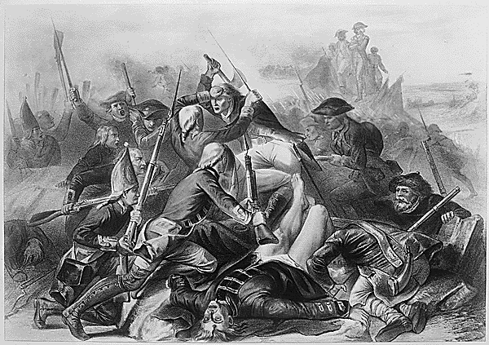
The Articles of Confederation
During the Revolution, the new United States needed a functioning government
States would retain sovereignty
Founders were fearful of concentrated power due to past experience with the British king.
2
Notes:
S2
The Articles of Confederation were crafted from a combination of urgent necessity and past experience. After the colonies declared their independence in 1776, the leaders needed a government to oversee the operation of the war and, if victorious, help the country settle the peace. Fundamental issues needed to be addressed: How much political power should be given to the central government when cooperation among the states was so important? Would France gamble on aiding the fledgling nation if the United States appeared weak? How would the central government speak for all the states while each state maintained its sovereignty?
In 1777, the “Articles of Confederation and Perpetual Union” were drafted and submitted to the states for ratification, but the states didn’t approve the document until March of 1781. The Articles were modeled after the colonial charters, with the legislative branch having supremacy over the other branches. The Articles’ creators made sure that each state would remain sovereign and would retain all power not expressly given to the national Congress. This would insure that all decisions made by the government were subject to discussion and debate and that the states would never face a distant dominant power as when they were colonies under Britain.

Slide 3
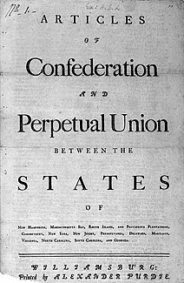
A Limited Government
Articles established a “firm league of friendship” among the states
Bills were passed on nine of thirteen votes
Amending the Articles took unanimous consent of the states
3
Notes:
S3
The Articles established a government which it characterized as a “league of friendship” for common defense, communication with other nations, and to administer and operate the government. It was assumed that most legislation and enforcement of laws would occur within the states and that laws passed by the national Congress would only be to administer the powers it was given. Even so, any law passed would have to be carried by a “supermajority” of over 67 percent, with nine of thirteen states voting in the affirmative. To further insure that the central government would not be granted any increase in power, any amendment to the Articles needed the unanimous consent of all the states.

Slide 4
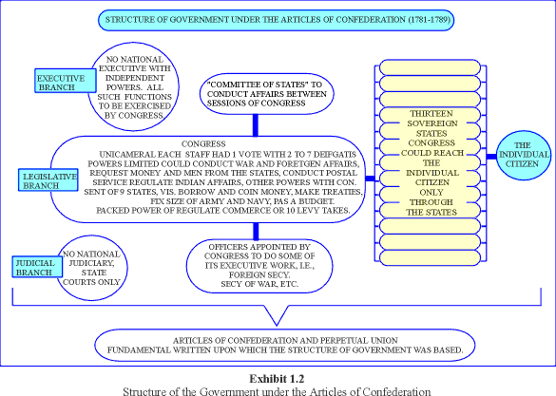
Structure of Government
Unicameral (single house) legislative body
Each state had one vote regardless of population size
Congress given sole authority to govern the country
4
Notes:
S4
The creators of the Articles believed that government was an agreement with the people and that power originated from the people. They further believed the best form of government was a republic, in which the people’s wishes were addressed by chosen representatives. The legislative body would be elected by and directly responsible to the people.
Soon after independence had been declared, many smaller states expressed concern regarding the overlapping claims to western lands made by many of the states with larger populations. The small states feared their voices would be drowned out if representation was based solely on population. Thus, to equalize representation in Congress, each state had one vote—regardless of the size of its population.
Congress was given the responsibility for governing the country; however, it wasn’t given much power to do so. An executive committee was meant to oversee the operations of the government, but it ended up serving more like a cabinet of advisors than as actual leadership. Congress had the authority to establish temporary courts to hear disputes among the states, but these courts could act only as mediators because they and the executive committee had no power to enforce the laws.

Slide 5
Powers Granted to Government under the Articles of Confederation
Declare war and make peace
Make treaties with foreign countries
Establish an army and navy
Requisition, print, and borrow money
Hear disputes among the states related to trade or boundaries
5
Notes:
S5
The Articles of Confederation granted Congress important powers to operate the government. When the document was drafted in 1777, the immediate concern was conducting the war and hopefully crafting a favorable peace treaty. To carry out the war, Congress needed the power to make treaties with foreign nations and to establish an army and navy and appoint military officers. Such powers gave Congress authority over affairs with foreign nations.
To help pay for the war and for the operation of the government after independence had been won, Congress would need to requisition funds and to print and borrow money. This requisitioning power allowed Congress to ask the states for funds, which the states would provide if they were able or inclined to do so.
Under the Articles, Congress also had the power to hear disputes among the states related to trade and boundaries. During and after the war, individual states sometimes established tariffs in order to raise revenue and discourage the sale of imports from foreign countries or neighboring states that competed with homegrown products. Other states targeted by these tariffs usually retaliated in kind.

Slide 6
Powers Denied to Government
No power to raise funds for an army or navy
No power to tax, impose tariffs, or collect duties
No executive branch to enforce laws
No power to control trade among the states
No power to force states to honor obligations
No power to regulate the value of currency
6
Notes:
S6
The Articles didn’t provide the government with enough authority to fully carry out the tasks it was given. Though Congress could declare war and raise military forces, it couldn’t pay for them because it lacked the power to tax. Congress could requisition funds from the states, but had no power to make them part with their money. Congress could borrow money, but had no way to raise funds to pay off the debt except to ask the states for funds. If a state disagreed with the way Congress spent the funds, it would refuse or delay payment.
Congress could appoint a court to hear the disputes between states, but it couldn’t enforce decisions the courts made. Thus, if a court ruled in favor of one state over another, the losing state wouldn’t have to comply with the decision.
After the war, the Treaty of Paris stipulated that British citizens still living in the former colonies would receive compensation for land or property seized. However, individual states did not force their citizens to make such restitution and Congress had no authority to compel the states to obey the treaty’s provisions.
To pay off the debt from the war, Congress was authorized to print money; however, each of the states had the power to print money as well. The resulting increase in currency, combined with a slowdown in the postwar economy, sent the young country into a deep economic depression. Inflation rose so high that the Continental Dollar became virtually worthless.

Slide 7
One Major Weakness
Congress did not have the power to collect taxes from the states.

Slide 8
What's a government to do?
Why doesn’t the government just print some more money?

Slide 9
PRINTING MONEY NEVER SOLVES YOUR PROBLEMS!

Slide 10
Money is only worth what other people will give you for it!

Slide 11
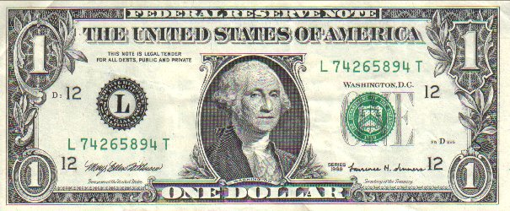
Paper money represents real things
One piece of gold
=
One piece of paper ($1)

Slide 12
Paper money represents real things
One can of soda
=
One piece of paper ($1)

Slide 13
Therefore...
One can of soda
=
One piece of gold

Slide 14
Remember...paper money represents real things. You haven't changed the number of real things, just the number of pieces of paper!
=
=

Slide 15
What if you don't have enough? What if someone won't give you what you want for the piece of paper that you have? Can you just print more paper?

Slide 16
INFLATION!
Now your paper money is worth less!
=
=
Soda used to cost $1. Now it costs $2!

Slide 17
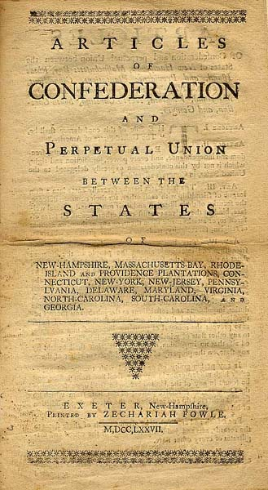
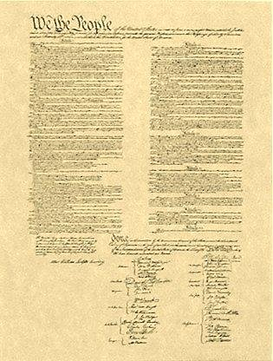
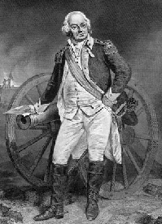
Weak Government = Problems!

Slide 18
Financial Crisis
The Congress didn't have the power to tax states they could only ask for money
The states said no
So Congress couldn't pay its bills
So they printed more money
So they caused inflation and made money worth less

Slide 19
Why is Property So Important?
Without property, you can't feed your family!
Without property, you can't vote!
Without property, you can't make money!
Without making money, you get thrown into debtor's prison!

Slide 20
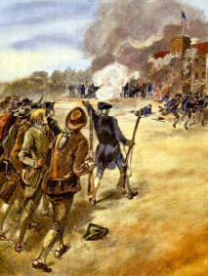
Shay's Rebellion
Daniel Shays and the farmers pick up their guns and go to the state courthouse to stop them from foreclosing on their homes.
AND IT WORKED!!!

Slide 21
So they kept doing it...
Since the Articles of Confederation did not give Congress the power to raise a standing army, the federal government could not help stop the rebellion.

Slide 22
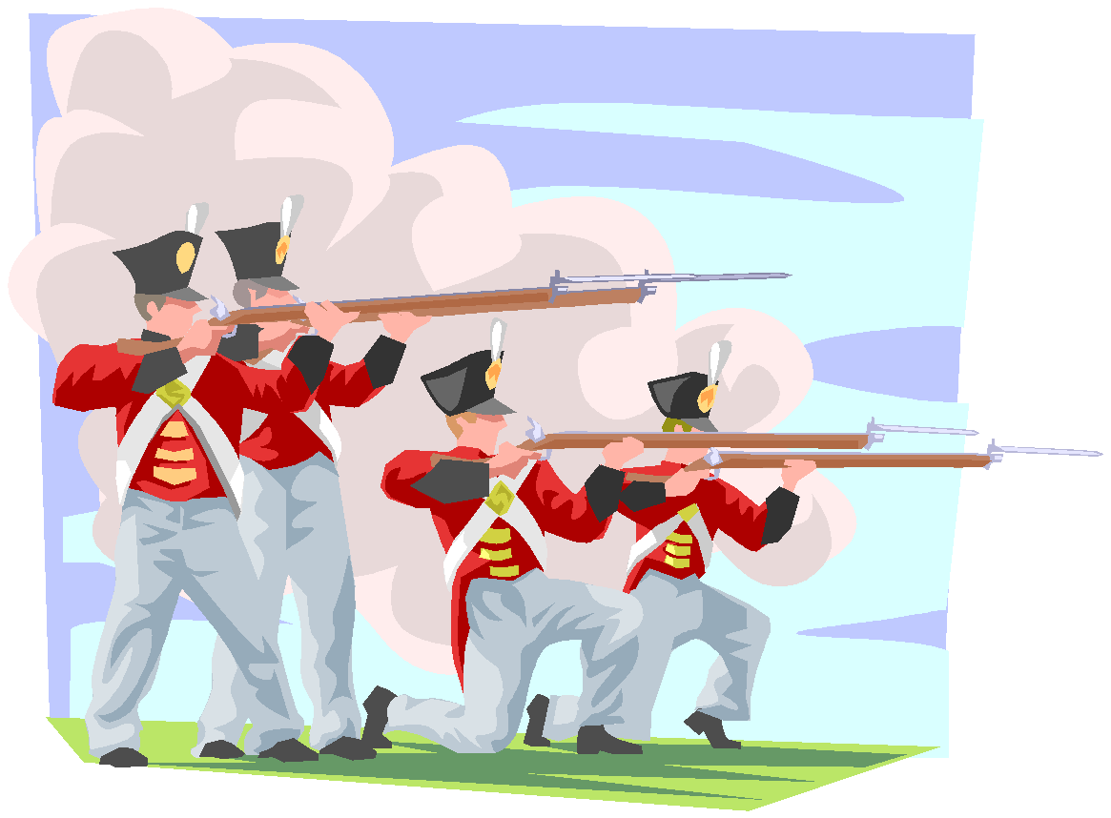
The Climax
The state of Massachusetts sets up an army.
Shays and his followers try to take over a federal arsenal to get more guns so that they could fight the army.

Slide 23
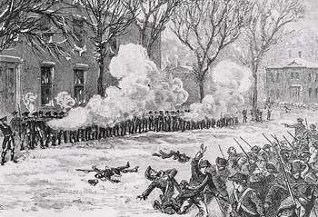
Shays and his men lost the battle. Some of them got the death penalty for having participated in the rebellion.

Slide 24
Something Needed to be Done
The failure of the federal government to solve the problem of Shays' Rebellion made people understand that the Articles of Confederation had made the government too weak.
A Convention was called to revise the articles
This Convention ends up writing the Constitution

Slide 25
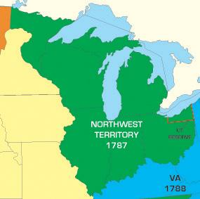
Accomplishments of the Articles of Confederation
Administered the seven-year war effort
Negotiated the Treaty of Paris with Britain in 1783
Established the Northwest Ordinance of 1787
NW Ordinance creates the 5 states north of the Ohio River and establishes how territories become states
Map of the land settled in the Northwest Ordinance of 1787
25

Slide 26
I. Constitutional Convention (1787):
Closed (not open to public) meeting between the delegates (representatives) from the 13 states.
Meeting took place in Philadelphia, Pennsylvania between May 25th and September 17th, 1787.
Delegates planned to amend (change) The Articles of Confederation.

Slide 27
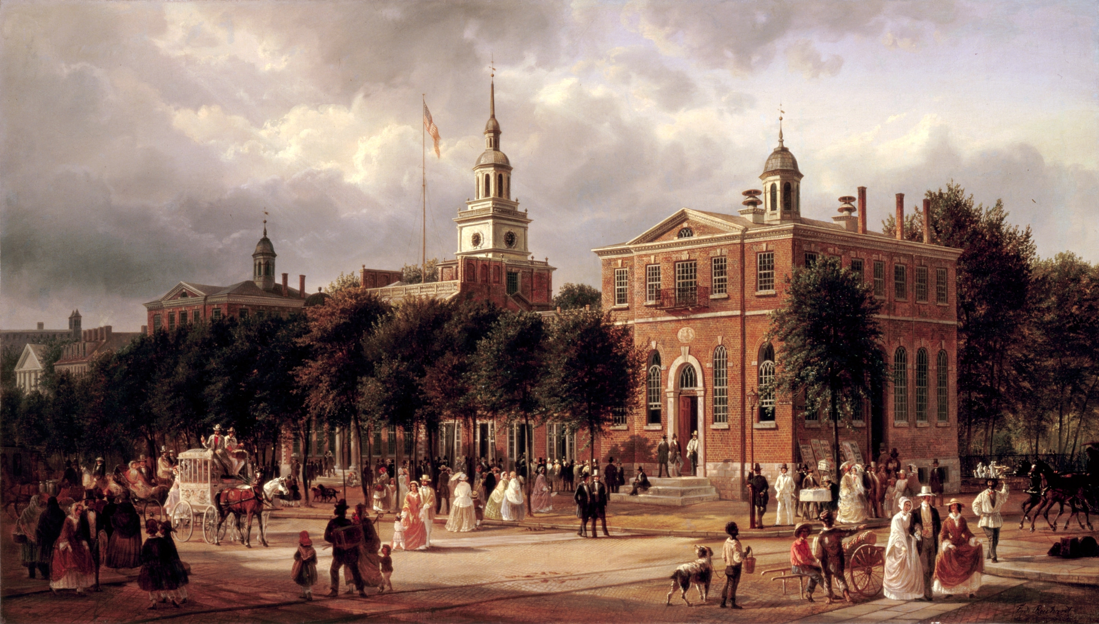

Slide 28
Results:
Delegates decided to scrap The Articles of Confederation and develop a new form of government.
It was a very long process which required a lot of compromise between states.
*George Washington was nominated to be president of the Convention.
**James Madison took very careful notes of the debates and discussions during the Convention.

Slide 29
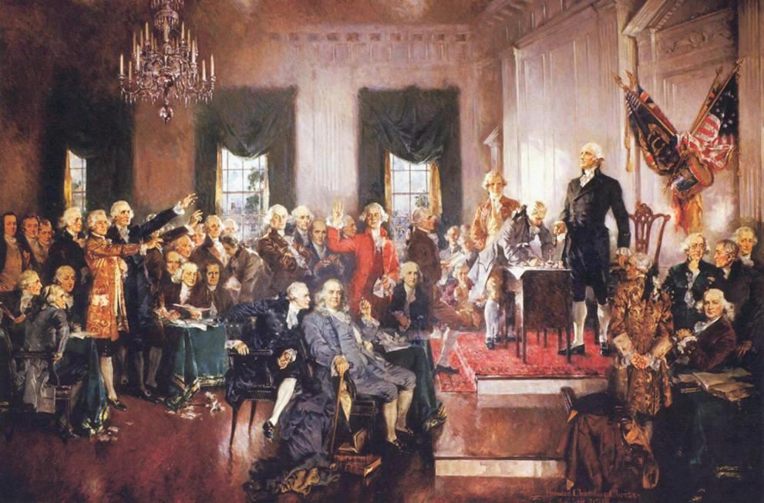
II. Major Arguments During The Constitutional Convention:

Slide 30
1. Representation of Large & Small States:
Large & small states argued over how their state would be represented.
Large (population) states felt they should have more say (power).
Small (population) states felt they should have equal say (power).
Results:
Two plans were proposed.
The debates over the issue of representation got so heated, the Convention almost ended.

Slide 31
a. Virginia Plan:
Favored the large states.
Each state would be given a number of votes / delegates based on their states’ population.
Proposed by James Madison of Virginia.

Slide 33
b. New Jersey Plan:
Favored the small states.
Each state would be given the same number of votes / delegates regardless of their states’ population.
Proposed by William Paterson of New Jersey.

Slide 35
A. Solution = The Great Compromise:
Used parts of both the Virginia & New Jersey Plan.
Set up a bicameral (two-house) legislature.
Proposed by Richard Sherman of Connecticut.

Slide 36
Results:
Senate (small states):
2 Senators per state regardless of population.
100 Senators total (today)
**from New Jersey Plan
House of Representatives (large states):
Votes / delegates per state based on population.
435 members of the House (today).
**from Virginia Plan
Problem of how to organize Congress was solved.
The Great Compromise satisfied both large & small states.

Slide 37
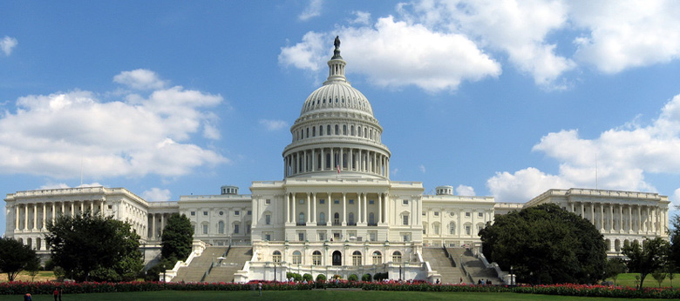

Slide 38
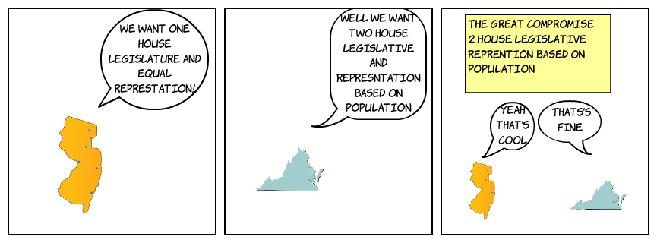
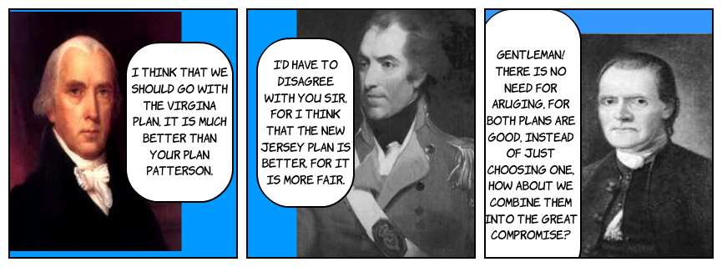

Slide 39
2. Slavery:
Some delegates from northern states wanted to abolish (end) the slave trade and slavery.
Many delegates from southern states threatened to leave the union if the slave trade or slavery were abolished in the U.S.

Slide 40
Results:
The word slavery does not appear in the Constitution.
Delegates agreed that;
The slave trade would not be discussed in Congress until 1808.
A $10 tax would be placed on the importation of each slave.
Runaway slaves would be returned to a state of slavery.
*Slavery was formally abolished with the ratification of the 13th Amendment (1865).

Slide 41
“The Migration or Importation of such Persons as any of the States now existing shall think proper to admit, shall not be prohibited by the Congress prior to the Year one thousand eight hundred and eight, but a Tax or duty may be imposed on such Importation, not exceeding ten dollars for each Person”.

Slide 42
“No Person held to Service or Labour in one State, under the Laws thereof, escaping into another, shall, in Consequence of any Law or Regulation therein, be discharged from such Service or Labour, but shall be delivered up on Claim of the Party to whom such Service or Labour may be due”.

Slide 43
3. Representation of the Slave Population:
Southern states wanted to count their slave population toward representation.
Southern states would get more delegates in The House of Representatives & have more electoral votes for the presidency.
Northern states did not want the slave population counted.
Results:
Solution = The 3/5’s Compromise:
Every 5 slaves counted as 3 free people for both taxation and representation.
*Without the 3/5’s Compromise, Thomas Jefferson would not have won the election of 1800.

Slide 45
The Ratification Process: Federalists, Anti-Federalists, The Federalist Papers, and the Bill of Rights Author: Michelle Williams

Slide 46
Compromises
3/5ths compromise agreed that slaves could be counted as 3/5ths of a person for representation
The Great compromise agreed to a bicameral legislature where one house (the senate) gets equal representation and the other house (the House of Representatives) gets representation via population.

Slide 47
Section Three Summary
By the end of this section you will…
Understand why the ratification of the new constitution was a challenge
Know the viewpoints of the Federalists and the Anti-Federalists
Learn about the Federalist papers and their influence on ratification

Slide 48
Ratification Proves to be a Big Challenge
9 out of 13 states had to ratify for the new constitution to go into affect
The ratification would be democratic: state citizens would elect conventions to decide whether or not to ratify
Even with all the compromising, large and small states could still not agree
Leaders split into two factions
1. the Federalists (pro-ratification)
2. the Anti-Federalists (anti-ratification).

Slide 49
Anti-Federalists
Proponents of a weak national government
Did NOT want to ratify the new Constitution because they didn’t think it was complete
Felt that individual rights were left out (the Constitution had no specific list of individual rights)
Did not like that:
the Supreme Court could overturn decisions of state courts
National Government maintained military forces even during peace.
That states were stripped of any real power

Slide 50
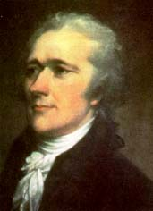
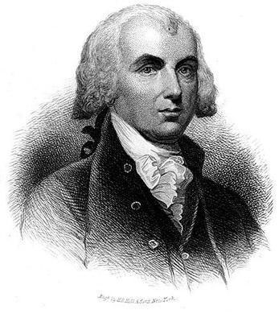
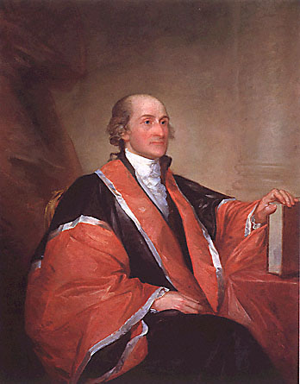
The Federalists
Proponents of the Constitution
Believed in a strong National Government
Knew that state governments would be reluctant to ratify a document that would strip them of power
Appealed directly to state citizens through rallies and written propaganda (Federalist Papers).
The Federalist papers will explain the Constitution and why parts of it were written, they also argue for ratification
Alexander Hamilton
James Madison
John Jay

Slide 51
The Constitution Was Ratified (1789):
11 of 13 states’ delegates ratified the Constitution.
The delegates had to get approval from their states’ legislature.
The Preamble (Introduction) clearly states where the power to govern came from; “We The People…”
Results:
It took almost 2 ½ years for all 13 states to ratify the Constitution.
Many delegates believed that a bill of rights needed to be added to the Constitution to protect individual rights, liberties, and freedoms.

Slide 52
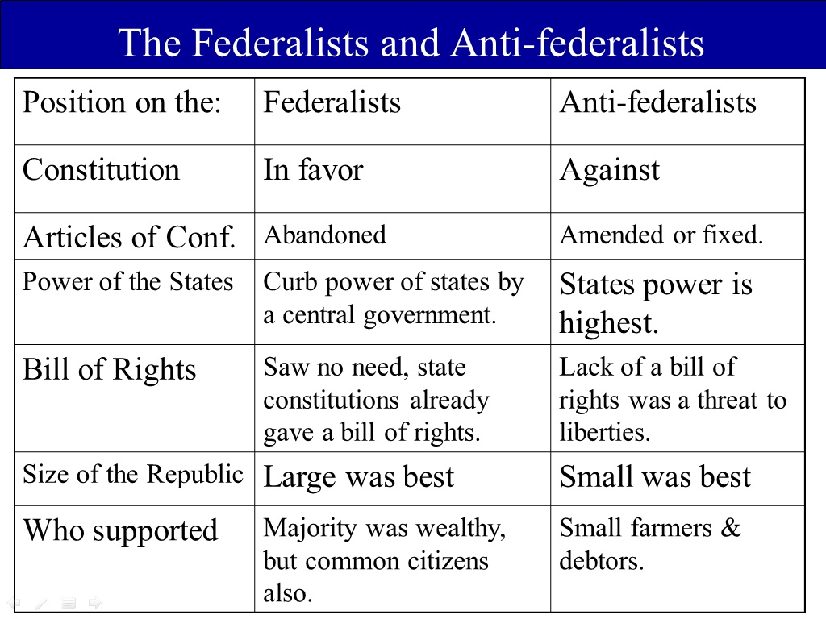

Slide 53
