Slide 1
Politics of the Gilded Age

Slide 2
Political Machines
A Political Machine was designed to take advantage of the spoils system
The spoils system is now called the patronage system
Boss Tweed was the king of the spoils system in New York running Tammany Hall, the Democratic Political Machine
Tweed took millions away from the taxpayer while arranging for friends and people who bribed him to get jobs.
In the End a man named Thomas Nast began writing cartoons of him in Harpers Weekly Magazine until public pressure forced his removal and conviction

Slide 3
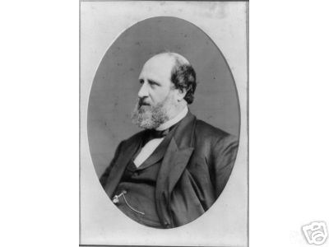
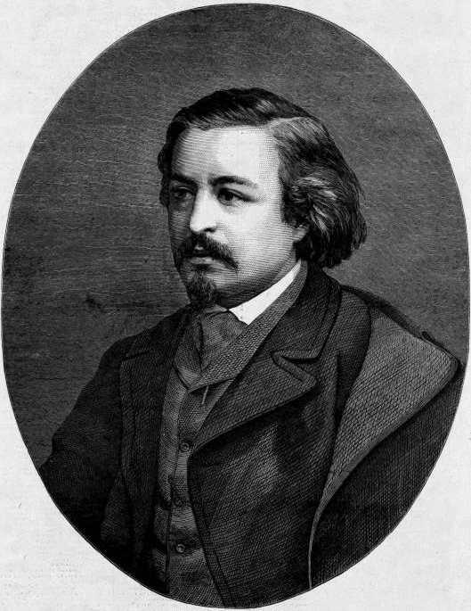
William (Boss) Tweed
Thomas Nast

Slide 4
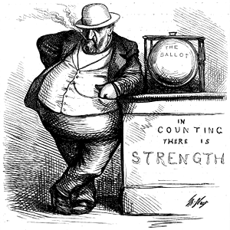
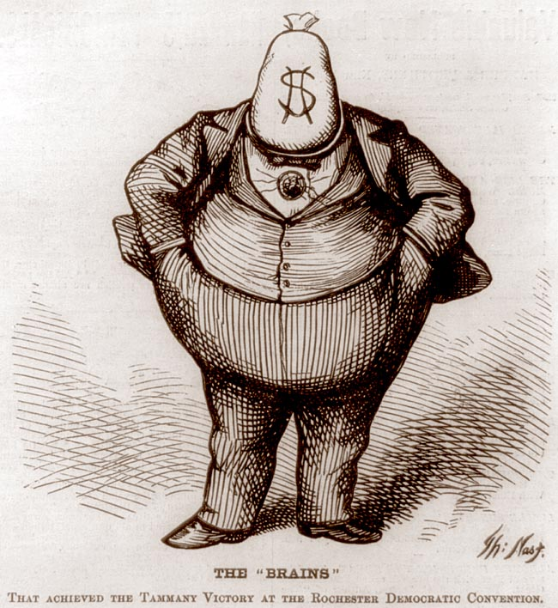
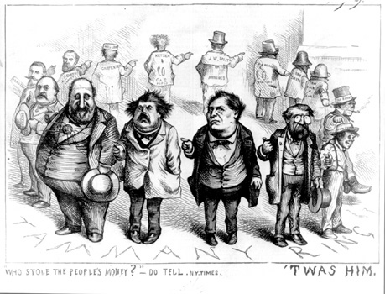

Slide 5
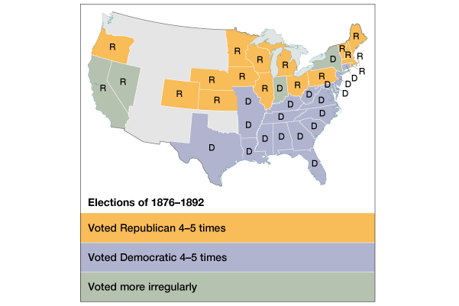
1. A Two-Party Stalemate

Slide 6
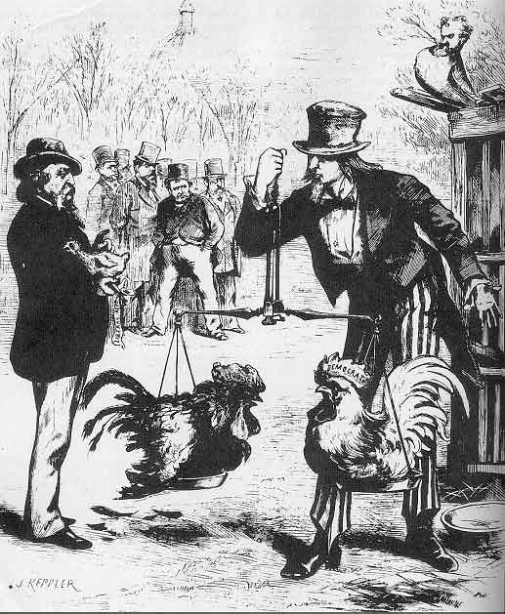
Two-Party “Balance”

Slide 7
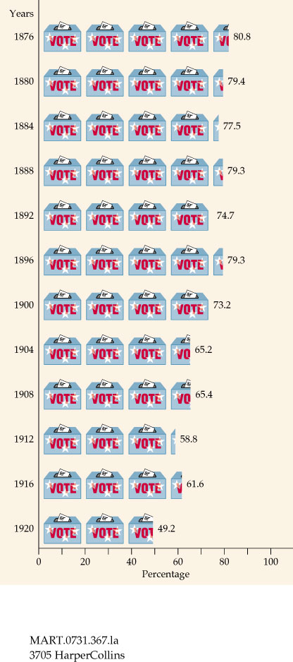
2. Intense Voter Loyalty to the Two Major Political Parties

Slide 8
3. Well-Defined Voting Blocs
Democratic Bloc
Republican Bloc
White southerners (preservation of white supremacy)
Catholics
Recent immigrants (esp. Jews)
Urban working poor (pro-labor)
Most farmers
Northern whites (pro-business)
African Americans
Northern Protestants
Old WASPs (support for anti-immigrant laws)
Most of the middle class

Slide 9
Very Laissez Faire Federal Govt.
From 1870-1900 → Govt. did very little domestically.
Main duties of the federal govt.:
Deliver the mail.
Maintain a national military.
Collect taxes & tariffs.
Conduct a foreign policy.
Exception → administer the annual Civil War veterans’ pension.

Slide 10
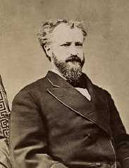
The Presidency as a Symbolic Office
Party bosses ruled.
Presidents should avoid offending any factions within their own party.
The President just doled out federal jobs.
1865 → 53,000 people worked for the federal govt.
1890 → 166,000 “ “ “ “ “ “
Senator Roscoe Conkling

Slide 11
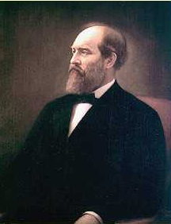
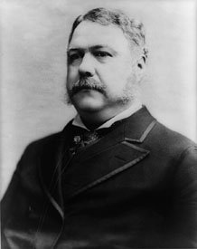
1880 Presidential Election: Republicans
Half Breeds
Stalwarts
Sen. James G. Blaine Sen. Roscoe Conkling (Maine) (New York)
compromise
James A. Garfield Chester A. Arthur (VP)

Slide 12
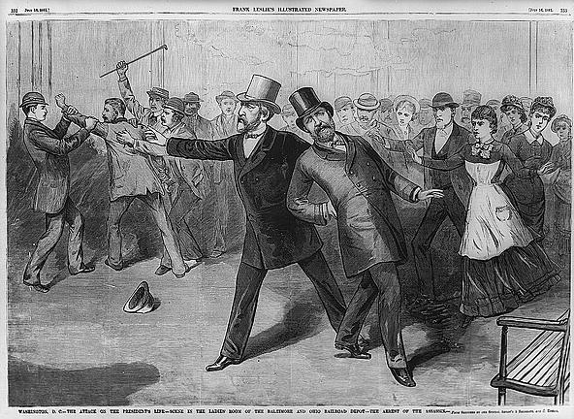
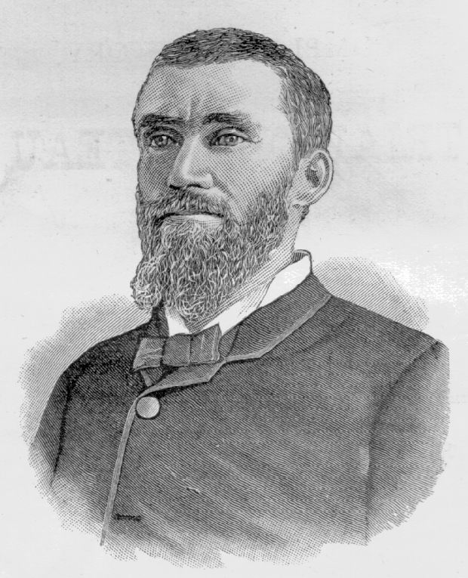
1881: Garfield Assassinated!
Charles Guiteau: I Am a Stalwart, and Arthur is President now!

Slide 13
Results of Assassination
In response to Garfield’s assassination, Arthur will change and support Civil Service Reform
Civil Service Reform is ending the spoils/patronage system

Slide 14
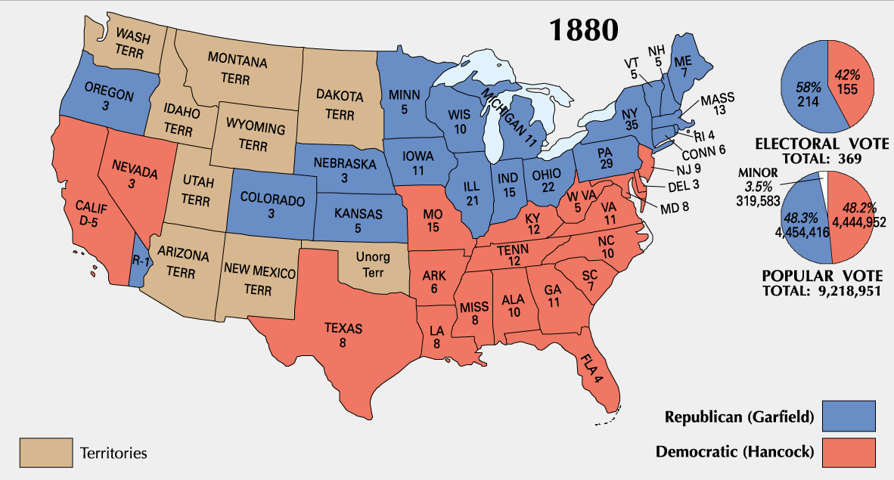
1880 Presidential Election

Slide 15
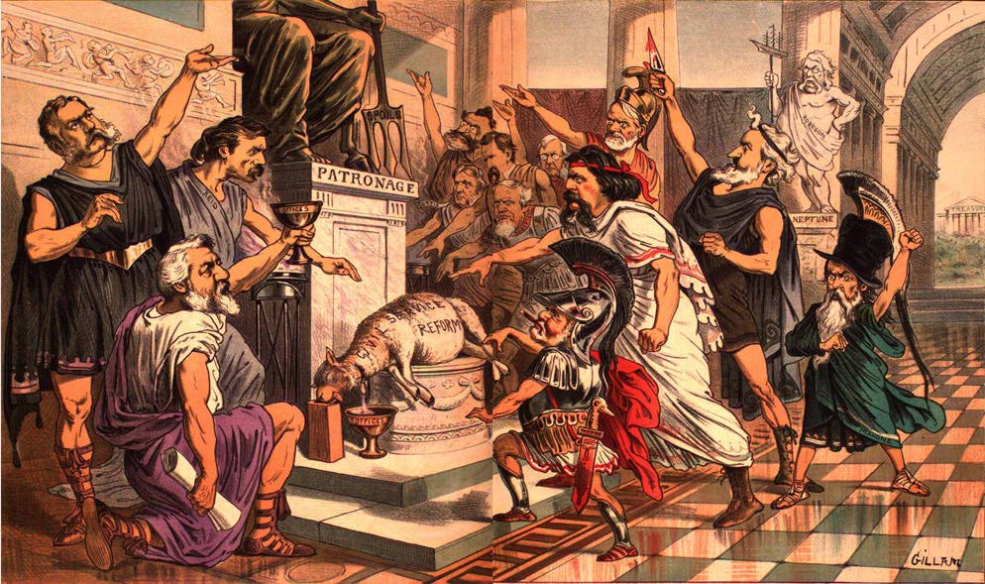
Chester A. Arthur: The Fox in the Chicken Coop?

Slide 16
Ending The Spoil System
After James Garfield a series of reforms will be passed
The first referendums will be held at this time, a referendum is when the public votes for or against a law
Recall laws will be put into place making it possible for the people to recall or fire their political leaders
For the first time people will also be voting by secret ballot, known as the Australian Ballot in this election, before this all voting was public

Slide 17
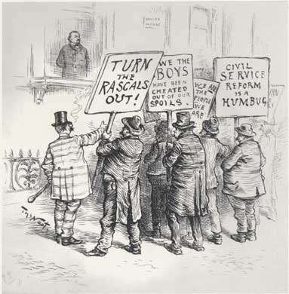
Pendleton Act (1883)
The Pendleton Act limited patronage jobs and that some government employees must be hired on merit with a test.
Effectively ends the spoils/patronage system
1883 → 14,000 out of 117,000 federal govt. jobs became civil service exam positions
1900 → 100,000 out of 200,000 civil service federal govt. jobs.

Slide 18
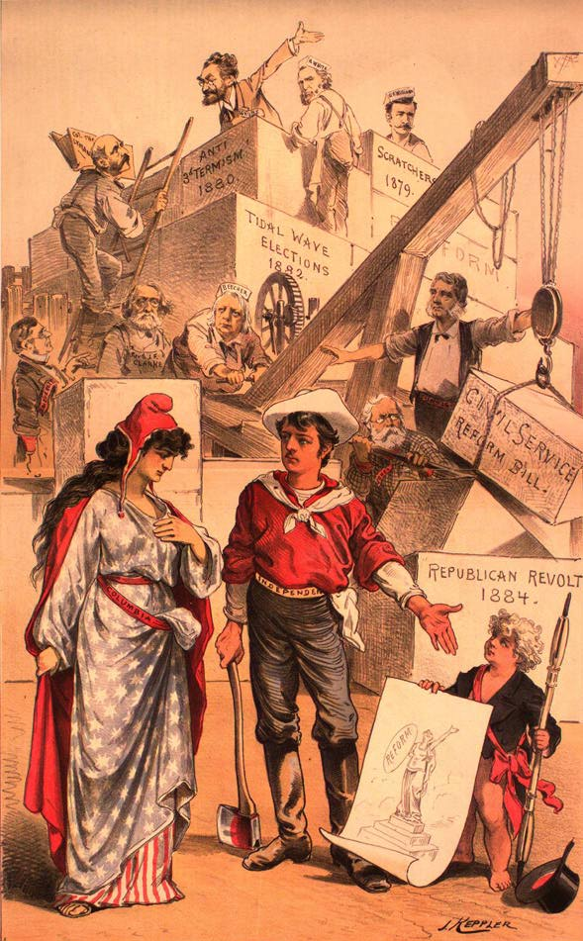
The Mugwumps
Men may come and men may go, but the work of reform shall go on forever.
Republicans that will support Cleveland in the 1884 election.

Slide 19
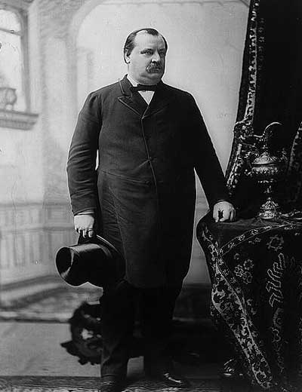
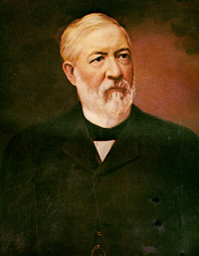
1884 Presidential Election
Grover Cleveland James Blaine * (DEM) (REP)

Slide 20
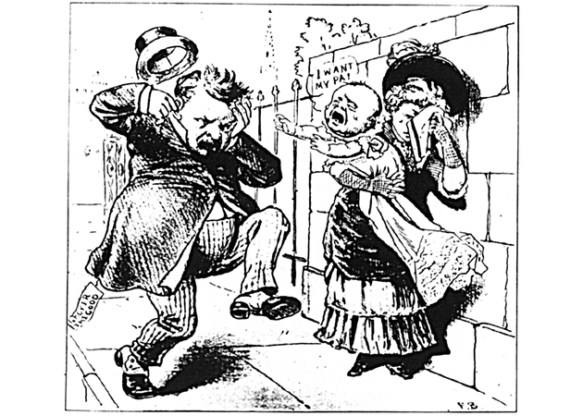
A Dirty Campaign
Ma, Ma…where’s my pa? He’s going to the White House, ha… ha… ha…!

Slide 21
Election of 1884
- Grover Cleveland will be the first democratic candidate since 1856 to win the White House
He won this because of Mugwumps, or republicans who would not support Blaine to vote for Cleveland, they rejected James Blain who was very corrupt

Slide 22
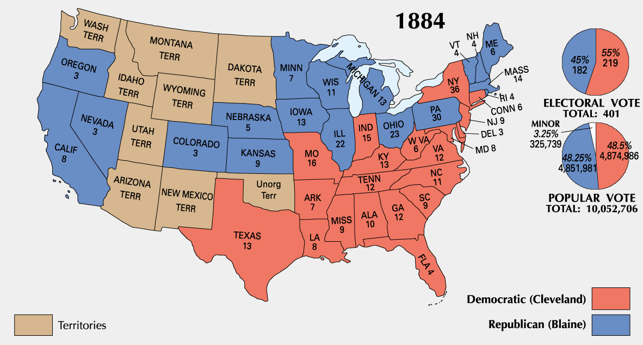
1884 Presidential Election

Slide 23
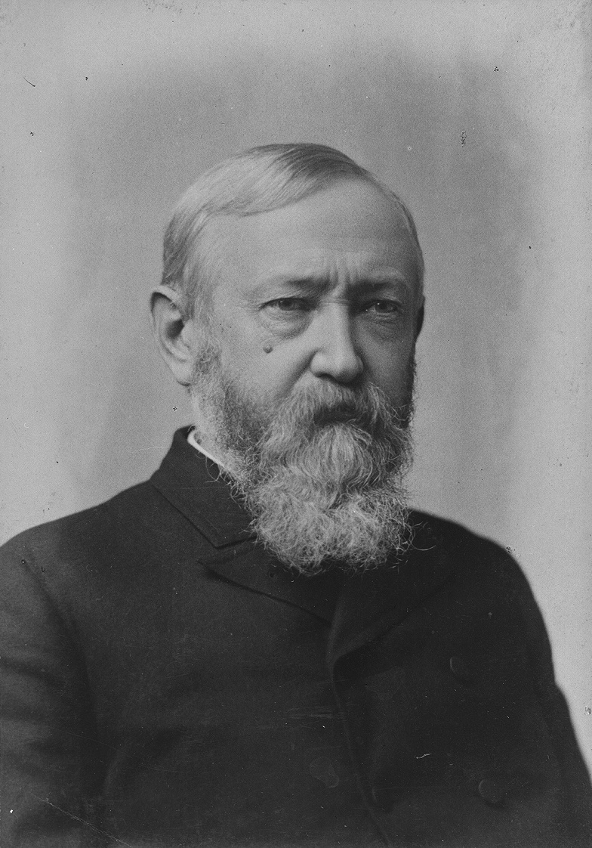
1888 Presidential Election
Grover Cleveland Benjamin Harrison (DEM) * (REP)

Slide 24
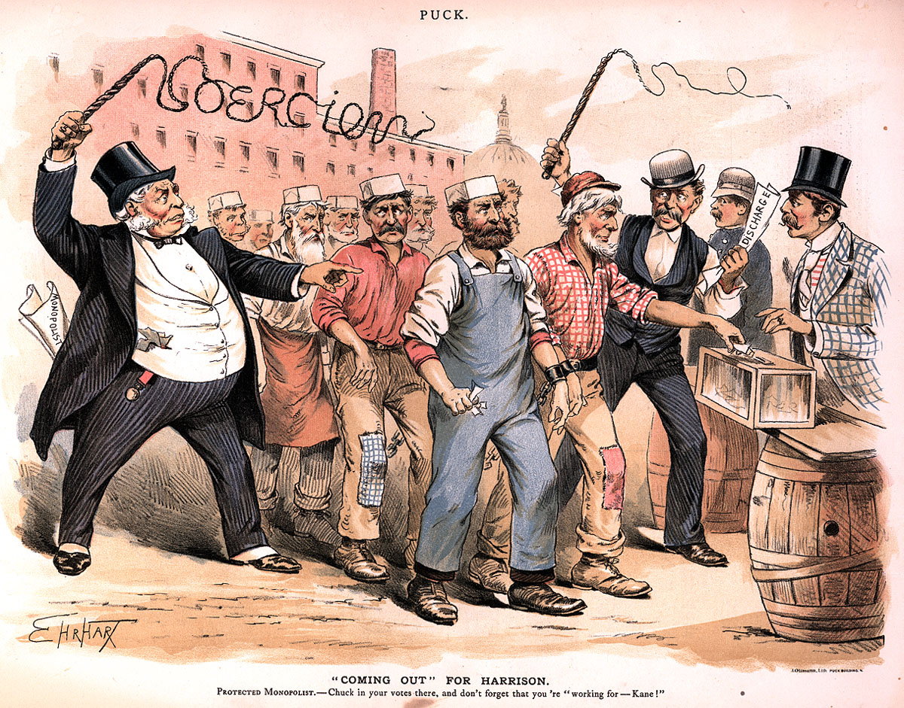
Coming Out for Harrison

Slide 25
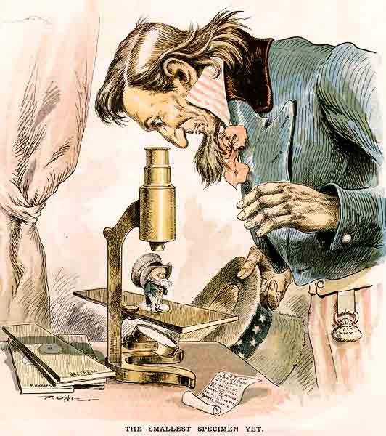
The Smallest Specimen Yet

Slide 26
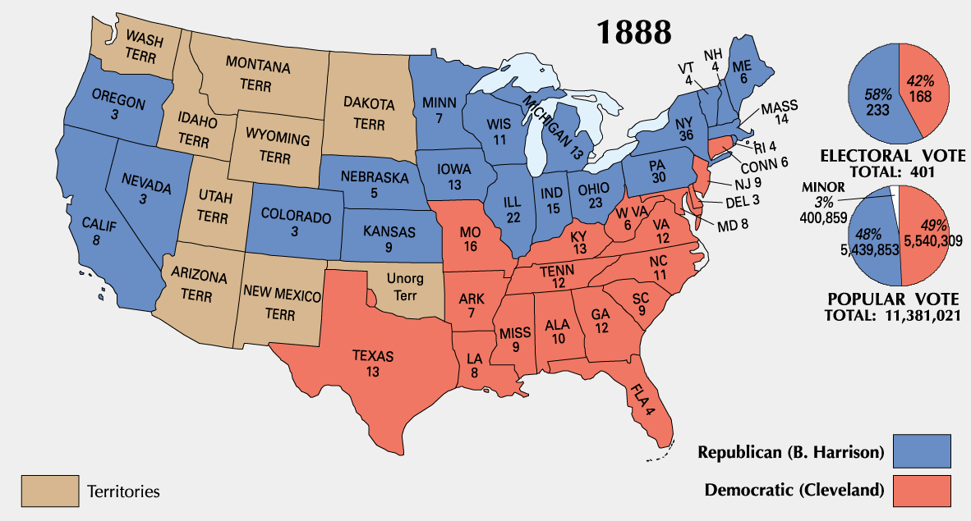
1888 Presidential Election

Slide 27
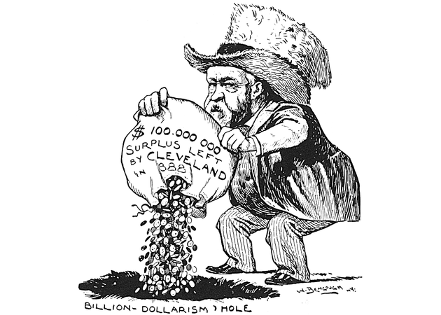
Disposing the Surplus

Slide 28
Changing Public Opinion
Americans wanted the federal govt. to deal with growing socio-economic. problems & to curb the power of the trusts:
Interstate Commerce Act – 1887
Regulates Railroads
Sherman Antitrust Act – 1890
Makes unauthorized trusts illegal

Slide 29
1892 Presidential Election
Grover Cleveland Benjamin Harrison again! * (DEM) (REP)

Slide 30
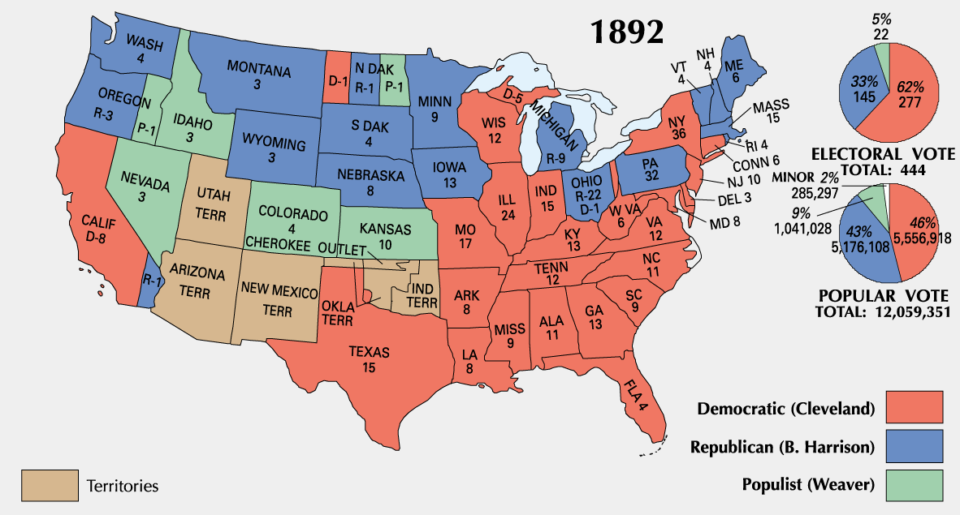
1892 Presidential Election

Slide 31
The Struggle of Labor

Slide 32
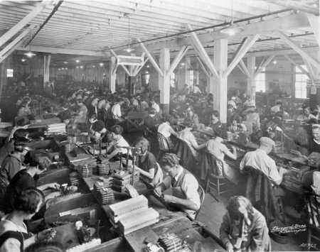
Labor Issues
The large trusts exploited their workers for increased profits
Wages were low and hours were long with no benefits
Child labor was used often, many children died or were injured trying to work to help bring money to the family

Slide 33
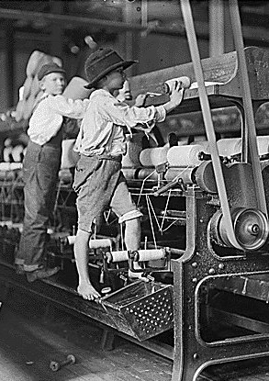
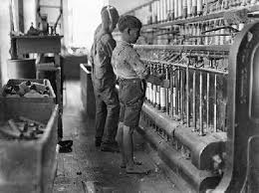

Slide 34
Unions
In response to the poor conditions workers began to form Labor Unions
A Labor Union is a a group of employees who negotiate with the owners for better wages and working conditions

Slide 35
Labor Organizations
The Knights of Labor
The American Federation of Labor
One labor leader was Eugene Debs, he would be in charge of the Industrial Workers of the World and be the Socialist Parties Candidate for president 5 times

Slide 36
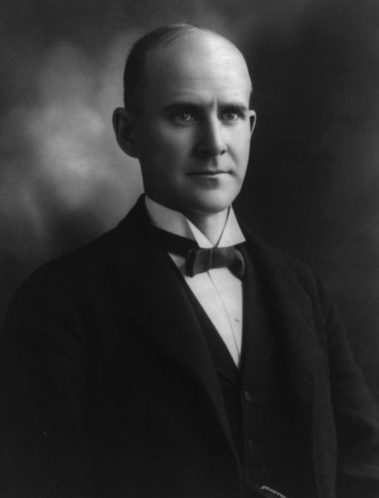
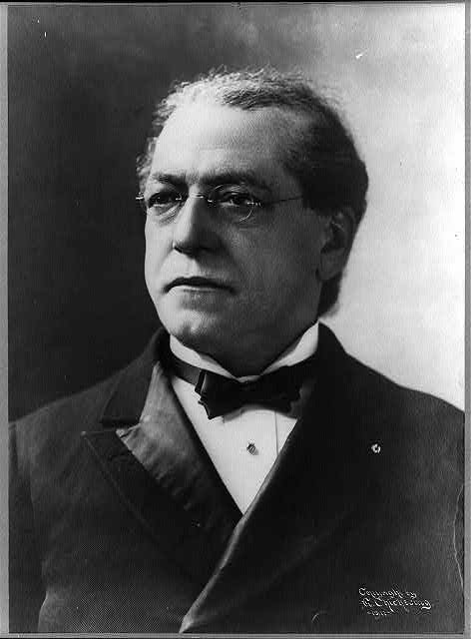
Eugene Debs Samuel Gompers

Slide 37
Haymarket Riot
May 1st 1884 workers demanded an 8 hour workday or they would go on strike
On May 4 workers gathered in the Haymarket, a busy financial part of Chicago, where a peaceful rally organized by the Knights of Labor turned into a riot
A bomb was thrown at the police line and exploded, killing a policeman The police immediately opened fire. 7 officers were killed and 60 officers were wounded in the riot along with an unknown number of civilians.

Slide 38
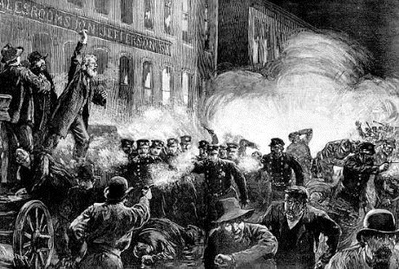

Slide 39
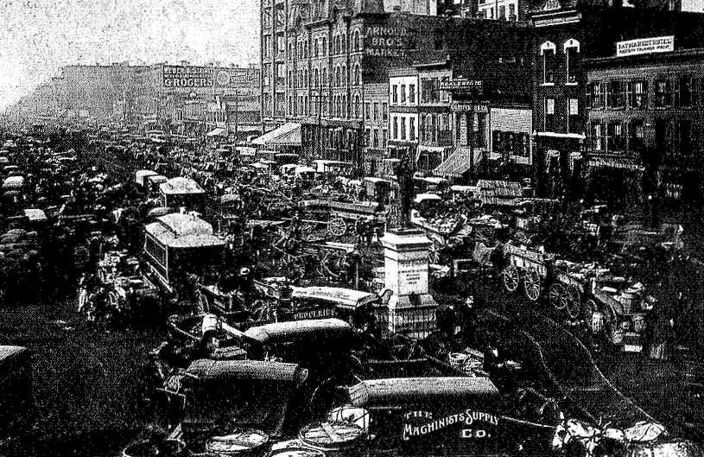

Slide 40
Management’s Tactics
When the Employees began to make demands the Businesses fought back in different ways
Employers forced the workers to sign Yellow Dog Contracts which stated that employees could not join a union
One way was to hire strike breakers and attack the strikers
Another was to hire replacement workers known as Scabs
Finally the government or one of the groups involved would ask for Arbitration, this is when an outsider makes a decision that both sides have to agree to

Slide 41
Strikes
A strike is when employees refuse to go to work
The Great Strike of 1877 began in West Virginia, and ended 45 days later after it was put down by the state militia, and federal troops.
The Pullman Strike occurred when 4,000 Pullman Palace Car Company workers reacted to a 28% wage cut by going on a strike in Illinois in 1894, bringing traffic west of Chicago to a halt, this ended when federal troops were sent in to force the employees back to work.
The Homestead Strike was a strike which began in 1892, ending in a battle between strikers and private security agents The dispute occurred in Homestead Pennsylvania, at the Carnegie Steel Company.
In every strike the government supported big business interests

Slide 42
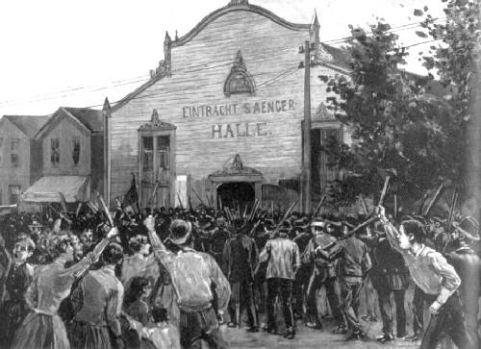
Great Railroad Strike

Slide 43
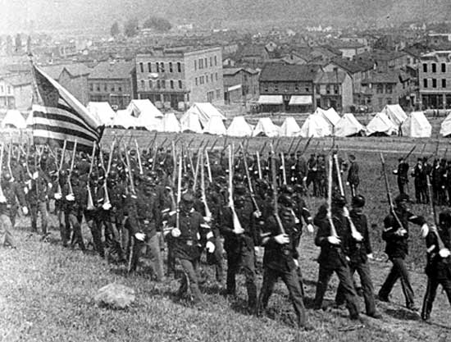
Homestead Strike

Slide 44
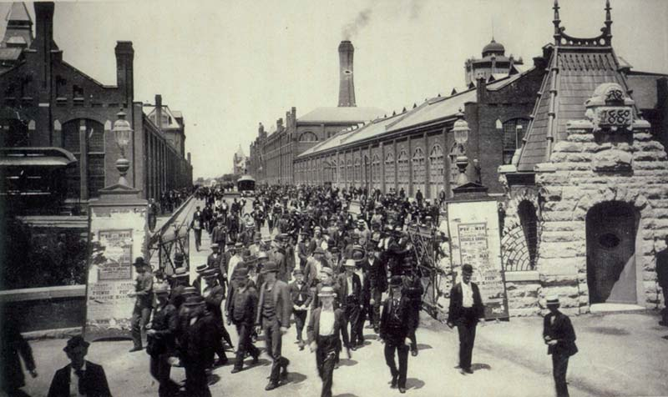
Pullman Strike

