Slide 1
The Gilded Age 1868-1900
"The golden gleam of the gilded surface hides the cheapness of the metal underneath." -Mark Twain

Slide 2
Robber Barons
The Men Who Made the Country

Slide 3
- Exxon-Mobil?
- Wal-Mart?
- GM?
- Microsoft?
-Which one do you think is the largest?
-Who used to own Microsoft
-How much money does he have?
-At his hight he had 100,000,000,000

Slide 4
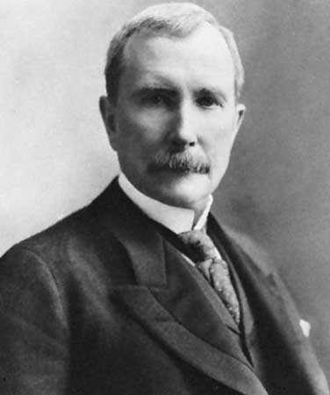
Gilded Age Wealth
Gates doesn’t come close to Rockefeller
Rockefeller only had 1.4 billion when he died, in today's money that equals 16 billion however standard oil controlled over 25% of the U.S. GNP, in today’s money that is over 1 trillion dollars

Slide 5
Robber Barons
Between 1868 and 1900 America was run by men known as robber barons
The presidents at the time were weak and pro-business, and there were few regulations on businesses
These robber barons, or captains of industry by those who liked them, would exploit their employees allowing low wages and terrible working conditions to gain more profit.
Andrew Carnegie → Steel
J.P. Morgan → Banking
Vanderbilt Family → Railroads
John D. Rockefeller → Oil

Slide 6
The Industrial Revolution
Industrialization and Urbanization brought about 3 major changes
1. People migrated from farms to the cities looking for work
2. Payment changed from production based to wage based
3. The world moved from hand made goods to factory made goods

Slide 7
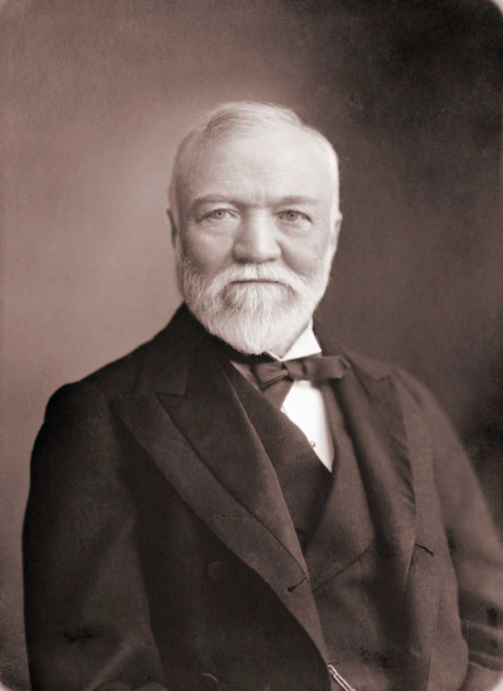
Andrew Carnegie
A Scottish immigrant he came to the country without a penny to his name
Eventually he will create Carnegie Steel, then U.S. Steel
He was able, through vertical integration, to create a monopoly that would earn him millions
Vertical integration→ buying the suppliers of your raw materials to put your competitors out of business
He would give much of it away creating libraries and concert halls to help all people
Wanting to help people with his wealth was known as the gospel of wealth

Slide 8
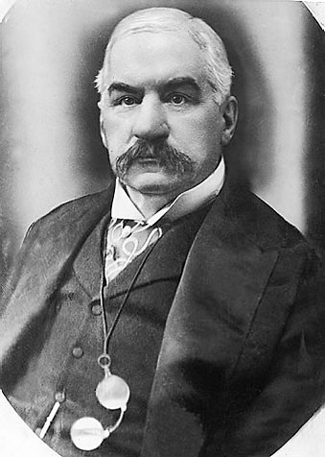
J.P. Morgan
Born in Connecticut to a banker Morgan would eventual become the leading banker in the world founding J.P. Morgan and Chase
His bank was so dependable that he helped the U.S. out of debt by lending it 65 million in gold
He would oversee the formation of General Electric and U.S. Steel

Slide 9
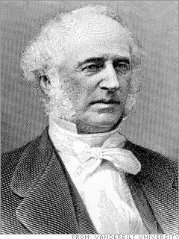
Vanderbilt Family
Cornelius “Commodore” Vanderbilt was the founder of a shipping company and the largest railroad company in the U.S.
After his death in 1877 his son will take over and continue to run the railroad, his monopoly will be so complete that by 1890 nothing can be shipped across country without being on a Vanderbilt Railroad

Slide 10
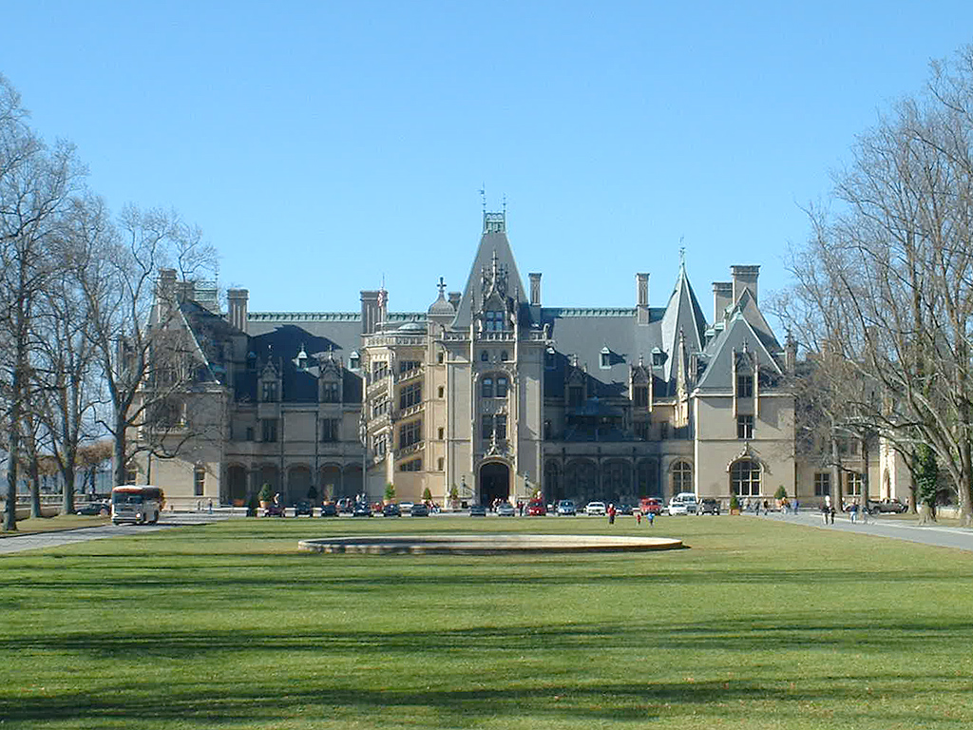
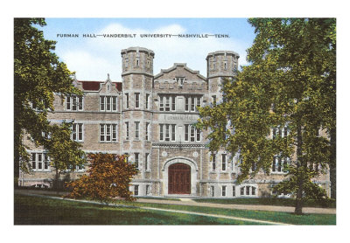

Slide 11
John D. Rockefeller
Rockefeller will form Standard Oil which will dominate the oil industry
Standard Oil will own over 70% of the Oil in the U.S. at one point
Standard will be ruthless gaining an advantage any way it can and destroying its competition
It will be Standard Oil who will attract the notice of anti-trust activists

Slide 12
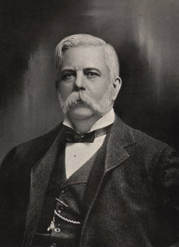
War of the Currents
In the late 1800’s it was Thomas Edison vs. George Westinghouse in a battle for how electricity will be distributed
Edison favored Direct Current Electricity and Westinghouse favored Alternating Current
Westinghouse will win and to this day we use AC

Slide 13
Social Darwinism
One of the reasons these Robber Barons as well as other factory owners would treat their employees so poorly was because of the idea of Social Darwinism
The belief was that every person was on their own in society and the strong would survive while the weak would die off

Slide 14
What Do You Think?
1. Do you agree with Social Darwinism Why or why not?
Answer in a paragraph
1. I expect at least 3 sentences to back up your thesis (minimum 4 sentences total)
2. At least one sentence should be a specific example
3. Grammar counts

Slide 15
Inventions and Inventors

Slide 16
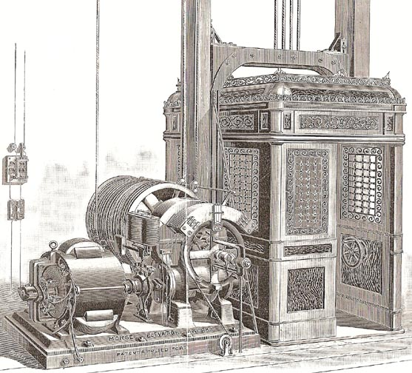
Elevator
The elevator will make it possible for the skyscrapers like the Empire State Building to rise

Slide 17
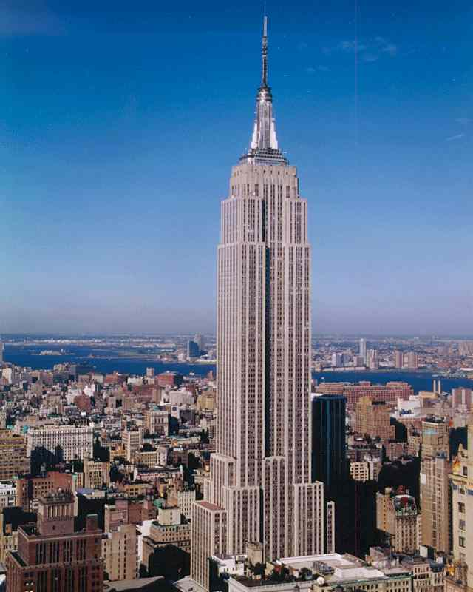

Slide 18
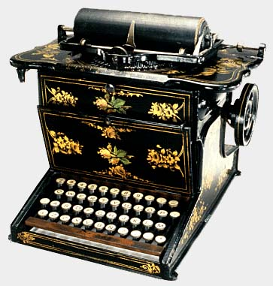
Typewriter
Makes creating documents faster and easier
Also creates many jobs for woman as typists and secretaries

Slide 19
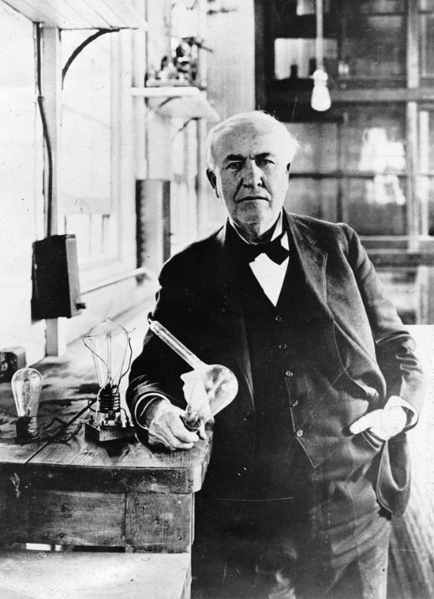
Thomas Edison
Greatest inventor of his time
Famous for the light bulb but also had over 1000 inventions and his own invention factory
The electric light will change the world, as for the first time people can live and work at night with more than firelight
He will also invent the earliest motion pictures making the movie industry possible

Slide 20
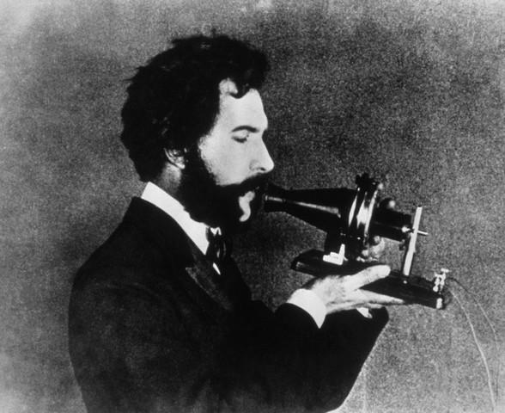
Alexander Graham Bell
Alexander Graham Bell will invent the telephone and phonograph a type of record player
This made communication much easier and gave people the opportunity to listen to music in their own home

Slide 21
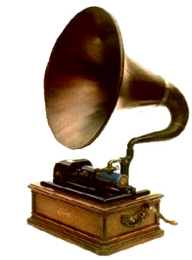

Slide 22
Urbanization

Slide 23
Immigration
The Gilded Age will see the greatest increase in population in American history
The population will double from 31.5 million to 76 million between 1865-1900
Most immigrants will come from southern and eastern Europe and be discriminated against

Slide 24
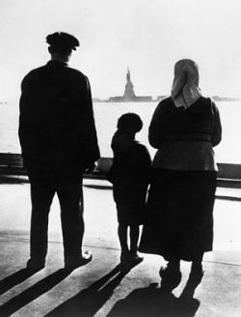
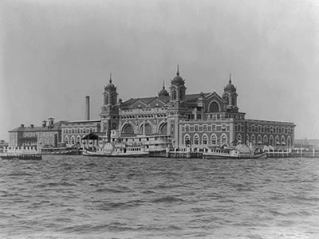

Slide 25
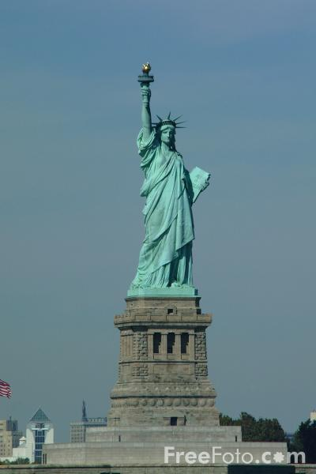
"Give me your tired, your poor, Your huddled masses yearning to breathe free, The wretched refuse of your teeming shore. Send these, the homeless, tempest-tost to me, I lift my lamp beside the golden door!"
Emma Lazarus, 1883

Slide 26
Chinese Exclusion Act
The group most discriminated against was the Chinese
In 1882 the Chinese Exclusion Act will be passed banning all Asian immigration and will not be lifted until 1968

Slide 27
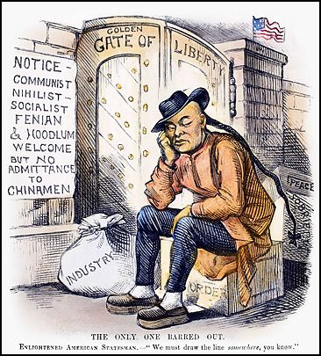

Slide 28
Transportation in the City
The electric trolley and subway will change city life. People could now live away from where they worked and take mass transit
However during this time some lived in terrible conditions in Tenement Housing tenements were apartments that were VERY close together and usually in terrible repair

Slide 29
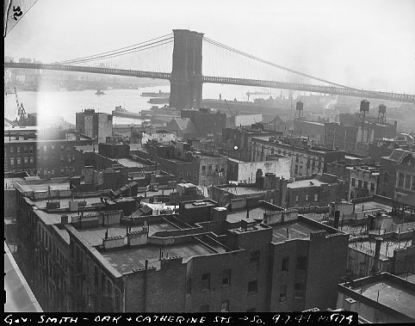

Slide 30
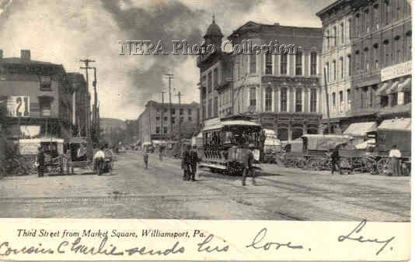

Slide 31
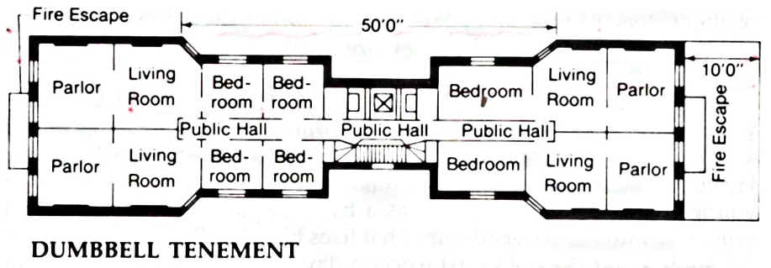

Slide 32
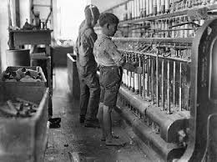
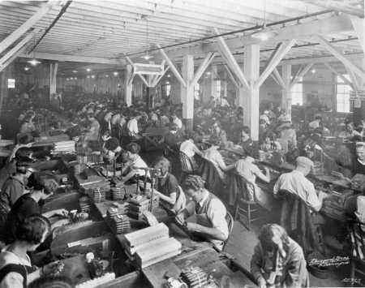
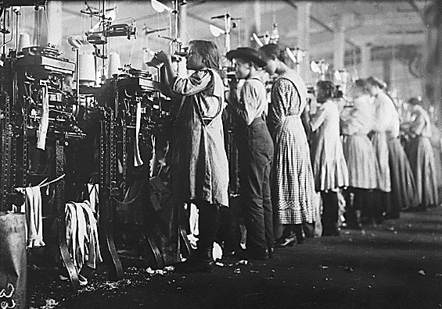
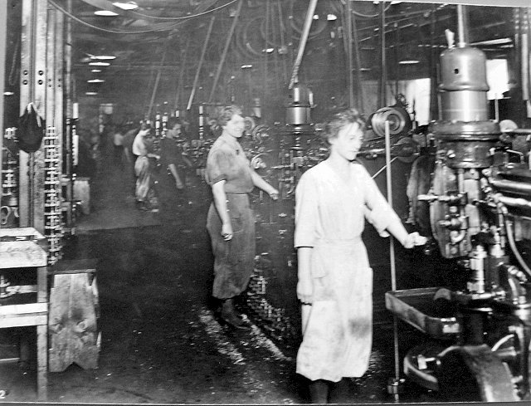

Slide 33
Entertainment
Also for the first time people will begin to watch spectator sports, especially baseball and boxing, this new entertainment will unite Americans
The first motion pictures will also be invented during this time
Also amusement parks will be developed at this time for people to enjoy themselves
City parks like Central Park were developed to give those in the city a little green area to relax

Slide 34
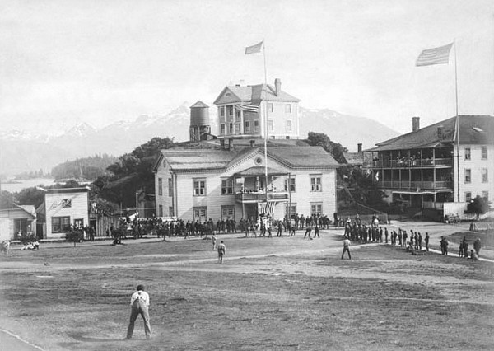
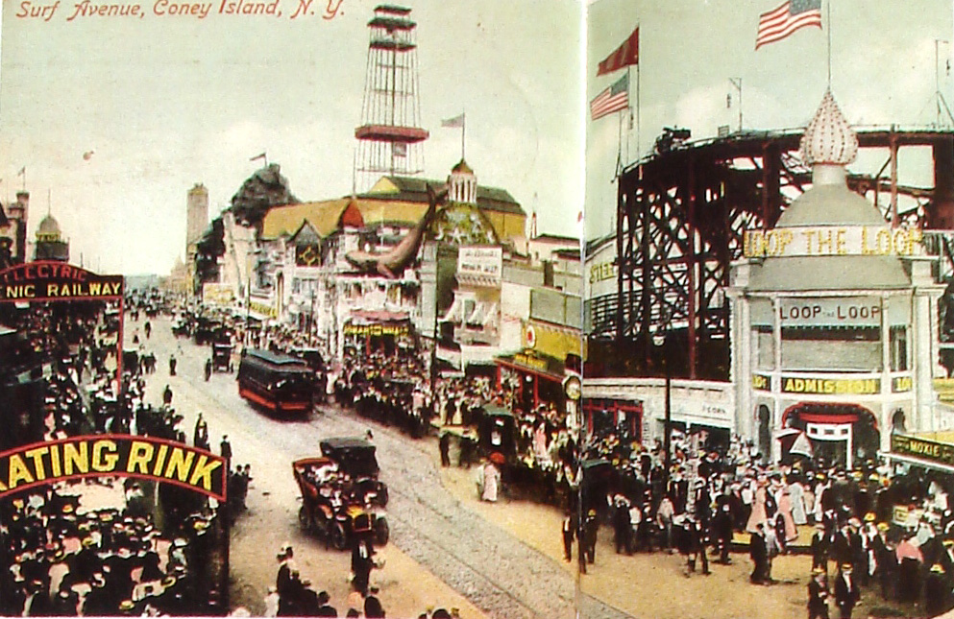
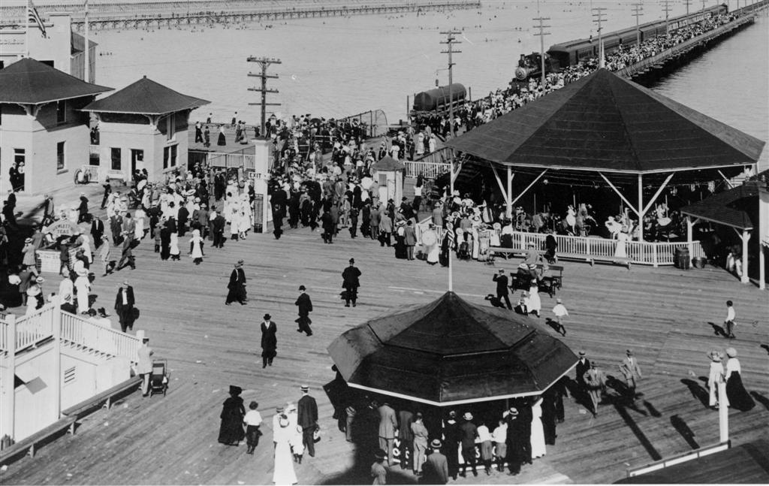

Slide 35
