Slide 1
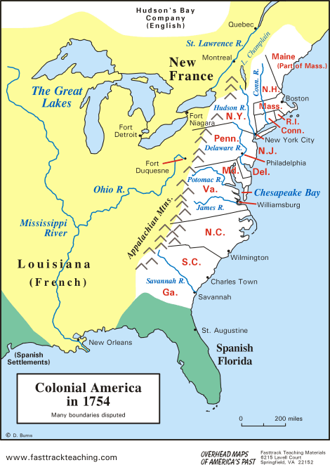
Colonial America

Slide 2
Reasons for English Colonization
England wanted to establish an American colony to increase her wealth and power.
  By finding silver and gold in America
  By providing a source of raw materials
  Would open new markets for trade.

Slide 3
Mercantilism
Colonies exist as a market for home-country's goods and a supplier of raw materials.
All trade had to be on English or colonial ships to prevent trade with other countries.
The English passed laws to enforce this known as Navigation Acts.
Generally these laws were not well enforced which gave the colonies a great deal of freedom.
Not enforcing the Navigation Acts was known as Salutary Neglect.

Slide 4
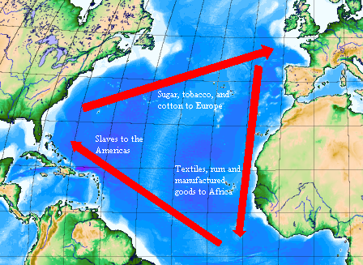
Triangular Trade
The Triangular Trade brought materials to Europe, Africa, and the Americas.
These areas became dependent on each other..

Slide 5
Jamestown
The First Colony

Slide 6
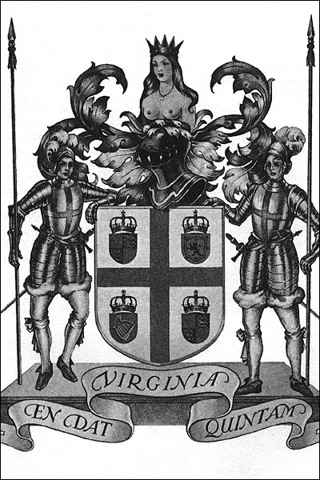
Importance of the Virginia Charters
The charters gave the Virginia Company the right to establish a settlement in North America.
The charters extended English rights to the colonists.

Slide 7
Why Settlers Came to Jamestown
Jamestown was primarily an economic venture.
The stockholders of the Virginia company of London financed the settlement of Jamestown.

Slide 8
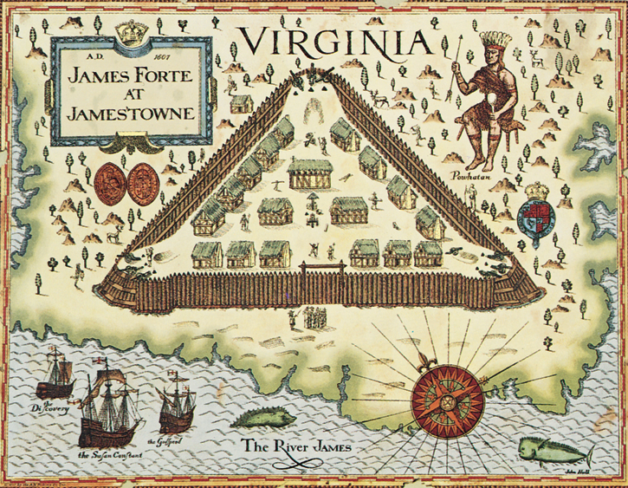

Jamestown became the first permanent
English settlement in north America in 1608.

Slide 9
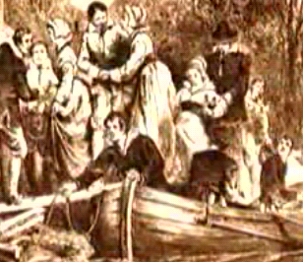
Women Come to Jamestown
The first women settlers came Jamestown in 1620.
The arrival of women made it possible for the settlers to establish families and a more permanent settlement at Jamestown.

Slide 10
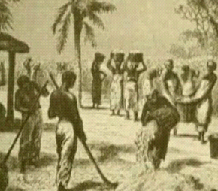
Africans Come to Jamestown
Africans arrived in Jamestown against their will in 1619.
The arrival of Africans made it possible to expand the tobacco economy.
Middle Passage
The part of the triangular trade that brought Africans to America was known as the Middle Passage.
The Africans were treated like cattle and often laid on the bottom of the boat for weeks, rarely being allowed on deck
As many as 1/3 died from the terrible conditions

Slide 11
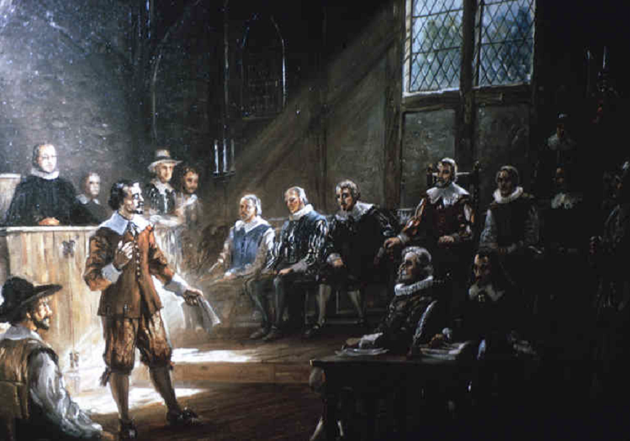
Virginia House of Burgesses
The Virginia House of Burgesses was the first elected legislative body in America giving settlers the opportunity to control their own government.
It became the General Assembly of Virginia, which continues to this day.

Slide 12
The Pilgrims

Slide 13
The Reformation and the Mayflower
In 1519 there were many that no longer agreed with the Catholic Church and wished to start their own Christian religions.
These “Protestants” will form many of the Christian denominations that still exist today.
One of these Christian groups were known as Anglicans
Anglicans were the Church of England and all English were expected to be members.
Some wanted to separate from the Anglican church and form a new church, these separatists were known as Pilgrims.
In 1620 they came to the new world in order to have religious freedom and founded Plymouth Colony

Slide 14
Mayflower Compact
The document was the group of rules all the men agreed on.
The men of the Mayflower voted on these rules.
This makes The Mayflower Compact the first group of rules made by popular vote in the New World and will be reviewed when we create the Constitution.

Slide 15
King Phillip's War
Although these Pilgrims will try and live along side the Indians, in the end they will be unable to.
After years of Pilgrim encroachment, the Indians, led by a native named King Phillip, will attack the New England colonies killing 1/10 of the men and destroying the economy.
Although in the end the colonists are victorious the losses make them less likely to settle further west

Slide 16
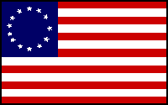
The 13 Originals
Exploring the who, when, where, and why behind the 13 original colonies of early America.

Slide 17
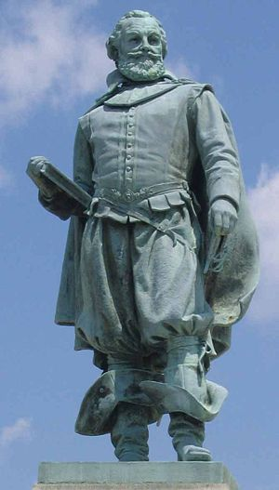
Colony # 1: Virginia
Founded in 1607 (Jamestown)
Captain John Smith is given credit for starting this colony.
Made money with Tobacco and became the richest southern colony.
Southern Colony

Slide 18
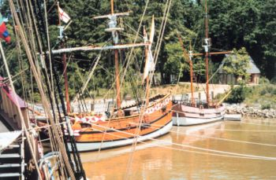
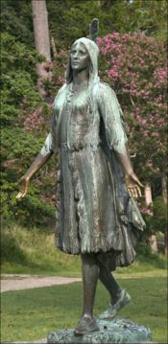
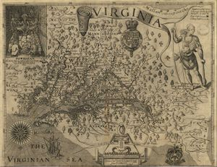
Colony # 1: Virginia
A Pocahontas statue was erected in Jamestown, Virginia in 1922
At Jamestown Settlement, replicas of Christopher Newport's 3 ships are docked in the harbor.
Map of Virginia published by John Smith (1612)

Slide 19
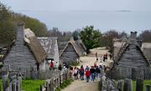
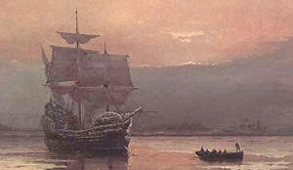
Colony # 2: Massachusetts
Founded in 1620 by the Pilgrims.
John Carver was the leader of the Pilgrims and author of the Mayflower Compact.
Puritans (those who wished to purify the church) then came and settled Boston
The Massachusetts Bay Colony of the Puritans will absorb the Plymouth Colony
John Winthrop was the governor of this settlement.
New England Colony
Plymouth Plantation, with Cape Cod Bay visible in the distance
Mayflower in Plymouth Harbor by William Halsall (1882)

Slide 20
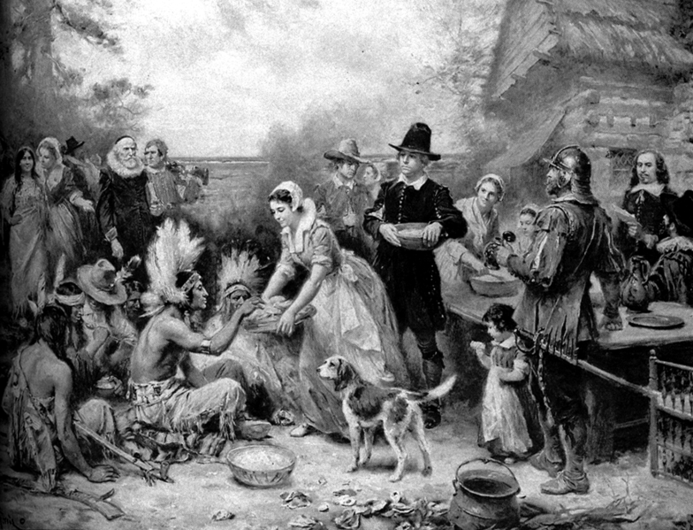
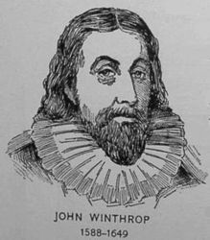
Colony # 2: Massachusetts
The first Thanksgiving.

Slide 21
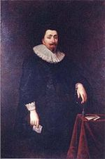
Colony # 3: Maryland
Founded in 1634 by George Calvert (Lord Baltimore) He believed all people should have religious freedom.
Maryland became known as a haven (safe place) for Catholics.
King Charles I was king and didn’t agree with the religious freedom.
In 1649, the Toleration Act was passed that guaranteed equality of rights for everyone for religion.
Southern Colony
George Calvert, Lord Baltimore

Slide 22
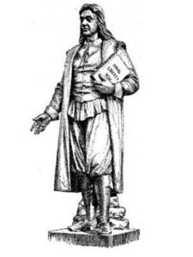
Colony #4: Rhode Island
In 1636, Rhode Island became a colony after Roger Williams obtained a charter from England to form the colony.
He spoke out against the Puritan’s strictness and went to this area to settle and provide religious freedom (for Christians).
New England Colony
Roger Williams
“minister, author”

Slide 23
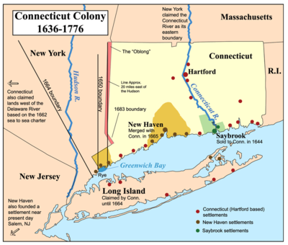
Colony #5: Connecticut
Also founded in 1636 by the clergyman Thomas Hooker.
He led a group of people from Rhode Island to start their own colony and they had freedom of religion.
New England Colony
A map of the Connecticut, New Haven, and Saybrook colonies.

Slide 24
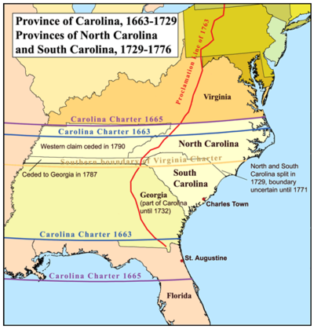
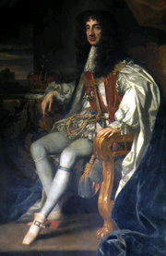
Colony #6: North Carolina
Founded in 1663 by English nobles.
Charleston: main city was named after Charles II. Became very important port city.
Bad politics forced a split of the colony into North and South.
Southern Colony
King Charles II

Slide 25
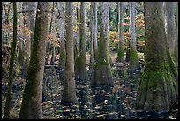
Colony #7: South Carolina
In 1729 South Carolina received its name after a political dispute and became a colony.
Had large plantations for growing crops and raising livestock and the port of Charleston.
Southern Colony

Slide 26
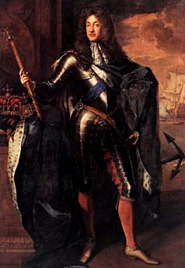
Colony #8: New York
Started as New Amsterdam, a Dutch colony in 1609.
The English took over in 1664 and renamed it New York.
Was a major port and financial center.
Middle Colony (Breadbasket Colony)
James, Duke of York

Slide 27
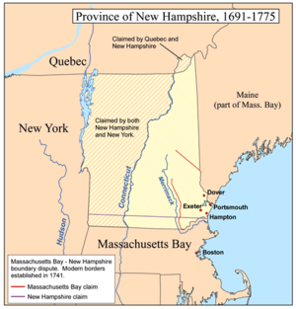
Colony #9: New Hampshire
Sold to the king of England in 1679.
Royal colony: king chooses governor and no elected government.
New England Colony

Slide 28
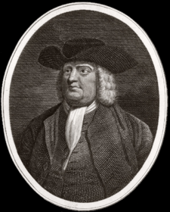
Colony #10: Pennsylvania
In 1681, William Penn was granted a charter for land between Maryland and New York.
King Charles was in debt to Penn’s father.
Penn was a Quaker and he gave the people two rights:
1. Freedom of Religion
2. Right to elect public officials.
Middle Colony (Breadbasket Colony)

Slide 29
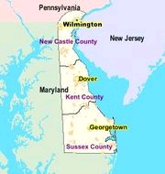
Colony #11: Delaware
In 1682, the Duke of York granted William Penn this land.
It became a colony in 1704.
Middle Colony (Breadbasket Colony)

Slide 30
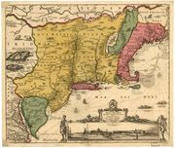
Colony #12: New Jersey
Royal colony governed directly by the king.
Middle Colony (Breadbasket Colony)
Map of New Netherland (17th century)

Slide 31
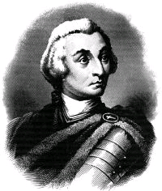
Colony #13: Georgia
It became a colony in 1733.
James Oglethorpe was granted a charter to start Georgia for the poor and unfortunate who leave prison.
It was known as a buffer zone between the Spanish and the English colonies.
Southern Colony

Slide 32
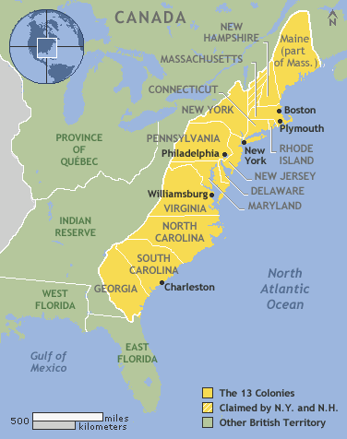

Slide 33
First Great Awakening
In the early 1700s many felt that the colonies had lost their original love of religion
In response there was the First Great Awakening, a series of revivals and preachings that tried to awaken the religious spirit of the colonies
The fire and brimstone speeches of this time period were very effective, many colonists became much more religious and reexamined their beliefs to better conform with protestant Christianity

Slide 34
Glorious Revolution of 1688
The protestants in Parliament overthrew the king.
  James’ daughter Mary and her husband William of Orange became king and queen.
  At the same time an English thinker wrote a very important book
  John Locke's Two Treatises on Government argued that power flows from the consent of the governed (the people), not from God and that citizens have inalienable (can’t be taken away) natural rights (life, liberty, property).
  …Does that sound familier?

Slide 35
Four Major Regions
Plantation South
Middle Colonies
New England
Frontier

Slide 36
Plantation South
Rich soil, well-suited to tobacco farming.
  Large plantations became economically more successful and became the center of life for the surrounding area, like a medieval manner.
  As indentured servants became harder to obtain (and retain), demand for slaves increased.
  400,000 in colonies by 1776
Plantation owners became the leading economic, political, and social forces of the South. Democracy limited to wealthy landowners.

Slide 37
Middle Colonies
Three large rivers (Hudson, Delaware, and Susquehanna) flowed north to south and served as trade paths.
Best farmland in the colonies, wheat, barley, rye.
Large numbers of immigrants
  Dutch in Hudson Valley
  Germans in Pennsylvania
  Scotch-Irish in Pennsylvania

Slide 38
New England
95% English immigrants, most from villages
Came in groups and settled in self-governing towns.
The New England town meeting was the center of power.
Occupations included farming (scarce labor, tough conditions), fishing, boat building, and trade
  Slavery, rum and the triangular trade with West Indies and Africa brought economic wealth to New England

Slide 39
Backcountry/Frontier
Large families, exhausted soil encouraged westward movement.
Religious dissenters, immigrants, and criminals all found "refuge" in the West.
Large emphasis on individual freedom
  Strenuous objection to any governmental interference in daily life.

