Slide 1
DISCOVERY OF A NEW WORLD
Europeans Come to America

Slide 2
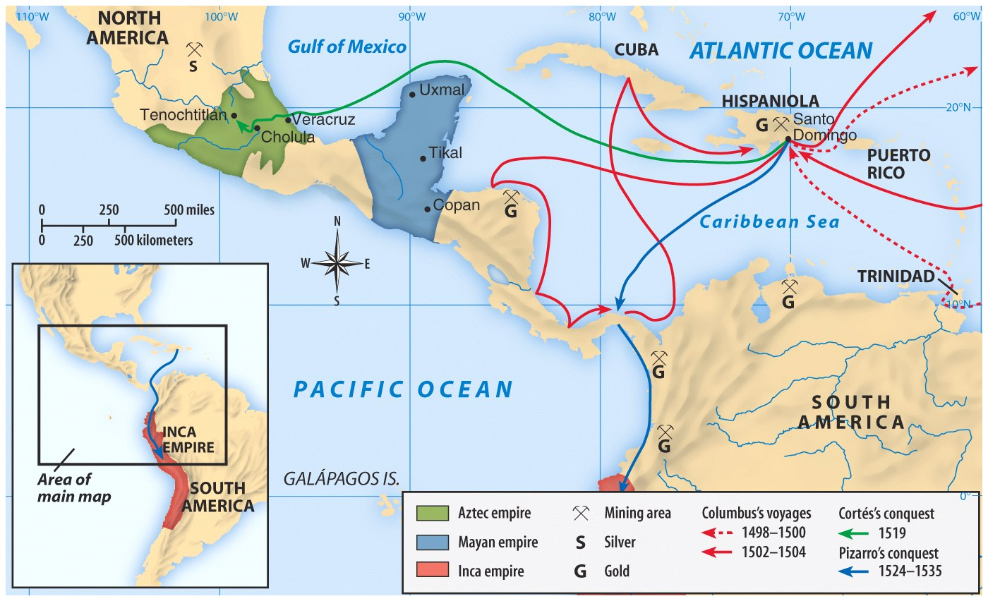

Slide 3
CULTURAL CLASHES

Slide 4
WHITE EUROPEANS
Used the land for economic needs
Clearing the land, destroying hunting areas and fencing it off into private property
Divided the land and selling it for monetary value.
NATIVE AMERICANS
Relationship with environment as part of their religion
Need to hunt for survival
Ownership meant access to the things the land produced, not ownership of the land itself.

Slide 5
Indirect Causes of Exploration

Slide 6
Motives for European Exploration
The Crusades created an interest in eastern spices and goods
The Renaissance created curiosity about other lands and peoples.
The Reformation led to refugees & missionaries who wanted to spread Christianity.
Monarchs sought new sources of revenue.
Technological advances made exploration possible.
Explorers wanted fame and fortune.

Slide 7
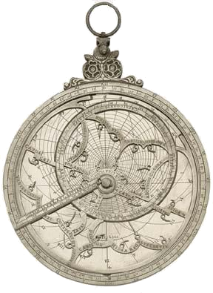
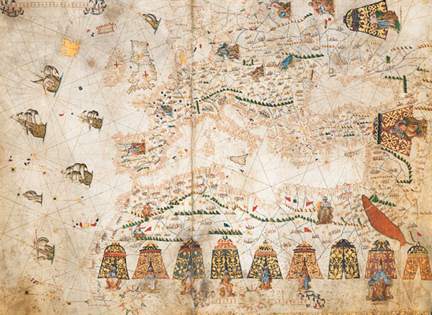
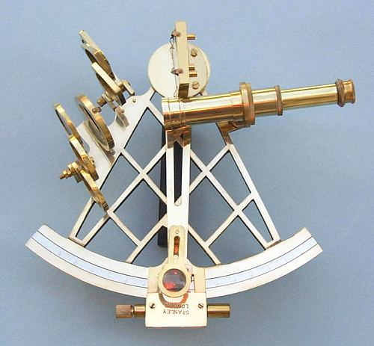
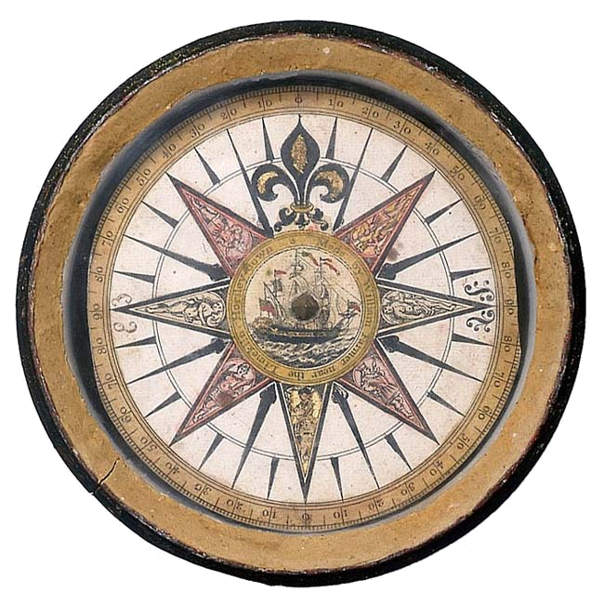
New Maritime Technologies
Better Maps
Hartman Astrolabe (1532)
Mariner’s Compass
Sextant

Slide 8
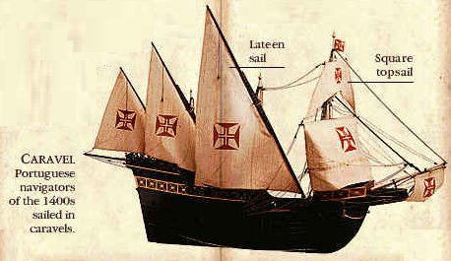
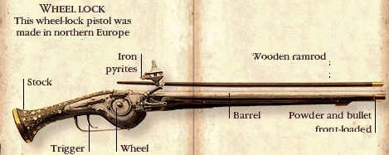
New Weapons Technology

Slide 9
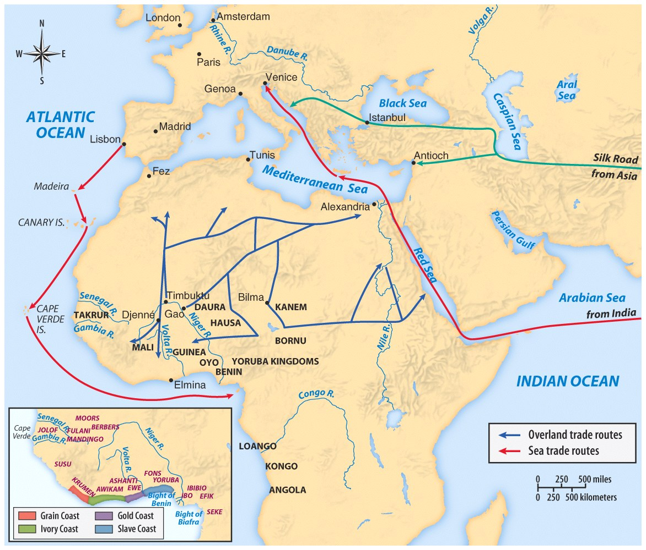
15th century trade routes

Slide 10
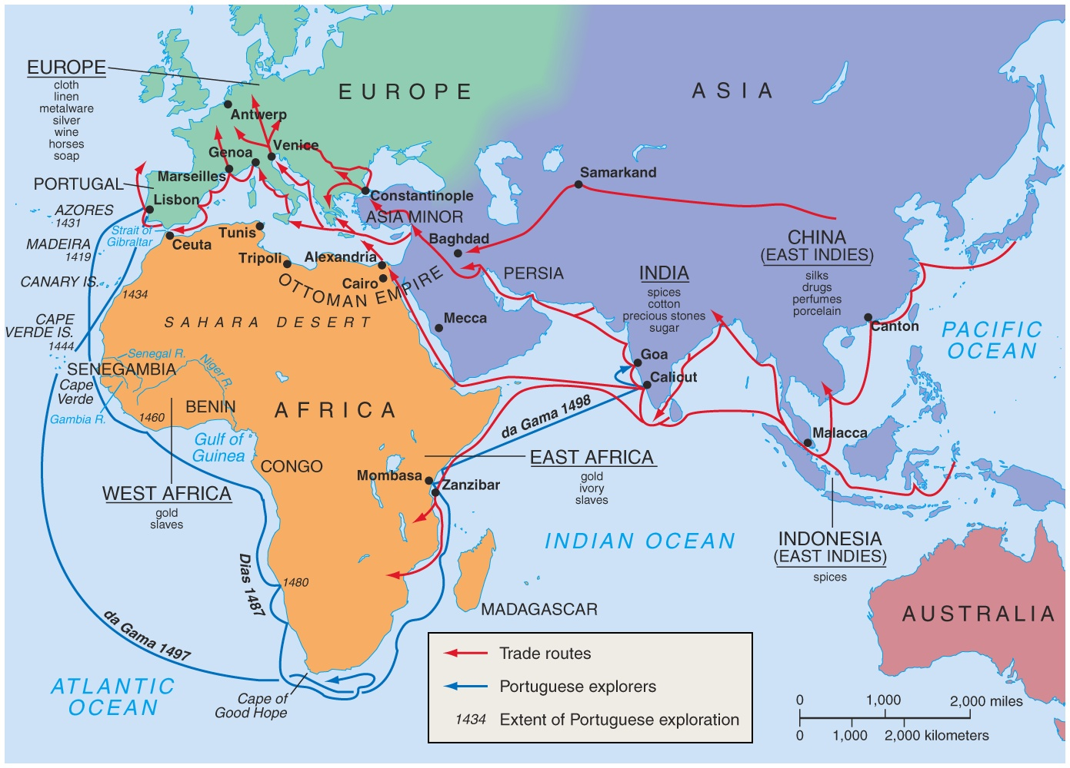
European trade routes

Slide 11
The Rebirth of Europe
Economy
Culture
Politics
Nations competed for Asian trade.
Ancient Greek, Roman and Muslim art and learning were rediscovered.
Reformation: revolt against the Roman Catholic Church
Improved sea- faring technology aided exploration and trade.
Philosophy of humanism: use of reason and experimentation in learning
Government by nobles and the Church declined.
Spain & Portugal competed to explore trade routes.
Michelangelo, Leonardo da Vinci Shakespeare
The rise of nations

Slide 12
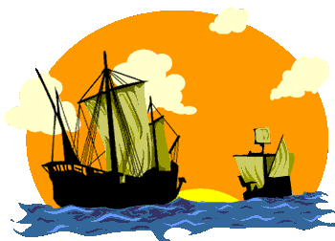
Direct Causes = 3 G’s
Political: Become a world power through gaining wealth and land. (GLORY)
Economic: Search for new trade routes with direct access to Asian/African luxury goods would enrich individuals and their nations (GOLD)
Religious: spread Christianity and weaken Middle Eastern Muslims. (GOD)
The 3 motives reinforce each other

Slide 14
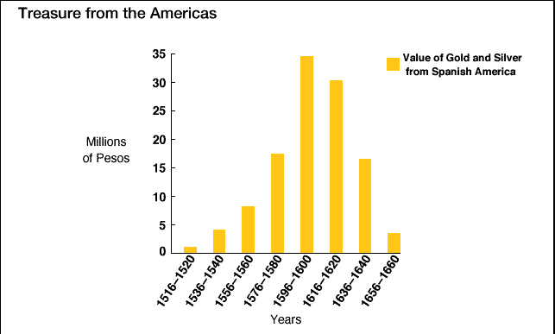
Treasures from the Americas!

Slide 15
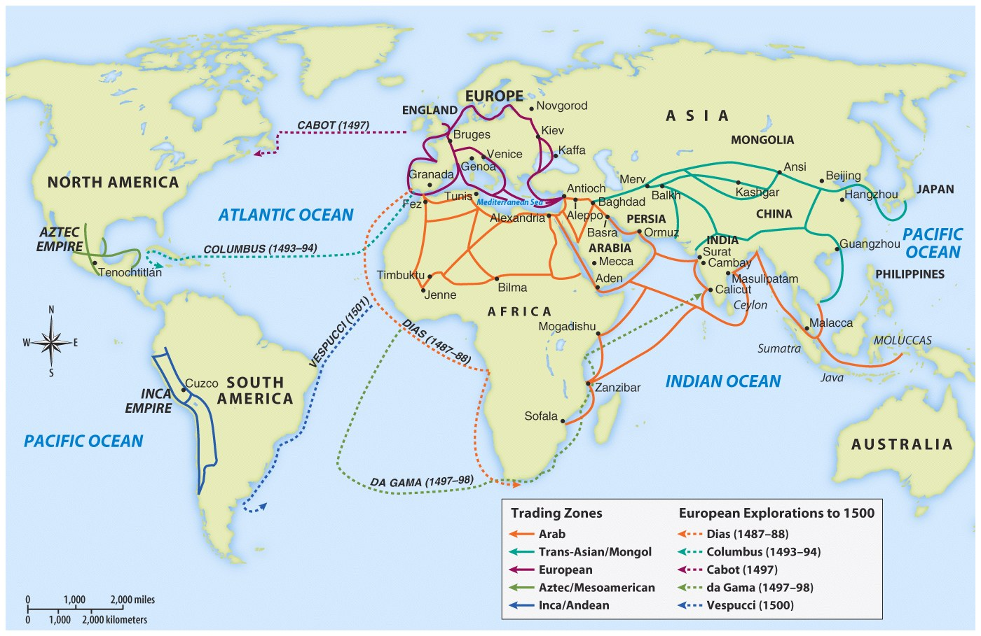

Slide 16
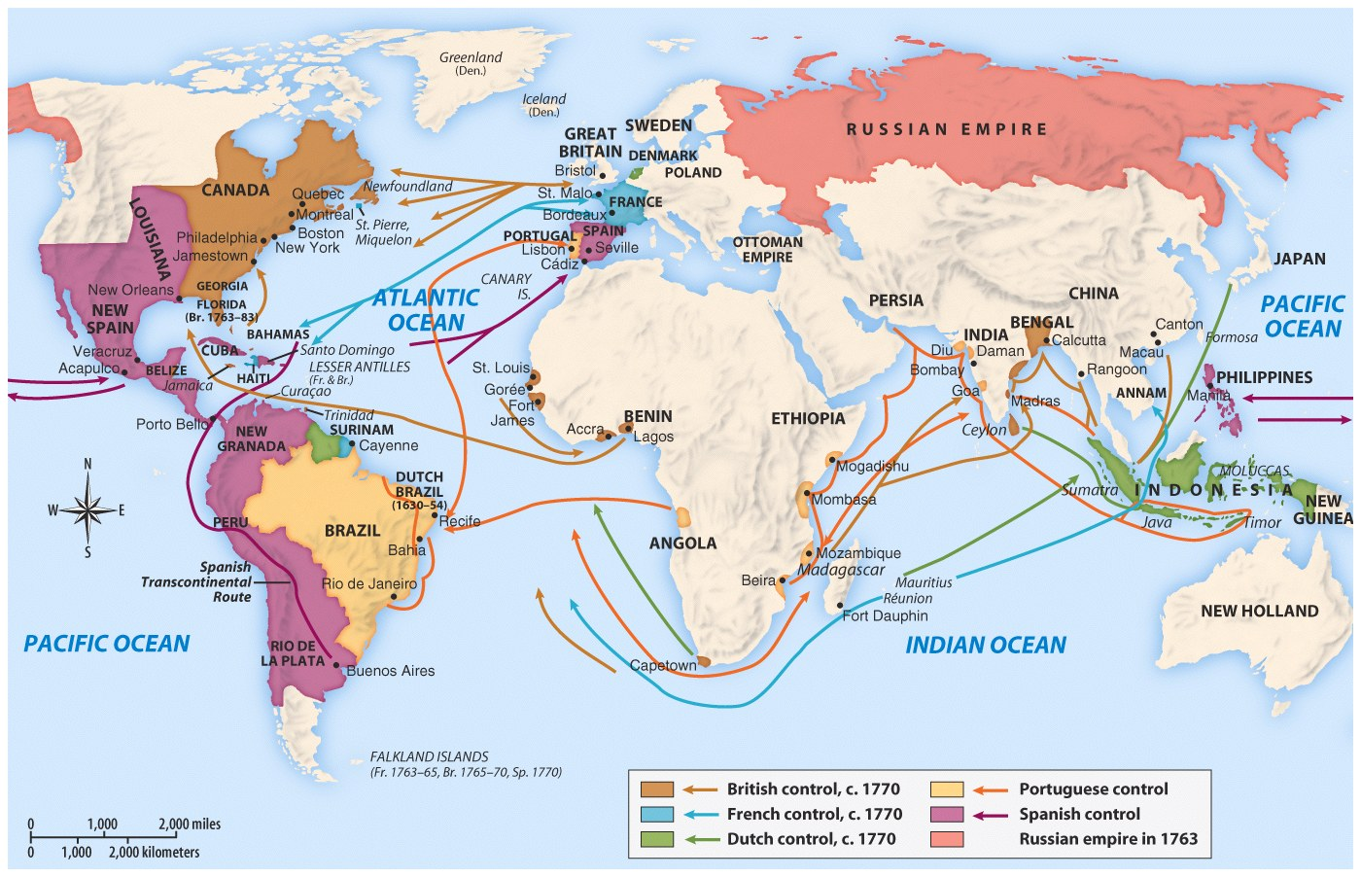

Slide 17
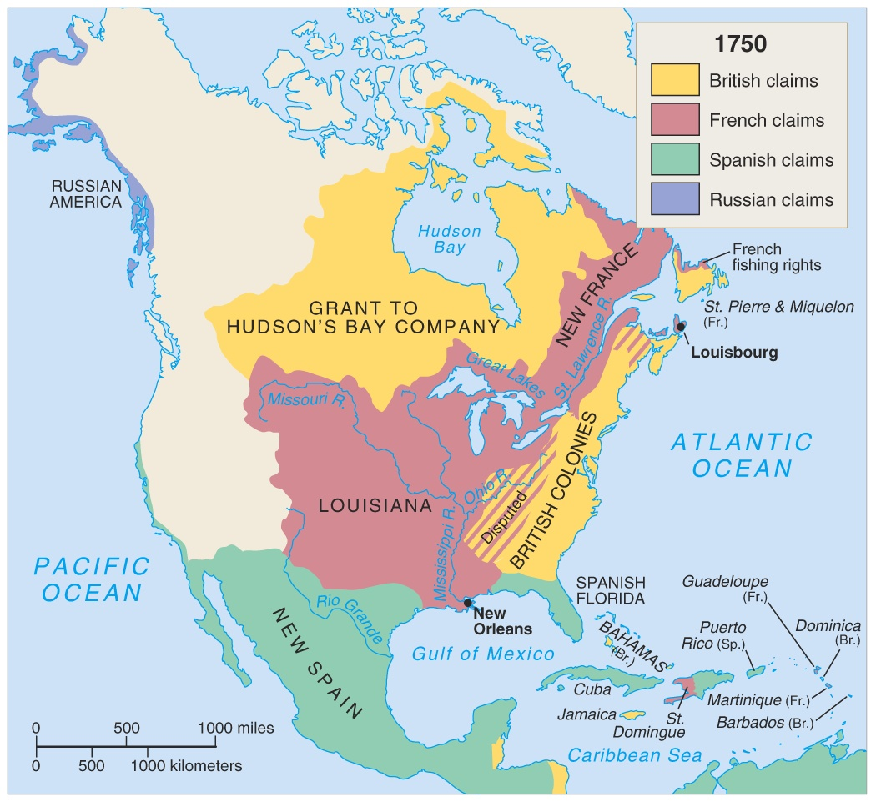

Slide 18
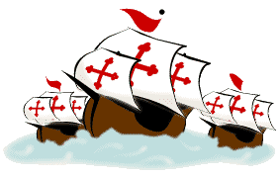
EUROPEAN EXPLORATION
1400 TO 1600
EFFECTS
Europeans reach and settle Americas
Expanded knowledge of world geography
Growth of trade, mercantilism and capitalism
Indian conflicts over land and impact of disease on Indian populations
Introduction of the institution of slavery
Columbian Exchange

Slide 19
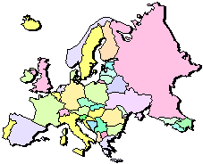
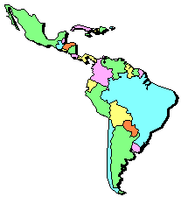
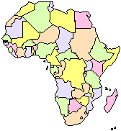
Columbian Exchange or the transfer of goods involved 3 continents, Americas, Europe and Africa
* Squash * Avocado * Peppers * Sweet Potatoes * Turkey * Pumpkin * Tobacco * Quinine * Cocoa * Pineapple * Cassava * POTATO * Peanut * Tomato * Vanilla * MAIZE * Syphilis
* Olive * Coffee Beans * Banana * Rice * Onion * Turnip * Honeybee * Barley * Grape * Peach * Sugar Cane * Oats * Citrus Fruits * Pear * Wheat * HORSE * Cattle * Sheep * Pig * Smallpox * Flu * Typhus * Measles * Malaria * Diptheria * Whooping Cough

Slide 20
European Colonization
European Colonization
Once the New World is discovered, the Big 4 four European countries begin competing for control of North America and the world….
Spain
England
France
Portugal
This power struggle ultimately leads to several wars.

Slide 21
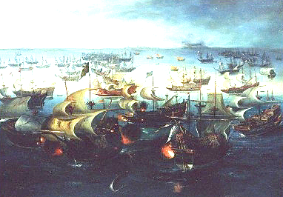
The
Spanish
Spanish first to pursue colonization
Start in Caribbean, then Central and South America—most important was conquest of Aztecs by Cortez (1521) and Incas by Pizzaro (1531)
First permanent colonies in what will become United States are founded by Spain
St. Augustine (Florida) is founded (1565) to protect Spanish treasure fleets

Slide 22
Explorers Sailing For Spain
Columbus - Italian sailing for Spain - Landed in the “West Indies” - 1492
Magellan - Portuguese sailing for Spain - 1st to circumnavigate the world - 1522

Slide 23
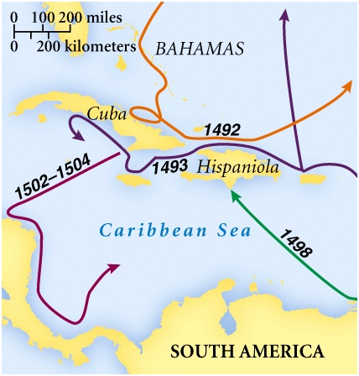
Columbus’ Four Voyages

Slide 24
Explorers Sailing From Hispaniola
De Leon - colonist of Hispaniola - Established colony at Puerto Rico - Sailed north looking for Fountain of Youth - Discovered Florida - 1508
Balboa - colonist of Hispaniola - Established settlement in Panama - 1st European to see Pacific Ocean - 1513
de Coronado - Spain - Explored north from Mexico; up Colorado River; saw Grand Canyon -1540
de Soto - Spain - Explored Florida into Carolina’s and west to the Mississippi River - 1541

Slide 25
Explorers Sailing For Spain & Portugal
Vespucci - Italian sailing for both Spain and Portugal - Sailed to the America’s - Amerigo is his first name (where we get “America”) - 1501

Slide 26
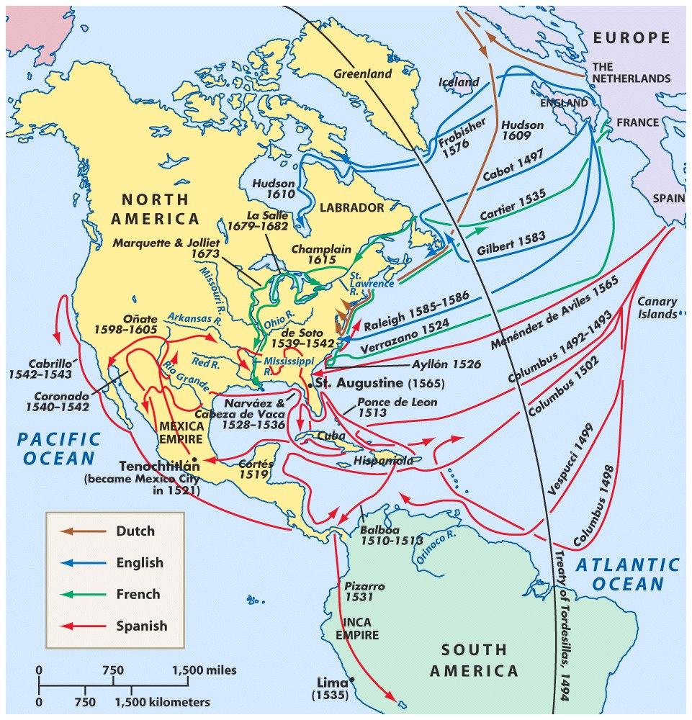
Spanish Exploration
Columbus
Balboa
Cortes
Pizarro
De Leon
De Soto
Coronado
Vespucci

Slide 27
Spanish soldiers who came to the New World to help conquer and settle the Americas for Spain.
Their methods were harsh to the Native American population resulting in many thousands of deaths.

Slide 28
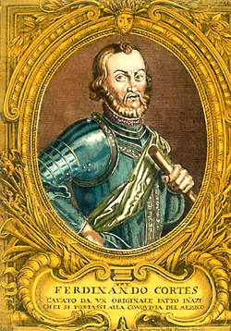
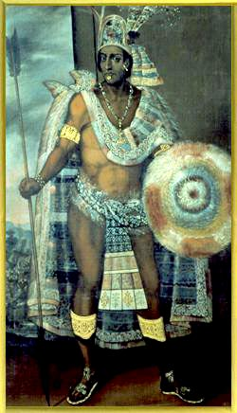
First Spanish Conquests: The Aztecs Cortes conquered Aztec Empire in 1519 and took control of modern day Mexico.
vs.
Hernando Cortés
Montezuma II

Slide 29
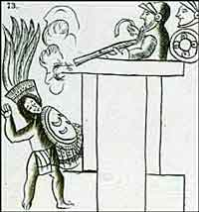
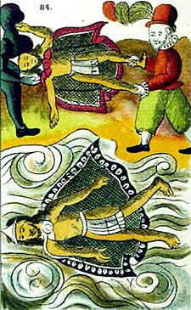
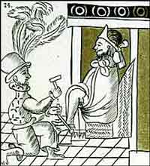
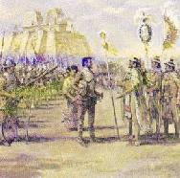
The Death of Montezuma II

Slide 30
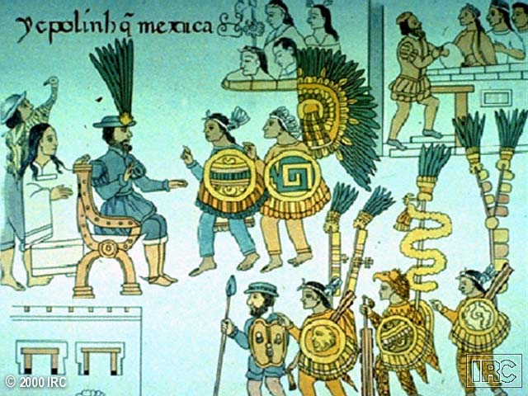
Mexico Surrenders to Cortés

Slide 31
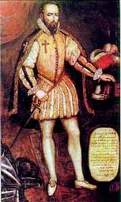
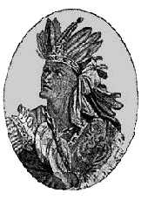
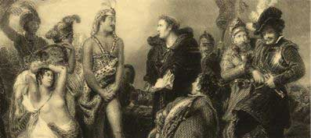
First Spanish Conquests: The Incas Pizarro conquered Incan Empire in modern day Peru in 1532
vs.
Francisco Pizarro
Atahualpa

Slide 32
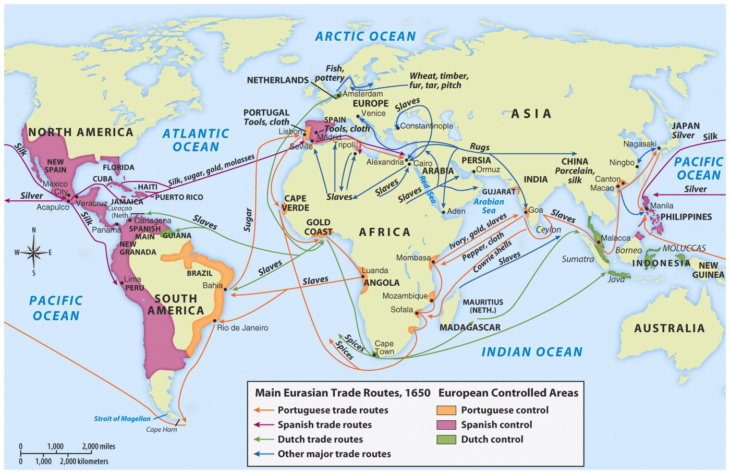

Slide 33
Cycle of Conquest & Colonization
Explorers
Conquistadores
Missionaries
European Colonial Empire
Permanent Settlers

Slide 34
COLONIAL PERIOD
COLONIZATION IS A NATURAL OUTGROWTH OF EXPLORATION
MERCANTILISM:
COLONIES EXIST TO BENEFIT THE MOTHER COUNTRY
3 COUNTRIES TOOK THE LEAD IN
COLONIZING THE NEW WORLD
SPAIN
FRANCE
ENGLAND

